Slide 1
Instructional Design Guidelines for Multimedia Materials
Tim van der Zee
Twitter: @Research_Tim

Slide 3
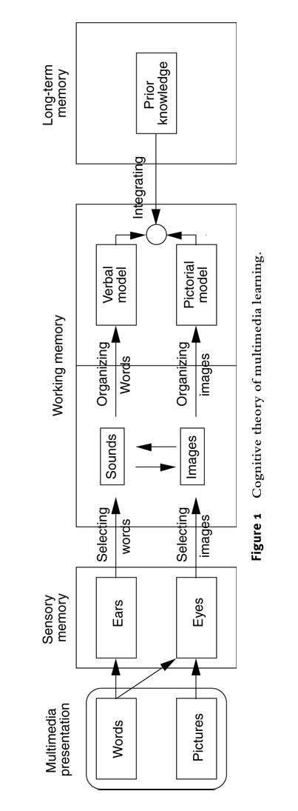

Slide 14
Segmentation/pre-training

Slide 15
Segmentation/pre-training
Cues

Slide 16
Segmentation/pre-training
Cues
Distribute information across modalities

Slide 17
Segmentation/pre-training
Cues
Distribute information across modalities
Minimize spatial/temporal distances

Slide 18
1
4
9
17
2
5
7
10
12
14
16
18
8
13
15
3
6
11

Slide 19
1 = Multimedia Presentation
2 = Words
3 = Pictures
4 = Sensory memory
5 = Ears
6 = Eyes
7 = Selecting Words
8 = Selecting Images
9 = Working memory
10 = Sounds
11 = Images
12 = Organizing Words
13 = Organizing Images
14 = Verbal Model
15 = Pictorial Model
16 = Integrating
17 = Long-term Memory
18 = Prior Knowledge

Slide 20
Segmentation/pre-training
Cues
Distribute information across modalities
Minimize spatial/temporal distances
No irrelevant information (edutainment)

