Slide 1
Instructional Design and
Study Success in Higher Education
Jeroen J.G. van Merriënboer
CEL Innovation Room, 13 February 2015, Delft

Slide 2
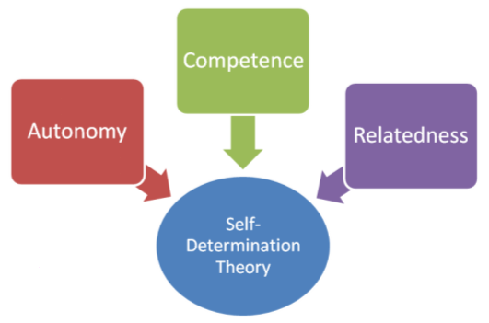
Contents
Motivation and drop-out
Competence; designing learning tasks
Relatedness; designing groups
Autonomy; designing learner control
Discussion & questions
Ryan & Deci, 2000

Slide 3
Motivation and Drop-Out
Research based on SDT shows a relationship between low intrinsic motivation and high drop-out (e.g., Vallerand et al., 1997)
Fortunately, instructional design may affect intrinsic motivation (Martens & Kirschner, 2006).

Slide 4
SDT - Competence
“Students seek to control the outcomes of their learning process and experience mastery…”
Learning tasks should be designed in such a way that they help students feel competent (also called “confidence”; Keller, 1983)

Slide 5
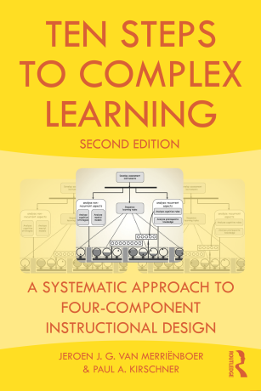
Learning Tasks (4C/ID)
Problems, projects, tasks, assignments, cases etc.
Often based on real-life tasks
Integrative (skills, knowledge, attitudes)

Slide 6
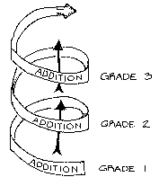
Levels of Complexity
Sequence from easy to difficult
Meaningful right from the start

Slide 7
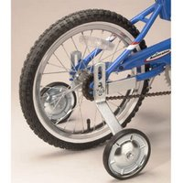
Support and Guidance
Zone of ‘proximal development’
Sawtooth pattern of support

Slide 8
Designing for Competence
Ensure high intrinsic motivation of students by setting them tasks that
are relevant to their future profession or field of work
are challenging, i.e. not too simple but a little beyond their reach
provide just enough support and guidance to help them complete the tasks

Slide 9
SDT - Relatedness
“the universal desire to interact, be connected to, and experience caring for others…”
Groups in which students perform the learning tasks should be designed in such a way that they help students feel related and part of a ‘community’

Slide 10
Small Group Work
Problem-based learning
Team-based learning
Project-based learning
And so forth

Slide 11
Year Groups
At the UM, the composition of PBL groups changes each 10-week period
As a result, students were seldomly in the same group with peers they already knew
Year groups
With one “own” mentor
PBL groups composed from the year group

Slide 12
Designing for Relatedness
Ensure high intrinsic motivation of students by organizing group work
That allows them to become and stay connected with fellow students and staff
That requires complementary contributions from all group members

Slide 13
SDT - Autonomy
“the universal urge to be causal agents of one's own life and act in harmony with one's integrated self…”
Educational programs in which students operate should be designed in such a way that they give students (some) control over their own learning

Slide 14
Educational Programs Based on 4C/ID
Supportive information
Procedural information
Part-task practice

Slide 15
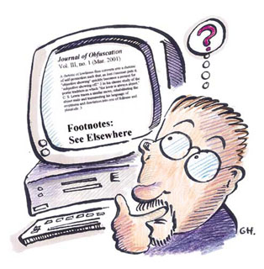
Resource-Based Learning

Slide 16
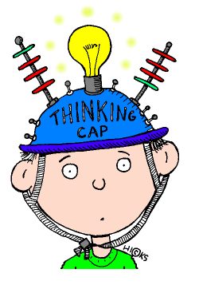
Question posed by the student
Useful
resources
Supportive
information
What should I study in order to be able to perform this task?
Textbooks, experts, Internet, multimedia, animations, microworlds etc.
Procedural
information
How should I perform this -routine- aspect of the task?
Colleagues, manuals, quick reference guides, on-line help, EPSS, mobile devices etc.
Part-task
practice
Which additional practice could improve my overall task performance?
Skillslab, drill & practice Computer Based Training (CBT), part-task trainers etc.

Slide 17
Self-Directed Learning
Students select own learning tasks
Right level of difficulty (task class)
Right level of help & support

Slide 18
Designing for Autonomy
Ensure high intrinsic motivation of students by organizing learner control so that
students can select their own learning resources
Or even their own learning tasks
But they are explicitly taught how to do this in a responsible way (“second-order scaffolding”)

Slide 19
Discussion
SDT as a theoretical basis for improving intrinsic motivation and reducing drop-out
Fits nicely with design guidelines from 4C/ID – also relates to student satisfaction (e.g., Frick et al., 2009)
Disclaimer: Available studies are mostly correlational and do not yet provide strong evidence

