Slide 1
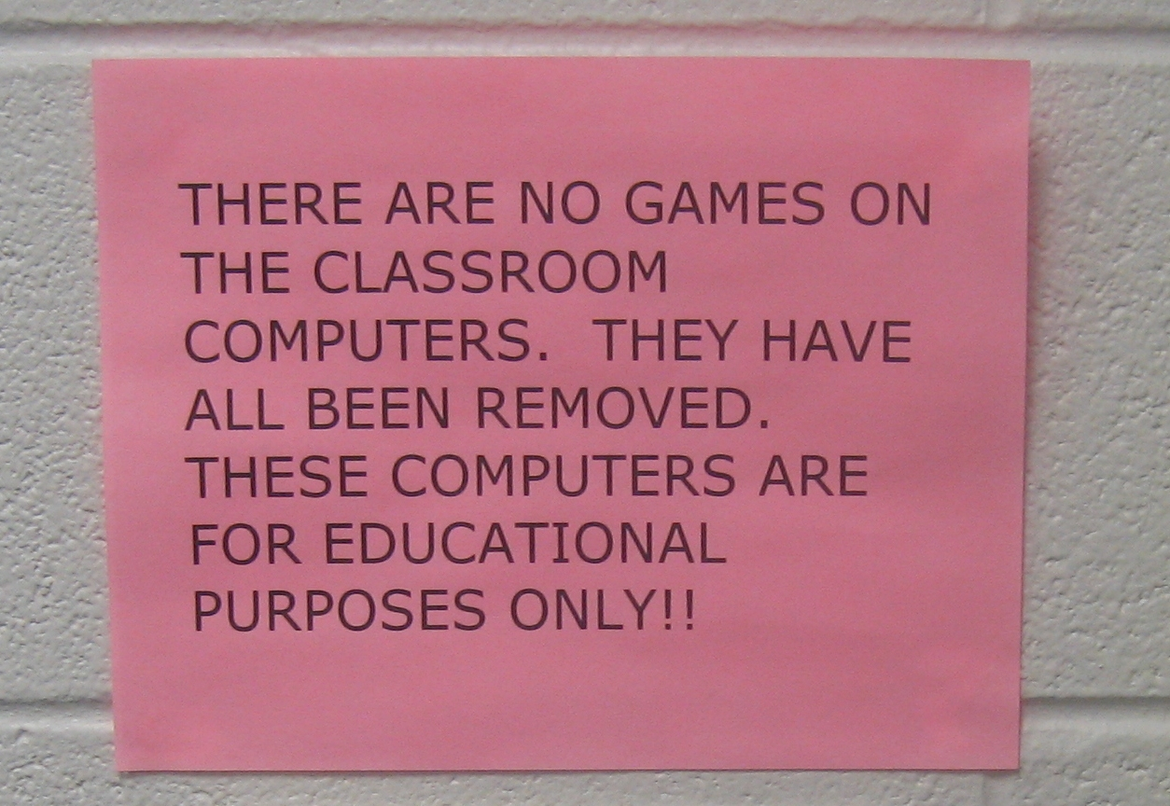
Hybrid (Instructional) Designs For Serious Gaming
Dr. rer.soc. Heide Lukosch
CEL Innovation Room, 18-12-2015
Image under Creative Common License

Slide 2
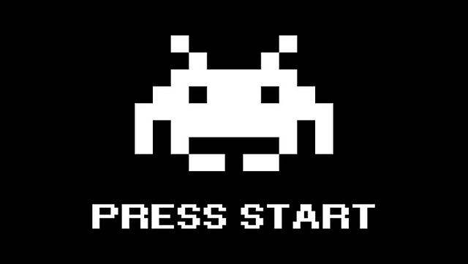
What to expect
The Role of Mental Models
What is a Game?
What is a Serious Game?
What is Design?
How to Design a Serious Game?
Hybrid (Instructional) Design
2 Examples
CRAFT
Yard Crane Scheduler
Conclusion and Discussion
ireaudfox.com

Slide 3
Let’s start… with a game – try to remember:
Slumber
Pillow
Dream
Night
Bed
Blanket
Quiet
Pajamas
Nap
Snooze

Slide 4
Write down as many words as you can!
Which ones do you remember?

Slide 5
These were the right ones…
Slumber
Pillow
Dream
Night
Bed
Blanket
Quiet
Pajamas
Nap
Snooze

Slide 6
Let’s do another one – Write the first word that comes to mind!
Color
Furniture
Flower

Slide 7
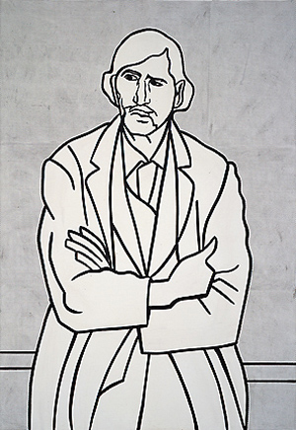
One last ‘game’…
Fold your arms the way you would do naturally, with one arm on top of the other. Look at your arms and notice which one is on top. Notice how it feels.
Now uncross your arms and fold them again the other way with the other arm on top.
How does that feel?
Wikiart.com

Slide 8
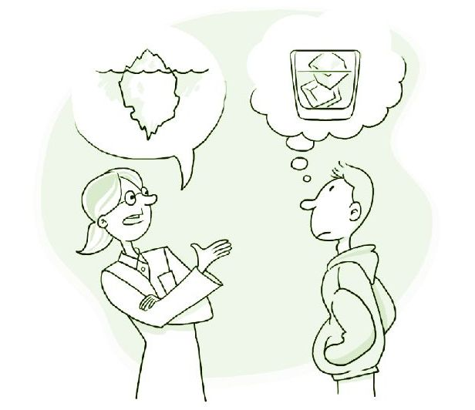
The Role of Mental Models
We all use certain mental models to understand the world around us
In one cultural circle, these mental models are quite similar
We all have our own comfort zone
Which sometimes hinders us to learn new things, as they feel unfamiliar
Picture by Ian Webster/CRED, grist.org

Slide 9
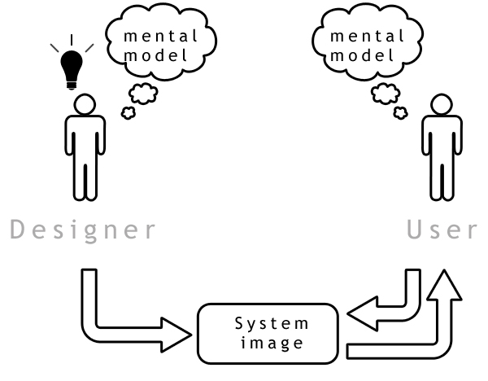
Mental Models and Games
Mental models are developed as a result of
Perception
Imagination
Knowledge
Comprehension of Discourse
Games can support the process of developing new mental models
Game
Adapted from www.foundationsofhci.com

Slide 10
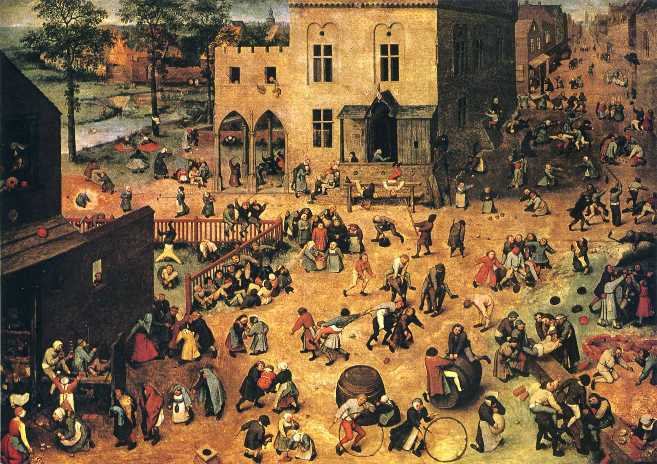
Everyone plays Games
Pieter Bruegel the Elder: Children’s games (1560)

Slide 11
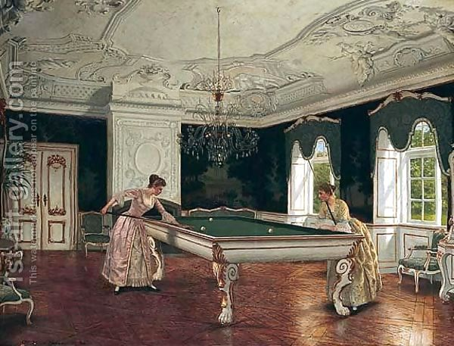
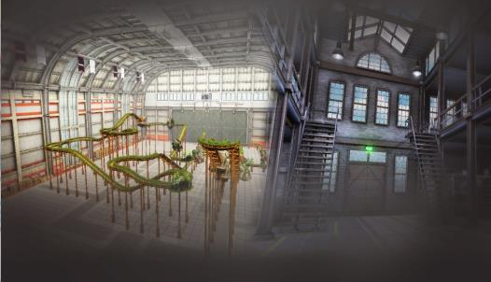
What is a Game?
Through the limits of time and space,
players enter a magic circle;
enact in a world, that is both real and imagined
Games consist out of roles, rules, and resources
Heinrich Hansen, 1821-1890
Klabbers, 2006
Craft Game, Kenteq/LittleChicken/TUD: Kenteq.nl

Slide 12
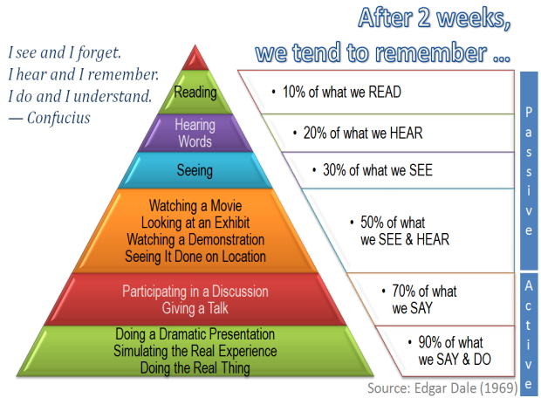
What is Serious Gaming?
Serious Games can be used for
Decision Making
Policy Building
Strategy development
Complex Systems Analyses and Design
Training and Learning
Learning as change process towards improved skills, knowledge, and attitudes

Slide 13
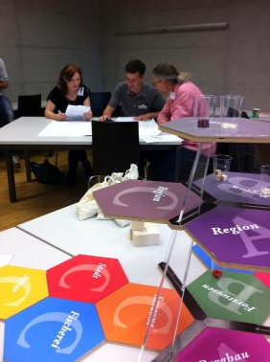
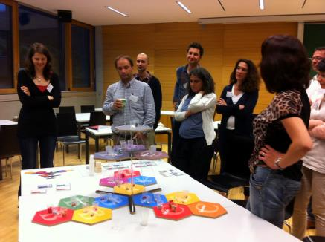
The role of Serious Gaming
The main educational effect of games is based on "learning by doing”
A game, which imitates and simplifies reality, provides a possibility for experiencing real life, e.g. decision-making under uncertainty and time pressure with insufficient or sometimes faulty information
Playing Hexagon (Duke, 1974) at the ISAGA 2014 Conference, AU

Slide 14
Serious Games Taxonomy…
Sawyer & Smith, 2008

Slide 15
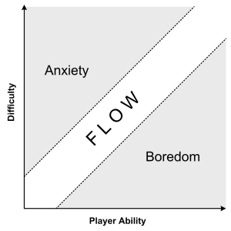
Characteristics of Serious Games: Engagement and Motivation
Csikszentmihalyi, 1990

Slide 16
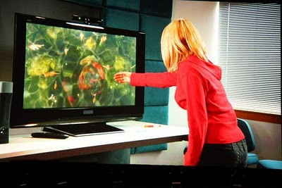
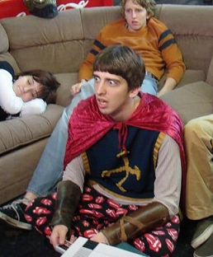
Characteristics of Serious Games: Interactivity and Immersion
seriousgamesmarket.blogspot.com; gamehaed.com

Slide 17
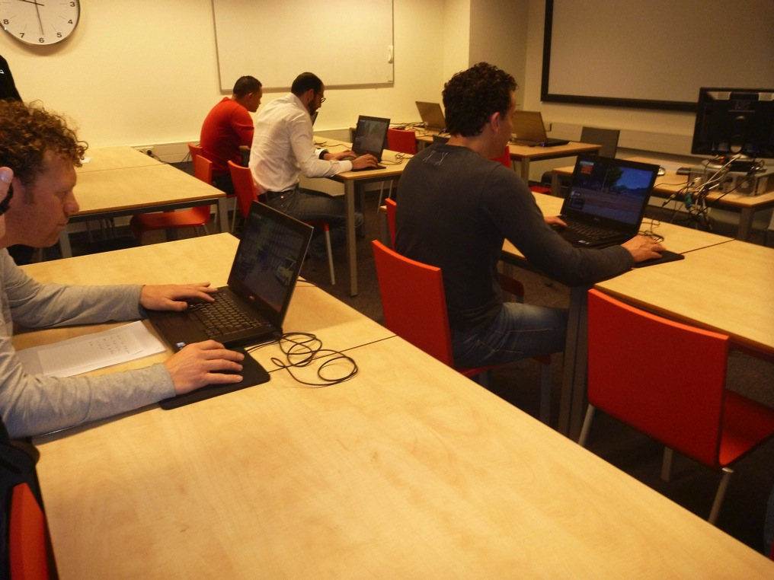
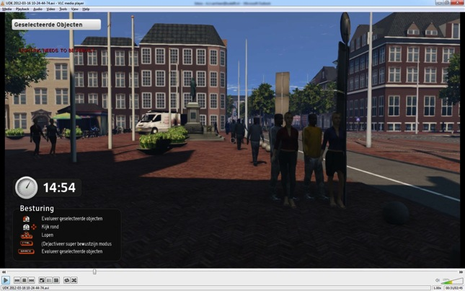
Characteristics of Serious Games: Participation and Involvement
CharliePapa - project

Slide 18
Characteristics of Serious Games: Feedback and Results
gamehaed.com

Slide 19
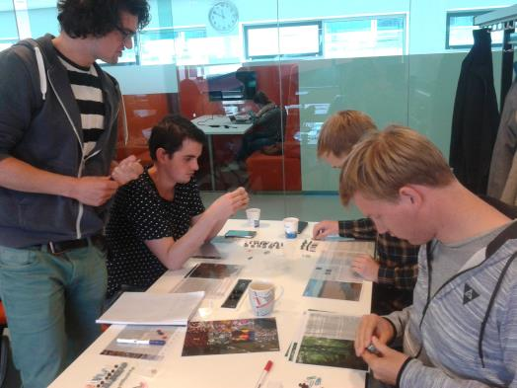
Design of Games
Include
the freedom to explore
the freedom to fail
the freedom of identity
the freedom of effort
… but games also need some closeness
they have rules
To represent a magic circle
snipview.com
MITx: 11.127x Design and Development of Games for Learning
Game Design Students TUD 2015/2016

Slide 20
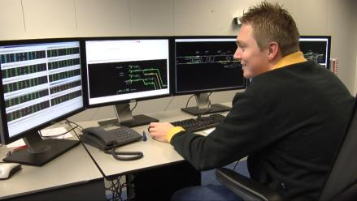
Design (in the large)
…means to conceive and to implement courses of action aimed at changing existing dysfunctional situations into preferred ones
This approach of design-in-the-large (DIL) is the foundation of all forms of consulting work, training, and education
new ways of thinking and acting in an organization
User within ProRail Gaming Suite Program

Slide 21
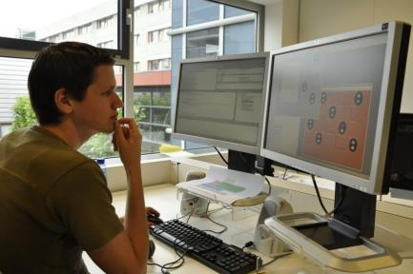
Design (in the small)
Simulation Games as a design-in-the-small (DIS) approach has always been a powerful method and is instrumental in modeling and changing social systems while aiming at their sustainable development.
contributes to the design-in-the-large processes of organizations
Developing for ProRail Gaming Suite Program

Slide 22
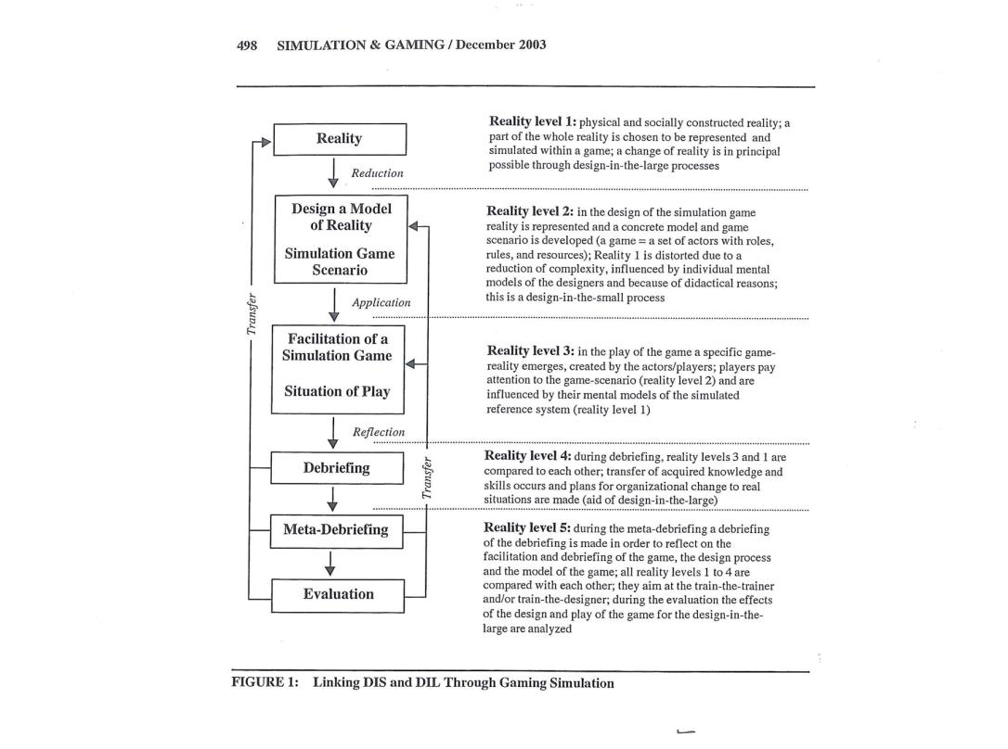
Serious Games and Design
Kriz, 2003

Slide 23
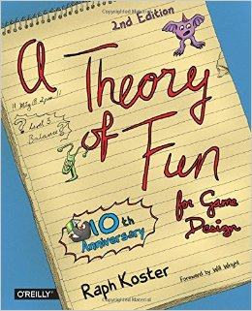
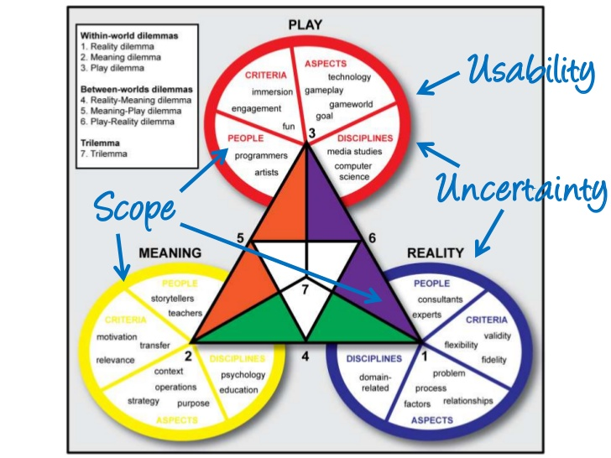
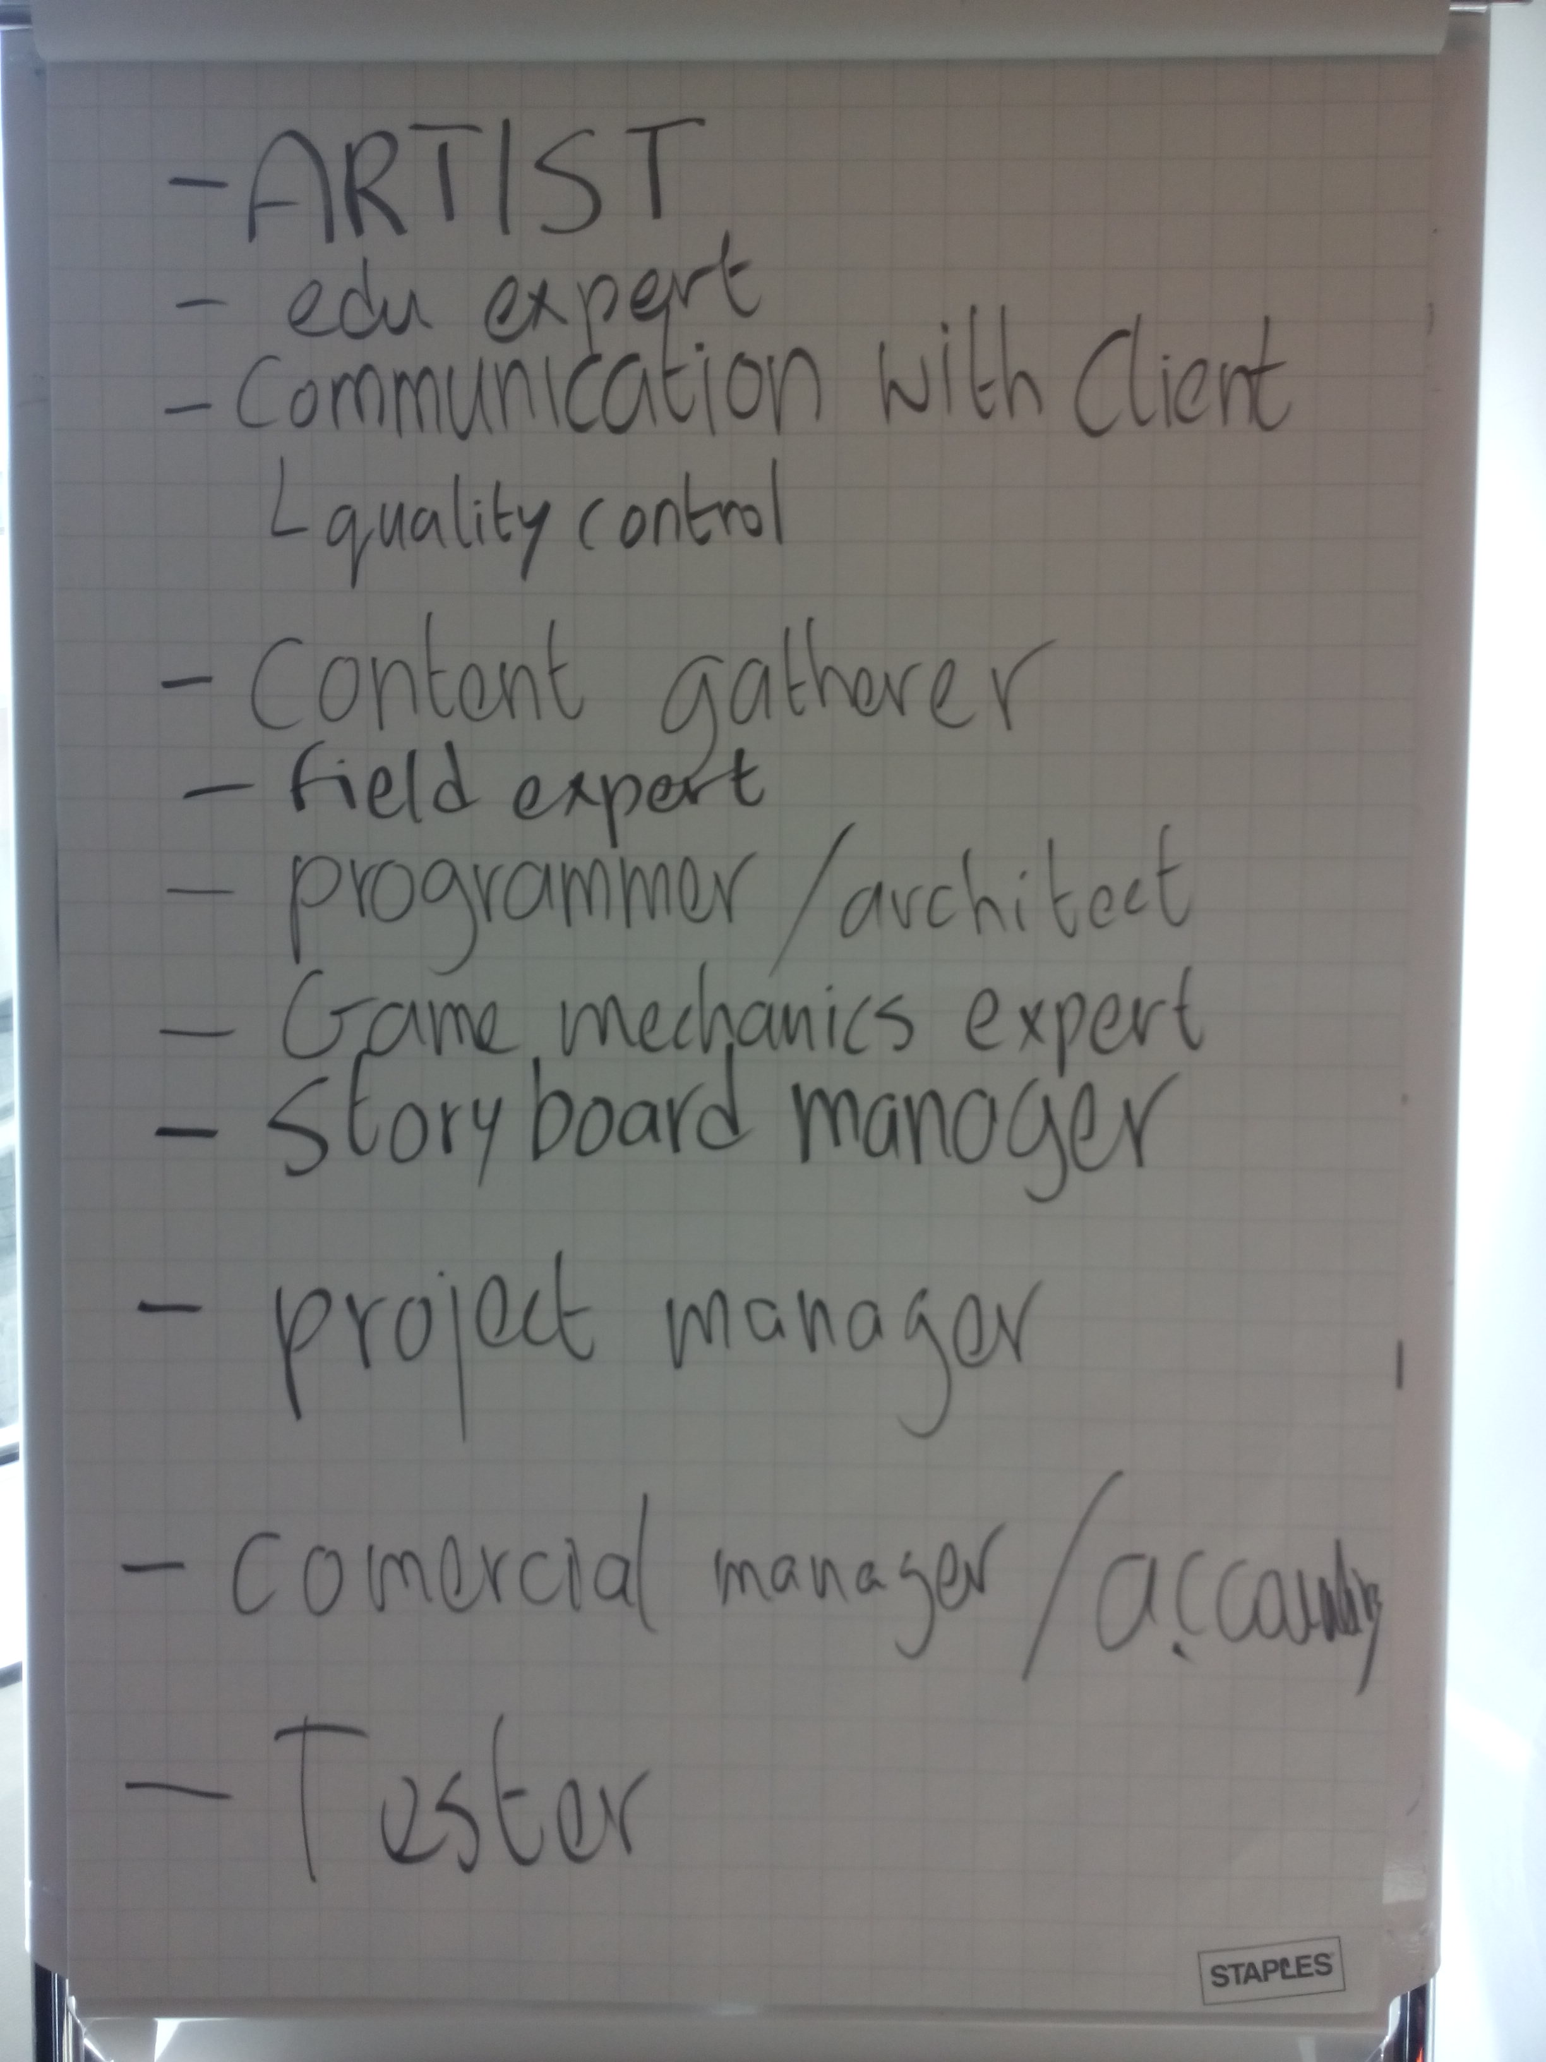
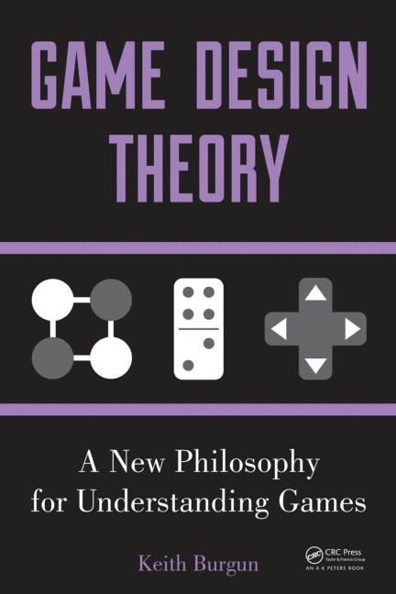
Serious Game Design Approaches
Harteveld, 2011
Overview by Game Design Students TUD 2015/2016

Slide 24
Hybrid (Instructional) Game Design
Hybrid (/ˈhʌɪbrɪd/):
Of mixed character; composed of different elements: hybrid diesel-electric buses
Craft Game, Kenteq/LittleChicken/TUD: Kenteq.nl

Slide 25
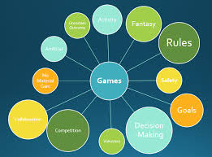
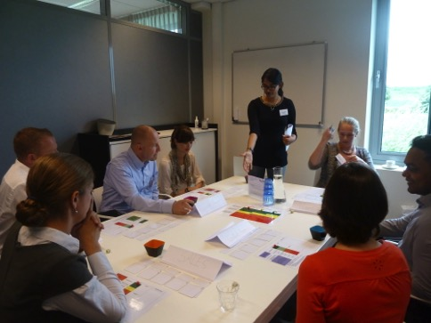
Hybrid (Instructional) Game Design
Refers to the elements of a game
Refers to the elements of a gaming session
Briefing
Gaming
De-Briefing
Facilitation
Data Collection
Feedback
Transfer testing
Acagamic.com
Disruption Game, Salomo - Project

Slide 26
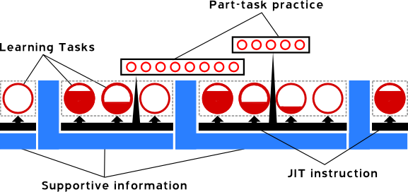
4C/ID: Hybrid Instructional Design
Involves the integration of
Knowlegde
Skills
Attitudes
Transfer of what is learned to daily (work) life
Van Merrienboer & Kirschner, 2012 – Illustration of the concept from learningwiki.com

Slide 27
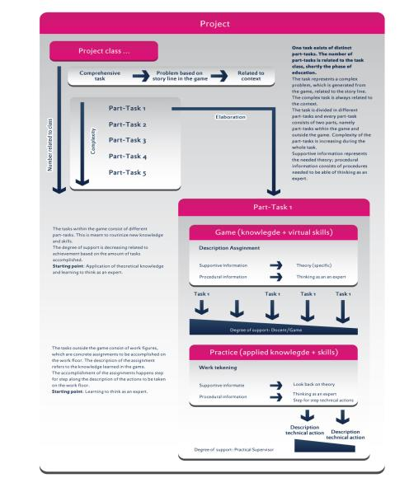
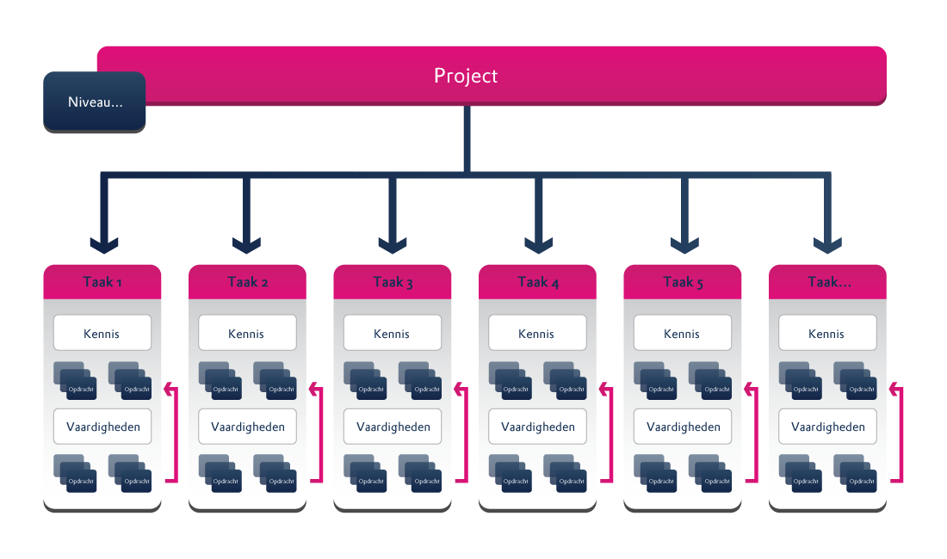
4C/ID: Hybrid Instructional Design
Translated into game design:
Nested structure of game assignments
Integration and coordinated performance of task-specific skills
Providing Supportive and Procedural information
From simple to complex tasks
Combination of “simulation and sandbox”
Figure 1. Nested design structure in CRAFT
Lukosch, van Bussel, & Meijer, 2013

Slide 28
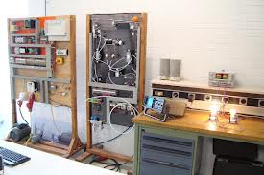
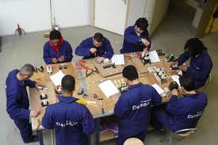
Example 1: CRAFT – Starting Points
Target group: Mechanic mechatronics
95% male, age 16-18
Transfer of theoretical knowledge needed in the workplace
Playing a game
over a period of 2 years of education
Kenteq.nl

Slide 29
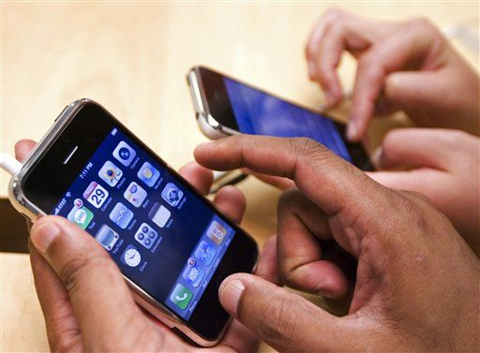
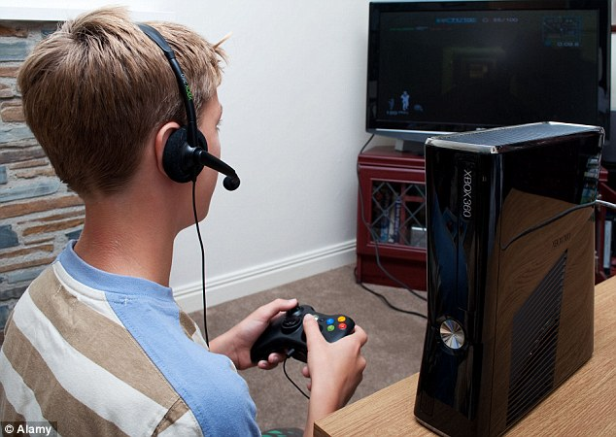
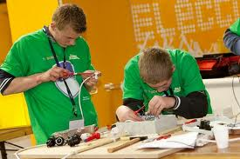
Example1: CRAFT – Motivation
High drop-out rates in vocational education
Discrepancy between (social) life and school
Distance between teaching and real world problems
Low motivation and engagement of the students for theoretical topics –
want to be engaged in
embodied (work) experiences
Kenteq.nl

Slide 30
Example 1: CRAFT – The Game
This video cannot be accessed
https://www.youtube.com/watch?v=DseBaC_AbGY&feature=youtu.be

Slide 31
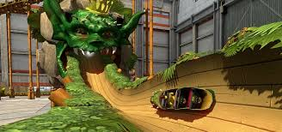
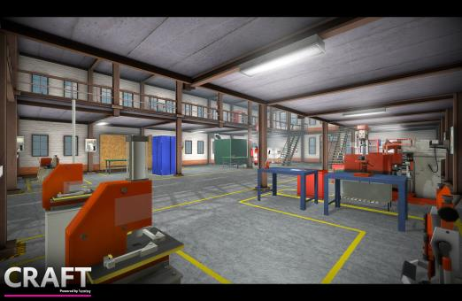
Example 1: CRAFT – The Gaming Session
Theoretical knowledge is transferred through the game
Practical knowledge and skills are derived from ‘real’ workplaces
Strong connection between the two
Change of mental models: Thinking as an expert!
Kenteq.nl

Slide 32
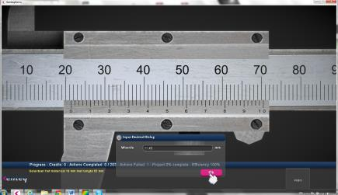
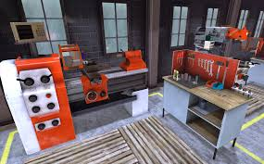
Example 1: CRAFT – Results
The high-fidelity approach worked well to motivate the students
Combination of simulation and sand box
The 4C/ID framework serves for designing a serious game in a very structured way
„Right“ information is provided
Game elements are important for motivation
Kenteq.nl

Slide 33
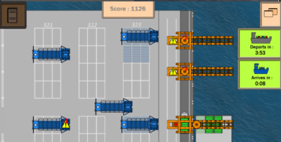
Microgaming – Another hybrid Approach towards Games
Short and flexible digital games
Represent simple models of complex systems
Based on constructivist approaches
Enable situated Learning
YCS Game – inthere.nl

Slide 34
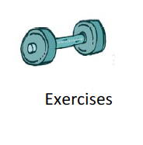
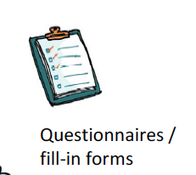
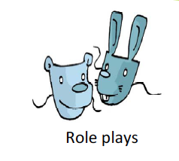
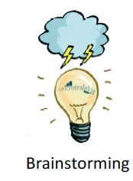
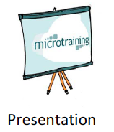
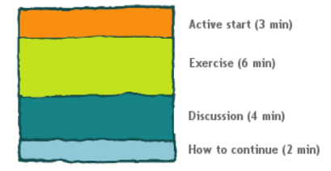
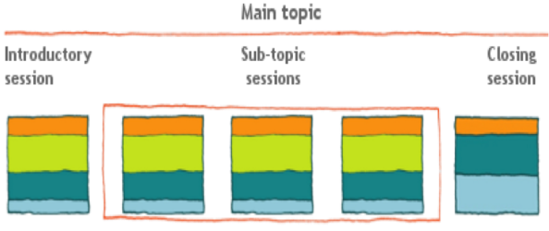
Microtraining
One approach towards situated learning
Answers the need for flexible learning activities
Structures formal and informal learning
Fosters active participation of the learner
De Vries & Brall, 2008; De Vries & Lukosch, 2009; Overschie, Lukosch, & De Vries, 2010; Overschie, Lukosch, Mulder, & De Vries, 2013

Slide 35
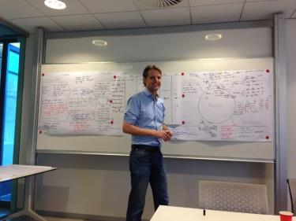
Microgaming
Microgames are developed in a participatory way
Using the Triadic Game Design Philosophy
Addressing Reality, Meaning and Play Aspects to enable situated learning
GameStorm session – inthere.nl
Harteveld, 2011

Slide 36
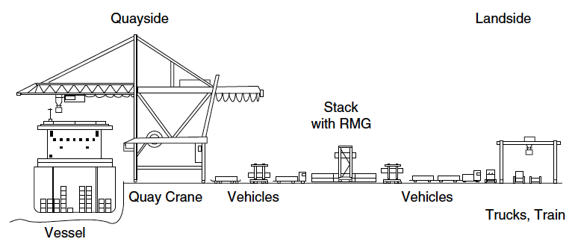
Example 2: Yard Crane Scheduler – Starting Points
Increase of transport of containerized goods by more then 600%
Planning of container terminal operations is integrated, complex task
Steenken, Voss, & Stahlbock, 2004, p. 13
Kurapati, Lukosch, Groen, & Verbraeck, 2014; Lukosch, Groen, Kurapati, Klemke, & Verbraeck, 2015; Kurapati, Lukosch, Verbraeck, & Brazier, 2015

Slide 37
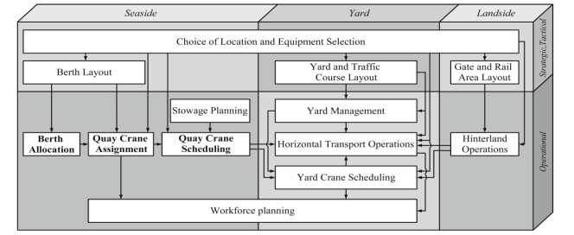
Example 2: Yard Crane Scheduler – Motivation
Lack of awareness of each others roles
Planning is still sequential
Increased transportation requires new skills and insights
Meissel, 2009
Kurapati, Lukosch, Groen, & Verbraeck, 2014; Lukosch, Groen, Kurapati, Klemke, & Verbraeck, 2015; Kurapati, Lukosch, Verbraeck, & Brazier, 2015

Slide 38
Example 2: YCS – The Game
This video cannot be accessed

Slide 39
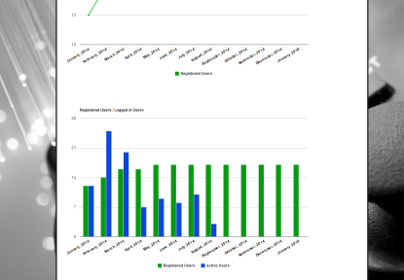
Example 2: Yard Crane Scheduler – The Gaming Session
YCS addresses integrated planning skills
Planning of various resources simultaneously
De-Briefing raises awareness for complexity and interconnectivity
Change of mental models: Thinking integrated!
Game statistics, The Whitebox
YCS session, Salomo project

Slide 40
Example 2: Yard Crane Scheduler – Results
Expert validation (t = 6) on the balanced design of the game
User group tests (t = 90) on playability and usability
Game was experienced as well balanced and fun to play
Game was valued as an excellent training tool to learn about challenges in container terminal operations (awareness)
Limitations due to its level of abstraction
Compilation by W. Kriz, 2013
Results for “The game as a training tool”
Kurapati, Lukosch, Groen, & Verbraeck, 2014; Lukosch, Groen, Kurapati, Klemke, & Verbraeck, 2015; Kurapati, Lukosch, Verbraeck, & Brazier, 2015

Slide 41
Summary
Serious Games require hybrid design
of different game elements
of different elements around the games
Transfer to what has been learned through de-briefing
Change of mental models
Salomo-project
Gettyimages.com

Slide 42
Future Work
CRAFT will be used within technical (further) education
Further (Micro)games will be developed and tested
Data will be analyzed in order to gain deeper understanding of design requirements
role of games for mental model development (learning, training, awareness, decision making)
Technode.com
Cnn.com
On the Spot project, NCTV

Slide 43
Discussion
What kind of hybrid designs of serious games do you have in mind?
What did you miss?
What did you like?
Videogamesblogger.com
Dr.rer.soc. Heide Lukosch
Delft University of Technology
Faculty of Technology, Policy and Management
h.k.lukosch@tudelft.nl

