Slide 1
The science of teaching science
Scientific training in the Bachelor of Medicine - LUMC
Prof.dr Friedo W. Dekker
Dept. Clinical Epidemiology LUMC
F.W.Dekker@lumc.nl

Slide 2
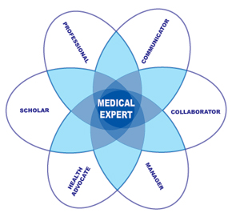
Why scientific training in medical curriculum?
CANMEDS competencies
Notes:
There has been some debate on whether to study Medicine is really academic, university related, or more practical like “HBO”
Royal College of Physicians and Surgeons of Canada.
Canadian Medical Education Directives for Specialists.

Slide 3
CANMEDS Key Competencies for Physicians: SCHOLAR Scholar:
Critically evaluate information and its sources, and apply this appropriately to practice decisions
Contribute to the creation, dissemination, application, and translation of new medical knowledge and practices
Using research
(Evidence Based Medicine)
➔ Doing research
Maintain and enhance professional activities through ongoing learning
4. Facilitate the learning of patients, families, students, residents, other health professionals, the public, and others, as appropriate
3
FWD
11-11-2016

Slide 4
CANMEDS Key Competencies for Physicians Scholar:
In The Netherlands (national Blueprint for medical education):
Personal development / teaching
Life-long learning
Critical appraisal of the literature (EBM)
Design and do a research project
(➔ to make all of them good doctors, and some of them good researchers / talent scouting)
➔ Using research
➔ Doing research
4
FWD
11-11-2016

Slide 5
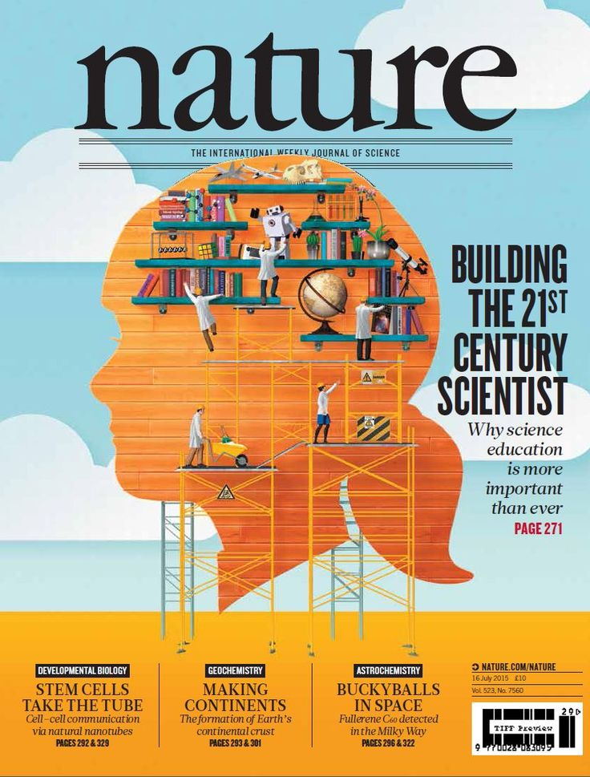
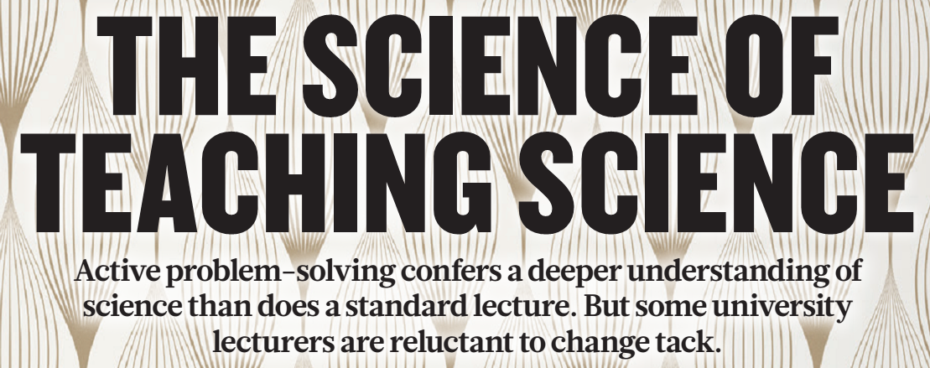
Nature 2015, July 15

Slide 6
Healey (2005)
Students as participants
Research-tutored
Research-based
Emphasis on research content
Emphasis on research process
Research- led
Research-oriented
Students as audience
In Barnett, R (ed) (2005) Reshaping the University: New Relationships between Research, Scholarship and Teaching. McGraw Hill / Open University Press, pp.67-78

Slide 7
Healey (2005)
Students as participants
Classical program …..
Research project
Practicals (lab, spss)
Emphasis on research content
Emphasis on research process
Talk about discoveries
Talk about methods
Students as audience
In Barnett, R (ed) (2005) Reshaping the University: New Relationships between Research, Scholarship and Teaching. McGraw Hill / Open University Press, pp.67-78

Slide 8
How to improve undergraduate science education?
Active learning (early in curriculum)
Small scale activities
Authentic assignments
Challenging, motivating
However, ….
In Bachelor of Medicine:
> 300 students each year
Limited amount of time / ECTS
Limited teaching staff
➔ How to solve this?

Slide 9
1st yr Medical Students: Research in a nursing home
All students do a 2-week internship in a nursing home in Sept 1st year
Assignment: collect data on 3 selected patients (comorbidity, lab, medication, ADL, cognition)
Webbased data entry (NetQ) => SPSS database
In December: back to nursing home, collect same data, => research question
In January 1st year: course of 2 weeks
Just in time: study design, Pubmed, statistics, SPSS (5 days of lectures, assignments, practical's and small working group sessions):
WG1: present research question (12 students, 1.5 hour, => research question which can be answered, discussion!)
WG2: read a paper
Answer own research question (2 days)
WG3: present research project (5 slides, 5 min, 2 min discussion)
Short report: 1 page text + 2 tables + 3 references (complete research project in a nut shell)
Short Exam

Slide 10
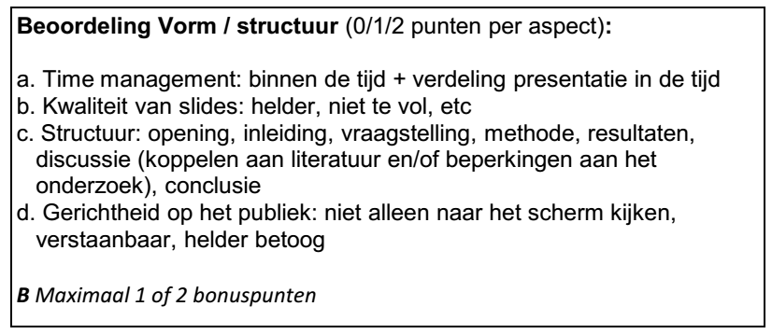
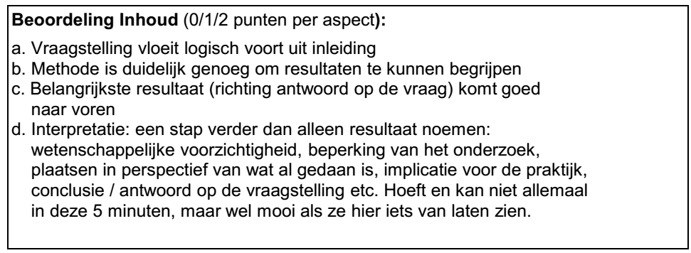
Evaluation form presentation
Honours student
Peer pressure

Slide 11
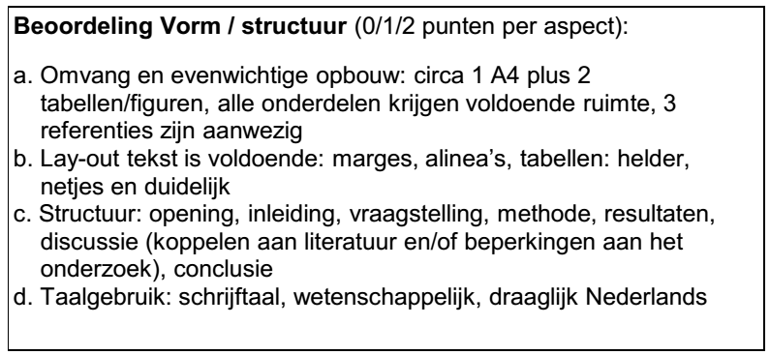
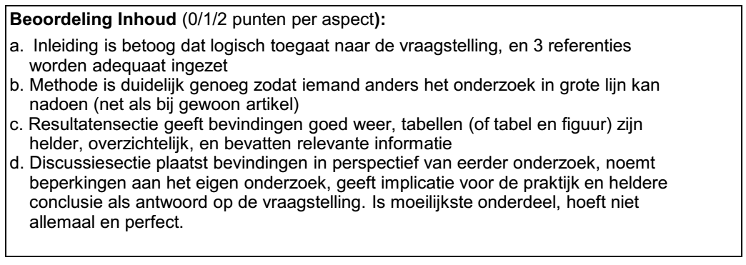
Evaluation form short report
Paper => Excel => mailmerge => Feedback

Slide 12
Effects?
How would you study the effects of this course?
Satisfaction?
Knowledge?
Skills?
Perceptions / motivation for research?

Slide 13
Results: Satisfaction and knowledge
2011 2012
Sufficient attention paid to scientific development?
Sufficient attention paid to scientific skills?
Strongly disagree
Strongly agree

Slide 14
Results: Skills
Random 2 x 50 abstracts (old versus new curriculum) blinded assessed by 6 reviewers

Slide 15
Results: Perceptions
Notes:
Je ziet: studenten percipiëren onderzoek sterker na curriculumherziening, terwijl in hun ogen de kwaliteit van de leeromgeving onveranderd is. Opvattingen zijn ook nagenoeg gelijk.

Slide 16
Results: Perceptions
Notes:
Je ziet: studenten percipiëren onderzoek sterker na curriculumherziening, terwijl in hun ogen de kwaliteit van de leeromgeving onveranderd is. Opvattingen zijn ook nagenoeg gelijk.

Slide 17
Course AWV-2: How evidence based are pharmaceutical advertisements?
2-week course: clinical epidemiology, medical statistics, philosophy
Also: critical appraisal, and the importance of critical appraisal
6 journals: Am J Med, Arch Int Med, BMJ, Lancet, JAMA, NEJM
1.5 volume ➔ 189 unique advertisements
Only advertisements with a claim on effectiveness, and a reference to an RCT

Slide 18
Course AWV-2: How evidence based are pharmaceutical advertisements?
Evidence based?
Typical patient?

Slide 19
Course AWV-2: How evidence based are pharmaceutical advertisements?
2-week course: clinical epidemiology, medical statistics, philosophy
Also: critical appraisal, and the importance of critical appraisal
6 journals: Am J Med, Arch Int Med, BMJ, Lancet, JAMA, NEJM
1.5 volume ➔ 189 unique advertisements
Only advertisements with a claim on effectiveness, and a reference to an RCT
Each student rates 2 advertisements + RCTs
Data input in NetQ => SPSS
Same RCTs used in training presentation techniques
“DEAR 300 FELLOW-RESEARCHERS”
Own research finding: only 1/3 of advertisements is evidence-based
Implication? => critical appraisal is important !
Peer pressure
Coordinators: Astrid van Hylckama Vlieg & Rutger Middelburg

Slide 20
Output
Winkelen P van, Denderen JS van, Vossen CY, Huizinga TWJ, Dekker FW. How evidence-based are advertisements in journals regarding the subspecialty of rheumatology? Rheumatology 2006; 45: 1154-1157.
Heimans L, van Hylckama Vlieg A, Dekker FW. Are claims of advertisements in medical journals supported by RCTs? Neth J Med 2010; 68: 46-49.
Eeden AE van, Roach REJ, Halbesma N, Dekker FW. Hoe evidence based zijn geneesmiddelenadvertenties in het Nederlands Tijdschrift voor Geneeskunde en het Pharmaceutisch Weekblad? Ned Tijdschr Geneeskd 2012; 156(1): A399.
Janmaat VT, Kortekaas KE, Moerland TM, Vereijken, Schoones JW, van Hylckama Vlieg A, Dekker FW. Research-Tutored Learning; an Effective way for Students to Benefit Research. Med Sci Educ 2013; 22: 269-277.

Slide 21
LUMC 2nd-year medical students study group
Rian Sanderse
m. van der Grift
Shu Zhen Zheng
Gina Griffioen
W.E. van der Starre
Stefan de Vroome
Aziza Magram
W.D.Tersmette
Sanne Minkenberg
nigel kooreman
MM Ewing
Z. Kellany
Lisa Menting
Marlieke Haeck
romy franken
nigel kooreman
Aziza Magram
yvonne leezer
Marga Eshuis
MF Hazelhoff
Esther Kuipéri
E.J. den Haan
MM Wagner
R.J.M. van der Mee
L. Broek
Abderrazak Zamri
Anke van Zuijlen
Sarah Woltz
Lotte Heimans
M.A.E. Dieben
Eva Verkuil
Wendy Damman
Maria Sleddering
Johan Spaan
Wong
Anne Bosman
Eline van der Kooi
J.D. Best
Abderrazak Zamri
R.J.M. van der Mee
S.A.A. Scheer
Ulas Hoke
Thomas Potjer
pim genzel
Nadine Pelzer
Sioe-Lie Thio
van Etten, E. S.
Saïd Askar
S.J. Eijsenga
Stefan de Vroome
MM Beshay
J.A. Smaal
Saskia Kruijdenberg
Rayner Maaijen
Luuk Ouwerkerk
K van Bergen
Matthijs Nijenhuis
Voorzaat B.M.
Astrid Zomervrucht
GIG Francisco
Joske Sewalt
J.M. Simons
Vincent Aalten
D.C van der Geest
S.L. Kleijn
Marjolein Plaisier
IP Tomson
Chin-A-Tam
Dave van As
Johan Spaan
Maria Sleddering
kirsten de Burlet
M.A.E. Dieben
Mark van der Bij
Stephan Hendriks
Eline van der Kooi
M. van Lent
Ulas Hoke
Mirjam Botermans
Eliane Lucassen
R Lauw
K.L.M. Gardien
Datema, M
Hanneke Borgdorff
Stephanie van Niele
Marloes Leemreize
Cynthia Hawi
rl nijhuis
AHJH Rambach
David Vroege
H. van Gent
Eva Verkuil
Wendy Damman
J.J.J.W van der Zalm
Kies, D.A.
Sanne Gianotten
E van Roekel
Charles Wallace
Maurits van der Graa
Stefan Pijl
Willemien Visser
Salomé de Bruin
F.W.T. Chiang
JJE Koopman
Thomas Potjer
Patty Kuiper
Laura van Dijck
P.Genzel
M. van Lent
Zeen Aref
C.Engels
Ellen Lohmann
Freddy Gan
Amita Sandhu
J. Weersma
H. van Gent
L. Broek
Rian Sanderse
Marlieke Haeck
Shu Zhen Zheng
Danielle van Schie
Raoel Maan
Jessica van Nies
D.G.Valerio
Shenara Sheikkariem
Caroline van Kinscho
L. de Visser
Iris van der Steen
Hans H. de Boer
Gretty Fokker
Wijnand Palmbergen
Anastasia Egorova
Wong
Anne Bosman
JJE Koopman
Y.I.Nikitenko
Hedwig Veldt
M.F.Blasius
M.P.A. Zegers
Gerrit Roorda
Luijendijk J
J.R. Sikkema
Frank den Heijer
Lindsay Bank
Shabiet Rahamat
J.H. Soderholm
Kim Beenen
Astrid van Gemeren
L. Seekles
Marlies Penning
F.W.T. Chiang
Mark van der Bij
Stephan Hendriks
Jori Stouthart
M.P. van 't Klooster
S.M. Kouwenhoven
Russ Natanov
Yvonne van Oirsouw
Y.C.Brinkhorst
B M Roest
Martje Visser
Luuk Spreeuw
Inge Liem
K.A. Kortekaas
IP Tomson
shabiet rahanat
S.L. Kleijn
Maartje van Seijen
MM Wagner
E.J. den Haan
Rayan Ramjiawan
Lisanne Plompen
Jolanda Salman
Joris Blok
femke hilgersom
M. Bevers
Judith Steemers
Frank Stoetman
Pauline Bakker
Daisy Ooms
Josephine van de Maa
SSL Thio
Datema, M
Stephanie van Niele
L.M.J. Tomas
N.J. Jansen
Martje Visser
Lisanne Plompen
Jolanda Salman
Marloes Bos
Sanne Visser
M. A. Blikkendaal
Tamara Paff
Dan Knoester
Lauri Coors
Sanne Gianotten
femke hilgersom
J.M. Simons
Vincent Aalten
Judith Steemers
Koen Vos
Ellen Lohmann
J. Weersma
Laurens Bollen
Wei-Yong Wang
eveline van dienst
Edwin van der Winden
B M Roest
Soon Seng Lim
E.G.B. Vijverberg
Zeen Aref
Laura van Dijck
Patty Kuiper
C.Engels
DS Roos
Maartje van Seijen
M. Bevers
M. Molenaar
kirsten de Burlet
Caroline van Kinscho
Melissa Kool
Iris van der Steen
Lydia Roelofsen
J.A.A. Reijers
Anne-Marie Stoetman
T.Almutair
D.F.M. van Winden
Martijn de Jong
Ali Lahdidioui
Jennifer Schreuders
Jackelien Geerlings
Miriam Felix
JC Koster
Anja van Dijk
Daisy Ooms
Pauline Bakker
Wei-Yong Wang
eveline van dienst
Salomé de Bruin
E van Roekel
Willemien Visser
Charles Wallace
Rebecca Minnaar
Hanneke Borgdorff
K.L.M. Gardien
Sanne van der Voort
Debbie Horsten
ilse stokman
Arianne Pieterse
Stefan Pijl
Maurits van der Graa
Dan Knoester
Lauri Coors
yvonne leezer
ilona coops
CSV Borstlap
Kerem Sebib Korkmaz
Marc van der Schee
Shenara Sheikkariem
JC Harthoorn
A.S. Figdor
Edwin van der Winden
CJM te Brake
Wouter Zandee
Luuk Ouwerkerk
K van Bergen
Martijn de Jong
Annerie van der Jagt
Antien Mooijaart
Bart Boesenach
Sophie Velthuis
Sophie Velthuis
Joost de Haas
Bart Boesenach
Anouk Netten
Ernst Dootjes
J.A.A. Reijers
Jennifer Verhoekx
Mays Zakko
Kamar
Janneke Tijmensen
Esther Kuipéri
MF Hazelhoff
van Etten, E. S.
Rayan Ramjiawan
Joris Blok
r.e. vogel
MS Lamens
A.C.S. Knijnenburg
Brian Bingen
Christiaan Huigens
S.J. Eijsenga
s.j. schnorr
Soon Seng Lim
E.G.B. Vijverberg
sjeel withaar
D.C van der Geest
M. Molenaar
Tom den Ouden
Antien Mooijaart
SWM Peters
Wijnand Palmbergen
Anastasia Egorova
D T Roodbergen
Joske Sewalt
Jennifer Verhoekx
GIG Francisco
Luuk Spreeuw
Inge Liem
J. A. Smaal
Rayner Maaijen
Brian Bingen
Eva Willems
Sanne Visser
M.P.A. Zegers
Willeke Mingelen
Cynthia Hawi
rl nijhuis
Antoine Sitters
romy franken
Marijke Lohbeck
Gina Griffioen
Jasmijn Herruer
Eva Willems
W.E. van der Starre
A van Sonderen
M.P. van 't Klooster
Joost van Asten
RF Lauw
Tom Luijters
Janneke Tijmensen
DS Roos
Peter Wagstaff
K. Chong
Jennifer Schreuders
K. Sebib Korkmaz
CSV Borstlap
Ali Lahdidioui
Muriel Blasius
R. Muradin
Saskia van Loon
Dave van As
Frank Lengers
Yvonne van Oirsouw
Willeke Mingelen
Antoine Sitters
Jori Stouthart
S.M. Kouwenhoven
Luijendijk J
J.R. Sikkema
Koen Vos
Laurens Bollen
G.K.R.Roos
Sarah Woltz
Z. Kellany
Anne-Marie Stoetman
Lydia Roelofsen
Sanne van der Voort
Arianne Pieterse
Saïd Askar
Marloes Bos
Russ Natanov
Y.C.Brinkhorst
Marga Eshuis
Marloes Leemreize
Kamar
Mays Zakko
Saskia van Loon
J.J.J.W. van der Zal
Frank Lengers
Tamara Paff
R. Muradin
Metteke Blikkendaal
Tom den Ouden
Kim Beenen
Marlies Penning
SWM Peters
gerdien kuijt (B)
ilona coops
V F M Buijs
L. de Visser
Hans H. de Boer
Lotte Heimans
AHJH Rambach
David Vroege
J.D. Best
S.A.A. Scheer
Voorzaat B.M.
Matthijs Nijenhuis
Katja ten Cate
Sanne Minkenberg
V F M Buijs
gerdien kuijt (B)
W.D. Tersmette
Y.I.Nikitenko
ilse stokman
Debbie Horsten
Hedwig Veldt
JC Koster
Eliane Lucassen
Anja van Dijk
Mirjam Botermans
Freddy Gan
Wouter Zandee
Amita Sandhu
MM Ewing
Anouk Netten
Ernst Dootjes
Lisa Menting
J.E. Kuipers
Gretty Fokker
J.F.J. Oosterhof
Marijke Lohbeck
m. van der Grift
s.j. schnorr
L.M.J. Tomas
sjeel withaar
Peter Wagstaff
K. Chong
Raoel Maan
Danielle van Schie
Saskia Bakker
L. Seekles
Astrid van Gemeren
Annerie van der Jagt
T.Almutair
Katja ten Cate
Danielle van Winden
Nadine Pelzer
Rebecca Minnaar
A.S. Figdor
jan de groot
D.G.Valerio
Jackelien Geerlings
Jessica van Nies
Jasmijn Herruer
Christiaan Huigens
LM Tiemessen
Marjolein Plaisier
Chin-A-Tam
LM Tiemessen
J.H. Soderholm
MM Beshay
Quirijn Tummers
Sabrina Badloe
Saskia Kruijdenberg
Lindsay Bank
A van Sonderen
Frank den Heijer
Joost van Asten
Josephine van de Maa
Frank Stoetman
CJM te Brake
Miriam Felix
Tom Luijters
Sabrina Badloe
Quirijn Tummers
K.A. Kortekaas

Slide 22
Discussion
Active learning / scientific training seems possible also early in the curriculum
Importance of real / authentic assignments?
Individual or in small groups?
Importance of peer pressure?
Is this a contribution to building the 21st century scientists?
Could you do something similar with your own students?

Slide 23
Thank you!
Mayke Vereijken (ICLON)
Titus van den Heuvel
Saskia le Cessie & Arno Roest
Astrid van Hylckama-Vlieg en Rutger Middelburg
John O’Sullivan & Liesbeth Adelmeijer (CiS)
All student-researchers in all courses
F.W.Dekker@LUMC.NL

Slide 25
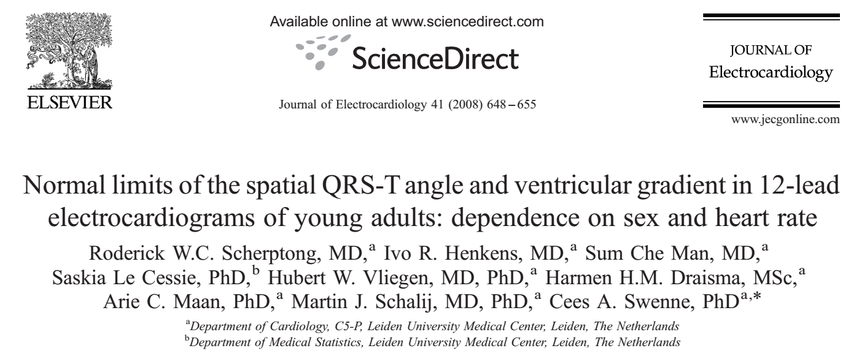
Example: Einthoven Science Project
First year module on Basics and homeostasis
Students learn about ECG
Make ECGs on each other
Data entered in database
Students think about research question to be answered with these data, analyze data and write an abstract
Best abstract wins Einthoven Science Award
Publication:

Slide 26
Why scientific training?
Who?
Critical thinking
Asking questions, critical reflection, wonder why and how
Using research
keep up to date with recent developments in medicine
Evidence Based Medicine / clinical reasoning
PICO / CAT
Doing research
Contribute to developments in medicine
Recognize and foster talents
All
All
All?

Slide 27
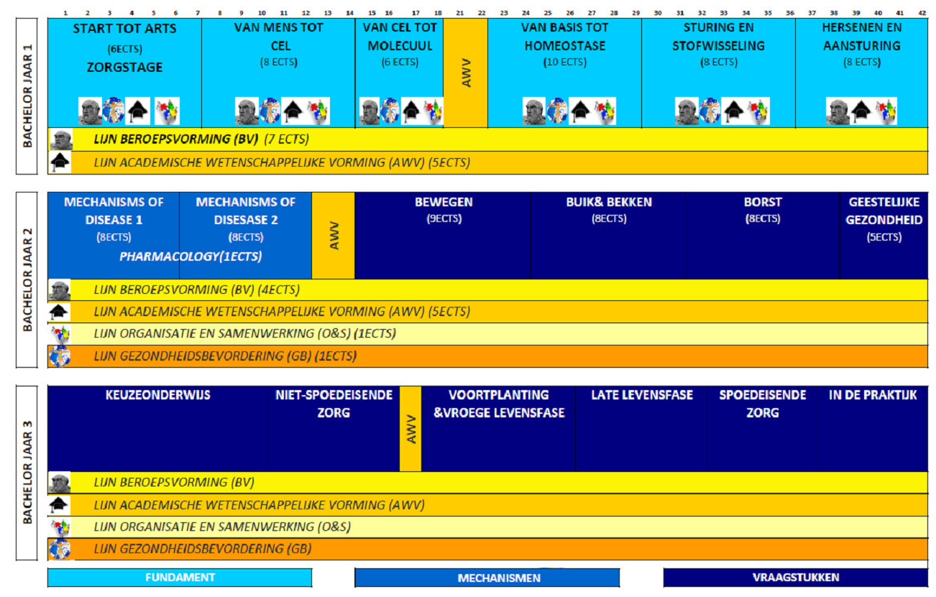
Outline Bacherlor Medicine LUMC (curriculum 2012)
Half minor

Slide 28
Outline Line Scientific Training
Integrated elements in regular courses
Medical history / Ethics / Philosophy
Debate in classroom (NNT bij DM?)
Assignments Pubmed / scientific writing / presenting evidence in working groups
Organised and tested in that course (cemeted hip replacement?)
Line assignments (on line-days)
Data collection
Scientific writing (peer review) and presenting
English in Medicine (6 working group sessions, write your own CV)
CAT-project = Bachelor-thesis
Courses scientific training - 2 weeks each year
[Half minor: 10 weeks in 3rd year Bachelor]

Slide 29
Course AWV-3: CAT-project
300 3rd-year students, each linked to a specialist-in-training (AIOS)
AIOS has real clinical problem, student prepares Critical Appraisal of a Topic (CAT)
AIOS gives supervision (is allowed to prepare 1 CAT less himself)
Preparation: 1 week course AWV-3 (7-steps CAT)
Supervision by Walaeus library (search-strategy) and CiS (writing, peer review)
Win – Win – Win:
Student: real clinical problem
AIOS: 1 CAT less to make
Department: motivated students around, new input by trained students
Coordinators: Saskia le Cessie & Arno Roest

Slide 30
Estimated time for students (4 ECTS in total)
Hours (student) | Activity
40 | Course AWV-3
8 | Develop search strategy
16 | Prepare draft 1
2 | Working Group: feedback on draft 1
2 | Peer feedback on draft 1
16 | Prepare draft 2
1 | individual tutorial (CiS)
2 | Working Group: feedback on draft 2
2 | Peer feedback on draft 2
9 | Prepare draft 3 (final version)
8 | Presentation
6 | Contact with AIOS
112

Slide 31
Assessment CAT-project
Summative judgement | Domain | % of final grade
1. Exam at end of course AWV-3 | Knowledge | 25%
2. AIOS evaluation of process and collaboration CAT-project | Professional behavior | 20%
3. AIOS evaluation of CAT-presentation (structure and content) | Skills | 20%
4. AIOS evaluation of report (content) | Knowledge | 20%
5. Communication in Science evaluation of report (structure- line of reasoning – scientific writing (English) | Skills | 10%
6. CiS evaluation participation in working group / peer evaluation Total | Professional behavior | 5% 100%

Slide 32
Discussion
Active learning / scientific training seems possible also early in the curriculum
Importance of real / authentic assignments?
Individual or in small groups?
Plagiarism? “Collaboration”?
Role of teacher – organizer, guard, or coach?
Peer pressure?
…?

Slide 33
Scientific training: integrated line or distinct courses?
PRO integrated line:
Scientific training central in curriculum
Continuity, not a strange element
Competentiegericht, verweven met andere competenties (Canmeds)
Nadelen geintegreerde lijn:
AWV weinig zichtbaar, niet herkenbaar
Minder leuke onderdelen overheersen in beeldvorming (‘statistiek…’)
Niet makkelijk apart te toetsen (“2 vragen per tentamen? 9,5 is ook goed!”)
Spanningsboog

