Slide 1
Research into University Education
Pieter de Vries
Thieme Hennis
LDE-CEL 14.5.2014
Notes:
Goal of this presentation: share Delfts vision, strategy & approach for the next phase of open & online education

Slide 2
Vision
‘Educate the world &
enhance quality of campus & online education’
Advancement of educational ‘productivity’
through research
with a shift from institute to learning ecosystem
Notes:
Meer keywords / taglines:
cross-fertilization between campus, hybrid, and open education models
Creating added value through combining research on open, hybrid, and campus learning

Slide 3
Research based Education
Shift happens:
From management to teacher tool;
From ad-hoc/experience to research based innovation;
From disconnected and distributed to connected and complementary
From interval-based to realtime (dashboard)
Online learning creates the momentum
Notes:
Research based education (often called evidence based, but that is too narrow) needed to make the transformation with the large amount of elements that play a role to make it work.
Wordt er met ‘research based education’ niet bedoeld dat het onderwijs gebaseerd is op onderzoek? Daarmee bedoel ik de onderwerpen, de curricula? Dus recente ontwikkelen op gebied van quantumbits worden direct omgezet in cursussen. Dus niet zozeer met ‘didactics/pedagogy’ of ‘educational research’ te maken.

Slide 4
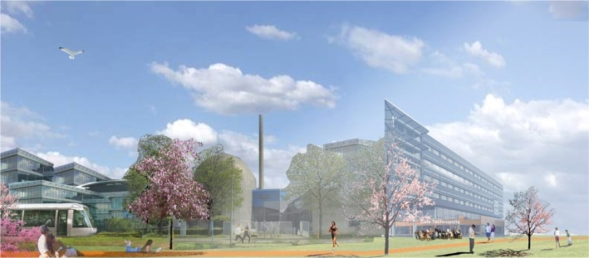
Open & Online portfolio
2013-2014: 11 MOOCs on edX
Finished: Solar Energy & Water Treatment
≈ 5.000 Certificates of Completion
No Credits
Massive Open Online Courses (MOOCs)
Open Course Ware (OCW)
Online Distance Education (ODE)
Campus Education
More than 120 courses online & 10.000 weblectures recorded
Unique visitors > 800 /day
No interaction with faculty
No accredited certificate
19.000 on-campus students
Bachelor – Master – Phd
2 blended Bachelors
1 full online master (25 courses)
2 modules, 1 minor, 1 master (6 courses)
50 students (30 on-campus)
Full Master Degree / Accredited Course Certificate
Notes:
OpenCourseWare: Course Materials available for use and re-use, for free, worldwide (700 visitors a day). No certificates, but pilot with Study Badges (informal certificates of Study Skills) Goal: Enlarge Access to Educational Materials, empower institution’s reputation
example: publishing OCW led to Cooperation with ITB Bandung and Mozambique institutions
Online Distance Education: Pilot starts september 2013, Students need to enroll but are not physically in Delft (everything happens online). Small numbers of enrolled studentsd (20?) Goal: provide a Masters degree via Online Education to those who want but are unable to come to Delft, enlarge audience
MOOCs: Online, Massive Goal: strenghten reputation, enlarge access to Higher Education

Slide 5
MOOCs on edX
Fall 2013:
Solar Energy
Introduction to Water Treatment
Spring 2014:
Aeronautical Engineering
Credit Risk Assessment
Next Generation Infrastructures
Fall 2014:
Delft Design method
Responsible Innovation
Technology for Bio-Based Products
Introduction to Functional Programming
Introduction to Water & Climate (onderdeel v reeks)
Solving Complex Problems
Solar Energy (Flipped + MOOC, second time)
Notes:
Enormous diversity of online courses, which gives us access to data at unprecedented scale, and the ability to do multiple experiments at once,

Slide 6
MOOCs & Research
Research interests include:
Student population and their online behavior (social learning, strategies, SRL)
Course design/didactics: each MOOC is different → from more active and project based to traditional lecturing
Tools used for learning and online collaboration (forum, social media, other tools)
Workflow and support: different teachers, different preferences, different requirements
Learning analytics & tools
Revenue models
And of course: cross-fertilization between MOOCs, campus education, and Extension School
Example: Flipped Classroom experiment Solar Energy (Fall 2014)
Notes:
This year we will be conducting a flipped classroom experiment with the Solar Energy MOOC, which will run at the same time as the campus course).
Last line provides the link with the Delft Extension School

Slide 7
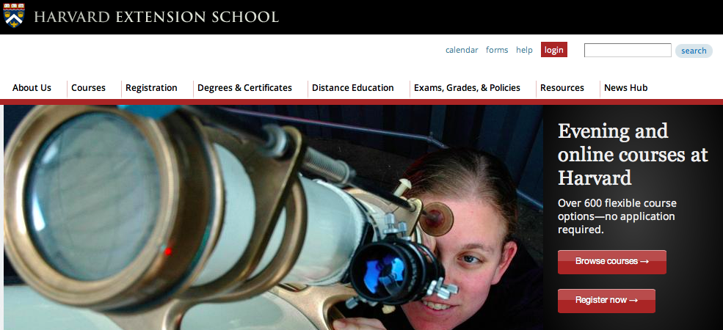
Extension school as Organizational Framework (Harvard-like)
At Harvard University’s primary resource for continuing education courses for a century, you’ll find open-enrollment classes in nearly 60 fields.
Attend evening classes on campus in Harvard Square.
Choose from more than 200 Harvard online courses, including Harvard College lectures.
Earn undergraduate or graduate credit or take a course for noncredit.
Take five courses in a focused area and earn one of our professional on-campus.
Notes:
Delft Extension School for open & online education supports the mission of the Roadmap 2020 to realize a permanent position among leading universities in engineering, science & design by:
Growing academic output:
More students & academic staff
Better reputation & visibility of academic niches
Higher & better quality international enrollments
New learning & research networks
Improving quality of both campus & online education
Higher quality courses
Better progress of students in full-time degree programs (study succes)
Better fit with future student expectations

Slide 8
Strategy
Experiment with open & online education in order to find new revenue models
Focus the online portfolio on Dutch and upcoming global markets for continuing education (post-initial / BRIC)
Strengthen research & education networks and collaboration with partners in edX
Incorporate online modules in regular curriculum & innovation of online didactics

Slide 9
Educational business column
Management
Organization
Teaching and learning process
Content
Technology
Business model
Notes:
We are confronted with a maze of criteria to make it work. The transformation process to improve education, enhance ‘educational productivity’

Slide 10
Learning innovation activities
Renate Klaassen (3TU Centre for Engineering Education)
Design education – IO
Blended learning
EWI – Flipped classroom
L&R - Peer instruction
TBM - BSc blended learning curriculum
CITG – Virtual labs, blended CITG-KO
OC Focus – Blended version of BKO
Online learning
Extension school, MOOCs, SPOCs
Online master (CITG, TBM, L&R)
Staff development
Digital assessment / assessment for learning
Architecture, IO, 3ME, EWI
Multidisciplinary projects
Entrepreneurial minor, Bio-inspired design, Industrial ecology, Green Village
Notes:
Many initiatives that cover an wide variety of educational innovation at the campus: the challenge is to make innovation and continuous improvement part of the education process, which is a cultural as well as institutional challenge.

Slide 11
Research in Education (PhD)
Maartje van den Bogaard
Student success in higher education
Learning analytics and academic analytics
Online learning and authentic learning environments
Thieme Hennis
MOOCs as research objects and research instruments
Applying motivational/psychological concepts in online education
Participatory learning for disengaged learners
Ebrahim Rahimi
Personalization of learning process using technology
Competency development
Facilitating self-regulated and self-directed learning
Designing and developing Personal learning environments using Web 2.0
Notes:
We are confronted with a maze of criteria to make it work. The transformation process to improve education, enhance ‘educational productivity’

Slide 12
Research in Education
Advancement of research based teaching and course-design
Online learning in Higher Engineering Education
Self-directed learning in an authentic learning environment.
Micro learning management for informal and experiential learning (at the workplace).
Open research and open innovation
Notes:
We are confronted with a maze of criteria to make it work. The transformation process to improve education, enhance ‘educational productivity’

