Slide 1
Study success@RSM
DEPARTMENT TECHNOLOGY & OPERATIONS MANAGEMENT
Dr. Michaéla Schippers

Slide 2
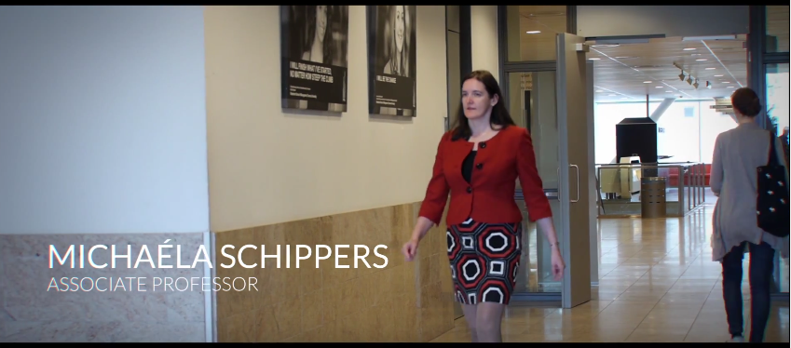
https://www.youtube.com/watch?v=2GkJ3xARKXo

Slide 3
THE GOAL-SETTING PROGRAMME
Intervention created to combat two problems at RSM:
High drop-out rates of 50%
Large differences in performance
Causes:
Students unsure about goals, no deliberate choices
Low motivation and low study performance
Reasons:
Individuals with clear goals are more able to direct attention and effort to goal-relevant activities

Slide 5
IkiGaI - goal-setting
People with a strong sense of purpose have:
- Boosted immune systems
- Lower stress hormones
And:
Are able to grapple with the difficulties of life
Live longer
Nowadays more attention to life goals
goal-setting seen an important skill
http://ngm.nationalgeographic.com/ngm/longevity/1108/daily_vid.html
Notes:
video

Slide 6
THE GOAL-SETTING INTERVENTION
Online computerized goal-setting programme (evidence based)
Part 1
Part 2
Guided writing about the future:
Habits
Learning
Social life
Leisure
Family
Career
Describe ideal future life versus the life you want to avoid
Describe future plan
Specifying, clarifying, defining and prioritizing 6-8 specific goals
Back-up plans, goal-monitoring
“I feel that after defining these goals I have much more direction in what I do every day.”
Part 3: I WILL statement

Slide 8
RESULTS AND EFFECTS
Overall the academic performance of the intervention cohort improved by ~ 20%
Both for credits (21 %) and retention rate (22%)
Gender gap closes by 98%
Ethnicity gap closes by 38% (and by 93% after the second academic year)
Schippers, M. C., & Scheepers, A. W. & Peterson, J. B. (2015). A scalable goal-setting intervention closes both the gender and minority achievement gap.
Open access: http://www.palgrave-journals.com/articles/palcomms201514
Notes:
On average students wrote 3,000 words

Slide 9
# ECTS participation goal-setting/I will (2012/2013)
Difference:
31 ECTS
SCM = study choice meetings

Slide 10
More full model, regression analysis First year students 2012-2013
Participation in exams
Study success
Retention
Goal-setting/I Will
Study-choice meetings
Goal setting
Nr. of credits β = .44***
Retention rate β = .45***
Controlling for age, gender, registration date and personality
Number of words and strategies/obstacles explained additional variance
Notes:
On average, students wrote 3,000 words

Slide 11
Conclusions
Goal-setting was effective in enhancing academic achievement and retention for a full cohort of students
Especially effective for students that fully participated, and for men and ethnic minorities
Academic institutions should consider using goal-setting as part of their curriculum

Slide 12
FUTURE ADDITIONS TO GOAL-SETTING
Goal Diaries
Create an online support network:
Connect with others who have the same goals and/or same past/present experiences
Achievements for reaching goals
Ongoing journaling of significant (life) events

Slide 13
Contact study success
Dr .Michaéla Schippers
Department of Technology & Operations Management
Rotterdam School of Management
Erasmus University
Burg. Oudlaan 50, Room T9-50
3062 PA Rotterdam
The Netherlands |Tel +31 (0)10 408 1892
e-mail: mschippers@rsm.nl | www.rsm.nl
studysuccess@rsm.nl

Slide 14
References
Schippers, M. C., & Scheepers, A. W. & Peterson, J. B. (2015). A scalable goal-setting intervention closes both the gender and minority achievement gap. Palgrave Communications 1:15014. doi: 10.1057/palcomms.2015.14
Schippers, M. C., Scheepers, A., Morisano, D. & Locke, E. L. & Peterson, J. B. (2016). Enhancing student retention and academic performance: the effects of guided reflection on goals. Working paper.
Schippers, M. C. (2014). Social loafing tendencies and team performance: The compensating effect of agreeableness and conscientiousness. Academy of Management Learning & Education, 13 (1), 62-81, doi: 10.5465/amle.2012.0191
Schippers, M. C., Homan, A. C., & van Knippenberg, D. (2013). To reflect or not to reflect: Prior team performance as a boundary condition of the effects of reflexivity on learning and final team performance. Journal of Organizational Behavior, 34, 6-23. doi:10.1002/job.1784

