Slide 1

CEL Innovation Room #6: Videos in Education
Developing a knowledge clip for a third-year psychology course
Harrie Boelens
20 May 2016

Slide 2

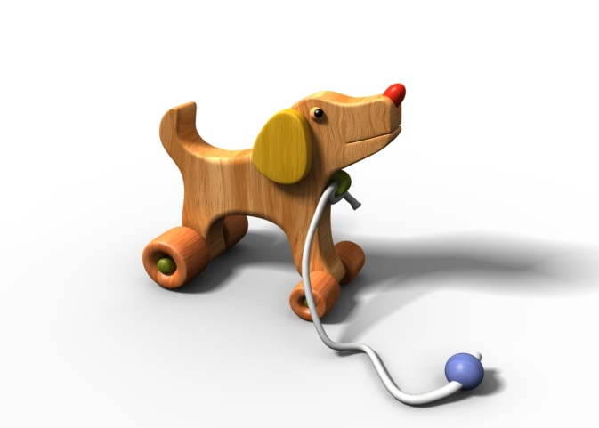

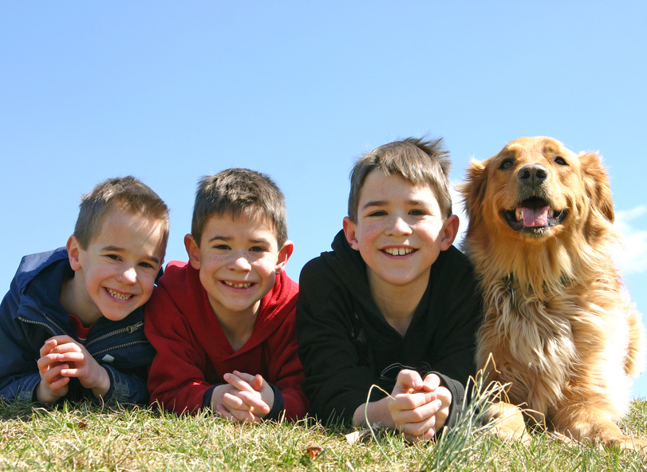
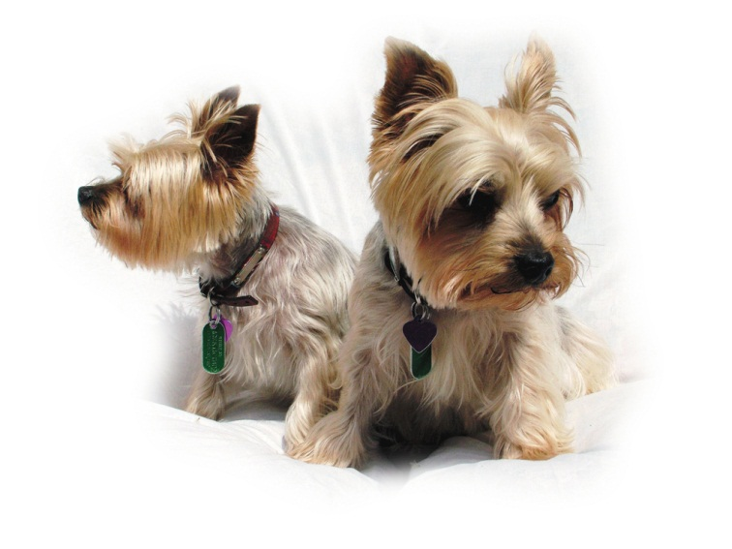
Conceptual development
and
the biological world
Harrie Boelens
7 December 2015

Slide 3

CHAPTER 4
Superordinate, basic level and subordinate categories
The role of language in conceptual development
The biological/nonbiological distinction
The representation of categorical knowledge: A historical perspective

Slide 4
Clip on mediasite

Slide 5
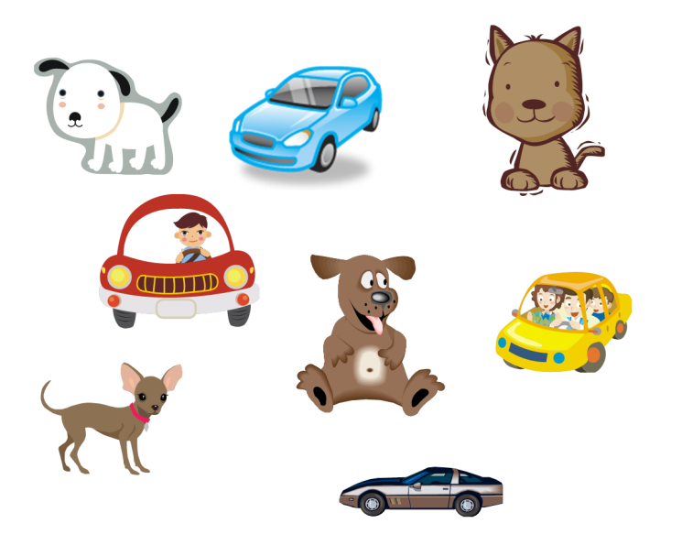
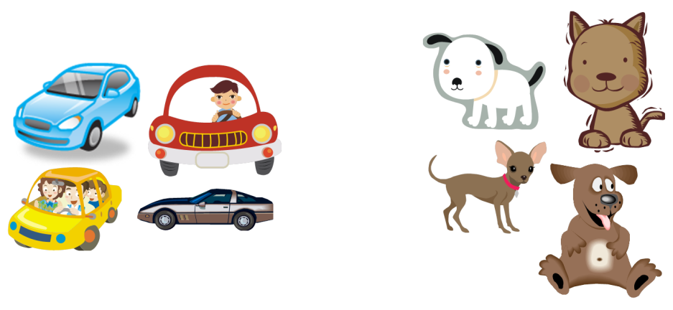
Made with Screencast-O-Matic
There are cars and dogs, scattered on the floor, in front of the child.
The child picks them up, and makes two groups, or piles.

Slide 6
Conclusions
Knowledge clips and flipped classrooms go together well.
Knowledge clips may be especially suitable for foundational content.
The animation-plus-voice-over type of knowledge clip may be especially useful when the original content is very 'visual', and might be especially effective when the owner of the voice is the instructor of the course.

