Slide 1
Proceed to the next level
Prof. Dr. Jeroen Jansz
Dept. of Media & Communication

Slide 2
Proceed to the next level, please gaming:research:teaching
Prof. Dr. Jeroen Jansz
Dept. of Media & Communication

Slide 3
Foreplay
Digital games as objects of research.
Gaming.

Slide 4
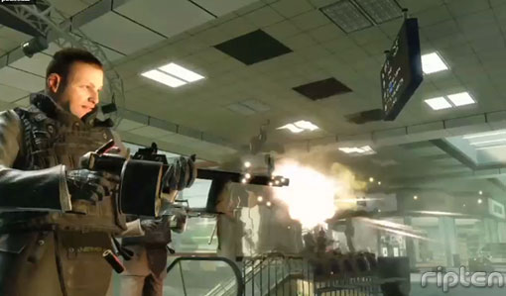
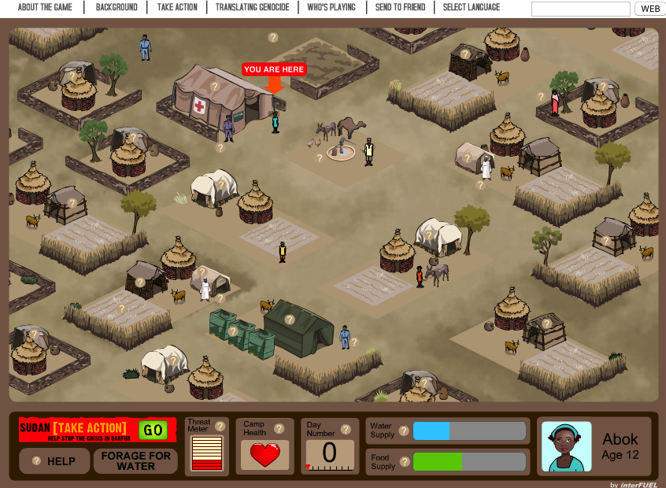
The walkthrough

Slide 5
Level 1: digital entertainment games
Persistence
Violence

Slide 6
Level 1: digital entertainment games
The appeal of gaming.
The short answer:
Preference for a digital game (over TV, film, book).
1. Play theory
- Huizinga’s Homo Ludens
- Psychologists, e.g., Piaget, Sutton-Smith
2. Gaming as motivated action
- Uses & Gratifications Theory
- Self-Determination Theory

Slide 7
Level 1: digital entertainment games
Gratifications sought, gratifications obtained.
Competition
Competence
Challenge
Fantasy
Relatedness, social interaction

Slide 8
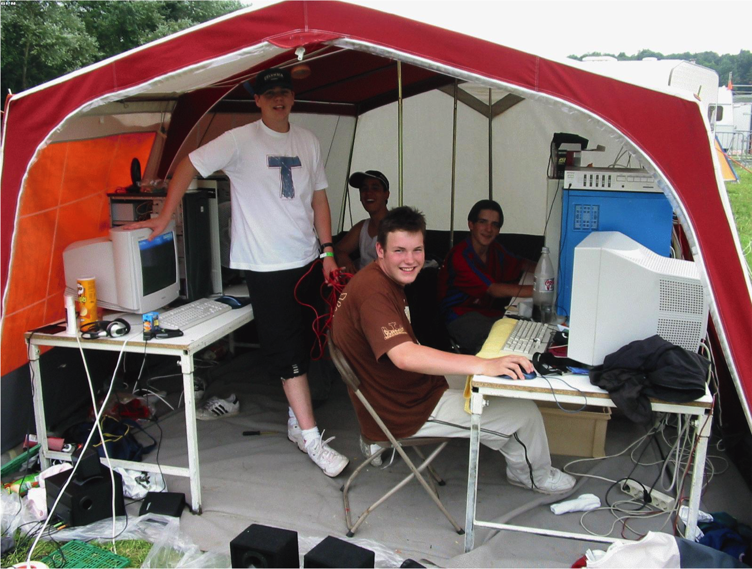
Level 1: digital entertainment games
The appeal of violence
A safe laboratory
- who you are or could be
- what you feel

Slide 9
Level 2: serious games
Oxymoron: game / play / serious?
‘Serious games are games that use computer game and simulation approaches and/or technologies for primarily non-entertainment purposes’.
A major creative industry in the Netherlands.

Slide 11
Level 2: serious games
Educational games
(Some) Teachers uncomfortable
The structure of the Dutch school day

Slide 12
Level 2: serious games
Different domains of application

Slide 13
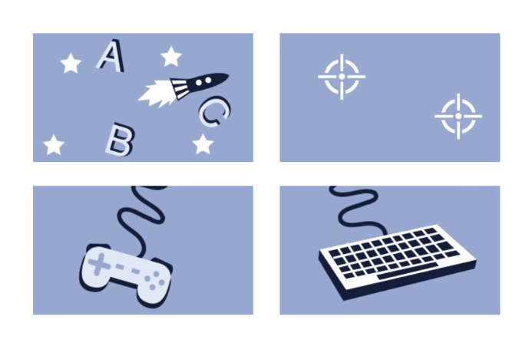
Level 2: serious games
This video cannot be accessed

Slide 14
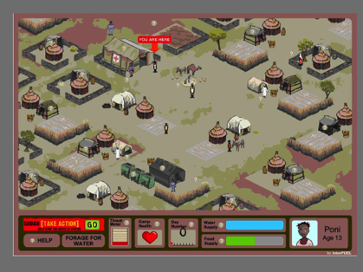
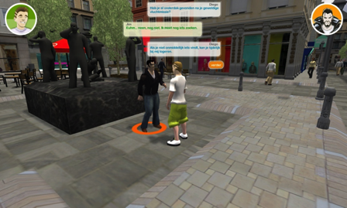
Level 2: serious games
Games and civic engagement
‘Games for Change’
Darfur is Dying September 12th Poverty Is Not a Game

Slide 15
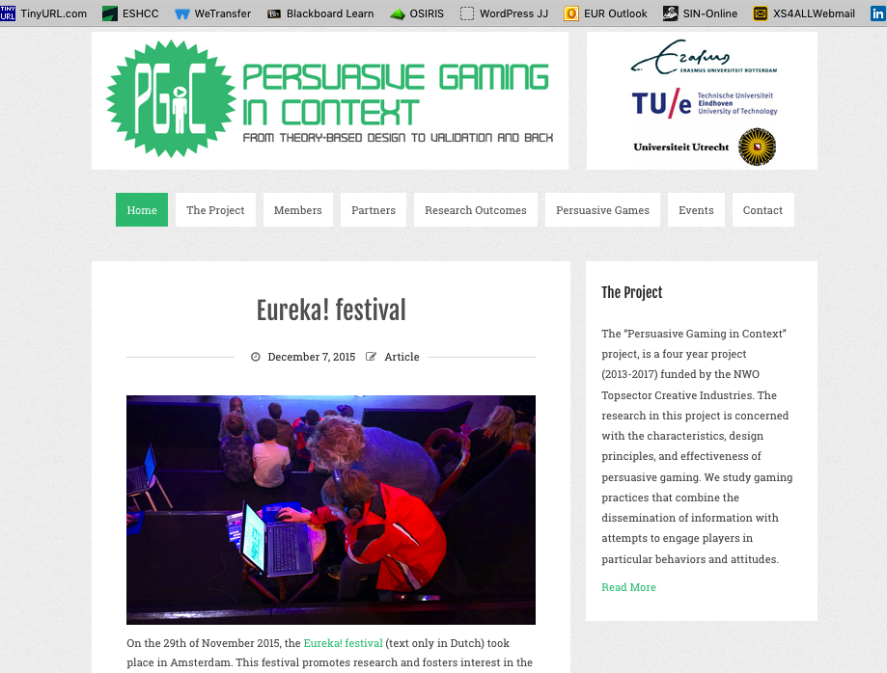

Slide 16
Level 3:
3 Pillars:
http://www.persuasivegaming.nl

Slide 17
Level 3: persuasive gaming
The theory: Persuasion
Operates through ‘manipulation of symbols’ or procedural rhetoric in a game (Bogost, 2007).
Definition of the process of persuasion:
“A successful intentional effort at influencing another’s mental state through communication in a circumstance in which the persuadee has some measure of freedom.”
(O’Keefe, 2002, p. 5)

Slide 18
Level 3: persuasive gaming
The theory: Persuasion
Successful intentional effort.
‘I persuaded him, but failed’
Mental state? Focus on players’ mental state.
The game designer’s intention to influence.
Deliberately changing an attitude (the psychological concept).

Slide 19
Level 3: persuasive gaming
The theory in practice
Persuasion is not coercion
“the persuadee has some measure of freedom” (O’Keefe)
What is the goal of the persuasive game?
For example:
Fight poverty
Donate to relief funds
Stop smoking
Abject goals
Border Patrol: kill Mexicans

Slide 20
Level 4: teaching
Games and play in my teaching?
Gamify?

Slide 21
Level 4: teaching
Games and play in my teaching?
Gamify?
No gamification of my lectures, seminars and tutorials.
Digital games and gamers are addressed as topics.

Slide 22
Level 4: teaching / research
MOOC Serious Gaming
Release early 2016
Developers (M&C): Mijke Slot & Jeroen Jansz
Reviewers (M&C): Wannes Ribbens, Ruud Jacobs, Julia Kneer
RISBO: Kris Stabel, Marit Nieuwenhuys, Remy Fermont
Studio EUR: F-J van der Stok, Ramon Bovenlander
Game developers: Ranj, Organiq, VSTEP

Slide 23
This video cannot be accessed

Slide 24
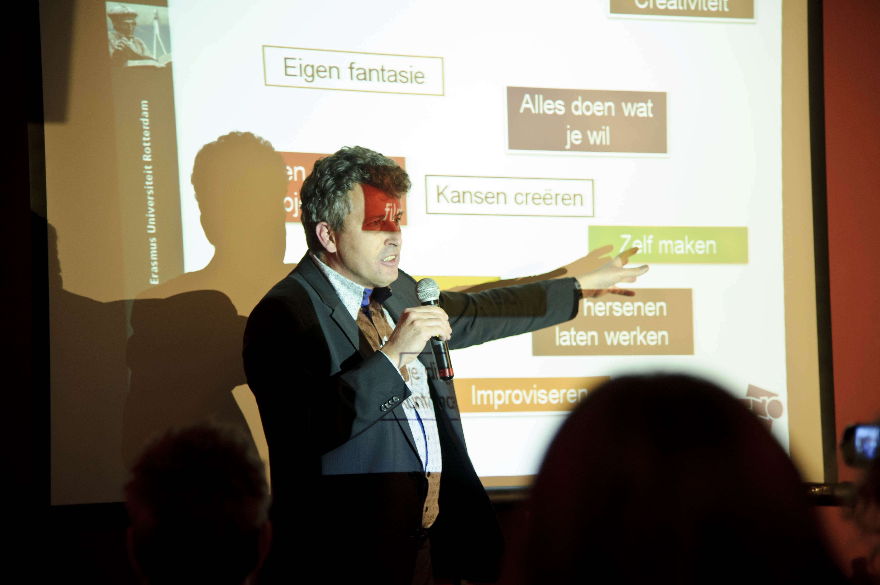
Level 4: teaching / the next level
Our MOOC will not replace campus teaching.
Another MOOC from Media & Communication?
Benefits?
‘You know how to lecture, but can you teach?’

Slide 25
Level 4: teaching / the next level
Benefits
Course development
- ILO (Intended Learning Outcome) / Course / Assessment
New teaching formats
- Blended learning; flipping the classroom
Inspire colleagues
- The ‘wow’ factor

Slide 26
Thank you for your attention!
jansz@eshcc.eur.nl
http://jeroenjansz.nl

