Slide 1
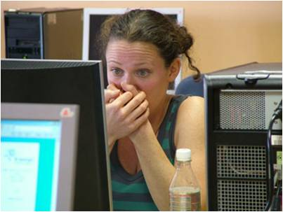
Effectiveness of Serious Games in University Health Care Education
Mary Dankbaar
Erasmus MC University Medical Center Rotterdam
CEL Innovation Room, December 2015

Slide 2
Overview
Why serious games in University Education?
What the research says on the effectiveness of games
Results PhD study: effects of games on performance and motivation
Conclusions and future directions for game design and research

Slide 3
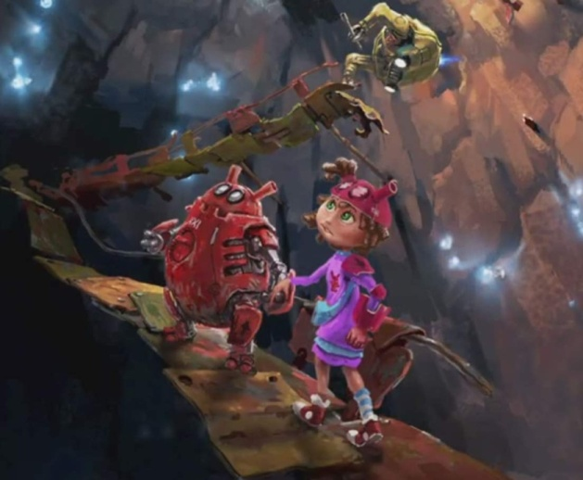
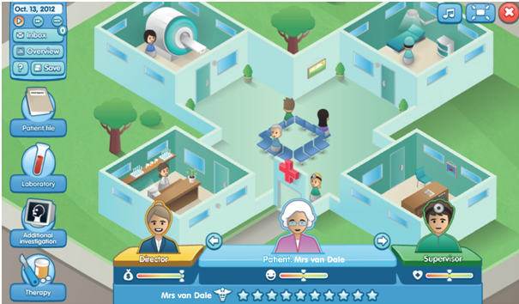
Why Serious Games?
Underground Laparoscopic skills
GeriatrX Clinical care for elderly patients
Air Medic Sky 1
Patient safety
ABCDEsim
Acute care skills
Involvement in a story-line with rules and principles
Experiential learning with challenging tasks (learning goals)
Immediate feedback (responsive characters, score,..)
Immersion and repeated play
Active learning
Scalability

Slide 4
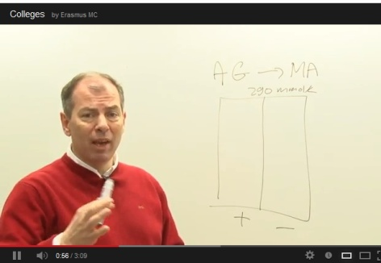
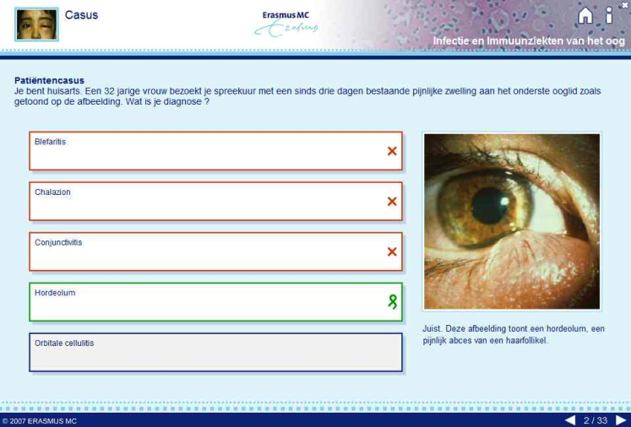
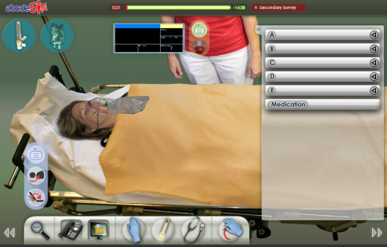
Statement 1- serious games
Serious games are superior learning format in terms of improvement of knowledge and skills
A. TRUE
B. NOT TRUE

Slide 5
Statement 1 - feedback
Serious games are superior learning format in terms of improvement of knowledge and skills
NOT TRUE
For knowledge acquisition there is in general very little added value in serious games. Other formats serve this purpose just as well, at lower costs.
Games may support skills learning, provided certain conditions for instructional design are met.
The effectiveness of an online program is mainly dependant on the didactic choices.
Dankbaar MEW, Comparative effectiveness of a serious game and e-module on patient safety knowledge and awareness, 2015
Mayer RE, The Cambridge Handbook of Multimedia Learning. New York 2005

Slide 6
Statement 2- Adapted Online Learning
Computer-driven adapted instruction, based on students’ learning styles improves the efficiency of learning
- TRUE
- NOT TRUE

Slide 7
Statement 2- feedback
Computer-driven adapted instruction, based on students’ learning styles improves the efficiency of learning
NOT TRUE
There is no solid evidence learning styles exist
Methods for assessing learning styles lack validity evidence
No proof that adapting computer-driven instruction to these ‘styles’ works
Positive effect of strong instructional methods for learning dominates
Cook DA, Revisiting cognitive and learning styles in computer-assisted instruction: not so useful after all, Ac. Medicine,vol.87,‘12.
Kirschner P, van Merrienboer J, Do learners really know best? Urban legends in Education, Educ. Psychologist, vol. 48(3), ‘13.

Slide 8
Research on effectiveness of serious games
Effectiveness of serious games was not supported in systematic review studies. Although some research indicates a positive effect; in general studies show mixed and ambiguous results. (Vogel et al 2006, Tennyson & Jorzack 2008, Akl et al 2010, Sitzmann 2011, Connollly et al 2012, Graafland et al 2012).
Games that train the same (psychomotor) skills that are needed in laparoscopic procedures, have shown to have a positive effect on laparoscopic procedures. (Schlickum, 2009).
Technology-enhanced simulation programs in health education are associated with large effects for knowledge and skills in comparison with no intervention. (Issenberg et al, 2004, Mc.Gaghie, Issenberg et al 2010) .
More research is needed to assess the effectiveness and critical design features of serious games on performance and motivation.

Slide 9
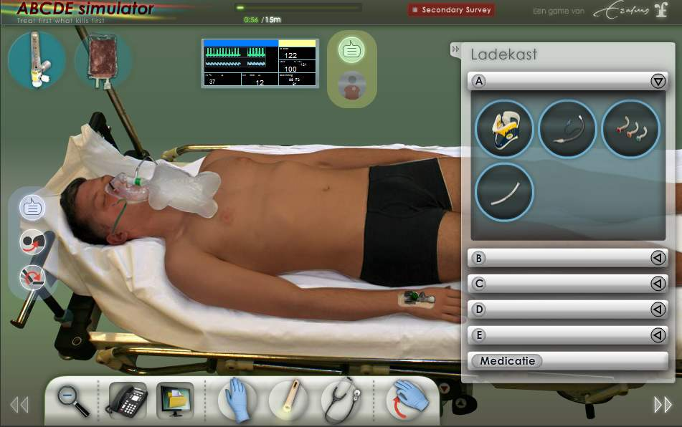
PhD study on the effects of serious games on performance and motivation
abcdeSIM game to train acute care skills for young doctors, as a preparation for face-to-face training
Research questions:
1.a Are young doctors, who use the game before a f2f training, better in clinical emergency care skills than residents who did not use the game?
1.b Are they motivated to play the game?
2. Are cognitive skills and motivation of medical students more improved by adding a simulation game or text-based cases to an instructional e-module?

Slide 10
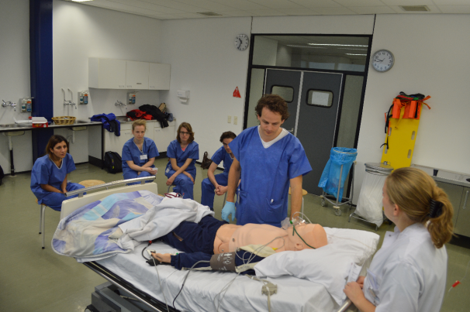
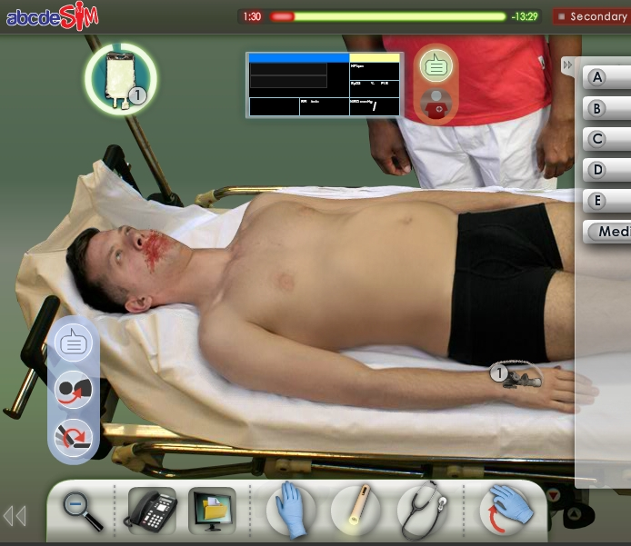
Effects of a serious game on complex skills
Self studytime
2-week certified training on acute care
a b c d e
Reading group
10 hr
a b c d e
Reading & game group
12.5 hr
Skills Assessment

Slide 11
Clinical skills before and after training
N=159
P= 0.03, ES = 0.62
P= 0.34
Before training
After 2 weeks training

Slide 12
Motivation of the reading & game groep
N=90
“This is a very good way to develop experience with the ABCDE approach”.
“This feels very ‘real’; it’s a great preparation. I can feel the stress”.
Completely disagree Completely agree

Slide 13
PhD study on the effects of serious games on performance and motivation
Research questions:
1.a Are young doctors, who use the game before a f2f training better in cognitive emergency care skills than residents who did not use the game?
1.b Are they motivated to play the game?
2. Are cognitive skills and motivation of medical students more improved by adding (high-fidelity) simulation-based cases or (low-fidelity) text-based cases to an instructional e-module?

Slide 14
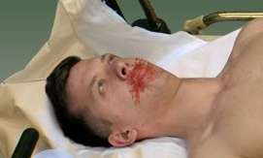
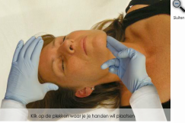
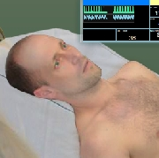
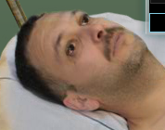
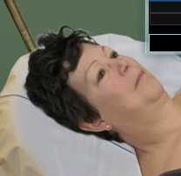
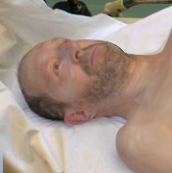
Simulation game (high fidelity cases)
High level of functional and physical fidelity

Slide 15
Text-based cases (low fidelity)
Ee-module-m
Low level of functional and physical fidelity, on the same cases

Slide 16
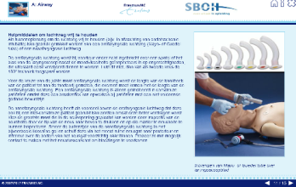
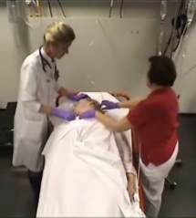
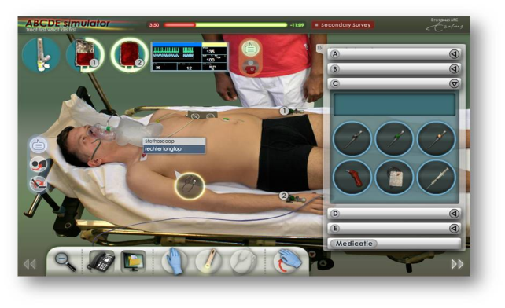
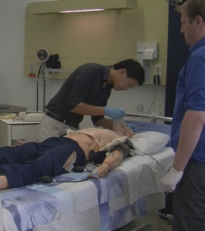
Research design
Instructional e-module
Cases
Questionnaires
Control group, n=16
Controle groep
Text-cases group, n=20
Low fidelity
Game group, n=25
Game groep
High fidelity
Knowledge test
Skills assessment

Slide 17
Questionnaires
Cognitive Load (10 items, scale 0-11)
Intrinsic load ‘the content of the game/cases was very complex’ (3 items)
Extraneus load ‘the explanations were very unclear’ (3 items)
Germane load ‘the game/cases really enhanced my understanding’ (4 items)
Motivation (9 items, scale 1-5)
Engagement ‘it was fun to work through the material’ (6 items)
Feedback ‘during learning, I could tell whether I was doing well’ (3 items)

Slide 18
Results (n= 61)
No differences between groups in age, clinical experience, GPA bachelor
No differences in knowledge scores between groups (M= 20, SD=3.7)
Self-reported learning time in minutes, mean (SD) |  |  |  | Logged game time
 | E-module | Game or Cases | Total
Control group | 133 (78) | - | 133
Game group | 146 (98) | 95 (53) | 241 | 83 (54)
Cases group | 177 (118) | 70 (46) | 247

Slide 19
Clinical skills
N=61

Slide 20
Cognitive load for game-based and text-based cases
N=54

Slide 21
Motivation
N=59
* Game vs cases+ control
** Game vs. control

Slide 22
Conclusions
For initial skills acquisition, an e-module with a video demonstration is a powerful instructional format.
Novice students do not profit from working on additional open cases, which appeared to be too complex, but nonetheless challenged them to study longer.
High fidelity game-based cases enhance motivation and cognitive effort, but also increases complexity and may impede learning for novices.
The same game improved clinical skills among residents in an engaging way, with limited self-study time.
‘Expertise-reversal effect’: a rich learning environment may benefit experts, but is counter-productive for novice learners (interaction prior knowledge - complexity of formats)

Slide 23
Conclusions- game design
Case complexity and fidelity in serious games should be well aligned with students’ proficiency level.
Case complexity may be reduced by offering guidance (worked cases, hints).
Exercising with cases with a range of task difficulty and clinical variation have proven to be effective for skills training with simulation programs.
Issenberg et al, Features and uses of high-fidelity medical simulations that lead to effective learning: BEME syst, review, 2005
Cook et al, Comparative effectiveness in instructional design features in simulation-based education: a systematic review , 2013

Slide 24
Future directions for game research
Design based research is needed on:
The relation between case-complexity, case-fidelity, motivation and skills development. How to facilitate optimal and engaged learning? (‘flow’)
Which design-features improve a game’s effectiveness for performance improvement? (forms of feedback, debriefing)
How should multi-player games to develop communication skills be designed? (critical design features)

Slide 25
Thank you for your attention! Questions?
Contact information
m.dankbaar@erasmusmc.nl
Mary Dankbaar
Erasmus MC University Medical Center Rotterdam

