Slide 1

Learning Analytics potential in understanding student interaction in MOOCs
Innovation Room 13.10.2017
Mohammad Khalil
@TUMohdKhalil

Slide 2


HELLO!
my name is Mohammad Khalil
@TUMohdKhalil

Slide 3
1.
Introduction
Overview and Background

Slide 4






Did Not Exists before 15 years!

Slide 5
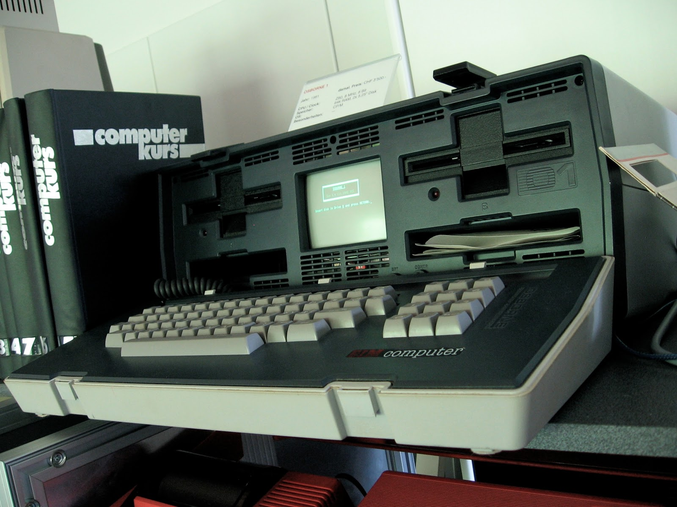

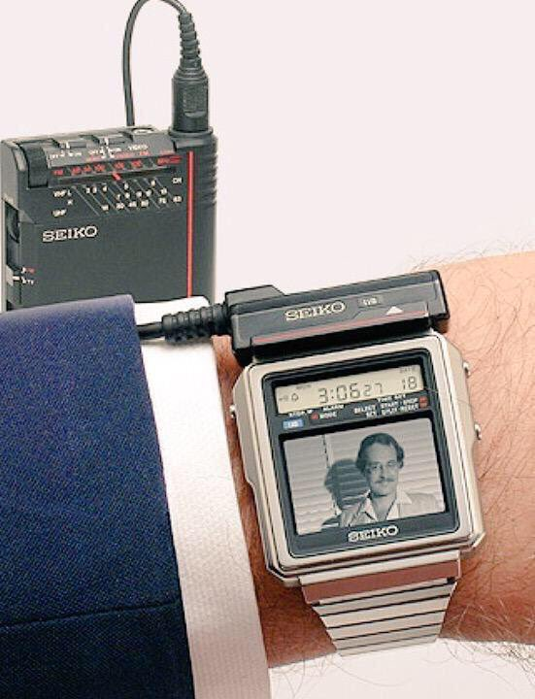
Osborne 1, 1981
Weighed 10.7 kg
Screenshot
1980 Seiko
TV Watch

Slide 6


How Educational Technology Started
Sydney Pressey Multiple Choice Machine (1924)
Plato V (1981)
Notes:
Sydney pressey is professor from Ohio..he tried to make a mcq machine without papers.
Plato V is a televised teaching machine with many figures and visualizations.

Slide 7

Technology Enhanced Learning path
CC0

Slide 8

Distance Education?
Slide taken from: Prof. Carlos Delago Kloos Slides, UC3M

Slide 9


Massive Open Online Courses
https://c2.staticflickr.com/2/1097/1296105722_057a1ab727_b.jpg

Slide 10
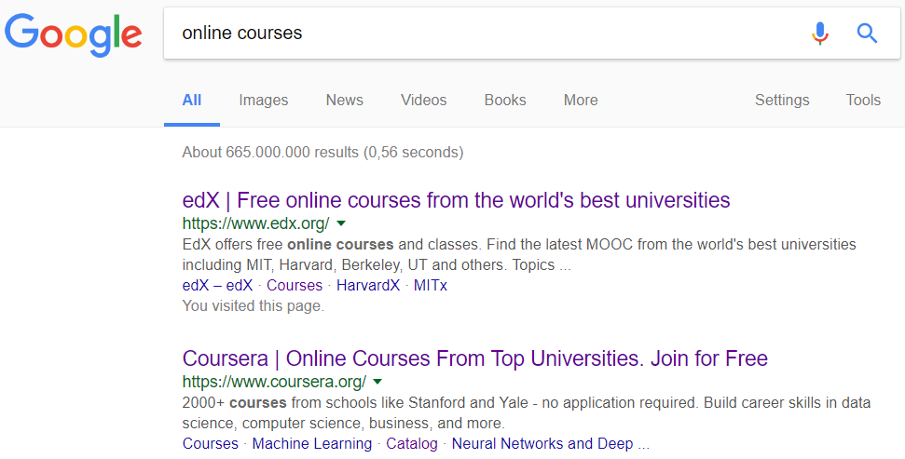

Why MOOCs??

Slide 11
2.
Research Motivation

Slide 12
Relative novelty of MOOCs and learning analytics
What hidden patterns can learning analytics unveil in MOOC educational datasets?
Notes:
Relative novelty of MOOCs and learning analytics, and shortage of research in both

Slide 13



Attrition ratio!
http://www.takepart.com/sites/default/files/styles/tp_gallery_slide/public/RTR33X5C-itok=5W4E1ycQ.jpg

Slide 14
Research Questions
How learning analytics can be developed in MOOCs?
What is the learning analytics potential in bridging student interaction gaps in MOOCs?

Slide 15
2.
Methodology

Slide 16
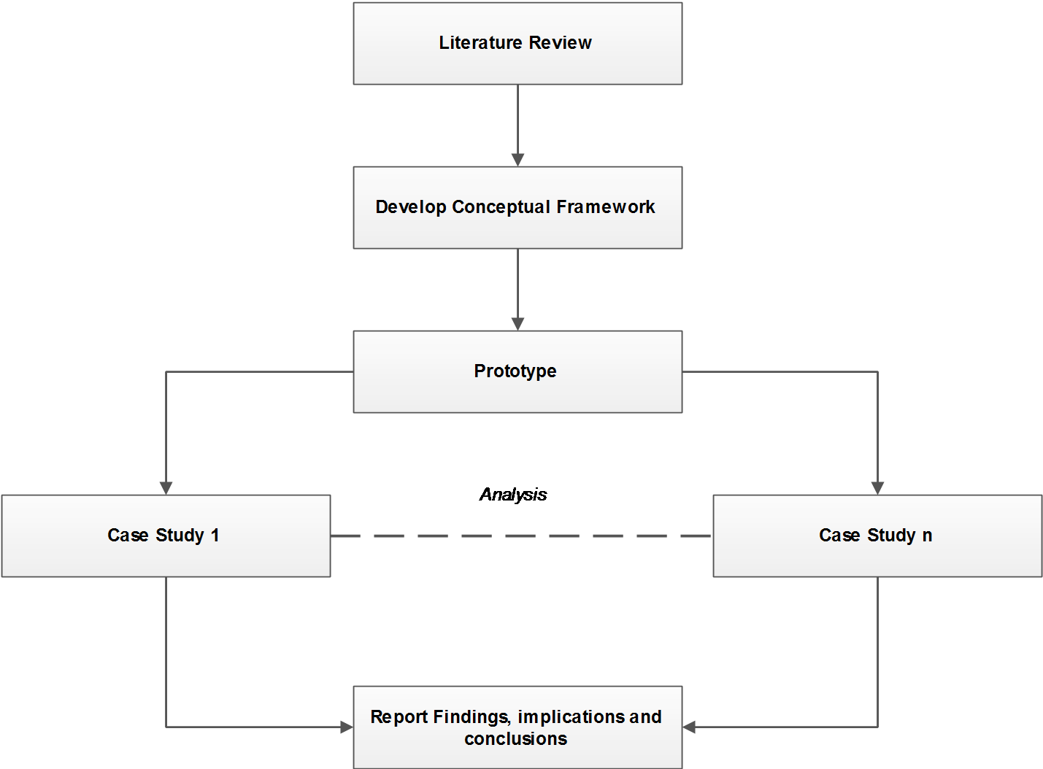
Methodology - Overall

Slide 17
Methodology – Case Studies
MOOCs timeline
Research Question
Data Collection
Data Analysis – Exploratory and content
Report
(Budde et al., 1992; Yin, 2003)

Slide 18
Learning Analytics

Slide 19
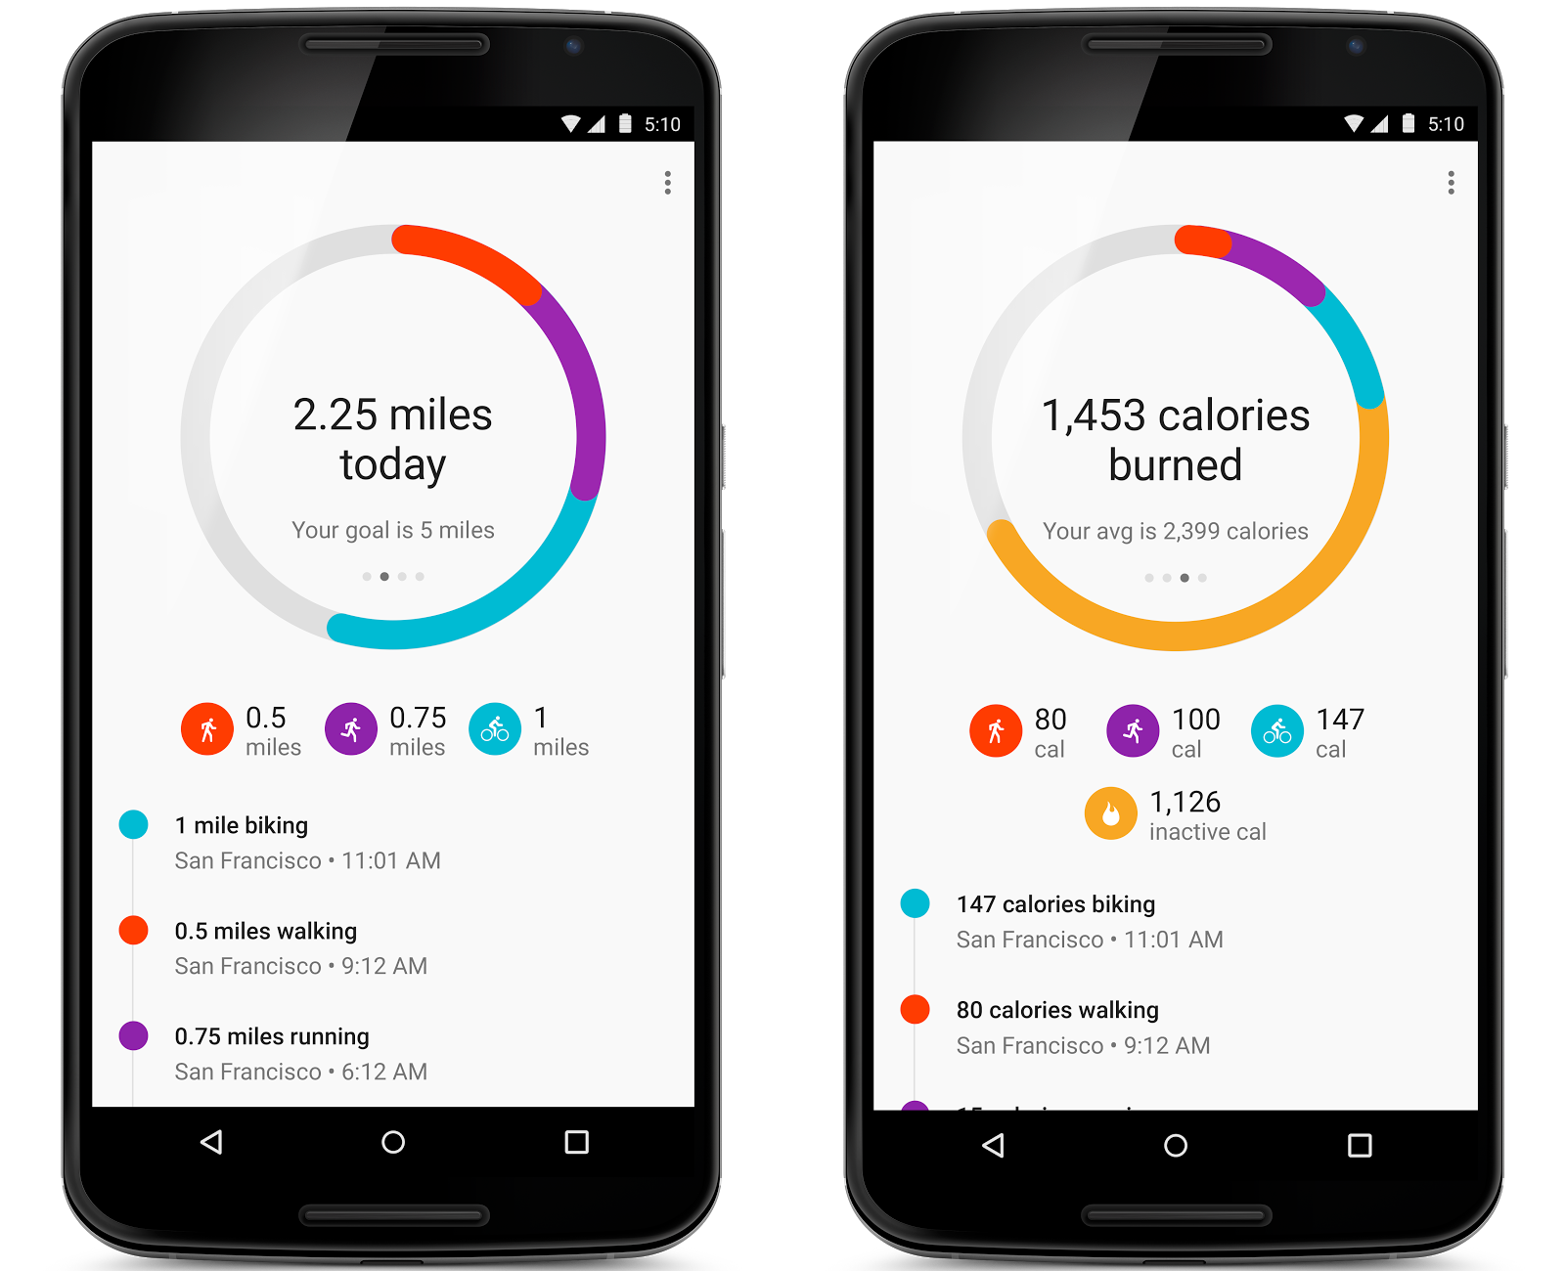
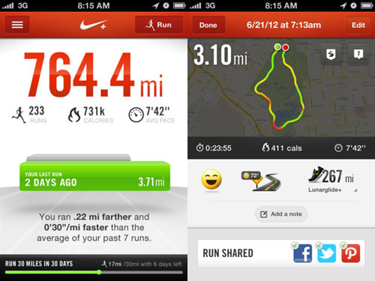
Tracking and Tracing…

Slide 20
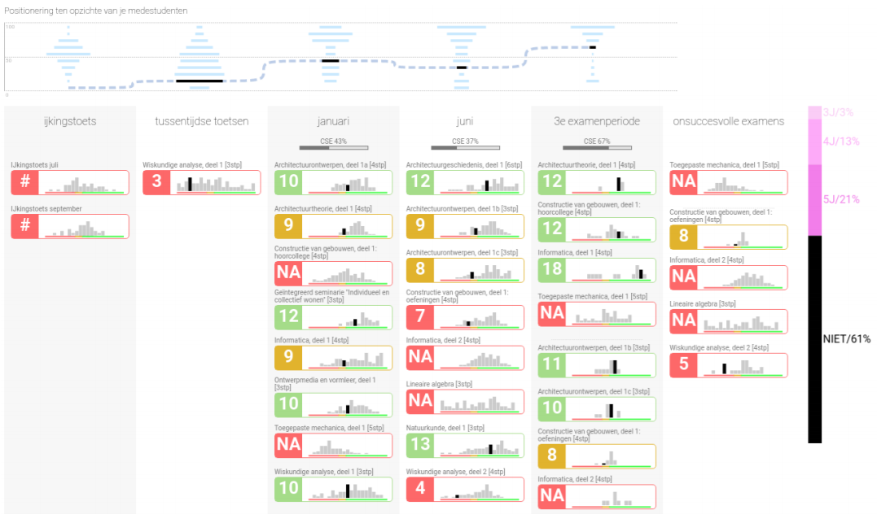
Charleer, S., Moere, A. V., Klerkx, J., Verbert, K., & De Laet, T. (2017). Learning Analytics Dashboards to Support Adviser-Student Dialogue. IEEE Transactions on Learning Technologies.

Slide 21



Learning Analytics
MOOC Data
Learning Analytics

Slide 22
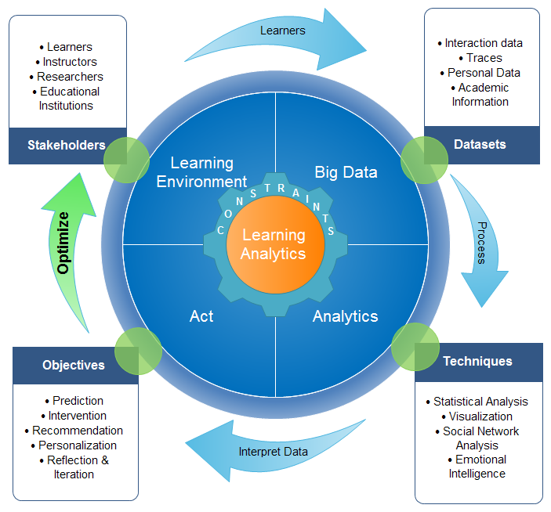
Learning Analytics Framework
Published in:
Khalil, M., & Ebner, M. (2015, June). Learning Analytics: Principles and Constraints. In Proceedings of EdMedia 2015 (pp. 1326-1336).

Slide 23
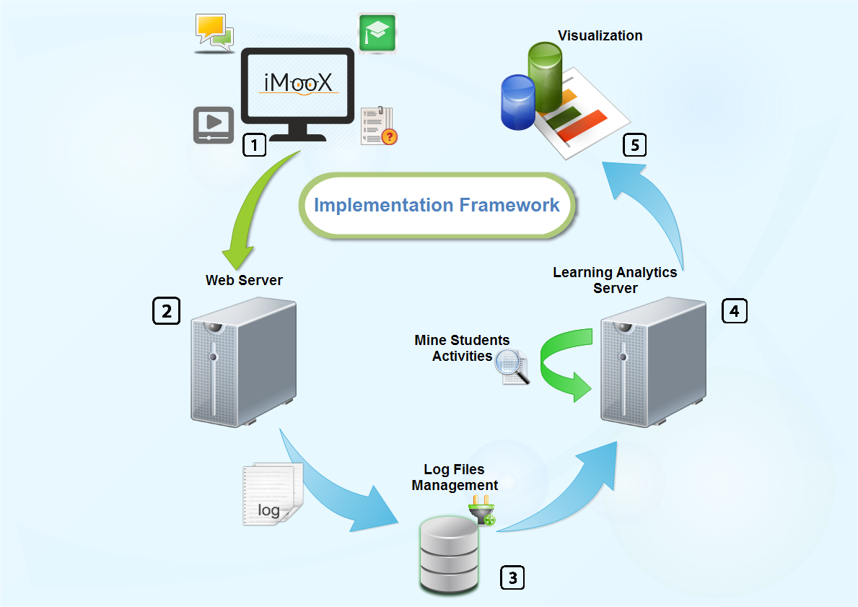
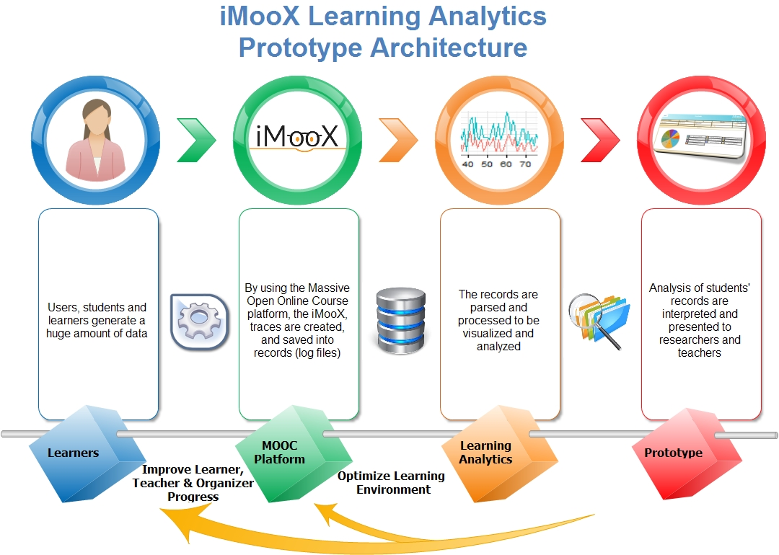
iMooX Learning Analytics Prototype (iLAP)
Published in : Khalil, M., & Ebner, M. (2016). What Massive Open Online Course (MOOC) Stakeholders Can Learn from Learning Analytics?. In Learning, Design, and Technology: An International Compendium of Theory, Research, Practice, and Policy, Springer International Publishing. (pp. 1-30).

Slide 24
Students activities

Slide 25
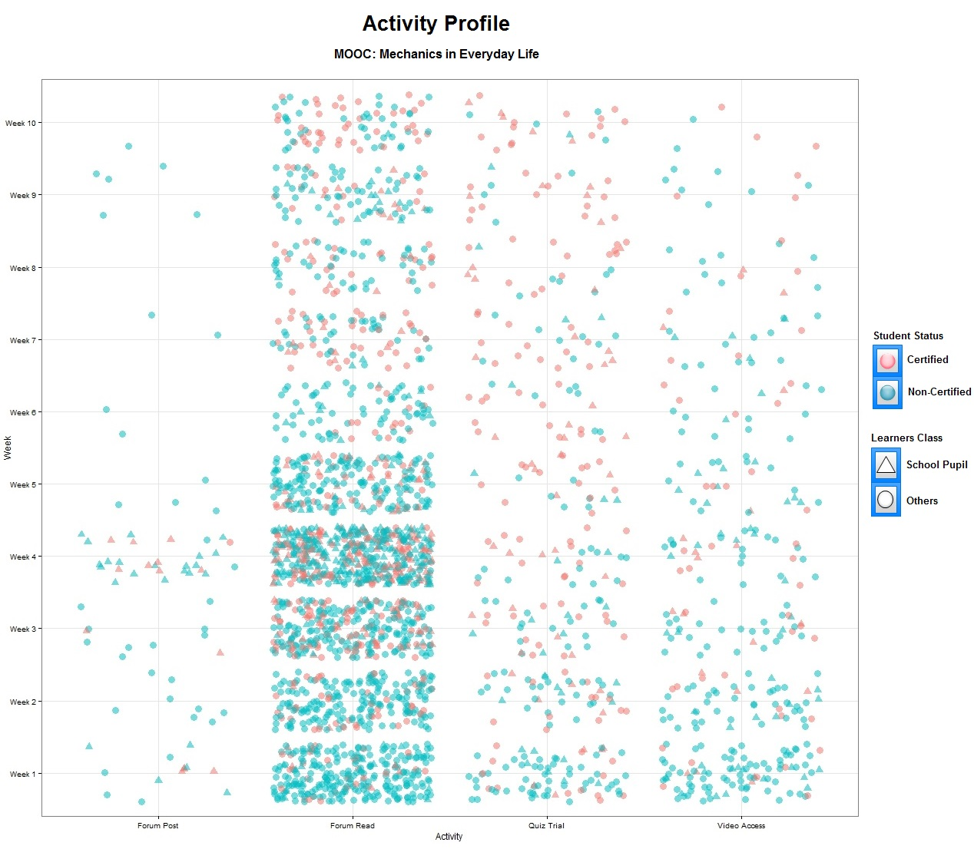
Video Interaction
Drop out
Published in:
Khalil, M. & Ebner, M. (2015). A STEM MOOC for School Children – What Does Learning Analytics Tell us?. In Proceedings of ICL2015 conference, Florence, Italy. IEEE

Slide 26
RQ
What student behavior exists in MOOC Videos?
What is the added value of interactive videos in MOOCs?

Slide 27
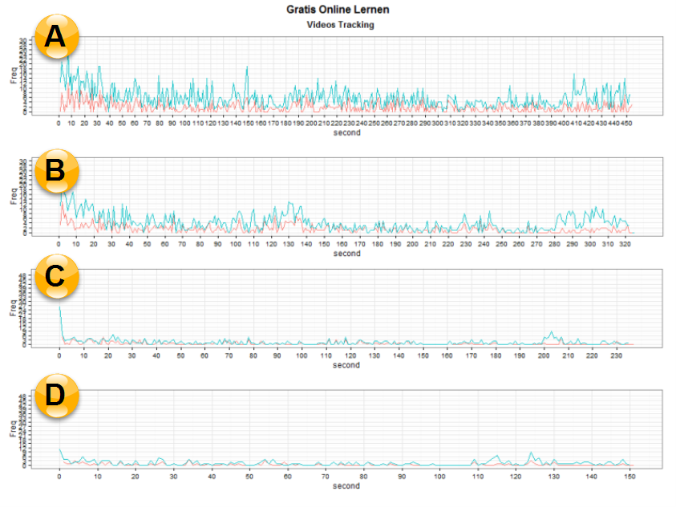
Week 1 & Week 2
Week 7 & Week 8
Published in : Khalil, M., & Ebner, M. (2016). What Massive Open Online Course (MOOC) Stakeholders Can Learn from Learning Analytics?. In Learning, Design, and Technology: An International Compendium of Theory, Research, Practice, and Policy, Springer International Publishing. (pp. 1-30).

Slide 28
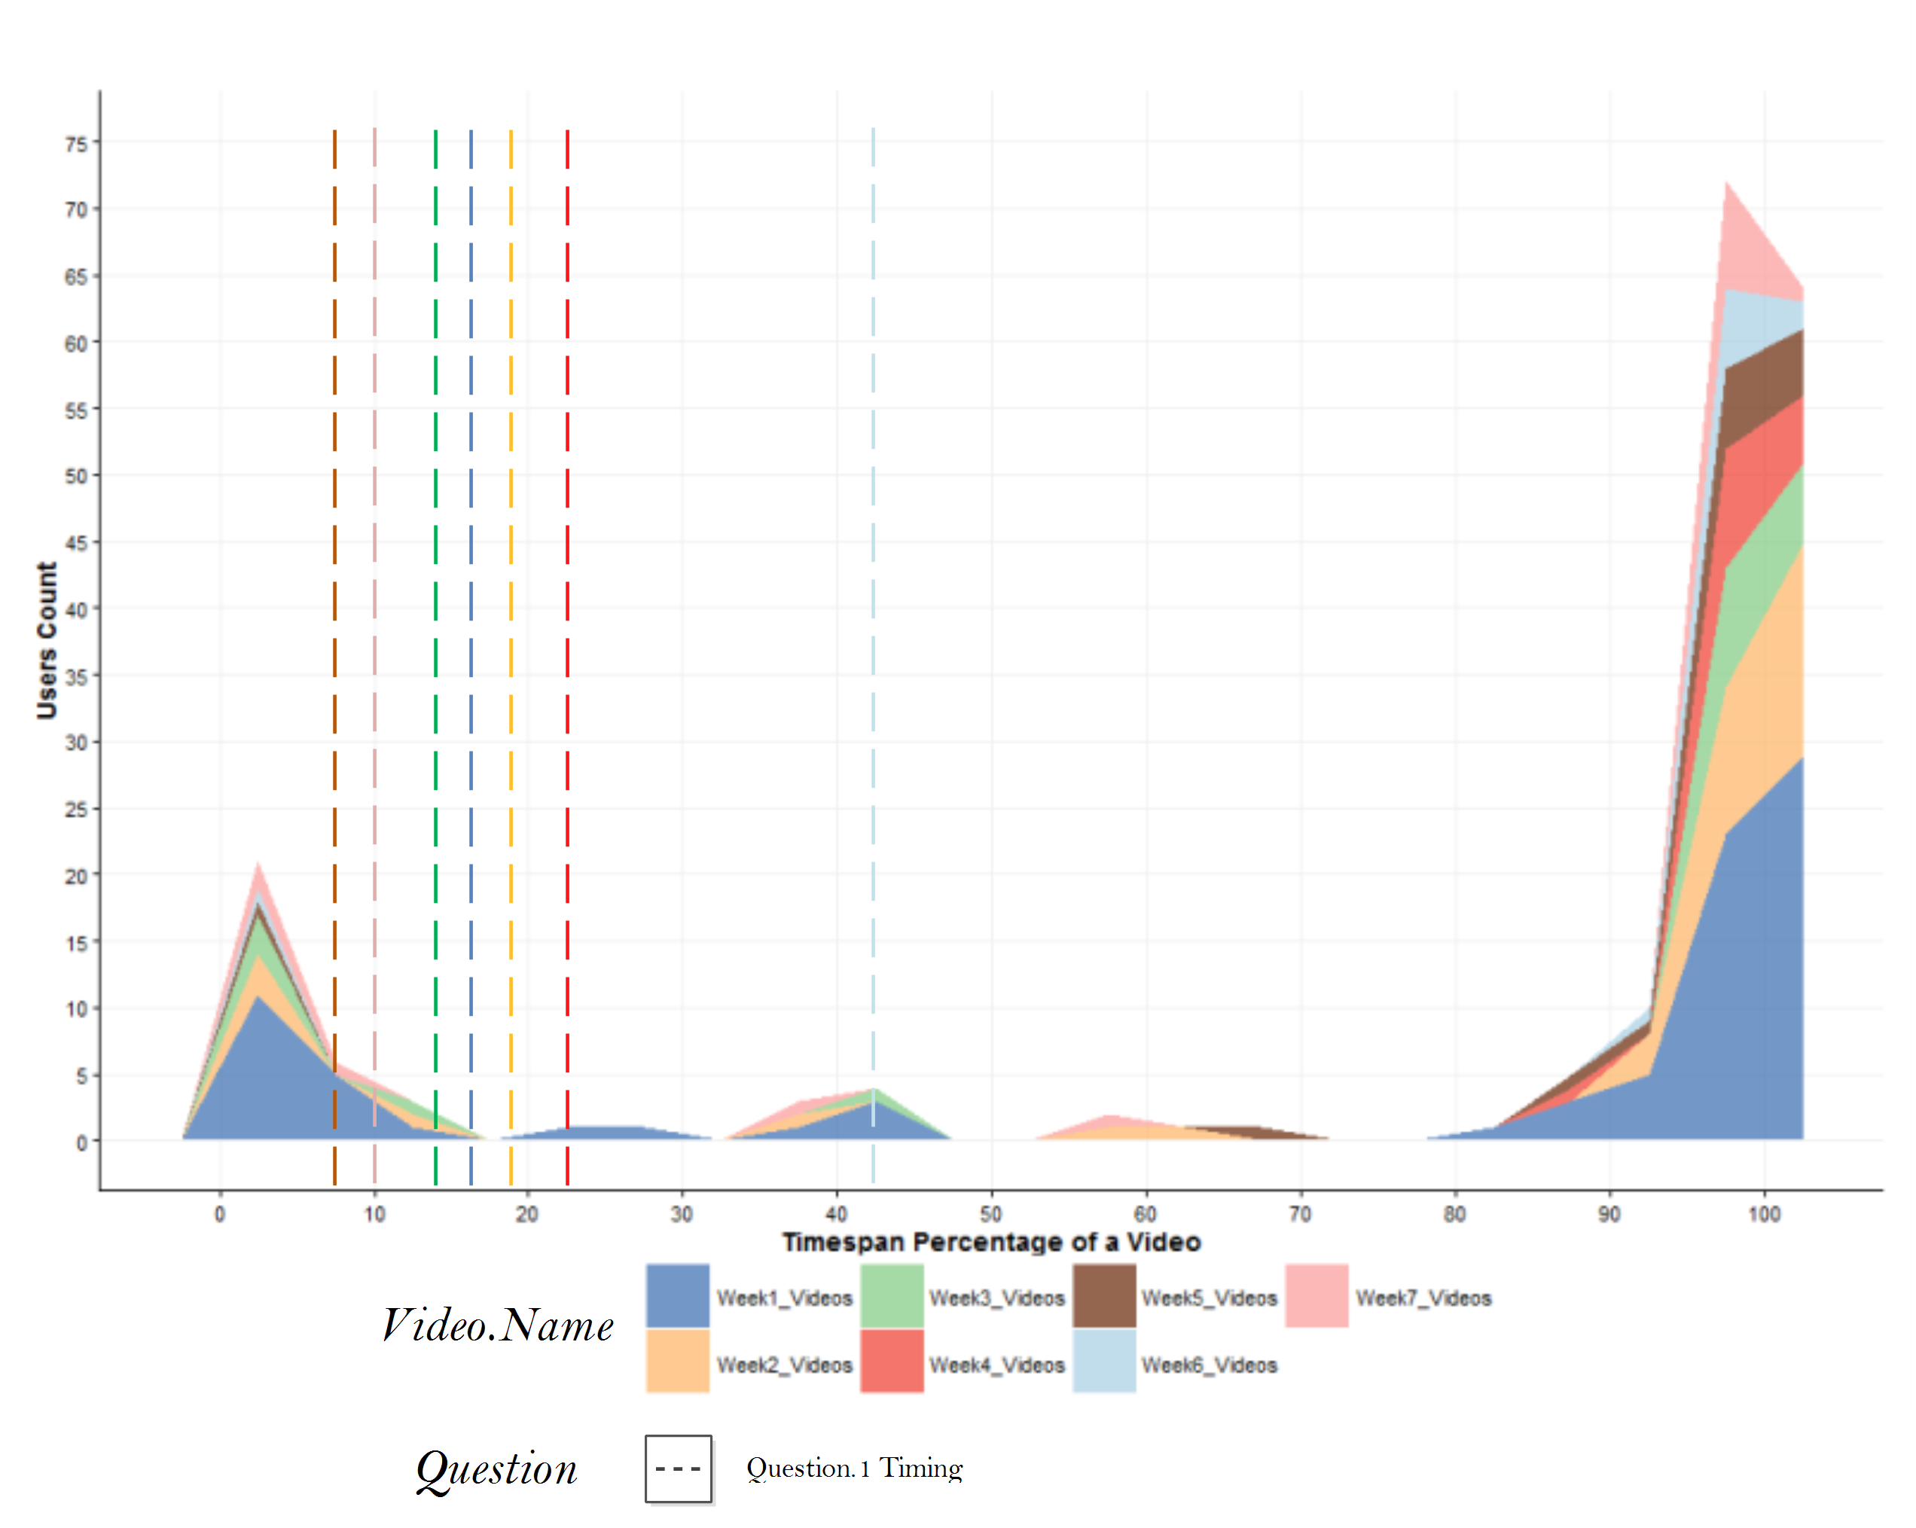
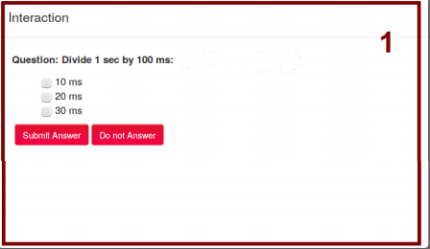
Interactive Videos in MOOCs
Published in:
Wachtler, J., Khalil, M., Taraghi, B. & Ebner, M. (2016). On using learning analytics to track the activity of interactive MOOC videos. In Proceedings of the LAK 2016 Workshop on Smart Environments and Analytics in Video-Based Learning (pp.8–17) Edinburgh, Scotland: CEURS-WS.

Slide 29
RQ
Is there a threshold in MOOCs where learners drop the course or become lurkers?

Slide 30
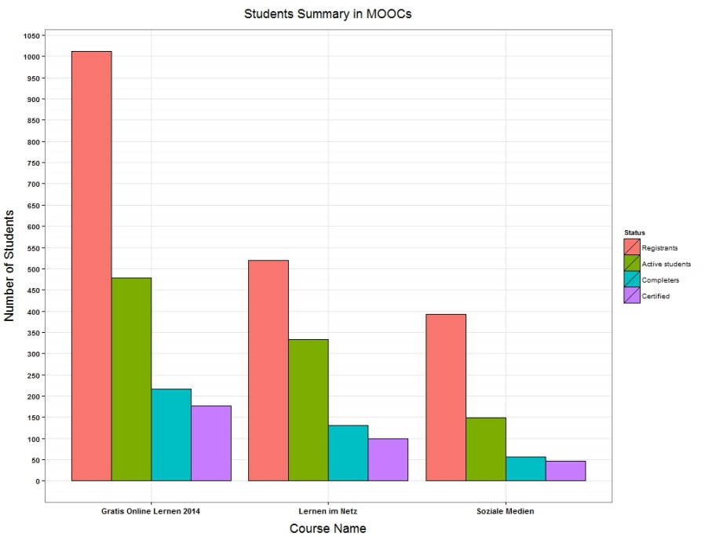
MOOC | Dropout 1 | Dropout 2
GOL | ~ 82.50% | ~63.10%
LIN | ~80.90% | ~70.30%
SZ | ~87.40% | ~67.33%
Published in : Khalil, M., & Ebner, M. (2016). What Massive Open Online Course (MOOC) Stakeholders Can Learn from Learning Analytics?. In Learning, Design, and Technology: An International Compendium of Theory, Research, Practice, and Policy, Springer International Publishing. (pp. 1-30).

Slide 31
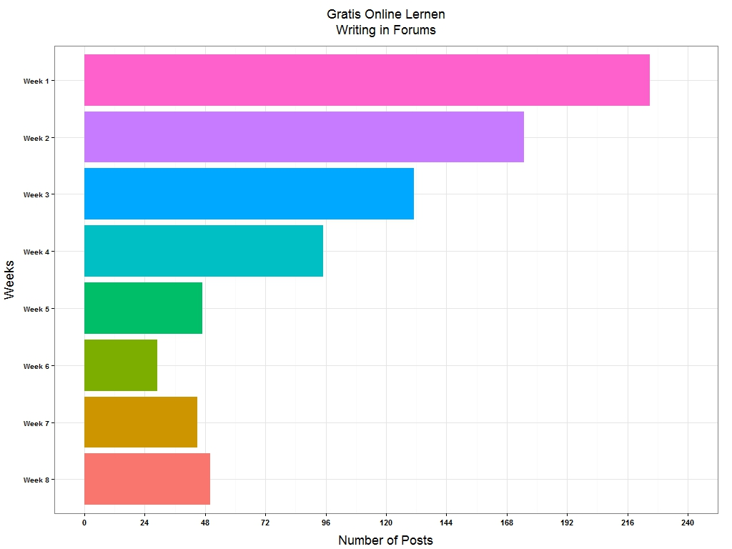
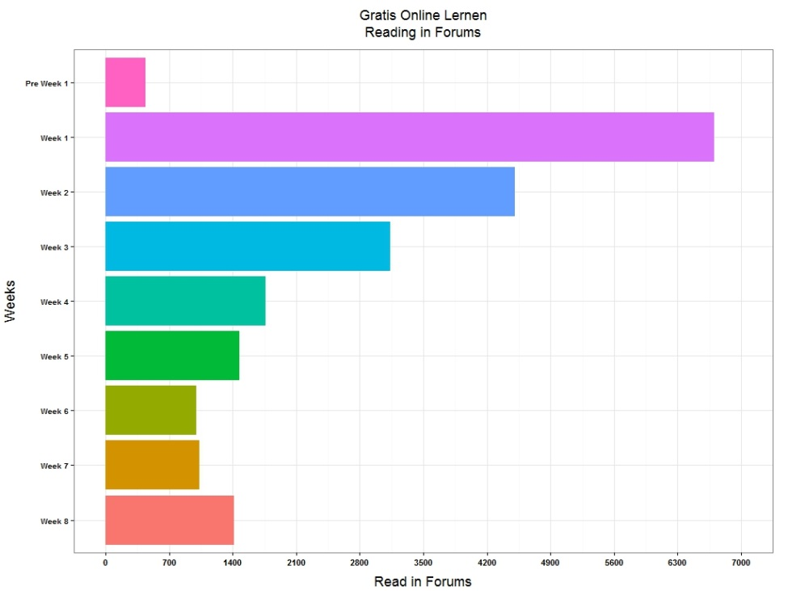
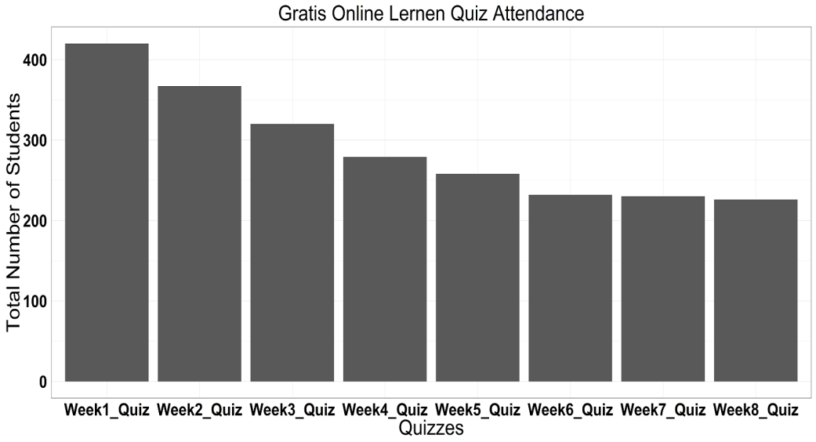
Published in:
Lackner, E., Ebner, M. & Khalil, M. (2015). MOOCs as granular systems: design patterns to foster participant activity. eLearning Papers, 42, 28-37.

Slide 32
RQ
How do students engage in MOOC discussion forums?

Slide 33
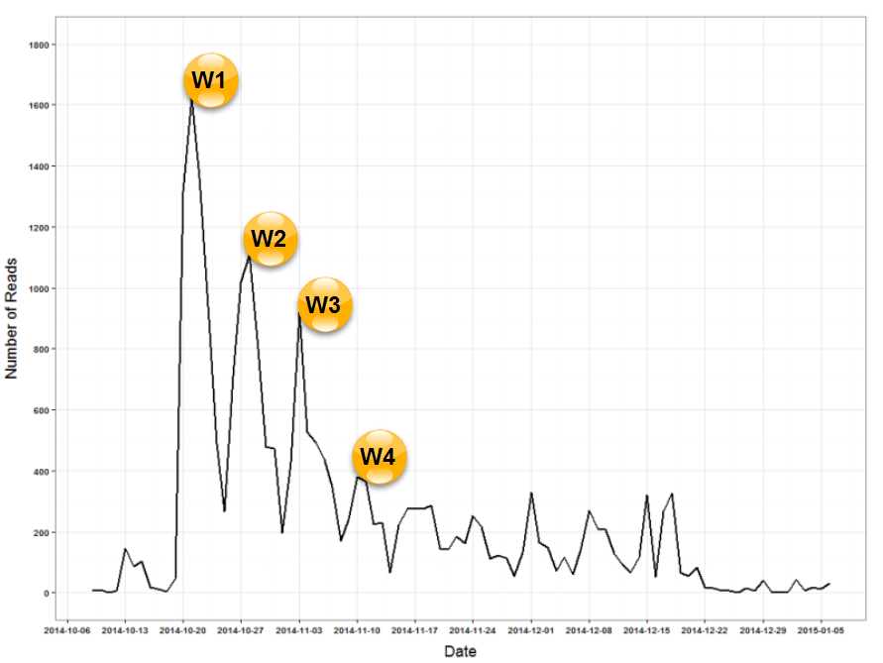
Published in:
Lackner, E., Khalil, M. & Ebner, M. (2016). “How to foster forum discussions within MOOCs. A case study”. International Journal of Academic Research in Education, 2(2).

Slide 34
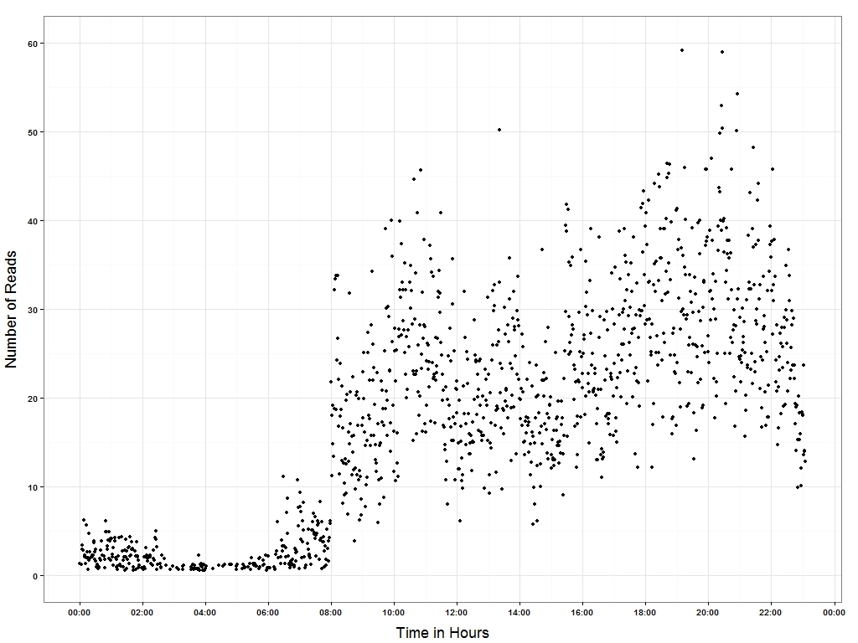
Published in:
Lackner, E., Khalil, M. & Ebner, M. (2016). “How to foster forum discussions within MOOCs. A case study”. International Journal of Academic Research in Education, 2(2).

Slide 35
RQ
What participant types can be clustered in MOOCs based on their MOOC engagement level?

Slide 36
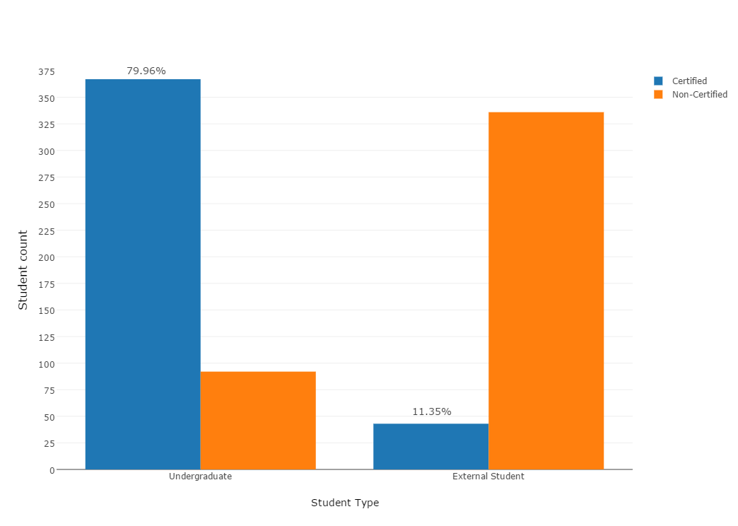
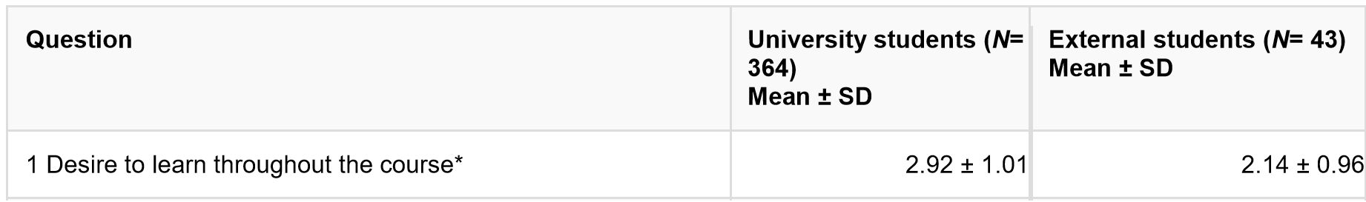

Undergraduates vs External Students
Social aspect of Information Technology MOOC (2016)
2.92 (1.01)
2.14 (0.96)
N=838
1. Strongly agree … 5. Strongly disagree
Undergraduates receive 3 ECTS points
Published in:
Khalil, M. & Ebner, M. (2016). “Clustering Patterns of Engagement in Massive Open Online Courses (MOOCs): The Use of Learning Analytics to Reveal Student Categories”. Journal of Computing in Higher Education.

Slide 37
Clustering
Two use cases: Undergraduates & External participants
K-Means Clustering (4 groups, 3 groups)
Selected Variables:
Reading in forums frequency
Writing in forums frequency
Video watching
Quiz attempts
Published in:
Khalil, M. & Ebner, M. (2016). “Clustering Patterns of Engagement in Massive Open Online Courses (MOOCs): The Use of Learning Analytics to Reveal Student Categories”. Journal of Computing in Higher Education.

Slide 38
Undergraduates Clusters
Cluster | Reading | Writing | Videos | Quiz attempts | Cluster Size | Certification ratio
Gaming the System | 23.99 ± 11.19 (M) | 0.00 ± 0.07 (L) | 0.00 ± 0.07 (L) | 19.64 ± 3.84 (H) | 44.88% | 94.36%
Perfect | 42.23 ± 23.23 (H) | 0.03 ± 0.19 (L) | 20.76 ± 6.01 (H) | 20.56 ± 3.84 (H) | 33.55% | 96.10%
Dropout | 6.25 ± 6.38 (L) | 0.01 ± 0.10 (L) | 2.44 ± 3.42 (L) | 2.76 ± 3.86 (L) | 20.69% | 10.53%
Social | 62.00 ± 53.68 (H) | 4.00 ± 1.41 (H) | 3.25 ± 4.72 (L) | 8.50 ± 9.61 (M) | <1% | 50%
Published in:
Khalil, M. & Ebner, M. (2016). “Clustering Patterns of Engagement in Massive Open Online Courses (MOOCs): The Use of Learning Analytics to Reveal Student Categories”. Journal of Computing in Higher Education.

Slide 39
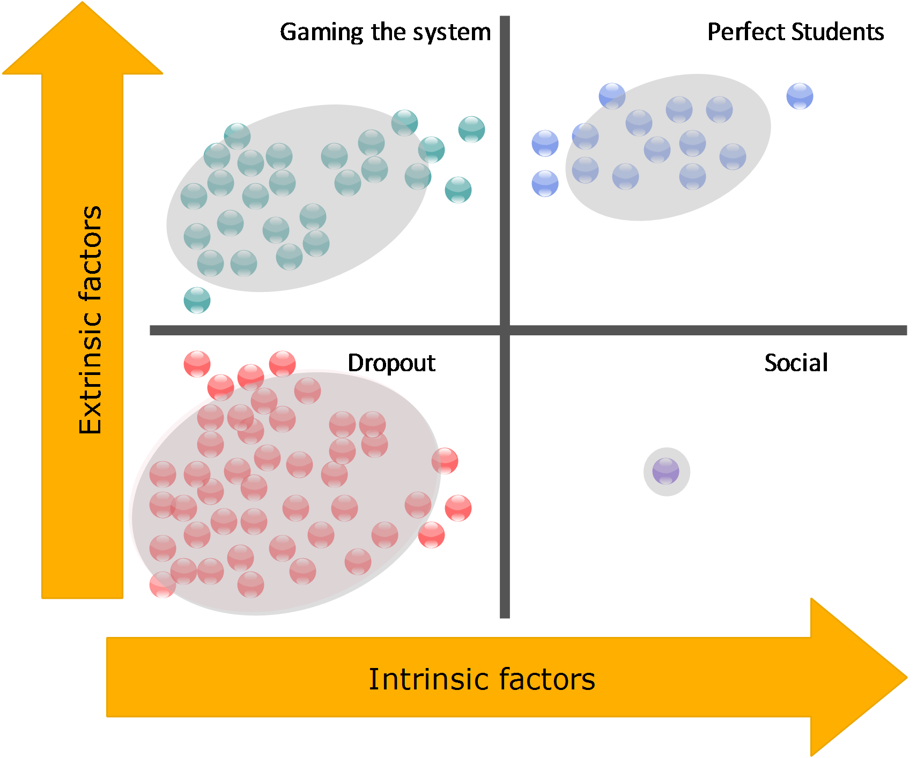
Cryer’s Scheme of Elton (1996)
Published in:
Khalil, M. & Ebner, M. (2016). “Clustering Patterns of Engagement in Massive Open Online Courses (MOOCs): The Use of Learning Analytics to Reveal Student Categories”. Journal of Computing in Higher Education.

Slide 40
RQ
How to motivate MOOC students and increase their engagement?

Slide 41
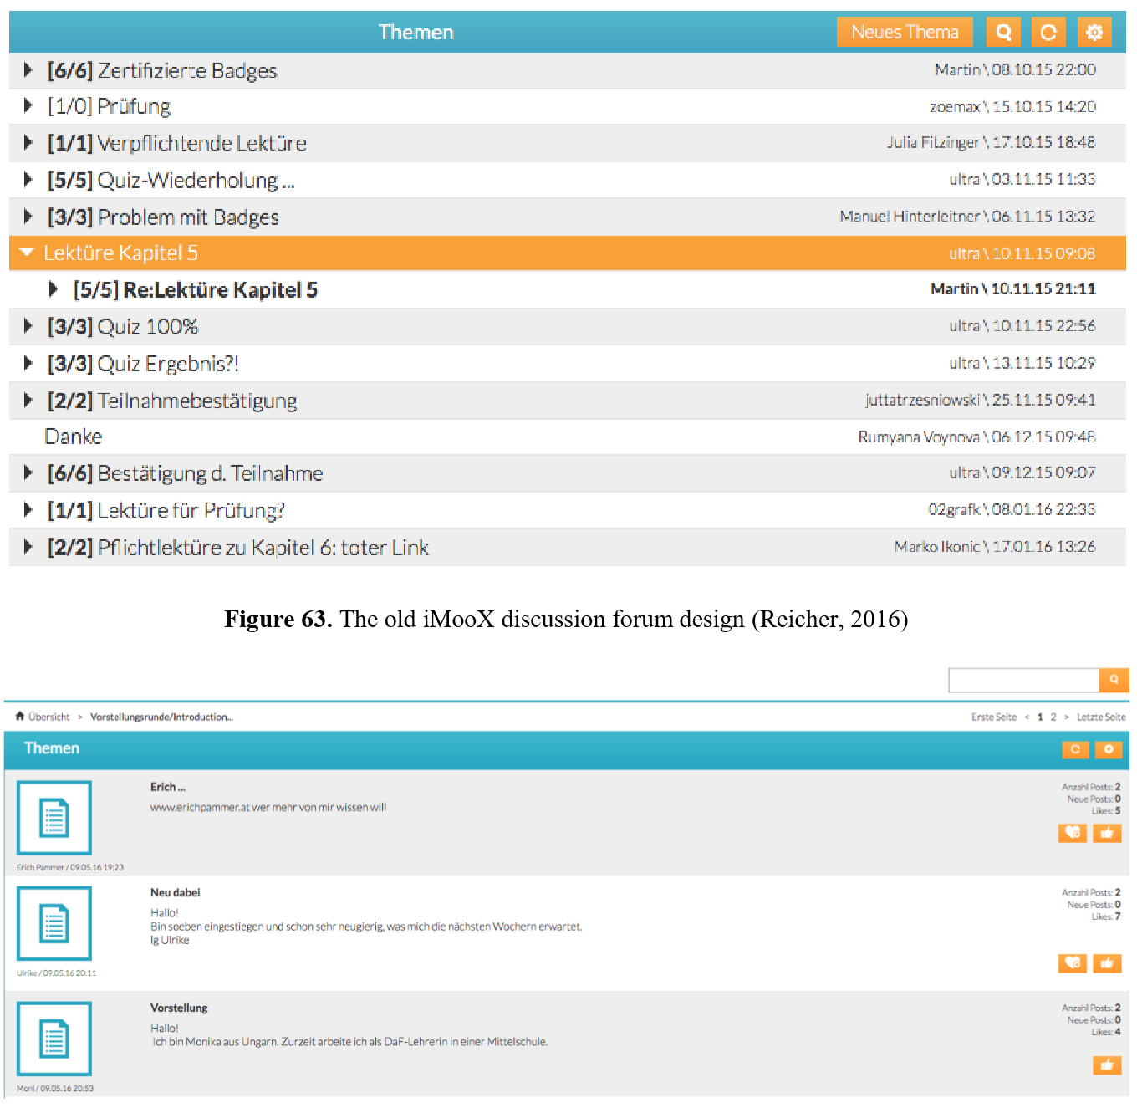
 | LIN 2016 | LIN 2014
Registered users | 605 | 519
Certified | 76 (12.6%) | 99 (19.07%)
Never used forums | 39.8% | 33.5%
Published:
Reischer, M., Khalil, M. & Ebner, M. “Does gamification in MOOC discussion forums work?”. In Proceedings of EMOOCS 2017, Madrid, Spain.

Slide 42
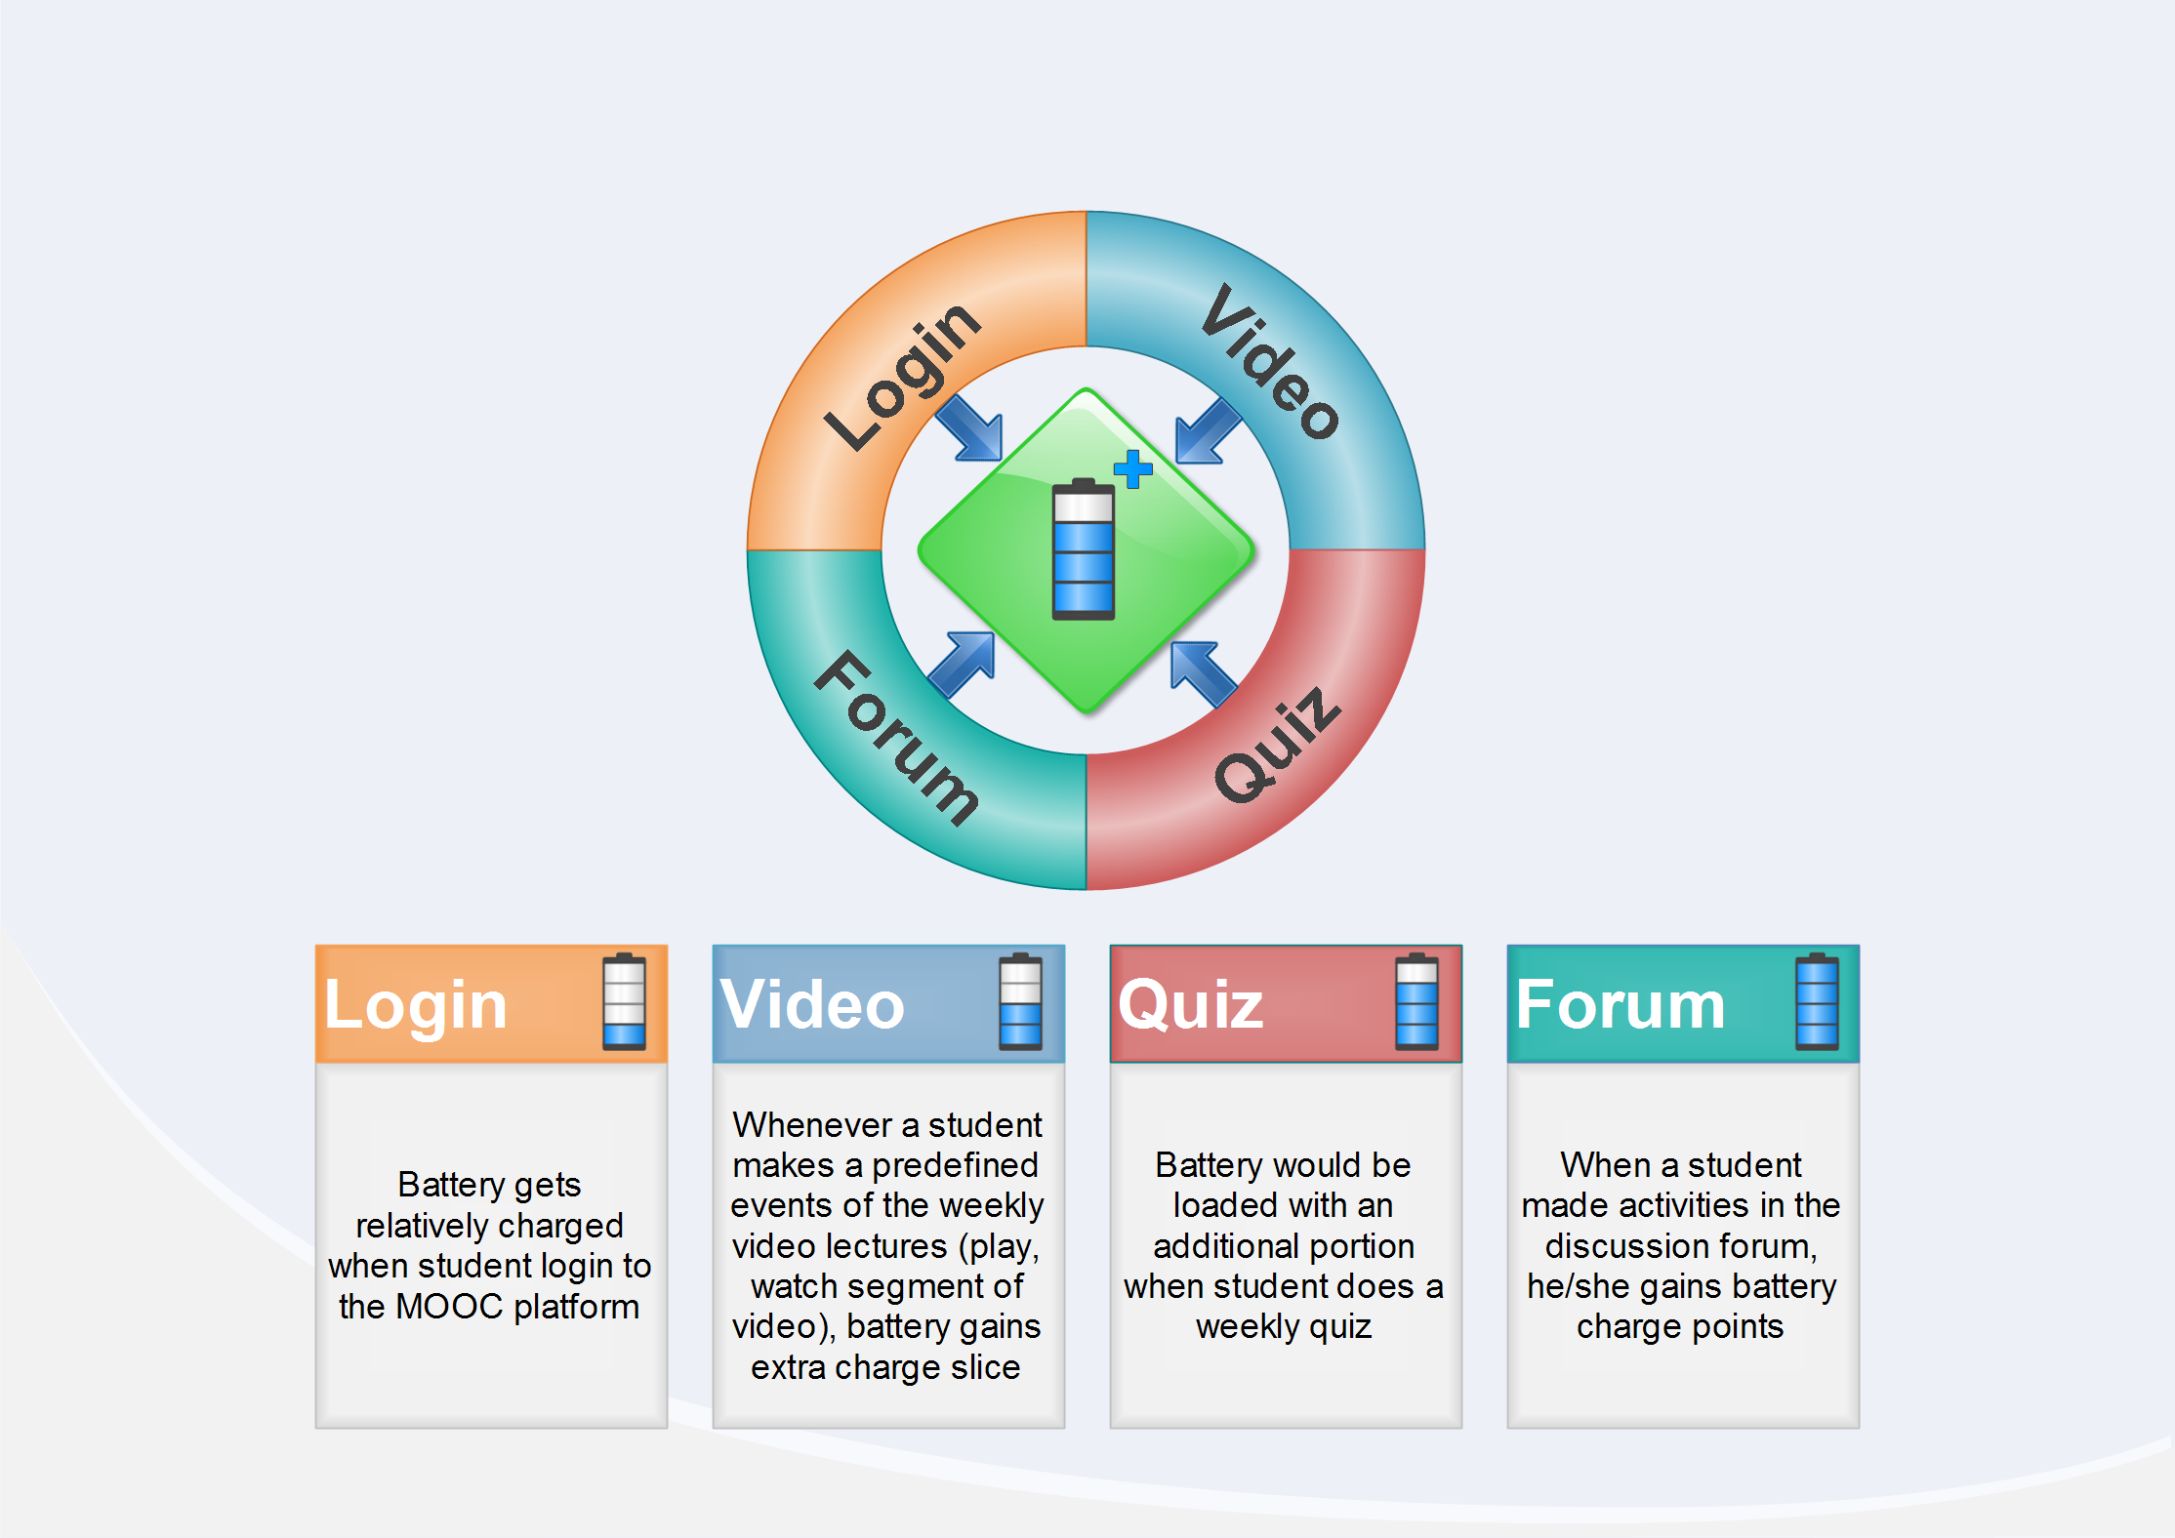
Motivating MOOC students approach
Intrinsic Factor
Extrinsic Factor
Published in:
Khalil, M. & Ebner, M. (2017). “Driving Student Motivation in MOOCs through a Conceptual Activity-Motivation Framework”. Zeitschrift für Hochschulentwicklung, pp.101-122.

Slide 43
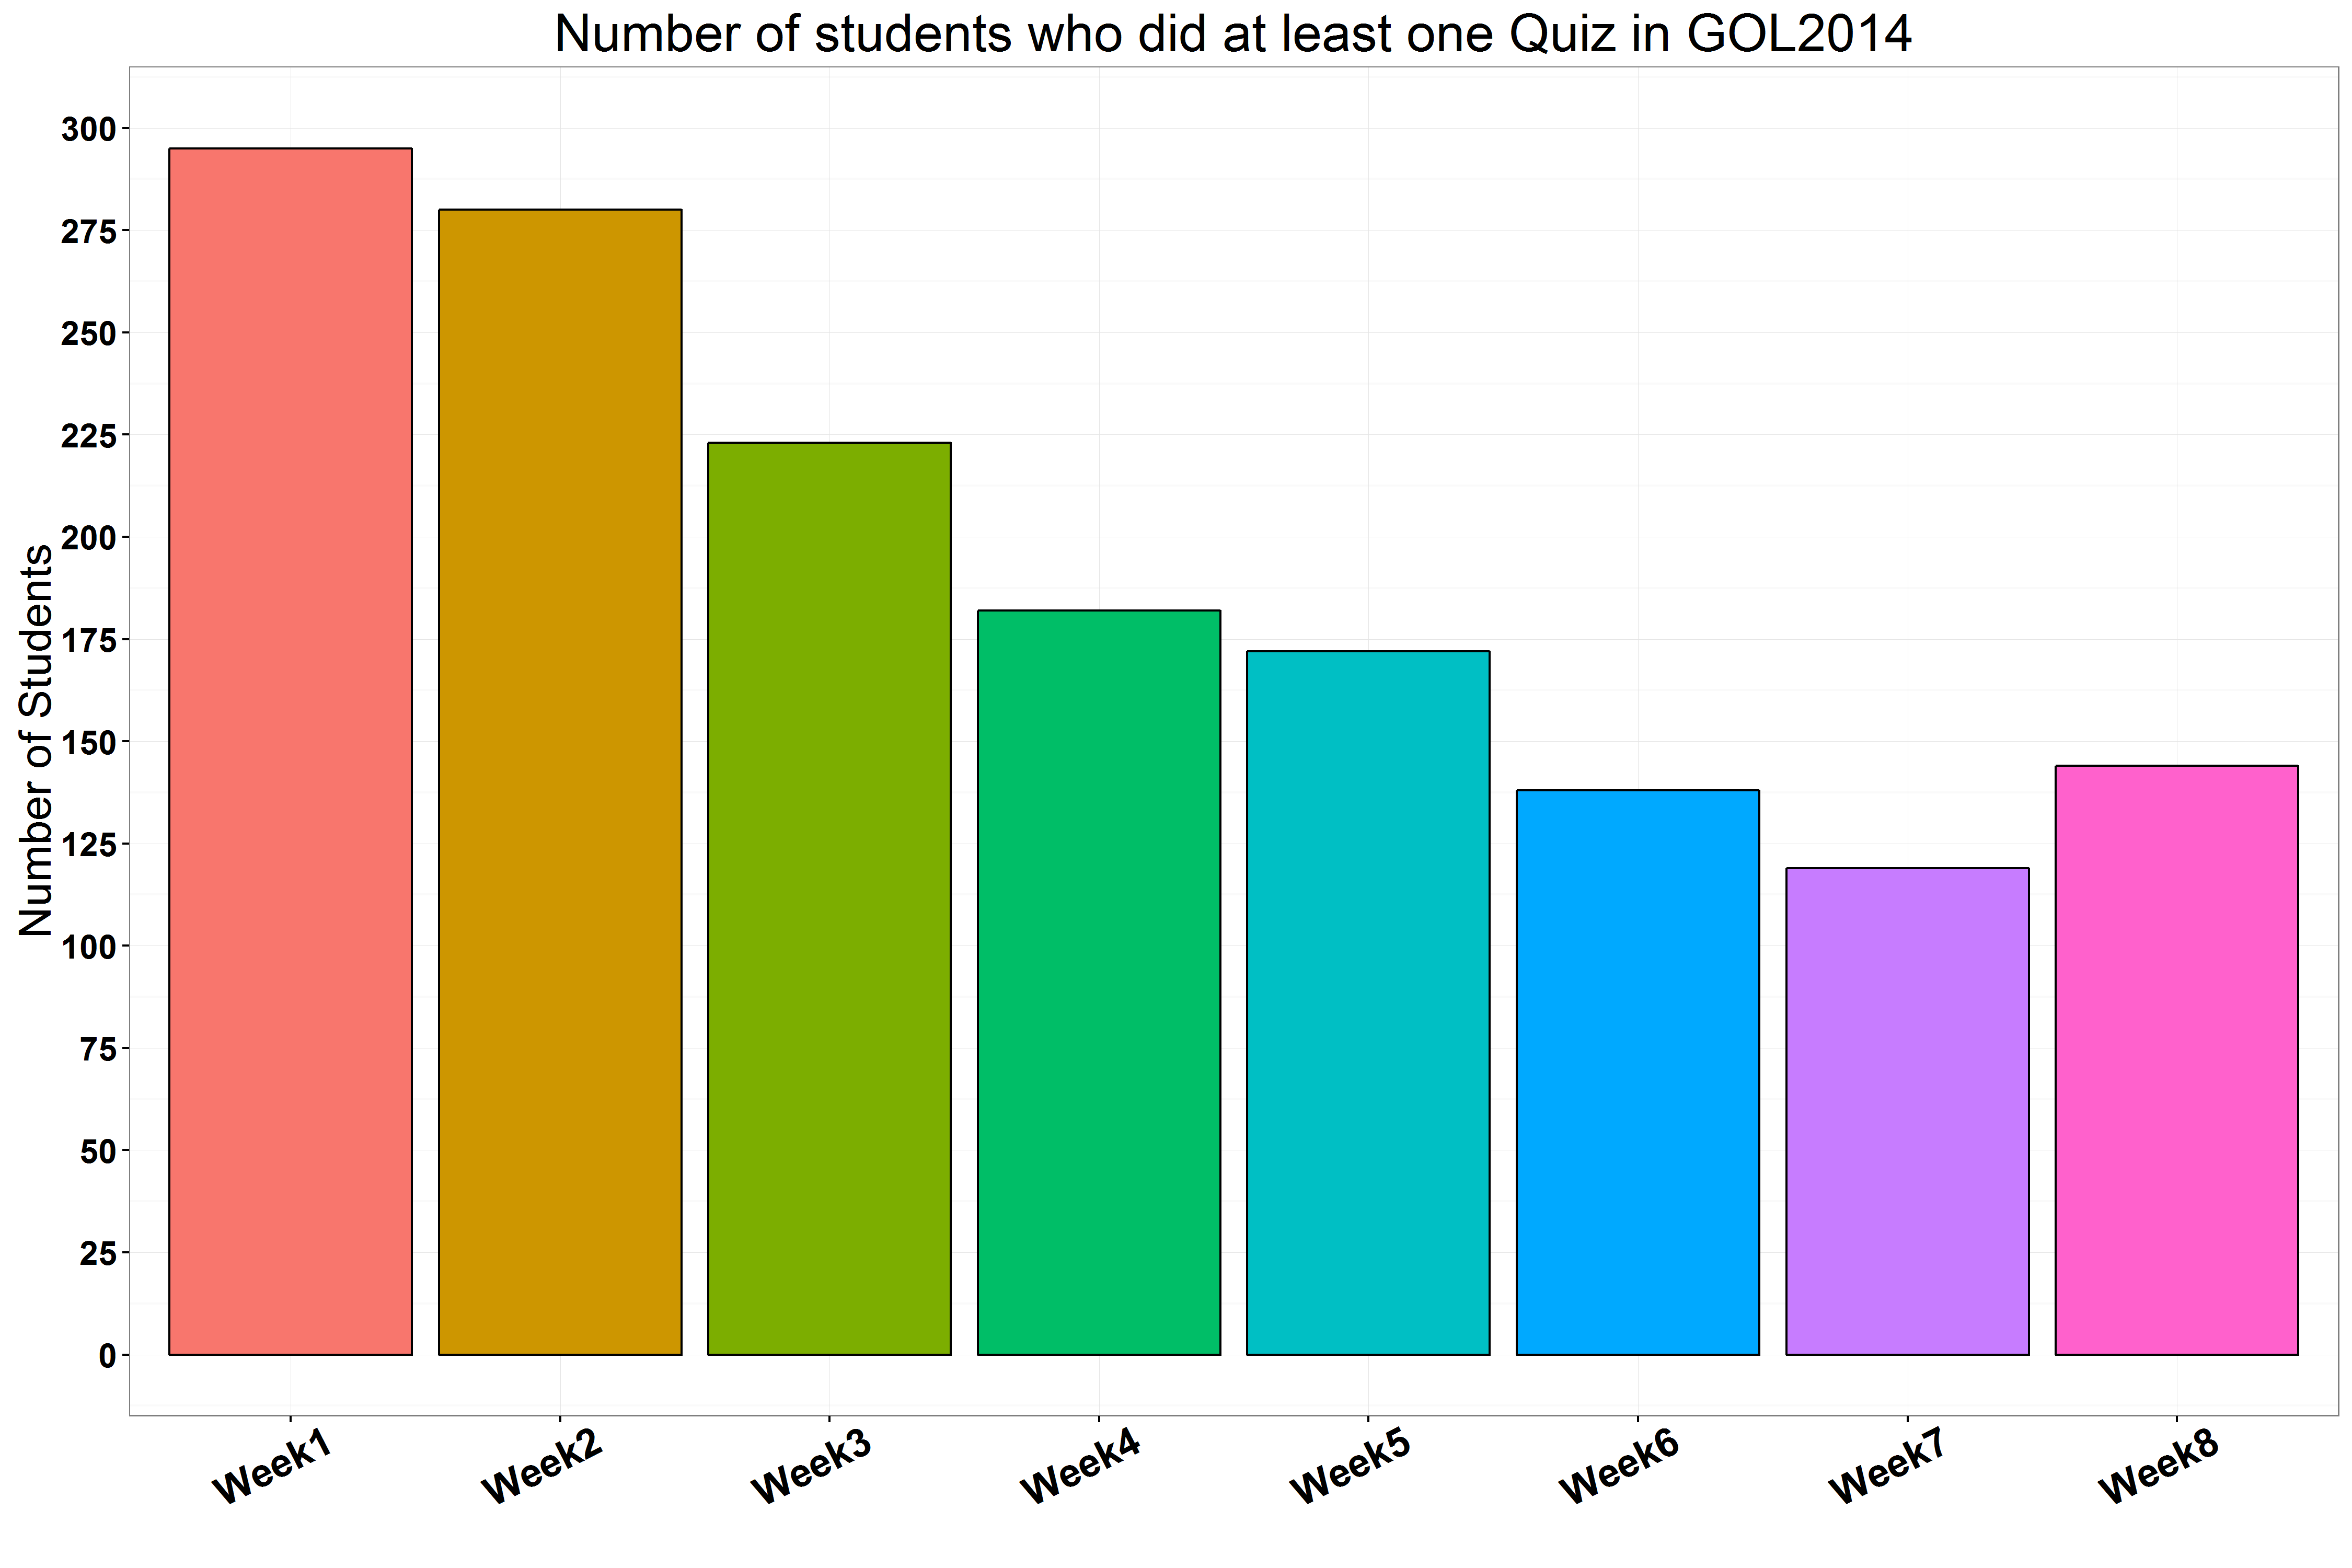
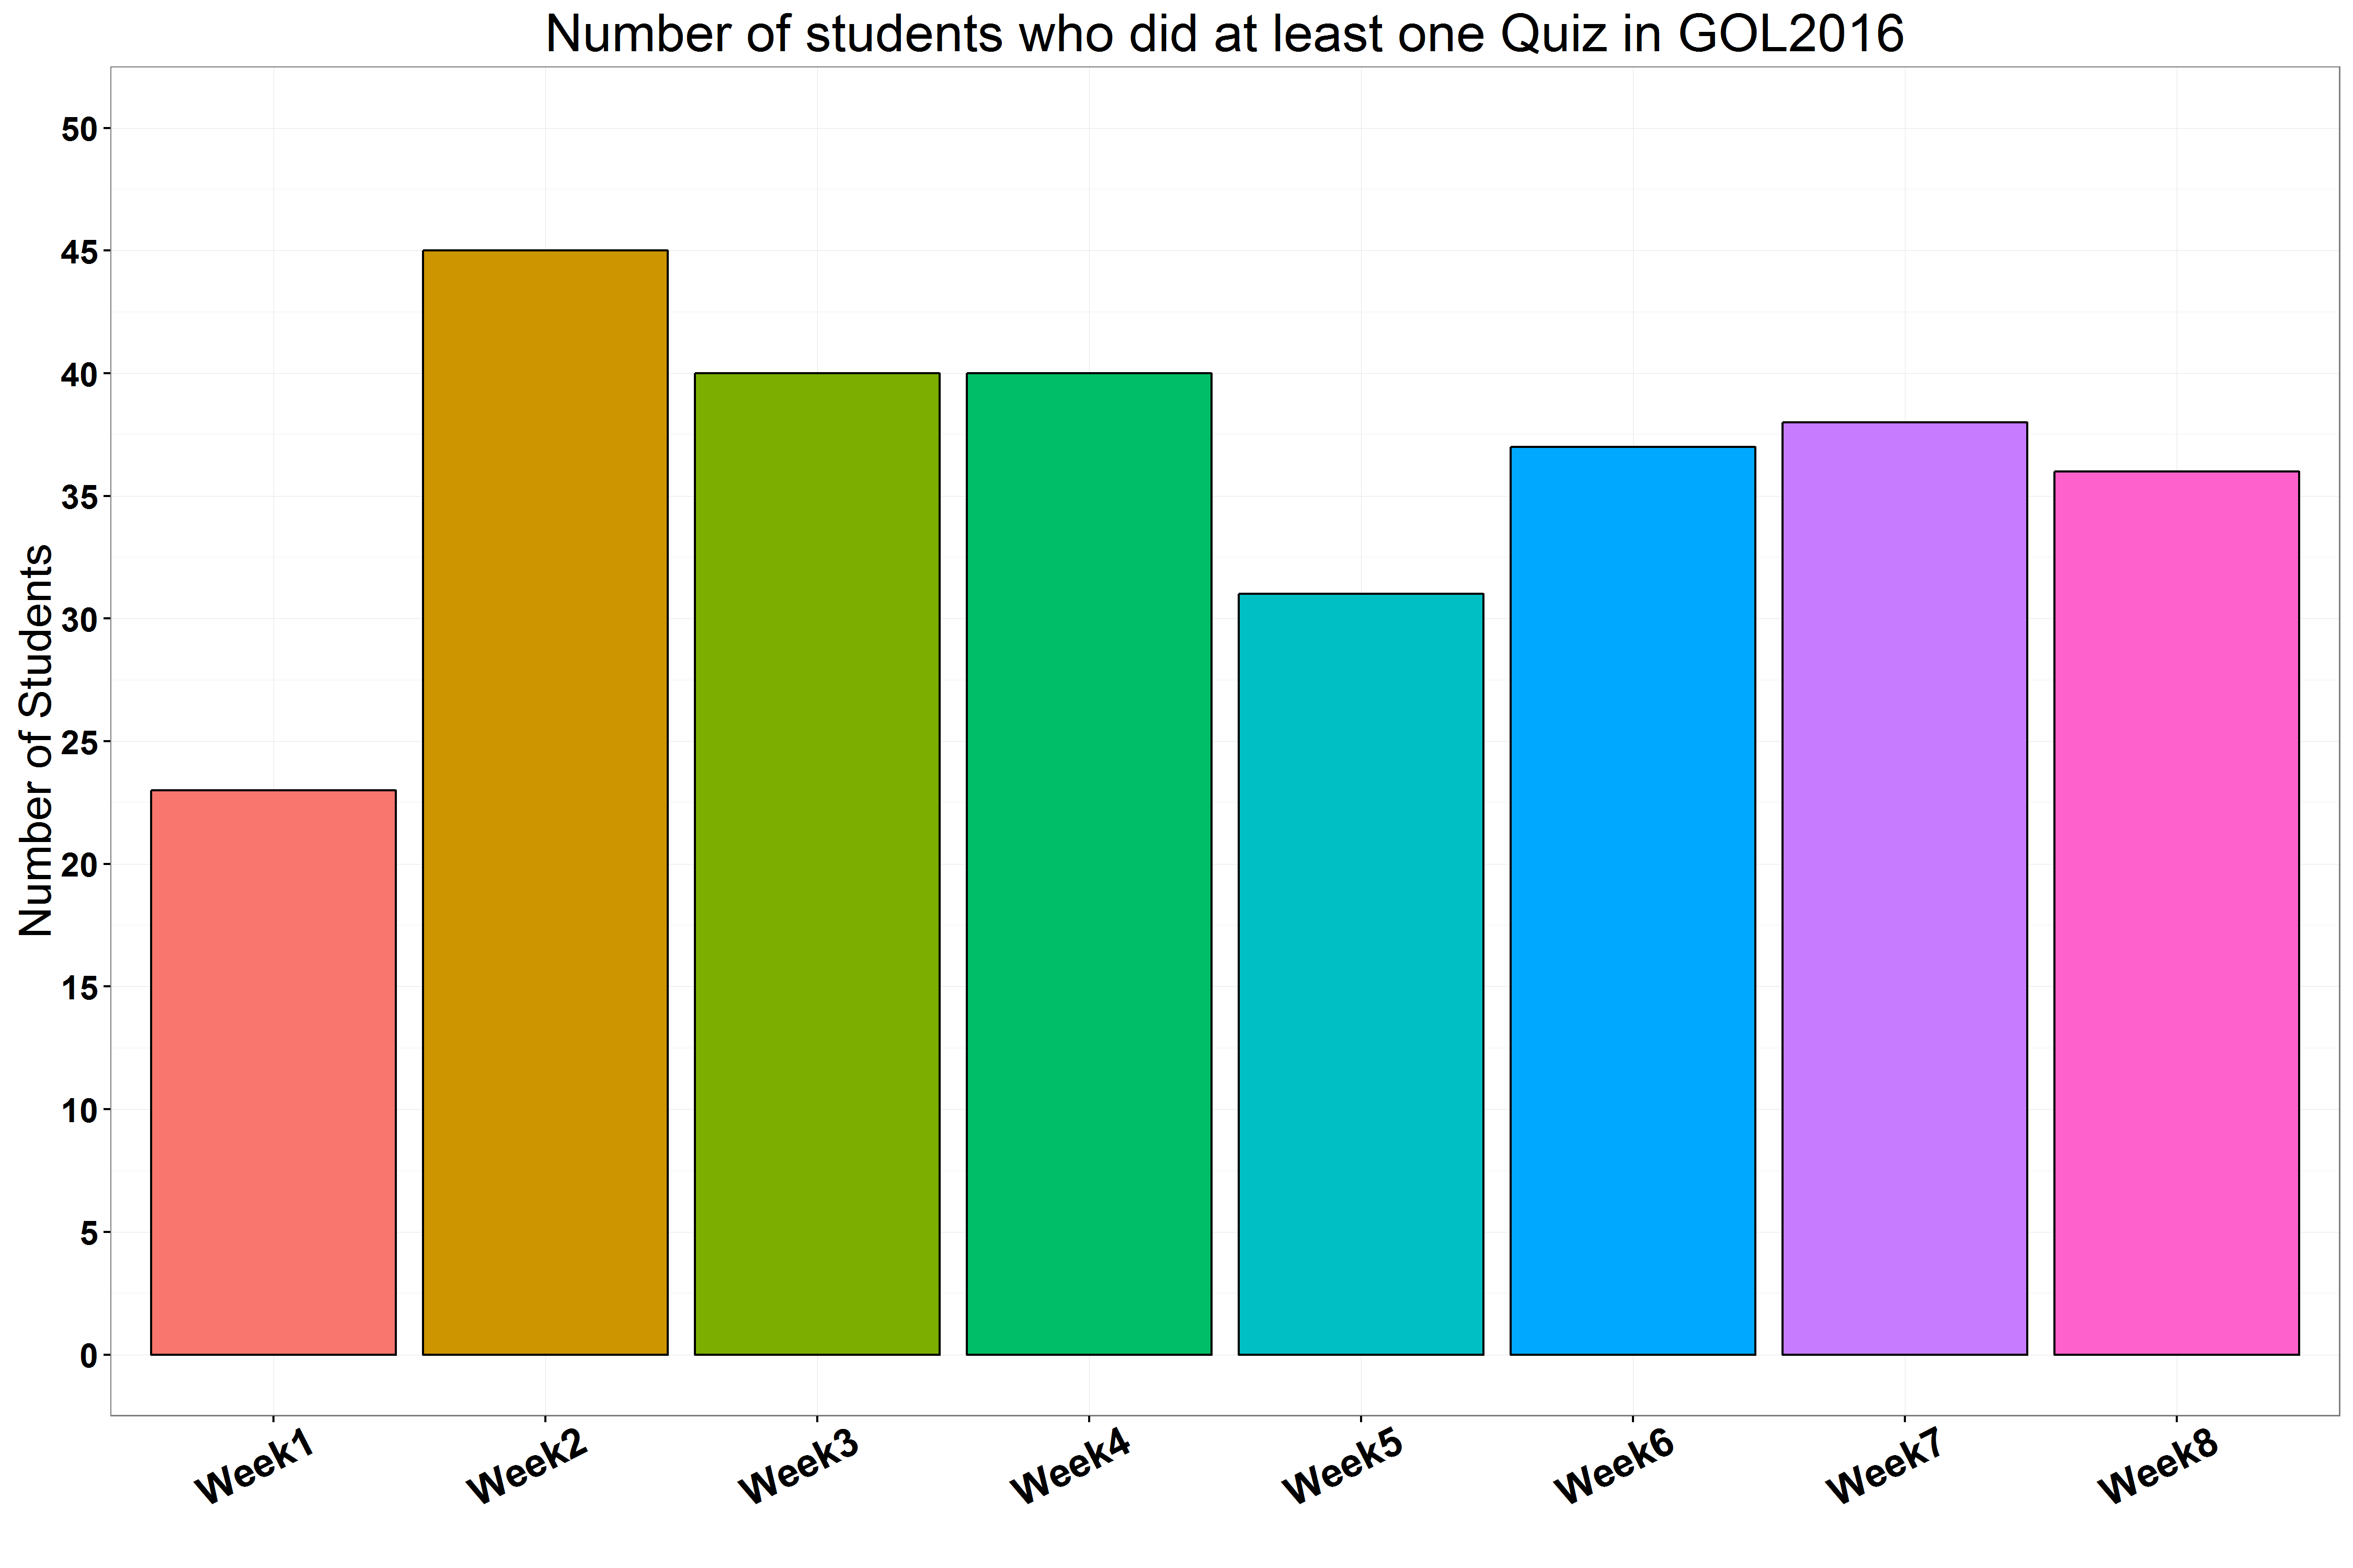


Gamification approach activity difference
Control Group
With gamification group

Slide 44
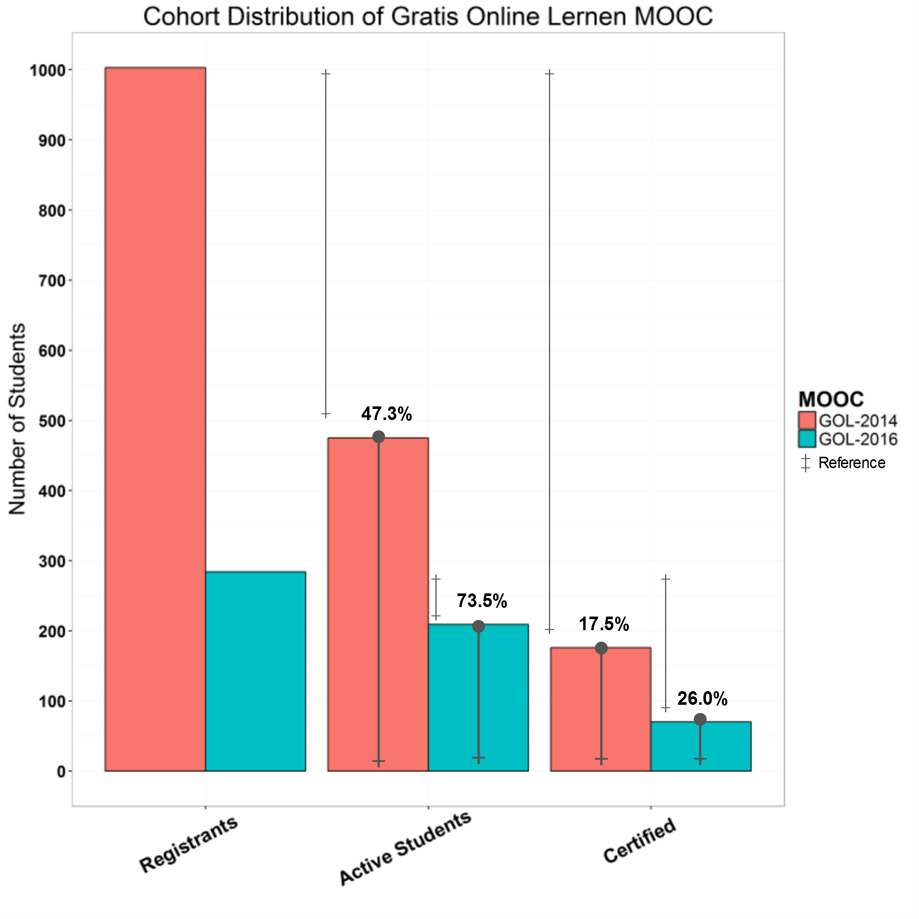
Gamification approach Impact
Increased Active Students
Increased Certification Ratio

Slide 45
- What are the security constraints of learning analytics?
RQ

Slide 46
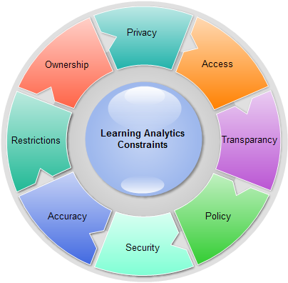
Revealing Personal Information
Morality to view students’ data
Collecting and Analyzing data
Transparency
Students’ data deletion policy
Published in: Khalil, M., & Ebner, M. (2015, June). Learning Analytics: Principles and Constraints. In Proceedings of World Conference on Educational Multimedia, Hypermedia and Telecommunications (pp. 1326-1336).

Slide 47
Who owns students data,
students or institutions?
Data Protection and Copyright
Laws limit the use of LA apps
Inaccurate analysis results?
Achieving Confidentiality, Integrity
and Availability
Published in: Khalil, M., & Ebner, M. (2015, June). Learning Analytics: Principles and Constraints. In Proceedings of World Conference on Educational Multimedia, Hypermedia and Telecommunications (pp. 1326-1336).

Slide 48
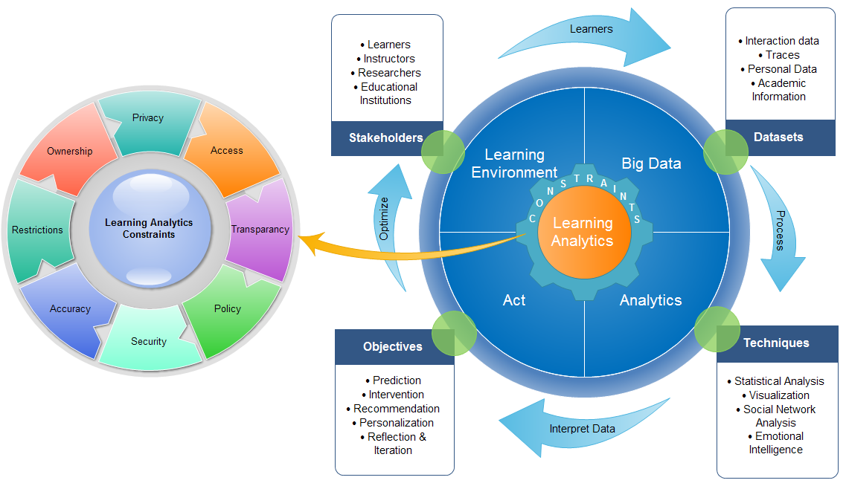
Published in: Khalil, M., & Ebner, M. (2015, June). Learning Analytics: Principles and Constraints. In Proceedings of World Conference on Educational Multimedia, Hypermedia and Telecommunications (pp. 1326-1336).

Slide 49
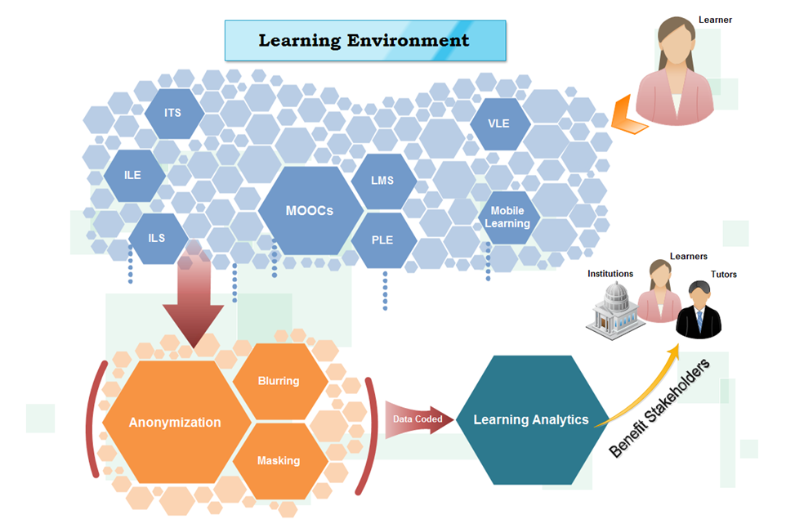
De-Identification Approach
Noising
Masking
Swapping
Suppression
European DPD 95/46/EC
Published in: Khalil, M., & Ebner, M. (2016). De-Identification in Learning Analytics. Journal of Learning Analytics, 3(1), pp. 129-138

Slide 50

Conclusions & Outcomes

Slide 51
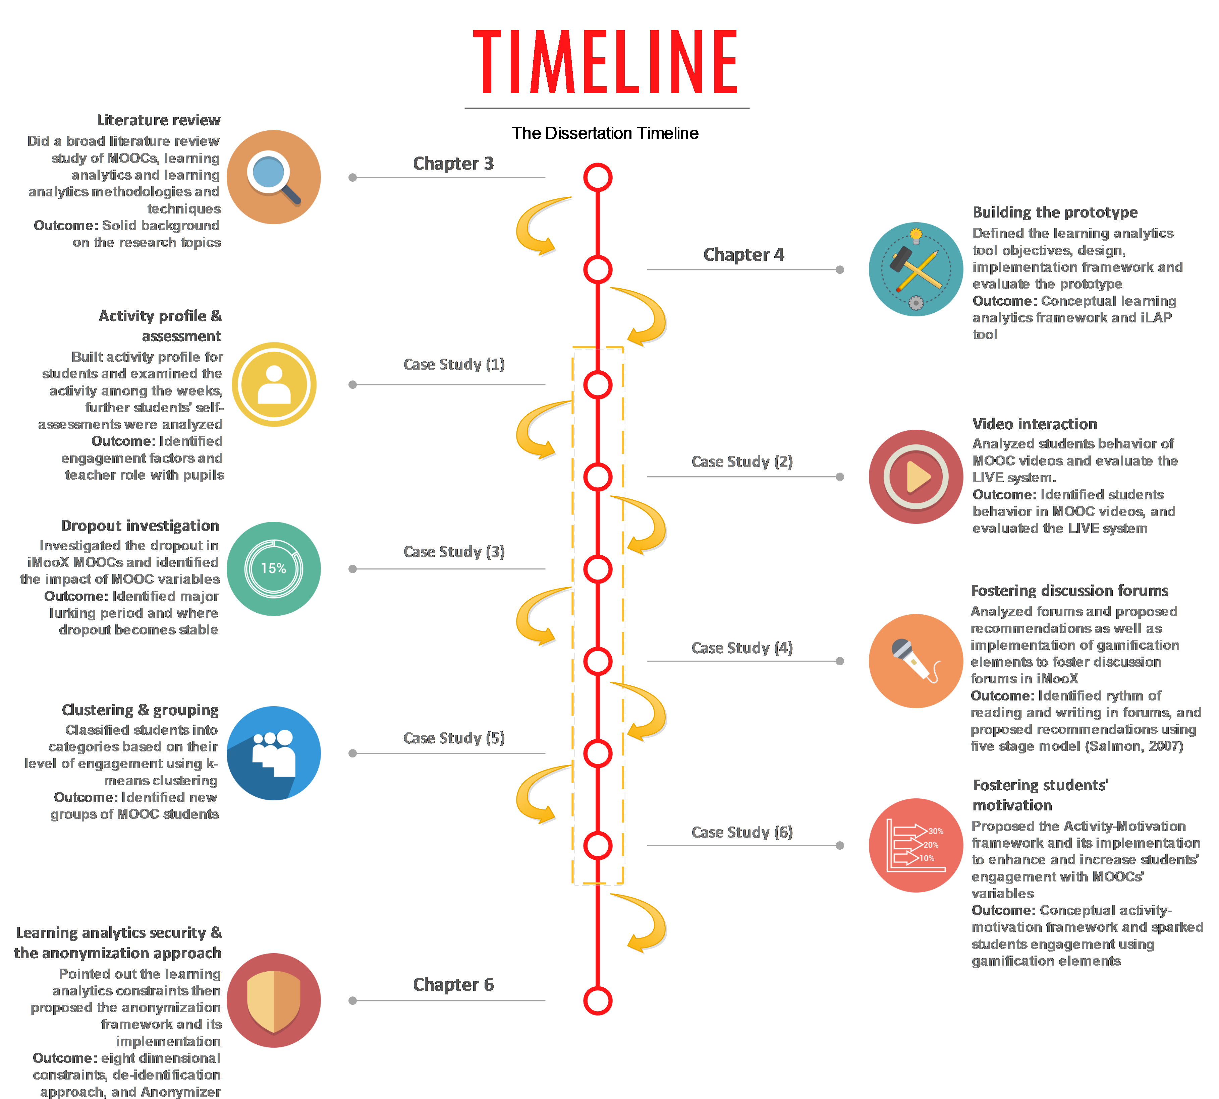

Slide 52
The Future
MOOCs
Learning Analytics

Slide 53
Future - MOOCs
1
7,000
Schools and Higher Education
More entertaining learning
Intrinsic factors
(1: Class-Central.com)

Slide 54
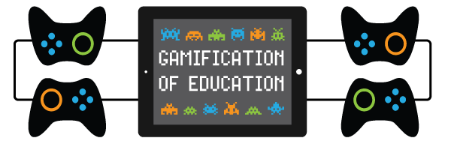
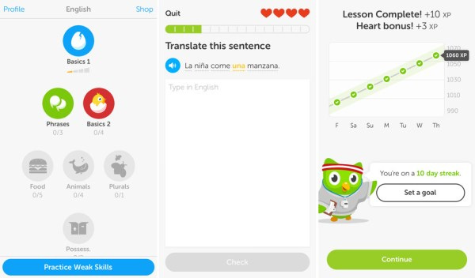
Gamify learning!
Image from: https://www.esparklearning.com/ and Duolingo

Slide 55
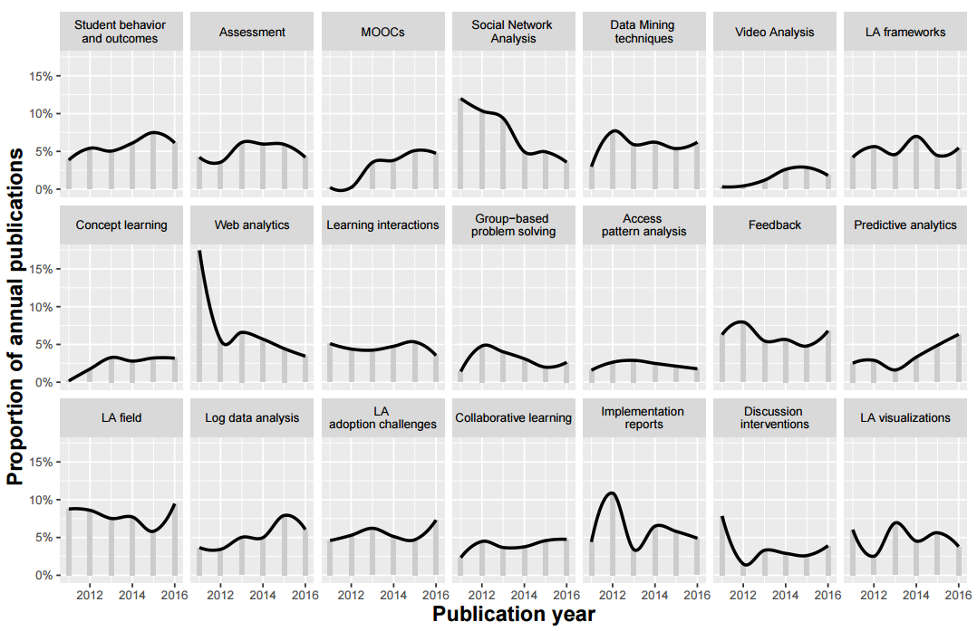
Khalil, M., Kovanovic, V., Joksimovic, S., Ebner, M., & Gasevic, D. (in preparation).

Slide 56


Slide 57

Learning Analytics is about learning…
And data are generated by students
Rts.ch/datak

Slide 58
THANK You!
Mohammad Khalil
@TUMohdKhalil

