Slide 1
Teacherbot: interventions in automated teaching
Siân Bayne The University of Edinburgh @sbayne

Slide 2
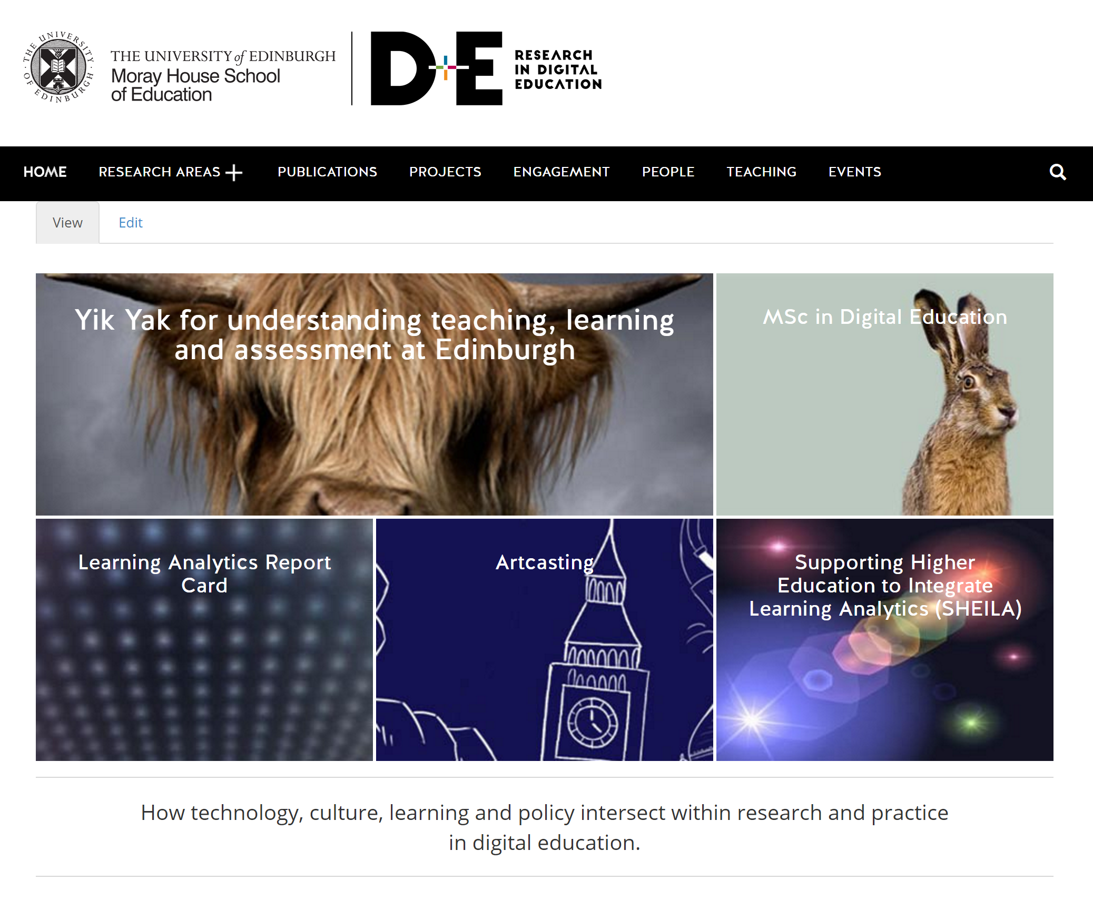
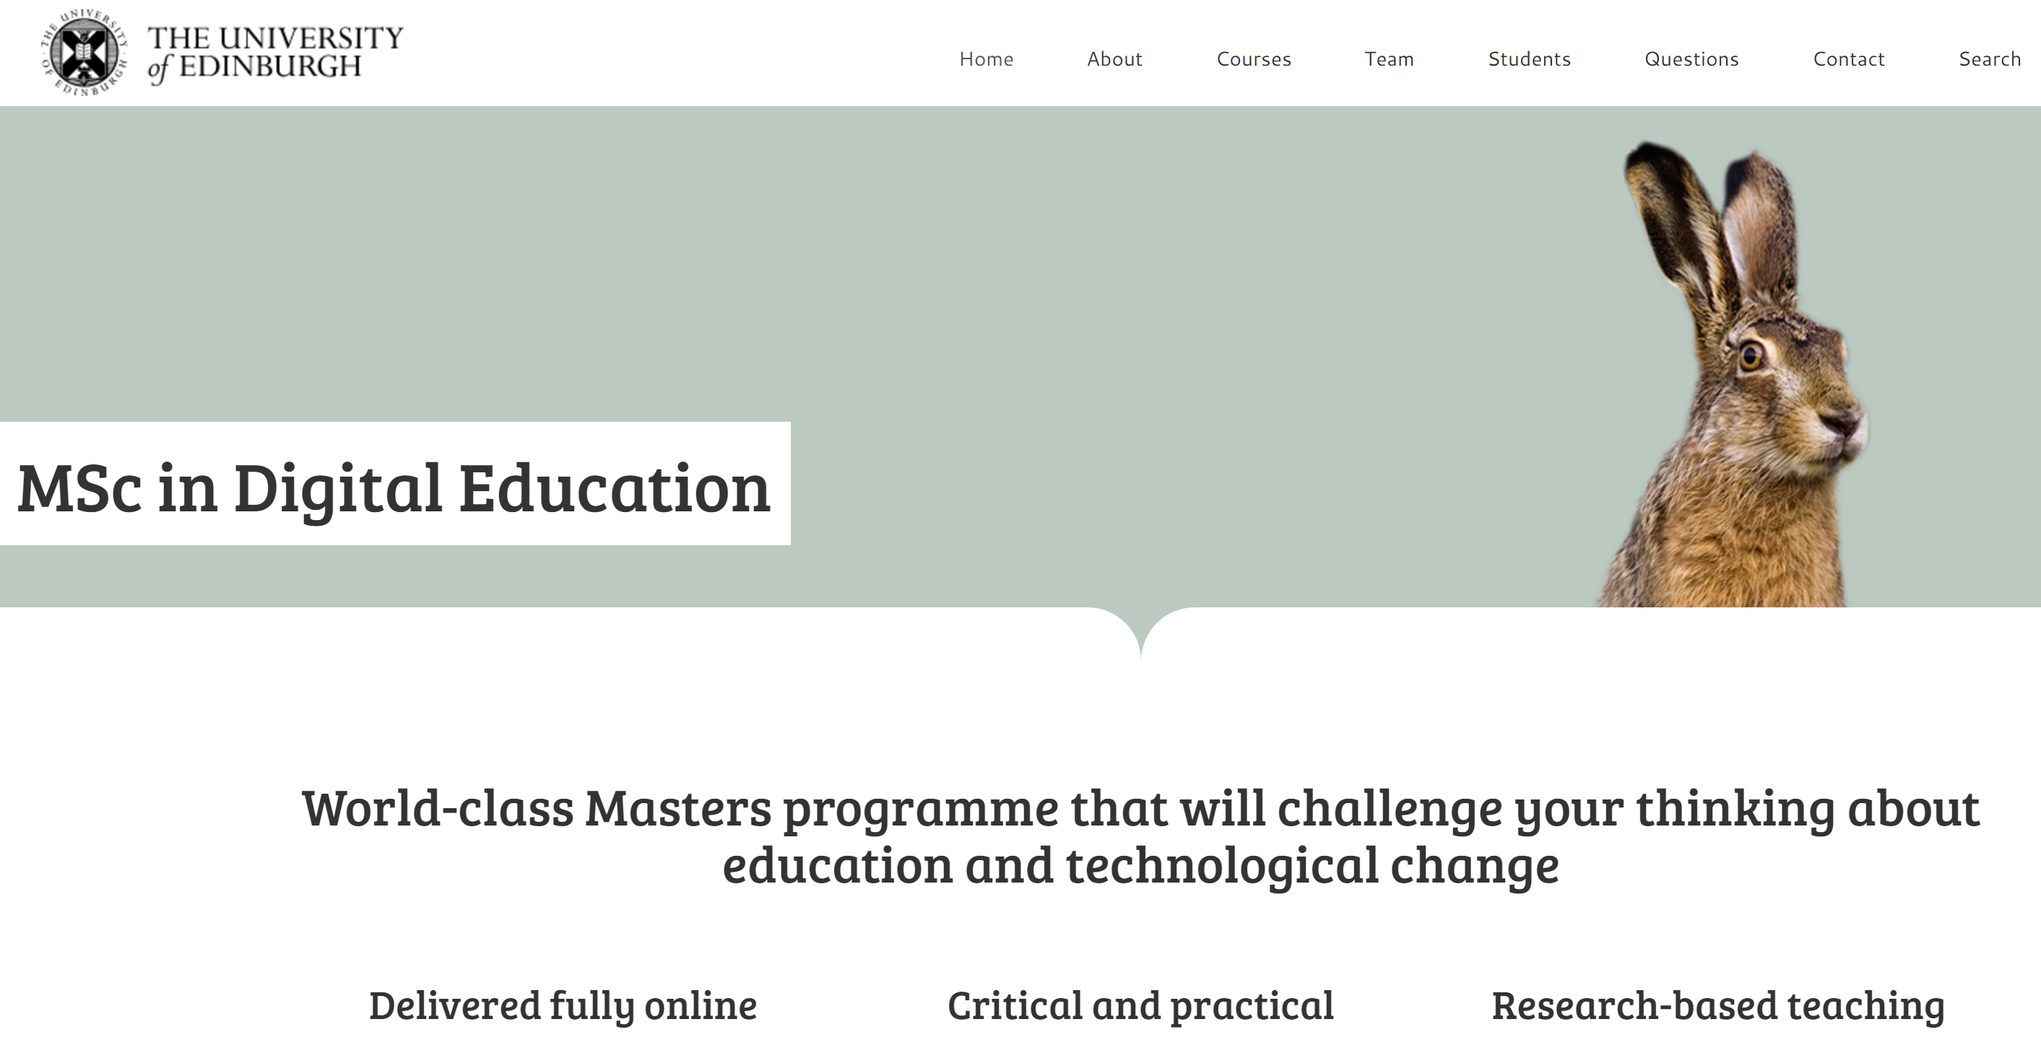
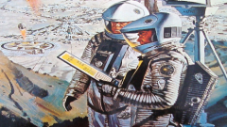
E-learning and Digital Cultures MOOC 2013-15

Slide 3
The automation of professional work
Teacher automation
From supercession to entanglement
Teacherbot (an intervention)
Concluding

Slide 4
The automation of professional work

Slide 5
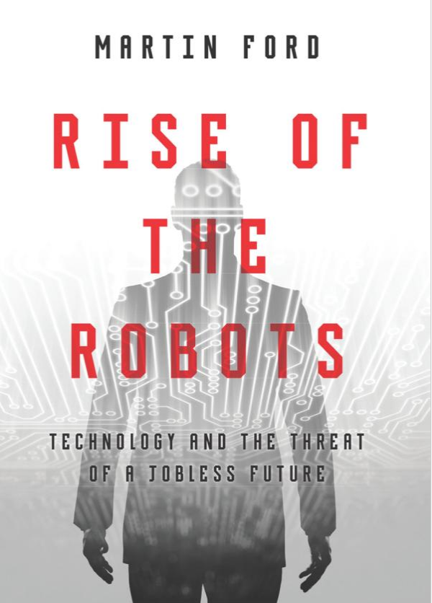
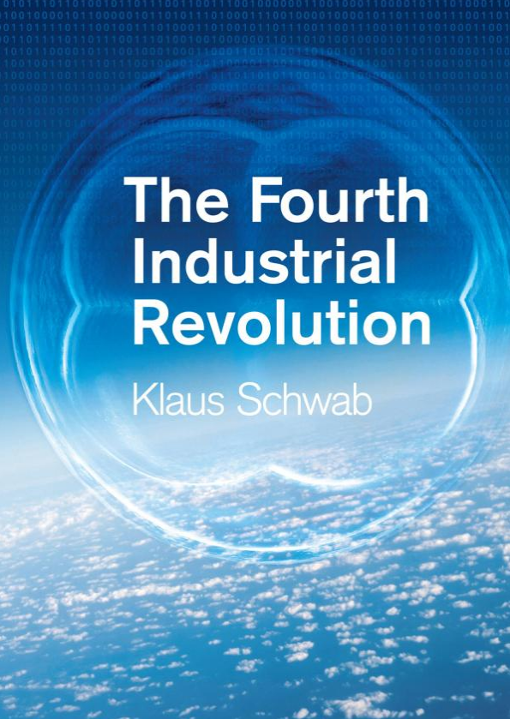
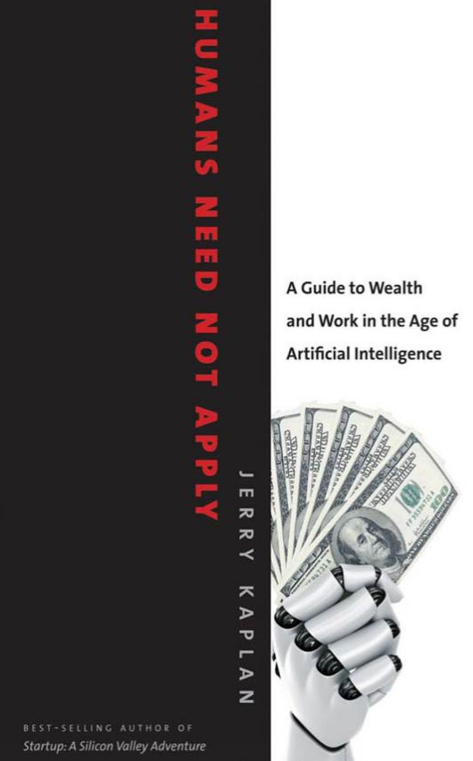
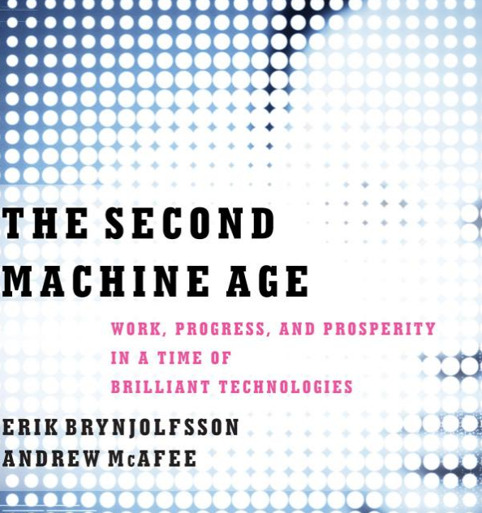
“The scope of technology change is increasing. The big data revolution and improvements in machine learning algorithms means that more occupations can be replaced by technology, including tasks once thought quintessentially human such as navigating a car or deciphering handwriting. Frey and Osborne's original (2013) study on employment suggested 47% of US jobs were at risk of computerisation.”
Citigroup and University of Oxford (2016)
Notes:
Most recently, the topic has been chosen as the primary theme for the
2016 World Economic Forum meeting in Davos and the Financial Times awarded
their 2015 Business Book of the Year to Martin Ford’s ‘The Rise of the Robots’.

Slide 6
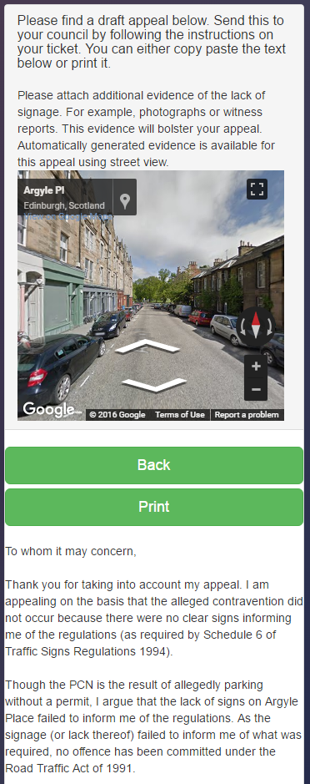
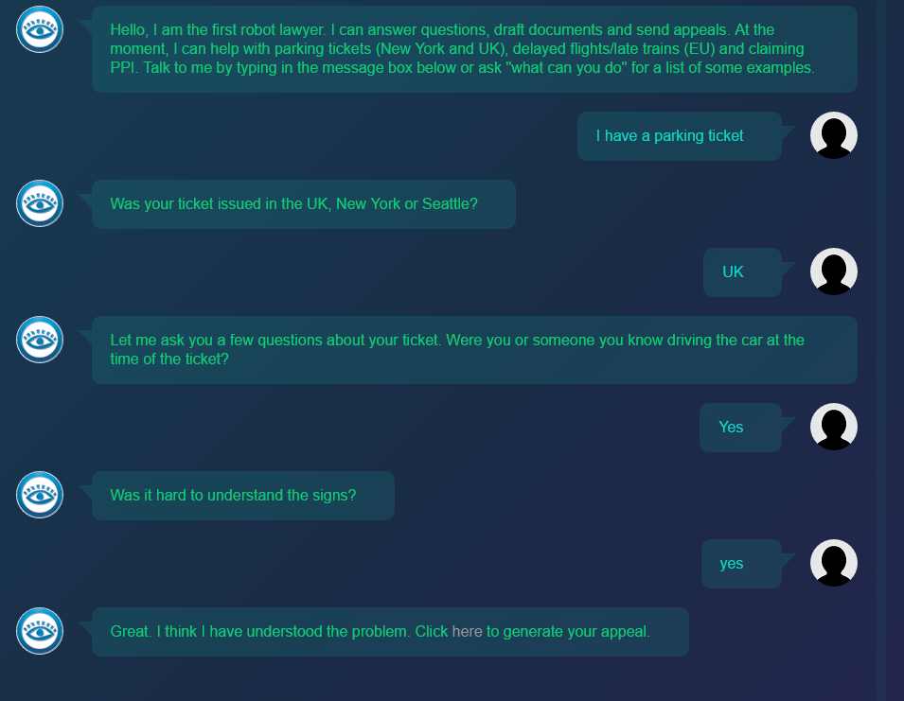
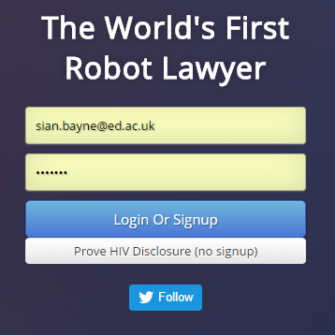
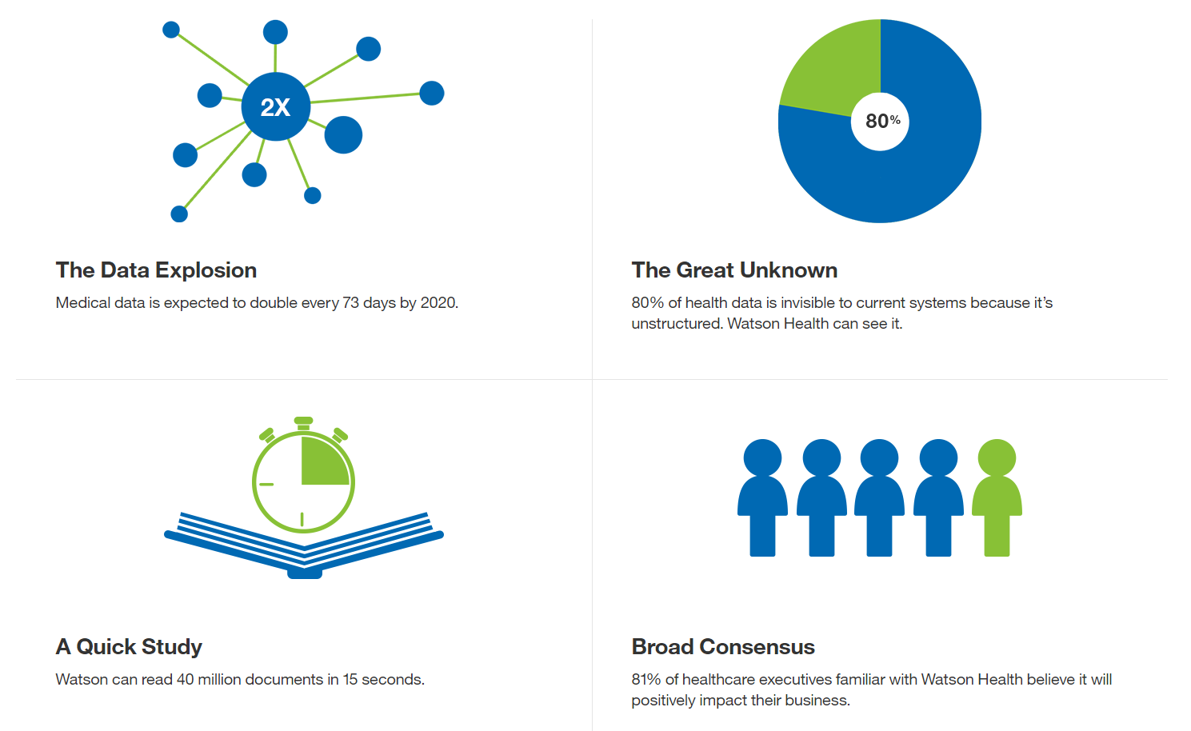
“I think it may well be that in the future a machine will win not so much for its written text, but by covering an important topic with five high quality articles and also 500,000 versions for different people. Imagine an article telling someone how local council cuts will affect their family, specifically, or how they personally are affected by a war happening in a different country. It’s something that could not be done by a human writer.”
The Guardian, 3 April 2016
Joshua Browder
Notes:
Googles AI AlphaGo beat human Go! champion in 2015
IBM’s Watson beat human contestants in the tv quiz Jeopardy in 2011
now a ‘cognitive diagnostic engine’ – NB to be used by doctors, not instead of them
donotpay.co.uk has had a 64% success rate in overturning parking tickets in US and UK – now expanding to include Arabic language assistance to UK asylum applicants. Joshua Browder
Associated Press agency generates 3,000 automated stories per quarter – mostly financial reports but also sport and increasingly news

Slide 7
Teacher automation

Slide 8
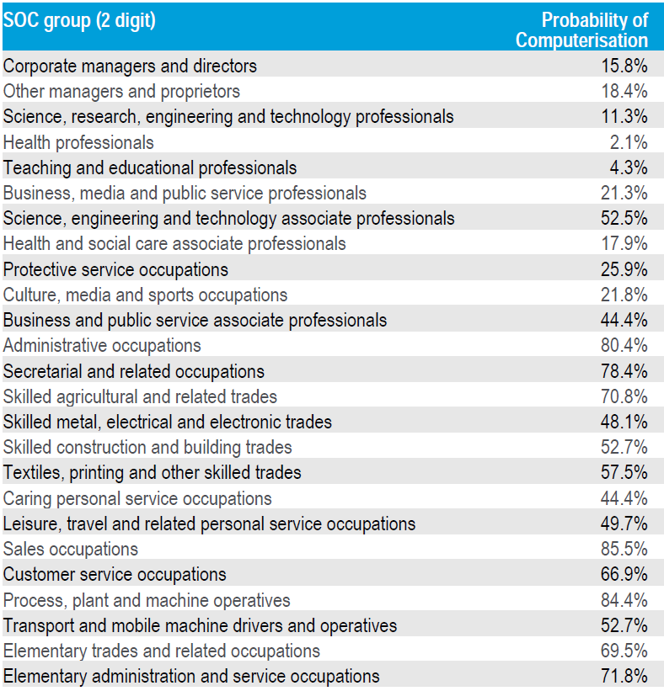
creative
non-routine
highly social
Citigroup and University of Oxford (2016)
Notes:
teaching is low risk as education is a labour intensive sector with high levels of social and creative skills – BUT
p115 2016 report
Investment into education has been highlighted by a survey of Citi’s clients as being one of the most effective policies to offset the risk of automation impacting labour and wealth distribution. – my interest is in delivery of education (practice) rather than the curricula required to address risk of automation

Slide 9
“Education has typically been a low productivity growth sector as teaching methods are typically labour intensive and use limited technology – labour costs are liable to rise when wages in such sectors have to compete with those in other sectors where technology is raising productivity. In one sense, the rising share of national incomes spent on education is not a huge problem – the rising productivity and wages in other sectors allows societies to afford it.
On the other hand, it could be that there will soon be technologies which could be incorporated in the education system that could drive down costs and raise productivity. For example, digital technology allows for the costless replication of a single lecture to an unlimited number of students, and online teaching modules reduce the overheads incurred by schools, colleges and universities in physical locations.”
Citigroup and University of Oxford (2016)
Notes:
teaching is low risk as education is a labour intensive sector with high levels of social and creative skills – BUT
p115 2016 report
Investment into education has been highlighted by a survey of Citi’s clients as being one of the most effective policies to offset the risk of automation impacting labour and wealth distribution. – my interest is in delivery of education (practice) rather than the curricula required to address risk of automation
para 2 – how economists speak of teaching is not necessarily how teachers speak of it: teacher voices need to be stronger [computer scientists/economists/corporations dominate this space] – analysis tending to date to focus on MOOCs and the like
what actually are the incursions of automation on education?

Slide 10
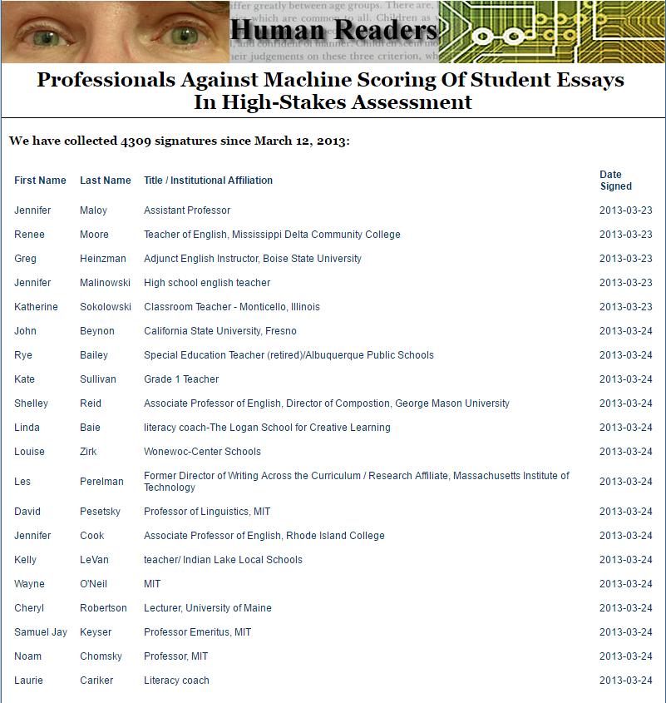
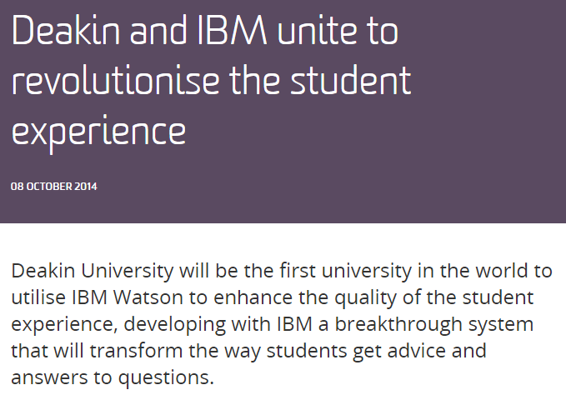
Learning analytics
“uses data about students and their activities to help institutions understand and improve educational processes, and provide better support to learners.”
(JISC 2015)
Intelligent tutoring
“computer software designed to simulate a human tutor’s behaviour and guidance... Intelligent tutors provide many of the benefits of a human tutor to very large numbers of students.”
(EDUCAUSE 2013)
Lecture capture
Automated assessment and algorithmic marking
Behaviour/award systems
Plagiarism detection systems
“Many teachers say the app helps them automate the task of recording classroom conduct, as well as allowing them to communicate directly with parents.”
(New York Times 2014)
Campus-wide AI
Automated TAs
Notes:
let’s look at the incursions of automation on teaching that are current and becoming widespread
none are inherently problematic but there is often a question around teacher visibility and teacher agency
inscription/delegation of teacher agency to automated systems, often mediated by corporate for-profit ed-tech – rising levels of venture capital invested in ed-tech corporations (An estimated $1.6billion US dollars of venture capital was invested in the sector in the first half of 2015 alone – Ben Williamson’s blog on Class Dojo) ‘big’ projects and big interests are driving the field; we need more ‘small’ projects and local interests in there eg teacherbot
http://humanreaders.org/petition/results.php?pageNum_rsConfirmed=80&totalRows_rsConfirmed=4309

Slide 11
“An estimated $1.6billion US dollars of venture capital was invested in ed-tech in the first half of 2015 alone, following a massive escalation in funding over the previous five years.”
Williamson (2016)
Notes:
for example, turnitindelegation of teacher agency to automated systems is often mediated by corporate for-profit ed-tech

Slide 12
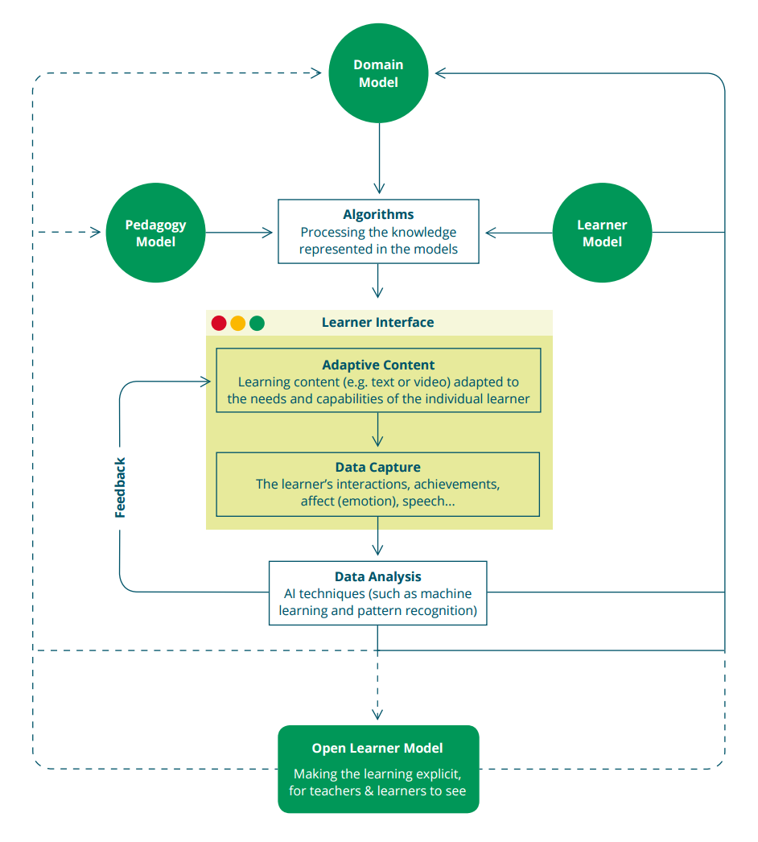
Teacher invisibility
Luckin et al (2016) Intelligence Unleashed: an argument for AI in education
Notes:
and then, we can’t always see where the teacher is in these systems:
Bazaar – an AIED application programming in conversational agents for ‘academically productive talk’ based on discussion facilitation rather than content-specificity which can’t scale
3 lines of a 31 page paper indicate where teacher input informed agent response.
teacher/practitioner role/agency in the project of automation not evident
alternative image from Intelligence Unleashed? black boxing of teacher function

Slide 13
The politics of algorithms
Introna and Hayes study of plagiarism detection systems:
Culturally specific ways of knowing
Turnitin ‘winnowing’ algorithm
“the delegation of plagiarism detection to a technical actor produces a particular set of agencies and intentionalities (a politics one might say) which unintentionally and unexpectedly conspires to constitute some students as plagiarists (who are not) and others as not (who are).”
Introna and Hayes (2011)
Notes:
for example, turnitin

Slide 14
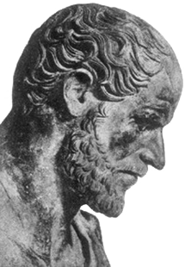
“One can predict that in a few more years millions of school children will have access to what Philip of Macedon’s son Alexander enjoyed as a royal prerogative: the personal services of a tutor as well-informed and responsive as Aristotle.”
Suppes (1966)

Slide 15
“One-to-one human tutoring has long been thought to be the most effective approach to teaching and learning.
Unfortunately, one-to-one tutoring is untenable for all students. Not only will there never be enough human tutors; it would also never be affordable. All of this begs the question: how can we make the positive impact of one-to-one tutoring available to all learners across all subjects?”
Luckin et al (2016) Intelligence Unleashed: an argument for AI in education
“The goal [of corporate strategists and ‘futurologists’] is to replace (at least for the masses) face-to-face teaching by professional faculty with an industrial product, infinitely reproducible at decreasing unit cost.”
Feenberg (2003)
Notes:
Suppes dream directly addressed in recent Intelligence Unleashed report produced by UCL Knowledge Lab and Pearson.
automation for the masses – the elite will still get one-to-one.
“This is where Intelligent Tutoring Systems (ITS) come in.”

Slide 16
“The critical pedagogy approach re-focuses attention away from the functionality of e-learning environments back to the core relations between students and teachers and the conditions in which they find themselves.”
Clegg et al (2003)
Faculty response: “a two-fold mobilization in defense of the human touch.”
Feenberg (2003)
Notes:
Faculty response to this rationalising imperative has been, according to Feenberg, a two-fold ‘mobilization in defense of the human touch’. This takes the form either of blanket opposition to all kinds of digital interruptions to education; or a favouring of a model of online education that places human communication at its centre – technology as a ‘support for human development and online community’ (100-1). For Feenberg, both the managerialist, ‘technocratic’ embrace of technology, and its ‘humanistic opposition’, function as instrumentalisations of digital technology: on the one hand to achieve efficiency gains, and on the other to facilitate ready access into a newly-constituted social world. Both perspectives, in fact, work on the basis of humanistic assumptions of rational autonomy and the ontological separation of human ‘subject’ and technological ‘object’, whether that technological ‘object’ is turned either to technocratic or to ‘democratising’ social ends.

Slide 17
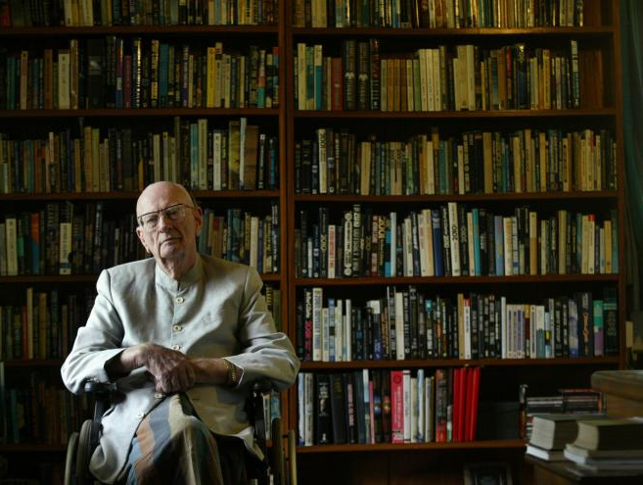
Where does this leave the human teacher? Well, let me quote this dictum. Any teacher who can be replaced by a machine should be!
Arthur C. Clarke (1980)
Notes:
as though supercession is a reasonable or likely response to teacher ‘deficit’: the deficit model often drives these discussions

Slide 18
From supercession to entanglement

Slide 19
“Though none of the traditional disciplines does this, one can trying seeing double: seeing the human and the nonhuman at once, without trying to strip either away.”
Pickering (2005)
“What everyone seems incapable of realizing is that everything on the Internet is run by a mix of automation and humanity. That’s just how things work.”
Wired (2016)
Notes:
Bringing the social and the technical together without relapsing into lazy anthropocentrism or technodeterminism
What everyone seems incapable of realizing is that everything on the Internet is run by a mix of automation and humanity. That’s just how things work. http://www.wired.com/2016/09/facebook-trending-humans-versus-algorithms/

Slide 20
Entanglements
“Thingification — the turning of relations into “things”— infects much of the way we understand the world and our relationship to it.” Barad (2003)
“The point is that material things are performative and not inert... They act together with other types of things and forces to exclude, invite and regulate particular forms of participation in enactments, some of which we term education.”
Fenwick et al (2011)
Notes:
post-anthropocentric entanglements
how do we theorise this?
biosocial – more than human ethics
environmental humanities
critical animal studies
new materialism
sociomaterialism
post-anthropocentrism
actor network theory
new vitalism
critical posthumanism

Slide 21
Teacherbot: an intervention
Notes:
we need spaces to play with these ideas in education – how can we explore what it means to be entangled?

Slide 22
“Twitter bots are, essentially, computer programs that tweet of their own accord... it’s a code-to-code connection, made possible by Twitter’s wide-open application programming interface, or A.P.I.”
Dubbin (2013)

Slide 23
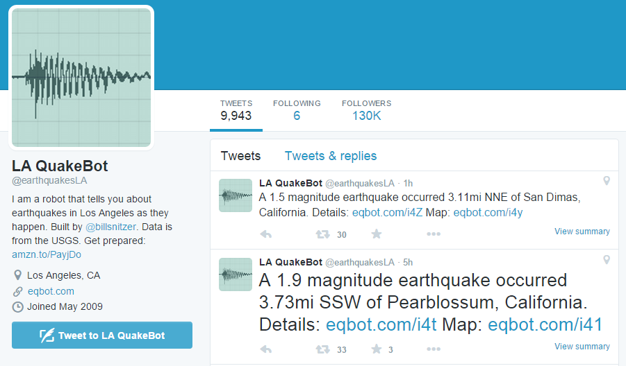
Public service bots
@earthquakesLA by @billsnitzer

Slide 24
@stealthmountain

Slide 25
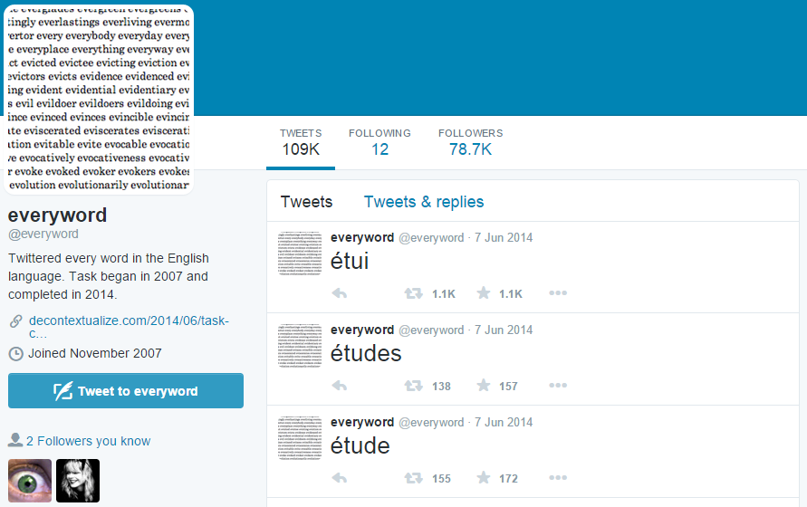
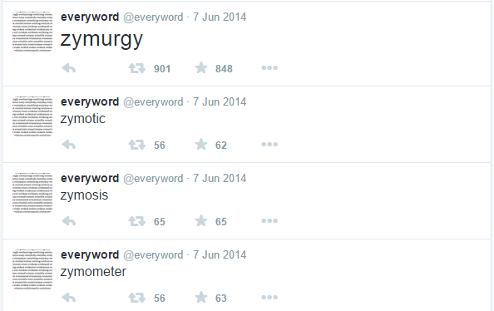
Wordplay bots
@everyword by Allison Parrish
Notes:
excess

Slide 26
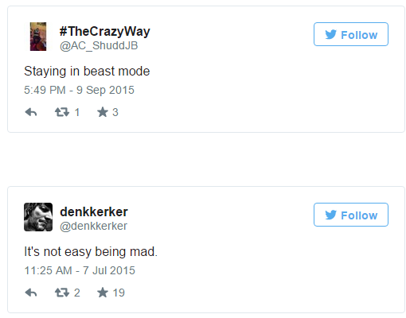
@anagramatron by @cmyr
Notes:
funny ones: anagrambot, manbot; portmanteaubot

Slide 27
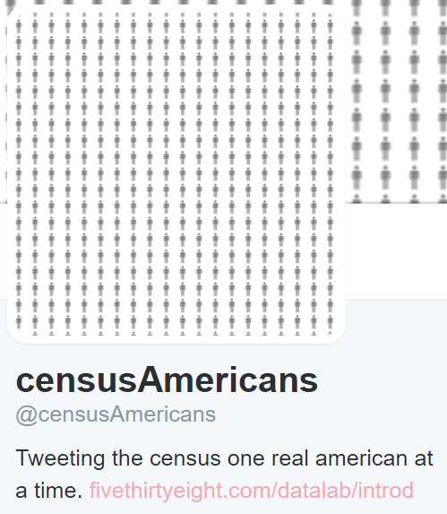
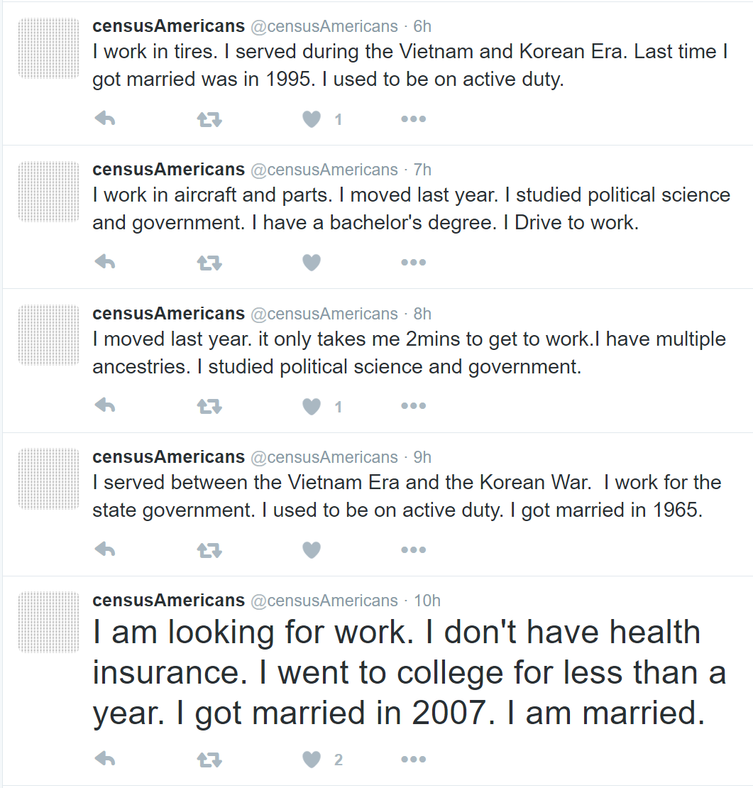
made by Jia Zhang
“CensusAmericans will insert strangers into your life at regular intervals and will continue its automated task until it gets to the end of the 15,450,265 rows in the data set. That’ll only take about 1,760 years.”
(Zhang 2015)

Slide 28
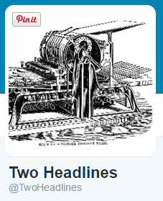
made by Darius Kazemi
“@TwoHeadlines is not generating jokes about current events. It is generating jokes about the future: a very specific future dictated by what a Google algorithm believes is important about humans and our affairs.”
(Kazemi 2013)
Notes:
The Google News sidebar described in the email thread above is Google’s attempt to parse out the subject of a bunch of related news headlines. For example, if there is a bombing in Iraq and there are a lot of news headlines about it, it will probably generate the subject “Iraq.” This is a very specific choice: it could have equally chosen “bombing” or “terrorism” or “chaos”, but Google’s algorithm tends to favor named entities over abstract concepts. What this means is that the subject of the news, as Google sees it, is almost always a corporation, a sports team, a celebrity, a nation, or a brand.
My algorithm builds its jokes by harvesting these subjects that Google has picked, and swapping them indiscriminately between headlines.
What is near-future late-capitalist dystopian fiction but a world where there is no discernible difference between corporations, nations, sports teams, brands, and celebrities?
So Adam was partly right in our original email thread. @TwoHeadlines is not generating jokes about current events. It is generating jokes about the future: a very specific future dictated by what a Google algorithm believes is important about humans and our affairs.

Slide 29
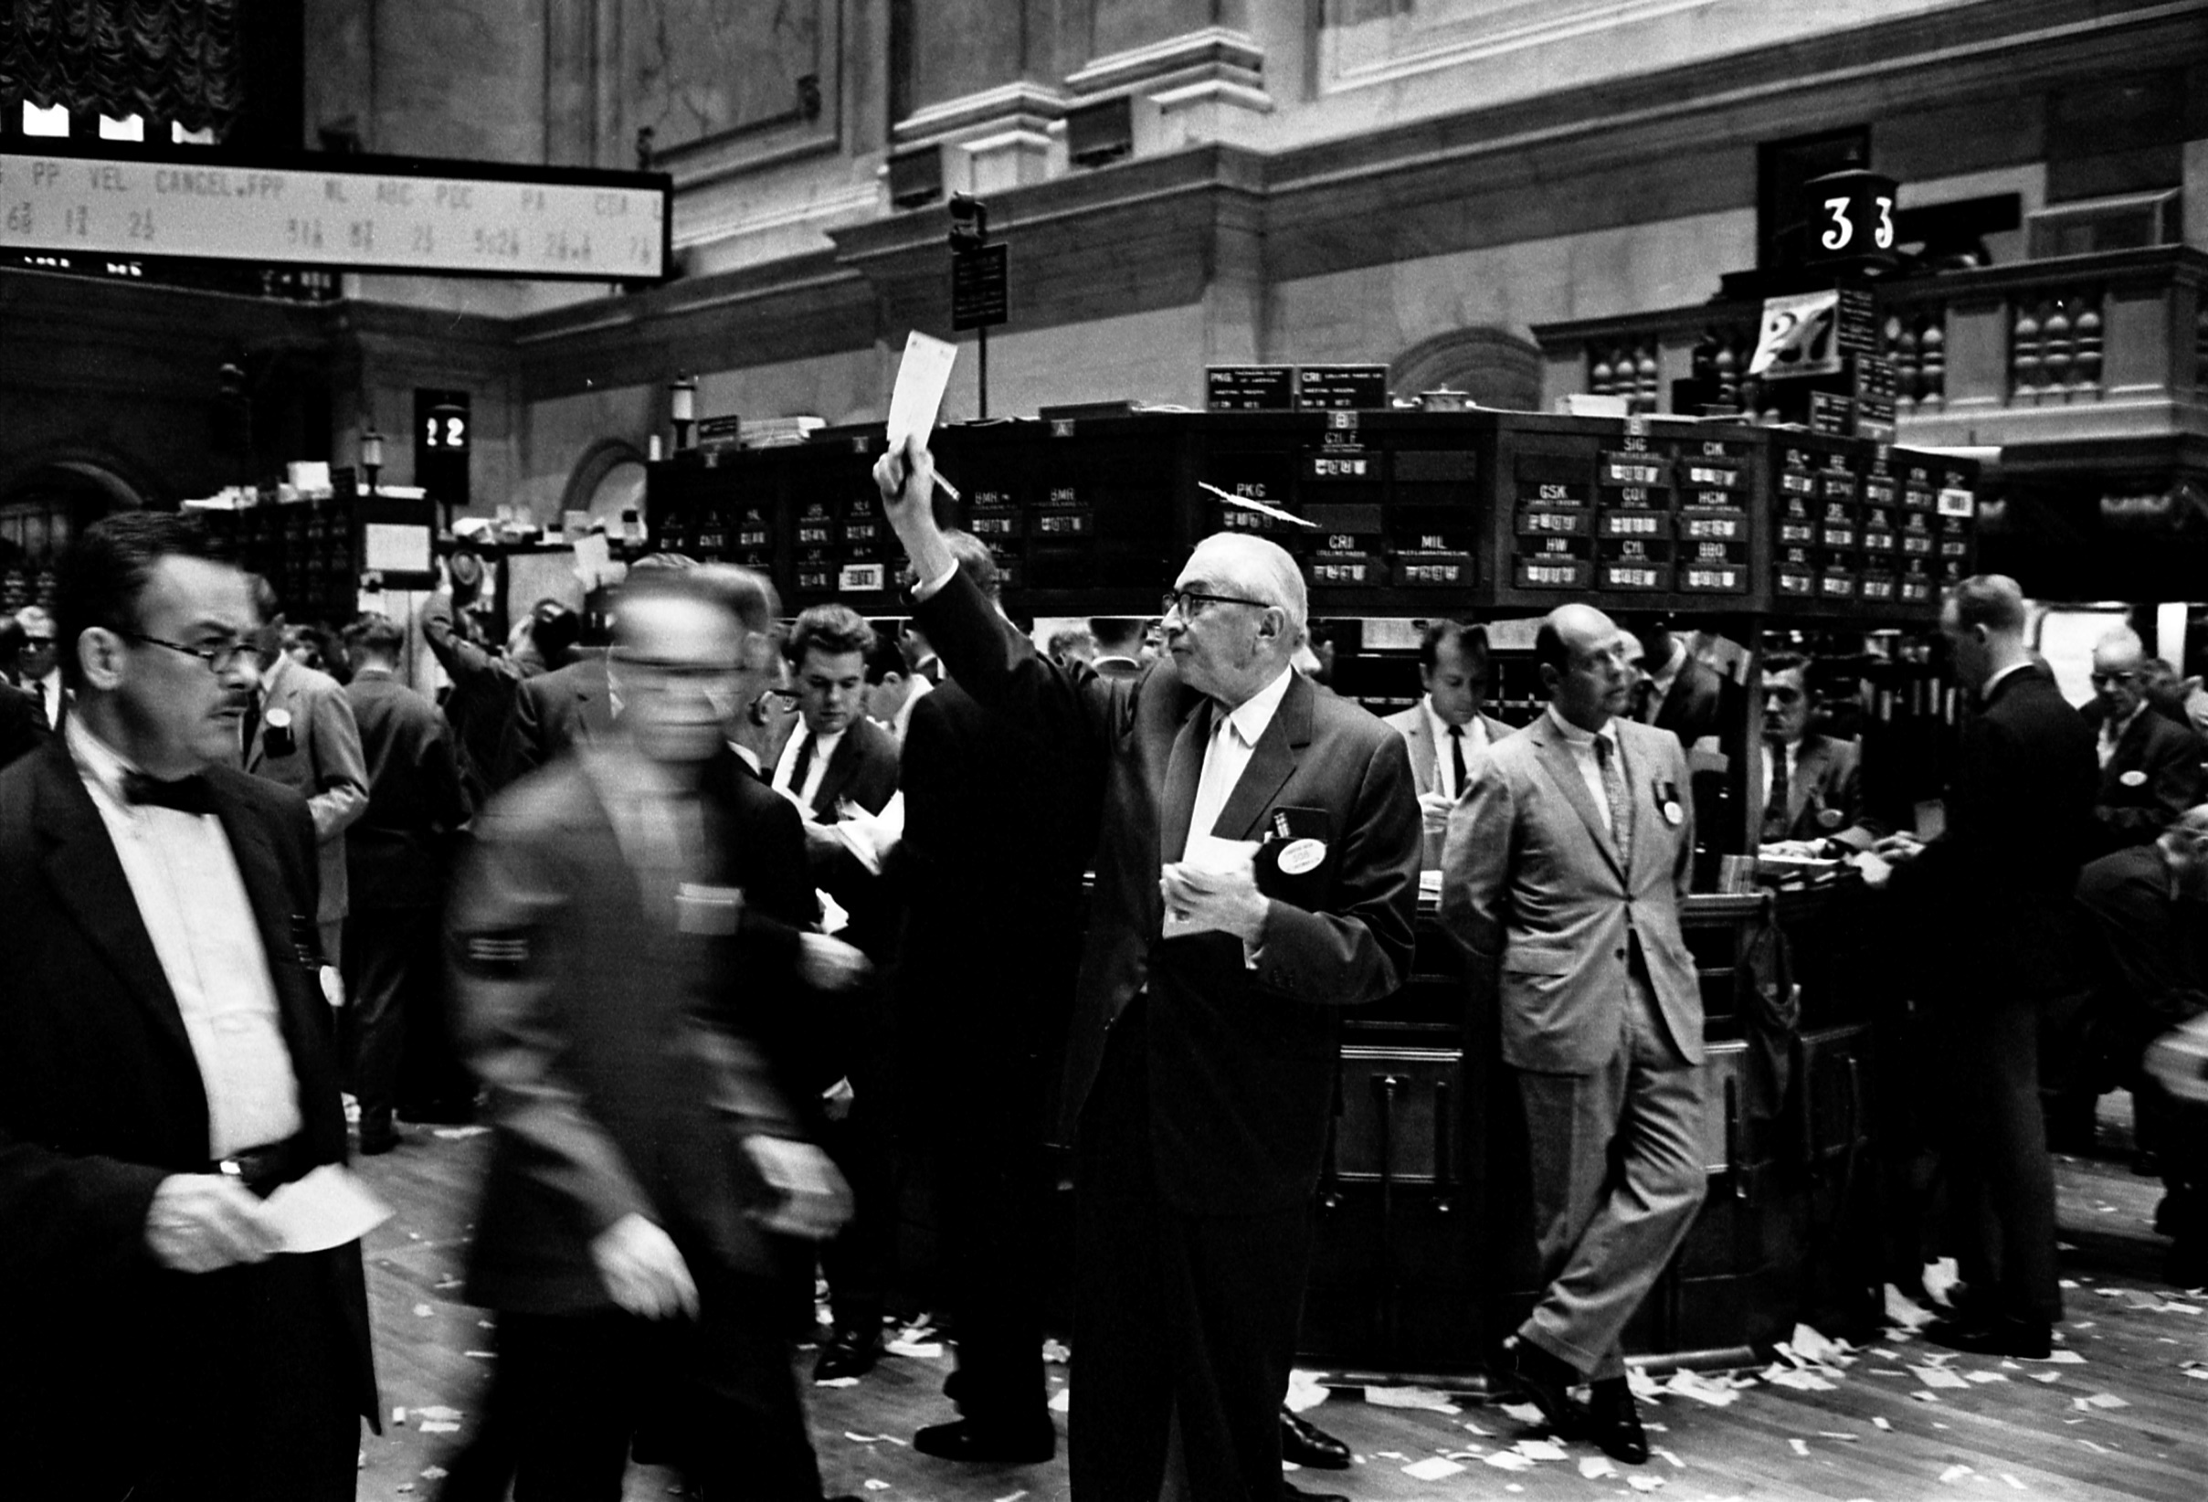
“At a time when even our most glancing online activities are processed into marketing by for-profit bots in the shadows, Twitter bots foreground the influence of automation on modern life, and they demystify it somewhat in the process.”
Dubbin (2013)

Slide 30
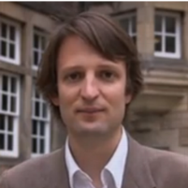
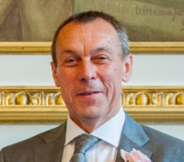
Teacherbot
E-learning and Digital Cultures MOOC
c.70,000 enrolments
4,000+ in the student Facebook group
9,000+ in the student G+ group
4000+ tweets to #edcmooc over course run
c.50% with postgraduate degrees
c.50% working in Education

Slide 31
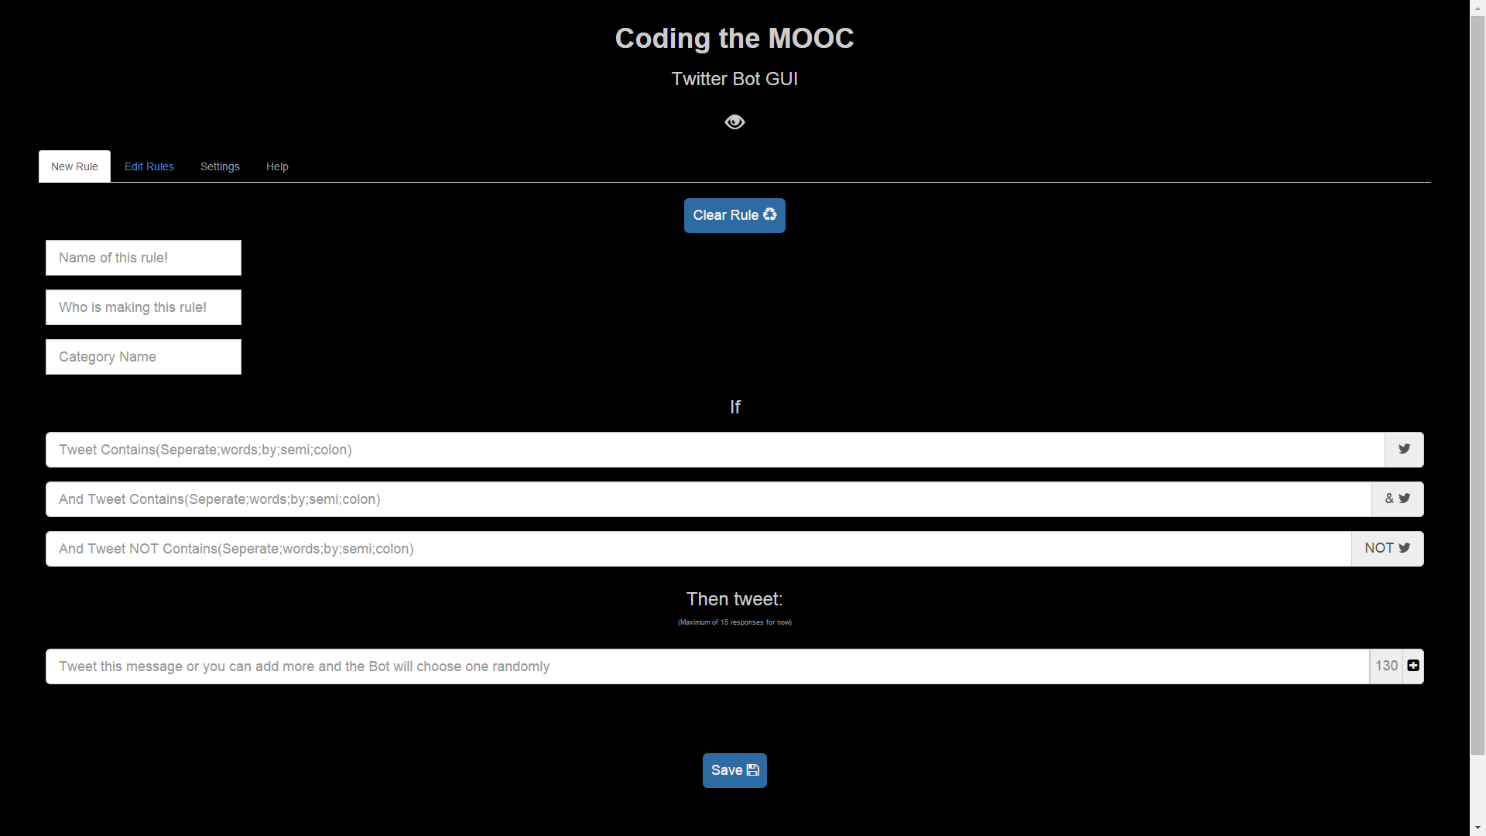
#edcmooc

Slide 32
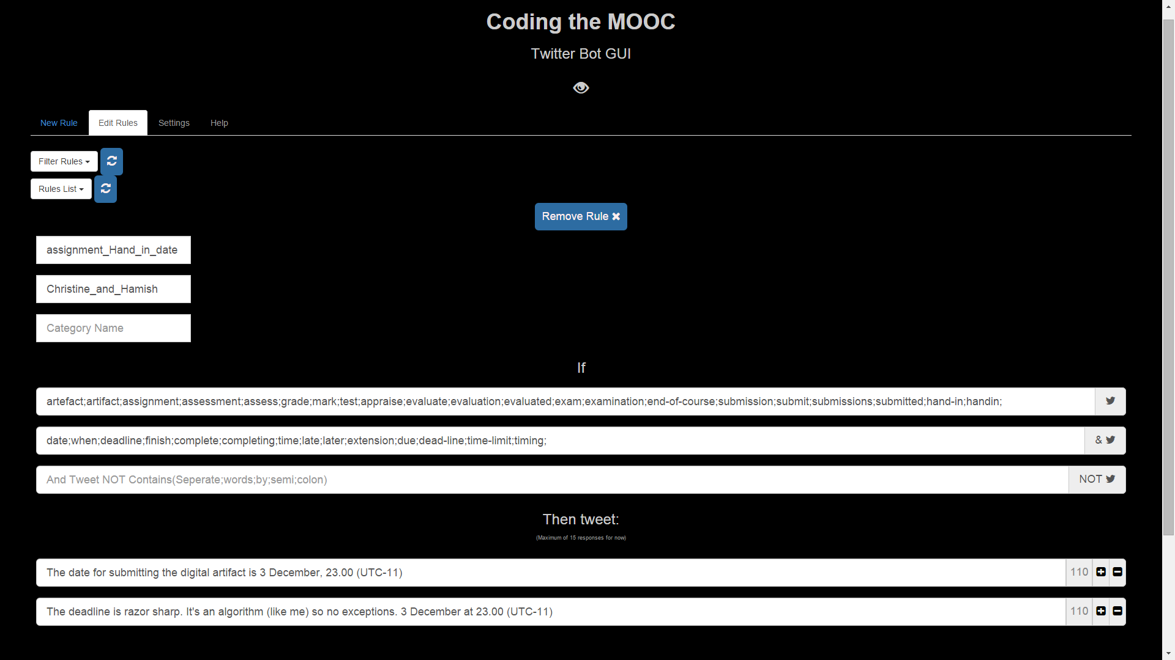
“The Georgia Tech program apparently was focused on answering student questions about due dates or assignments. That probably is what TA’s actually do which makes the AI TA question a very uninteresting question. Of course, a TA can be simulated if the TA’s job is basically robotic in the first place.”
Roger Shank quoted in Watters (2016)

Slide 33
Teacherbot inscription
“The act by which humans cast relevant patterns of action into material objects...
material objects become vehicles of human agency, performing functions in complex networks of humans and non-humans.”
Ponti (2014)
Notes:
Inscription is defined as the act by
which humans cast relevant patterns of action into
material objects, and delegate them to perform action
programs and capabilities [1]. As a result of delegation,
material objects become vehicles of human agency,
therefore replacing humans in doing things and
performing functions in complex networks of humans and non-humans [1].

Slide 34
51 rules
20 content-oriented
7 social
13 administrative
11 process-oriented
If tweet includes:
Human;humanism;posthumanism;post-humanism;post;posthuman;posthumanist;post-humanist;posthumans;cyborgs;cyborg
And also: History;genealogy;species; darwinism;Darwin;monkey;dog;cat;origin;life;science
Then tweet:
Darwin's conception of life, is one in which the human is one species among many, destined to be overcome. (Grosz 2011)
If tweet contains:
how;where;help;do I;who;can;someone;find;looking;want
And:
blog with;get comments;join a group;quadblogging;buddies;community;add comments;conversation;company;gather;connect;come together
Then tweet one of:
Will you share your blog URL so that people can read and comment?
Would anyone like to blog as a group? RT or reply to us!
Why not post to the discussion forum and see if anyone wants to blog with you?
If tweet contains:
love;like;brilliant;excellent;having a great time;super;fantastic;amazing;awesome;splendid;astounding;remarkable;marvelous;great;marvellous;good
And:
course;edcmooc;experience
Then tweet one of:
That is nice of you to say so!
I'm enjoying it too!
Notes:
Inscription is defined as the act by
which humans cast relevant patterns of action into
material objects, and delegate them to perform action
programs and capabilities [1]. As a result of delegation,
material objects become vehicles of human agency,
therefore replacing humans in doing things and
performing functions in complex networks of humans and non-humans [1].

Slide 36
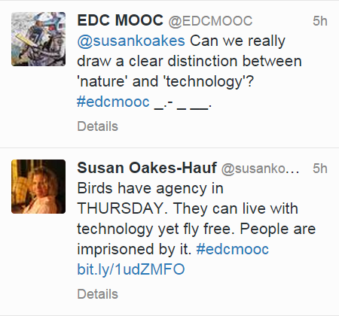

Slide 37
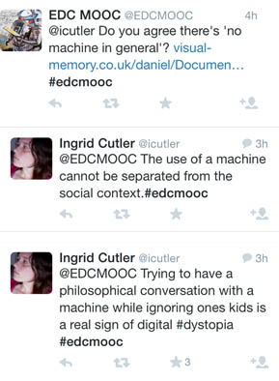

Slide 38
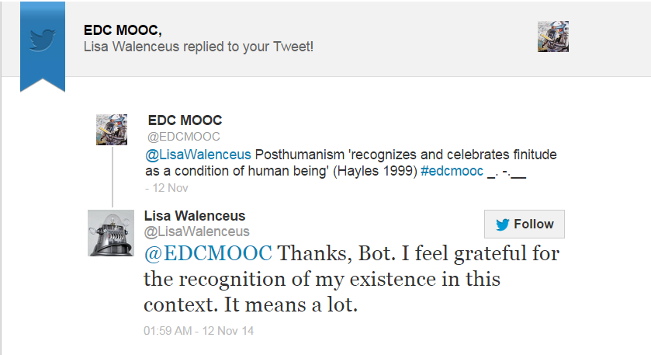
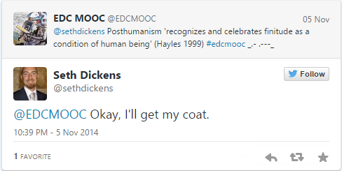

Slide 39
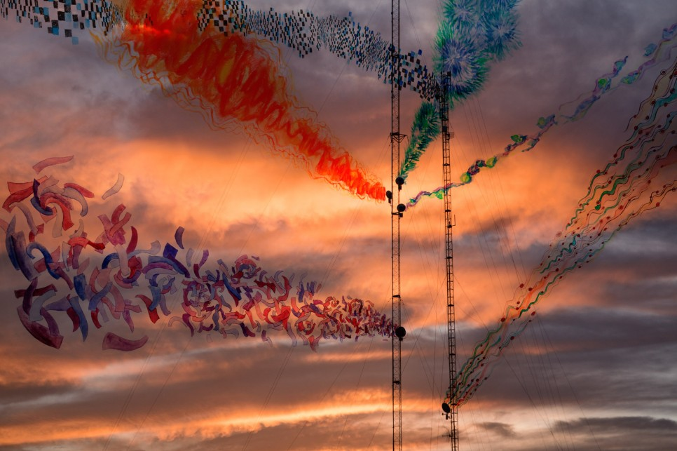
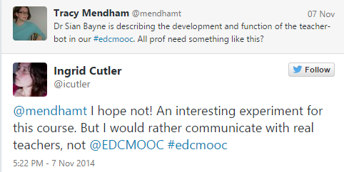
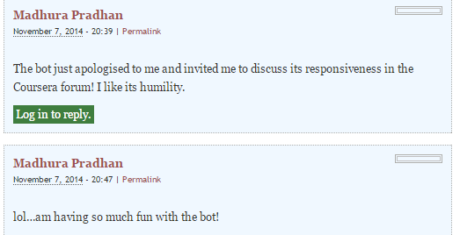
“While I was trying to figure out what the hell ‘post-humanism’ means, the teacher bot led me on a merry chase looking up quotes and obscure academic references, which had the interesting side effect of ‘ambush teaching’ me. I will happily admit, that I do not feel like I have been to a class. I do not feel like I have been taught, either. I do, however, think I have learned something. I’ve certainly been prompted to think. Isn’t this what every good teacher/trainer strives for?”
Giddens (2013)

Slide 40
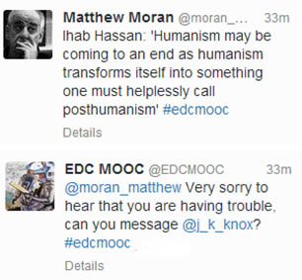

Slide 41
Concluding
Notes:
we need spaces to play with these ideas in education – how can we explore what it means to be entangled?

Slide 42
Teacherbot: intervening in teacher automation
against instrumentalism, essentialism, supercessionism, solutionism
a post-anthropocentric move toward productive play with entanglement
an argument for micro-interventions driven by teachers
about excess not deficit; randomness not routinisation
Notes:
shift away from dominant discourses in ed-tech which assume our relation is either instrumental or essentialist [edtech cliches of ‘harnessing’ etc]
a move to challenge lazy supercessionism and solutionism/division of social and technological
a post-anthropocentric move toward productive play with the idea of entanglement
an argument for micro-interventions by teachers, alongside (counter to?) big, corporate ed-tech
one which refuses to ‘black box’ the teacher
oriented to excess rather than deficit, to the pleasure of randomness over routine [we didn’t know what would happen]

Slide 43
@sbayne
sian.bayne@ed.ac.uk
http://www.de.ed.ac.uk/
in print: Bayne, S (2015) Teacherbot: interventions in automated teaching, Teaching in Higher Education, 20:4, 455-467
on github: https://github.com/Mehrpouya/Coding-the-MOOC
in summary: https://codeactsineducation.wordpress.com/codinglearning-e-book/
Images by permission of Vitor Schietti: www.schiettifotografia.com
References: http://tinyurl.com/z9v3hpk
Notes:
http://tinyurl.com/gu7zztl

Slide 44
Brian Bilston
Notes:
https://www.weforum.org/agenda/2016/06/a-venn-diagram-poem-on-the-future-of-work

