Slide 1
Building Intelligent Tutoring Systems
ECEL Annual Meeting 2016: Innovations for the Enhancement of Teaching and Learning in Higher Education
Rotterdam, the Netherlands
October 14, 2016
Vincent Aleven
Human-Computer Interaction Institute
Carnegie Mellon University
Notes:
Although I am a technologist at heart and I love to build new things; in fact I love to build tools with which to build new things. But I also want to know what is worth building. So this talk is not about how to build things, but about what is worth building for learners.

Slide 2
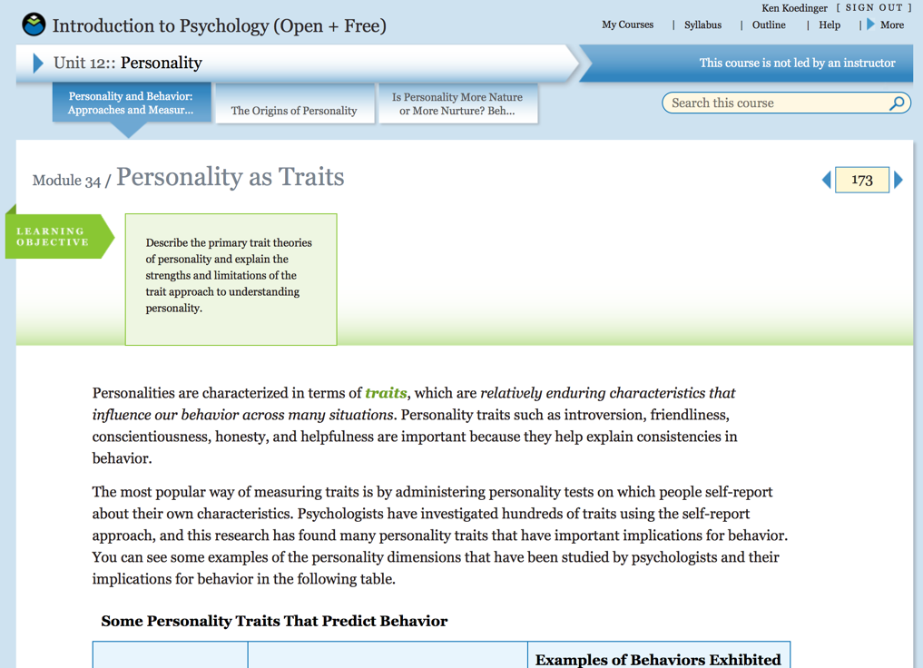
Learning by Reading/Video Watching
Psychology MOOC by the Open Learning Initiative (OLI)

Slide 3
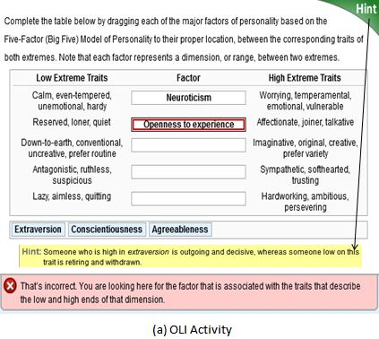
Learning by Doing
Notes:
Other forms as well
Automated essay grading or automated program evaluations
Peer grading
- Discussions

Slide 4
“the learning effect of doing is about six times greater than that of reading”
Data from four online courses
Concepts in Computing
Introduction to Biology
Introduction to Psychology
Statistical Reasoning
Koedinger, K. R., Kim, J., Jia, J. Z., McLaughlin, E. A., & Bier, N. L. (2015). Learning is not a spectator sport: Doing is better than watching for learning from a MOOC. In G. Kiczales, D. M. Russell, & B. Woolf (Eds.), L@S '15: Proceedings of the Second (2015) ACM Conference on Learning @ Scale (pp. 111-120). New York: ACM. doi:10.1145/2724660.2724681
Koedinger, K. R., McLaughlin, E. A., Jia, J. Z., & Bier, N. L. (2016). Is the doer effect a causal relationship?: How can we tell and why it's important. In D. Gašević, G. Lynch, S. Dawson, H. Drachsler, & C. P. Rosé (Eds.), LAK '16: Proceedings of the Sixth International Conference on Learning Analytics & Knowledge (pp. 388-397). New York: ACM. doi:10.1145/2883851.2883957

Slide 5
Opportunity
How can we support learning-by-doing even more effectively?
Notes:
Possible answer: Intelligent Tutoring Systems (ITSs)
ITSs are not often found in MOOCs and online courses – I would argue however that they could fulfill a real need

Slide 6
Conclusions
Intelligent Tutoring Systems (ITSs) are an effective way of supporting learning by doing
Can be built without programming using dedicated authoring tools (CTAT)
Can support self-regulated learning (SRL)

Slide 7
Overview
Intelligent Tutoring Systems (ITSs)
Tools for building ITSs without programming
Research study: Supporting self-regulated learning (SRL) with an ITS
Notes:
Illustrate what they are, how they are different from other forms of technology-enhanced learning, evidence that they are effective, and what makes them effective

Slide 8
1. Intelligent Tutoring Systems

Slide 9
What Are Intelligent Tutoring Systems?
Adaptive, real-time guidance during learning-by-doing
  Provide feedback and help w.r.t. problem steps, not just final answer
  Follow students along different solution paths
  React to individual strategies, errors
Individualized problem selection
  Track individual knowledge growth, support mastery learning
Notes:
Much better than getting feedback from the teacher the next day; much better than answers in the back of the book; and better than having to ask a sibling, who may extract who knows what promise
Help the learner know they are on a successful path; abandon, in timely fashion, unproductive paths, to avoid frustration and wasted time

Slide 10
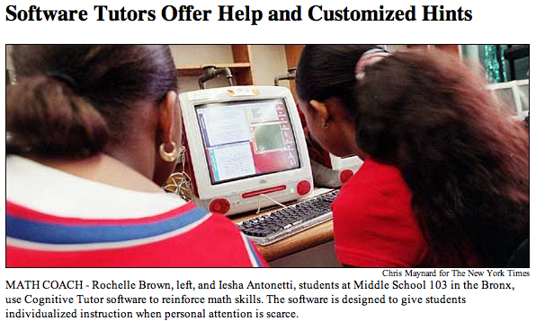

Real-world Impact of ITSs
Cognitive Tutor used in Blended Courses
Spin-off company Carnegie Learning, Inc.
Over 500,000 students per year
http://www.carnegielearning.com/
Notes:
Photo illustrates
Shows how these systems have mostly been used: In schools.
2002 in Miami-Dade: The study compared FCAT performance for 6,395 students in 10
high schools, including 770 Exceptional Student Education (ESE) students
and 976 limited English proficiency (LEP) students.
FCAT scores
were 16 points higher for Cognitive Tutor LEP students
(259.94 vs. 243.62; p<.001), and 27% of Cognitive Tutor
LEP students passed the FCAT, as opposed to only 18.9%
of LEP students using a conventional curriculum (see
Figure 3). African American students (p<.05) and male
students (p<.001) using Cognitive Tutor demonstrated
higher performance than their conventional-curriculum
counterparts. Hispanic and female students using the
Cognitive Tutor also earned higher scores, but the
differences were not statistically significant.

Slide 11
Evaluations of ITS Effectiveness
Four meta-analyses show ITSs are often more effective than other forms of instruction
              (Kulik & Fletcher, 2015; Ma, Adesope, Nesbit, & Liu, 2014; Steenbergen-Hu & Cooper, 2013; 2014)
Meta-review indicates that ITSs are “nearly as effective as human tutoring” (VanLehn, 2011)
Notes:
Educational software that

Slide 12
Effectiveness of Cognitive Tutor at Scale
Study by the RAND Corp.
Involved 17,000 students
Compared Cognitive Tutor Algebra course to “business as usual”
Treatment effect size in high schools in Year 2: d = 0.20
Cognitive Tutor group learned twice as much as business-as-usual group
Pane, J. F., Griffin, B. A., McCaffrey, D. F., & Karam, R. (2014). Effectiveness of cognitive tutor algebra I at scale. Educational Evaluation and Policy Analysis, 36(2), 127-144. doi:10.3102/0162373713507480
Notes:
Over 17,000 students in 147 schools across 7 states
Duration: 2 years
Cost: $6 million
Test: Algebra Proficiency Exam, 32-item multiple-choice assessment
in both cases, the magnitude is sufficient to improve the median student’s performance by
approximately eight percentile points.
The difference was about the same as doubling math learning in a year for a high-school student
“Another way to gauge the magnitude of an
effect of .20 is to consider the amount of mathematics
growth typically seen from one grade to
the next on nationally normed assessments.
Lipsey et al. (2012) report typical mathematics
achievement gains of .32 for 8th grade, .22 for
9th grade, and .25 for 10th grade (most students
in our two studies were in these grades). These
data suggest that a treatment effect of .20 is
nearly comparable in size with the amount of
mathematics growth typically seen over a full
year for 9th or 10th graders, or about two thirds
of the amount typically seen for 8th graders.
However, it worth noting that the typical gains
cited here are from spring to spring (e.g., spring
of 7th grade to spring of 8th grade for 8th graders)
and thus might include the effects of any
decline in achievement over the summer when
school is in recess. Such a summer decline
would not be captured in our effect estimates
because we measured fall to spring gains.”

Slide 13
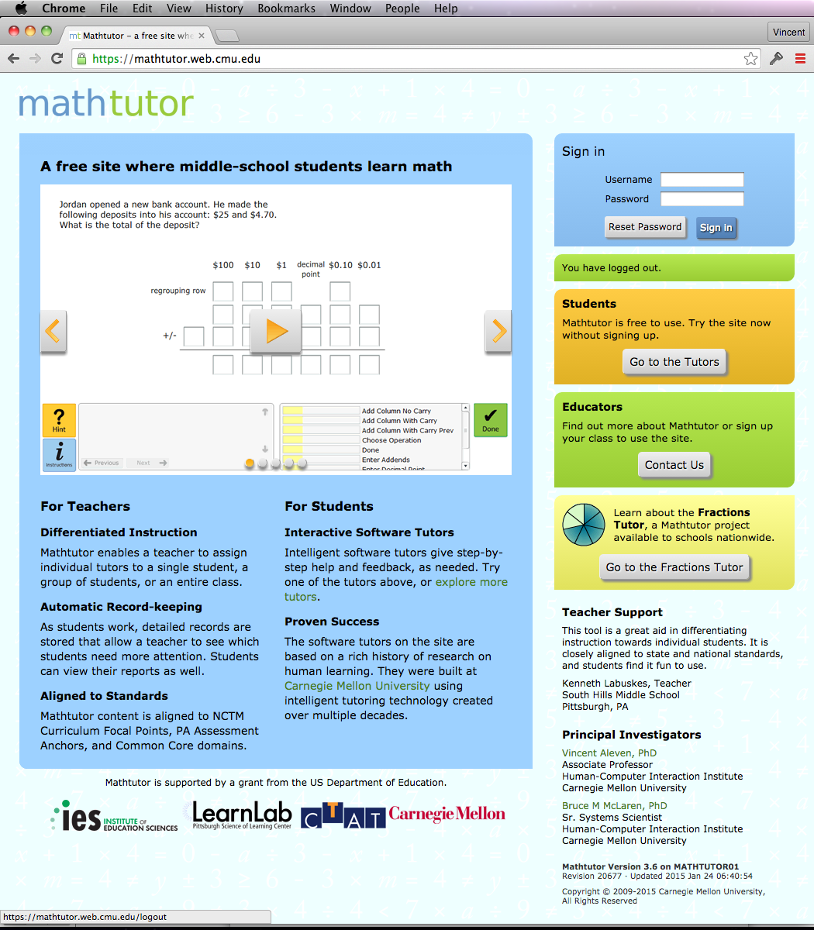
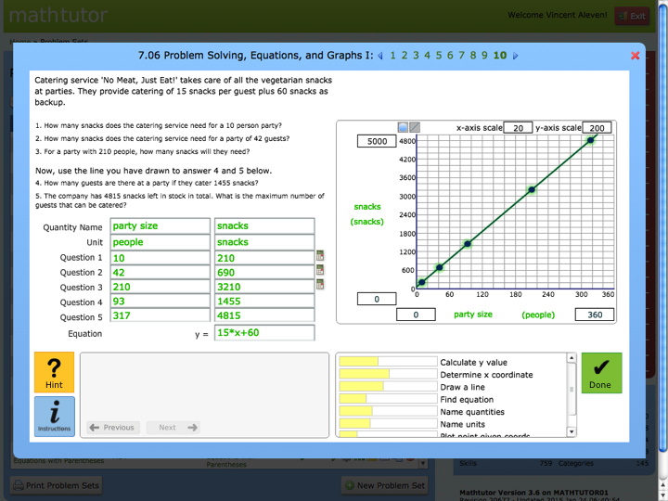
Mathtutor
http://mathtutor.web.cmu.edu

Slide 14
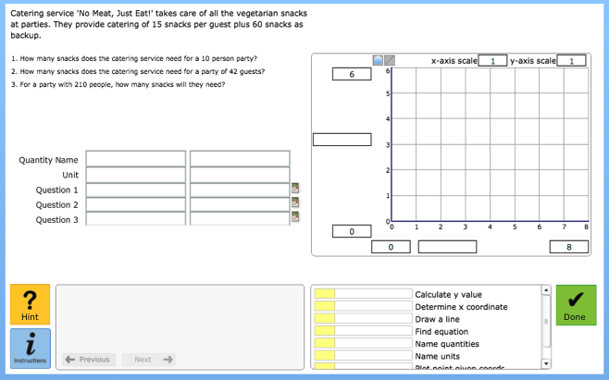
ITS Support for Student Learning
http://mathtutor.web.cmu.edu
Analyze real world
problem scenarios
Use graphs, graphics calculator
Interface makes thinking visible
Use table, spreadsheet
Model tracing to provide context-sensitive step-level guidance (correctness feedback, error messages, on-demand hints)
Student knowledge growth tracked for “open learner model” and individualized problem selection

Slide 15
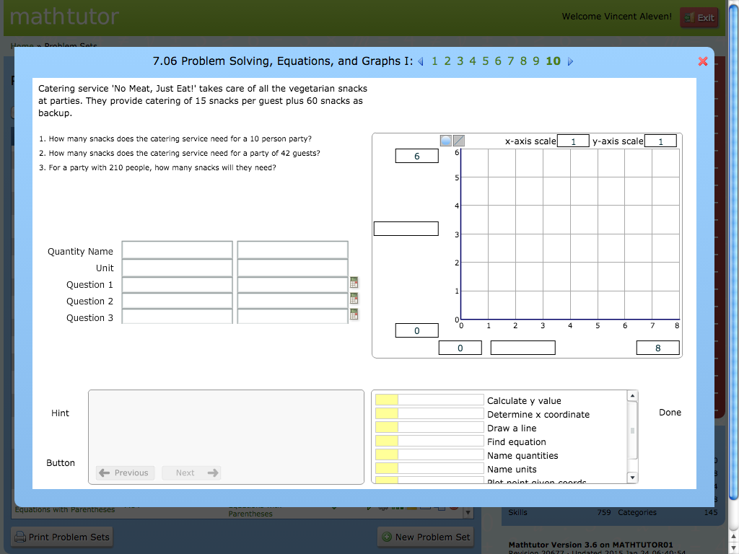



Hint
Done

Slide 16
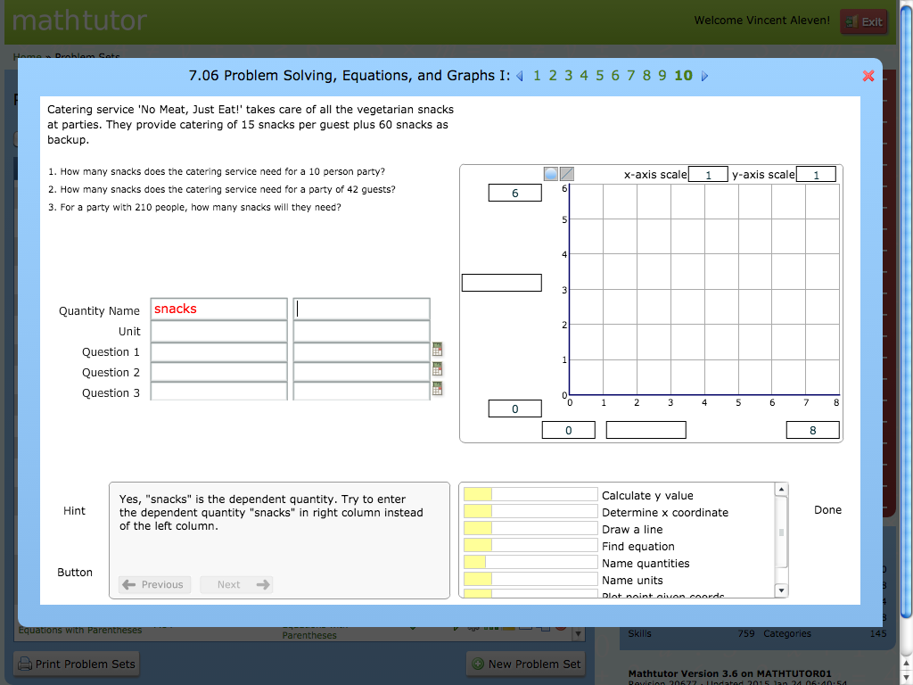
Hint
Done

Slide 17
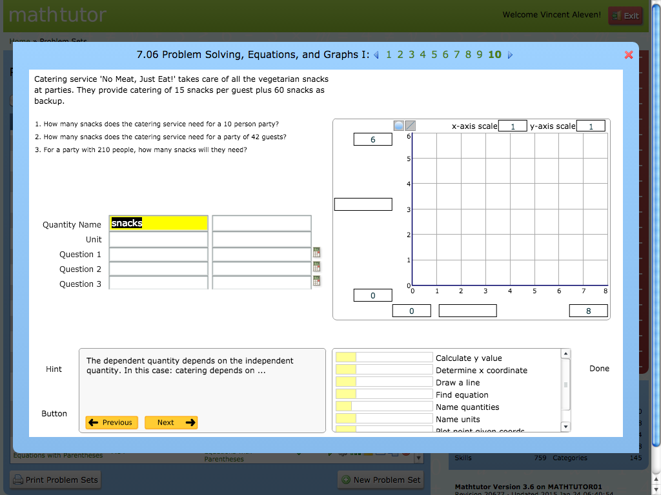
Hint
Done

Slide 18

Hint
Done

Slide 19
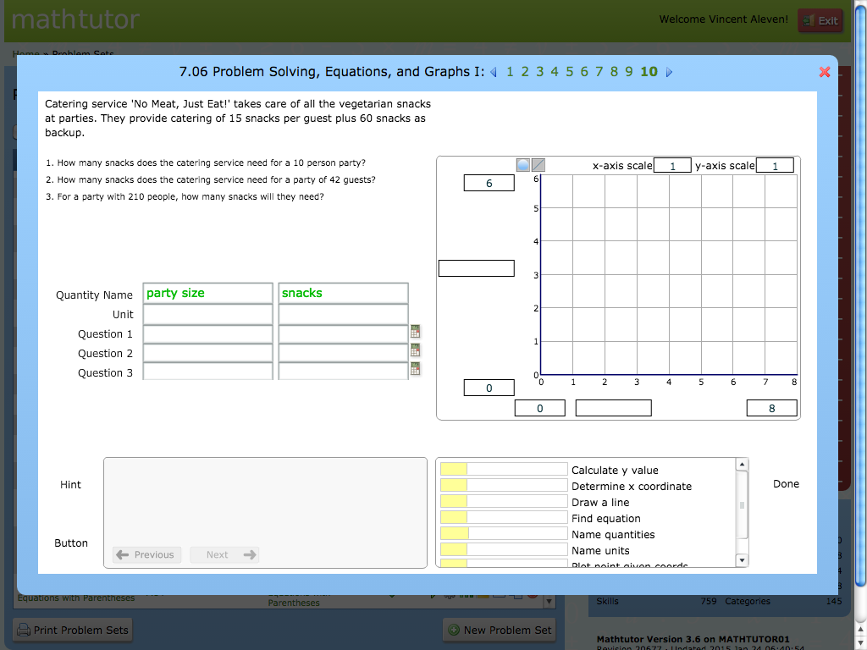
Hint
Done

Slide 20

Hint
Done

Slide 21
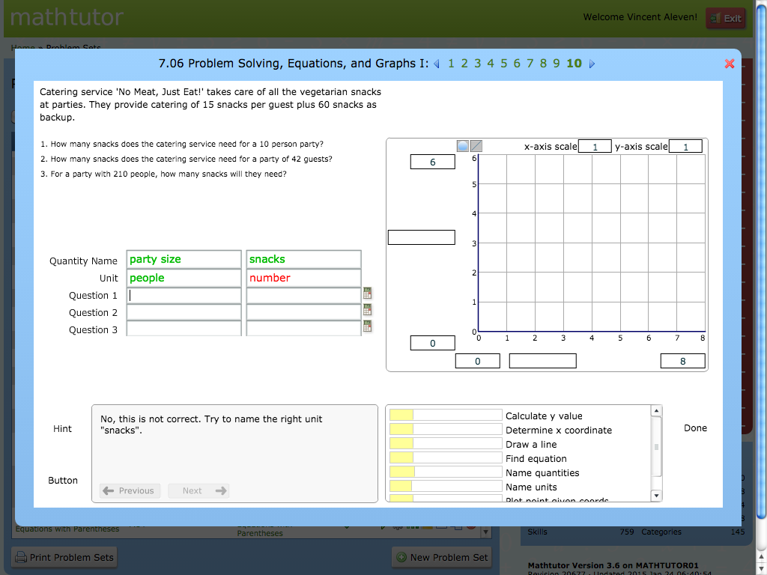
Hint
Done

Slide 22
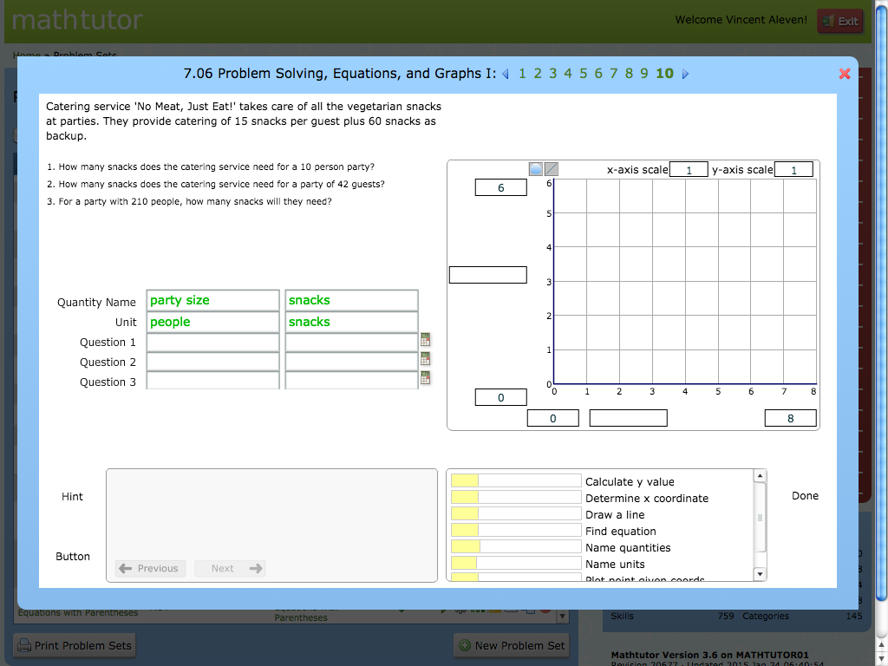
Hint
Done

Slide 23

Hint
Done

Slide 24

Hint
Done

Slide 25
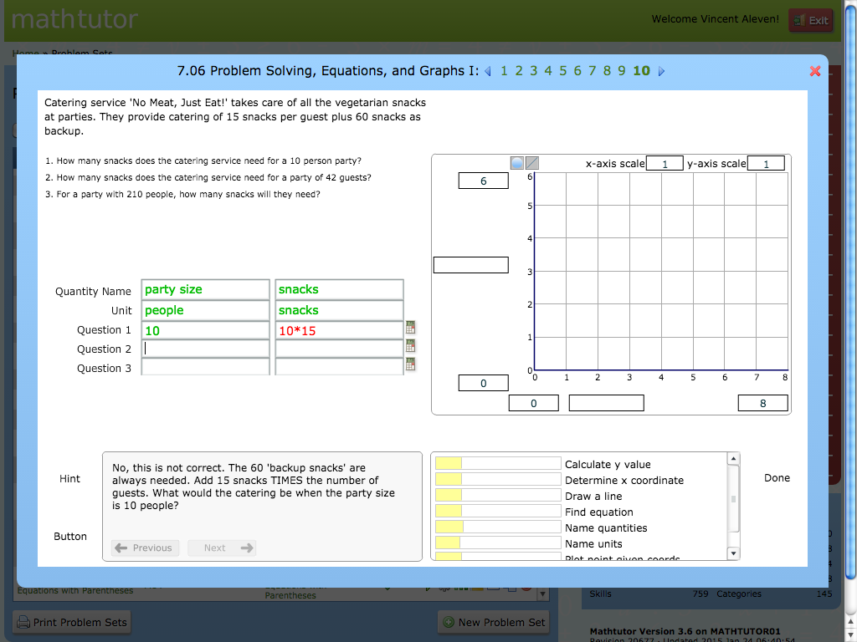
Hint
Done

Slide 26
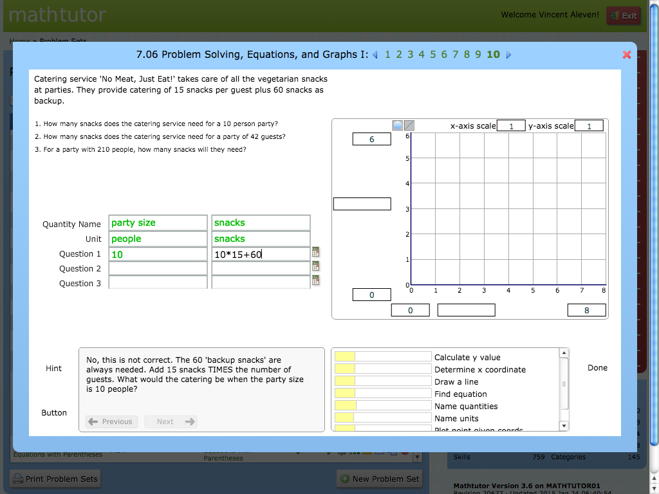
Hint
Done

Slide 27

Hint
Done

Slide 28

Hint
Done

Slide 29
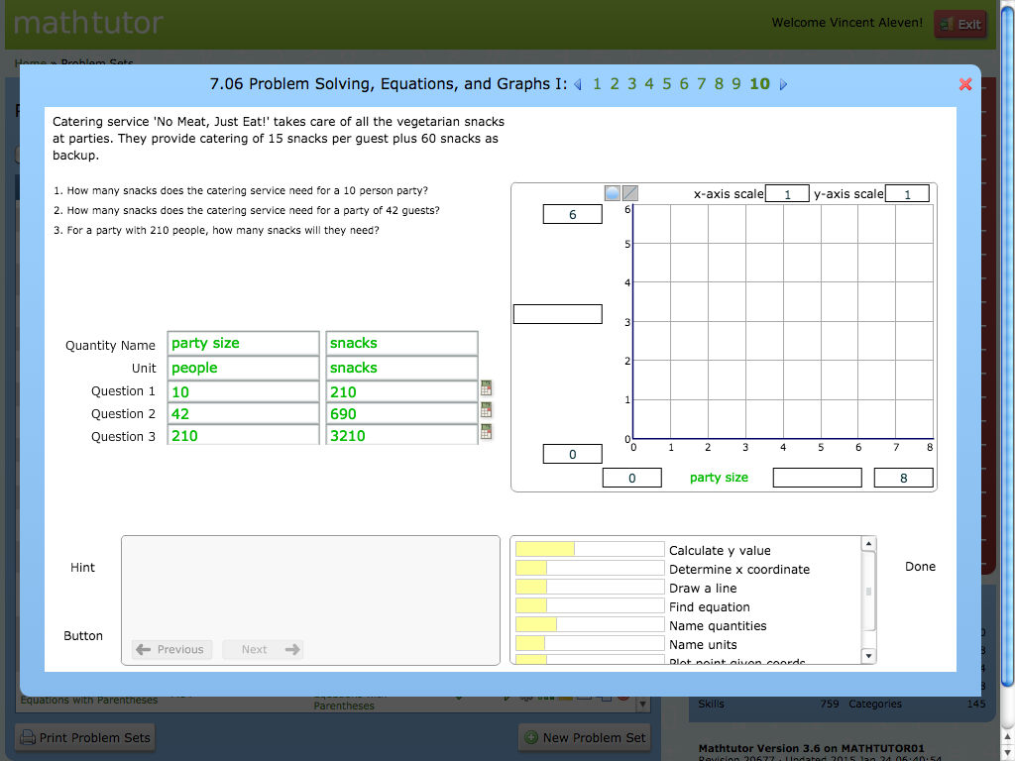
Hint
Done

Slide 30

Hint
Done

Slide 31
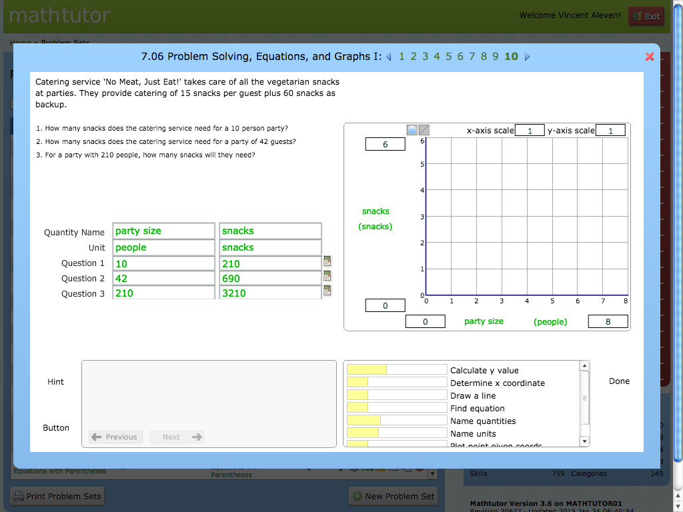
Hint
Done

Slide 32
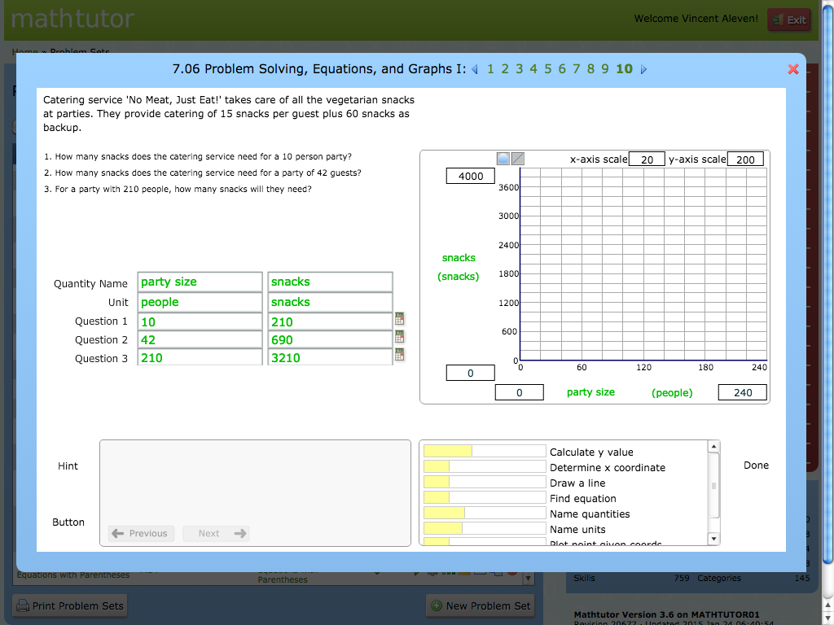
Hint
Done

Slide 33
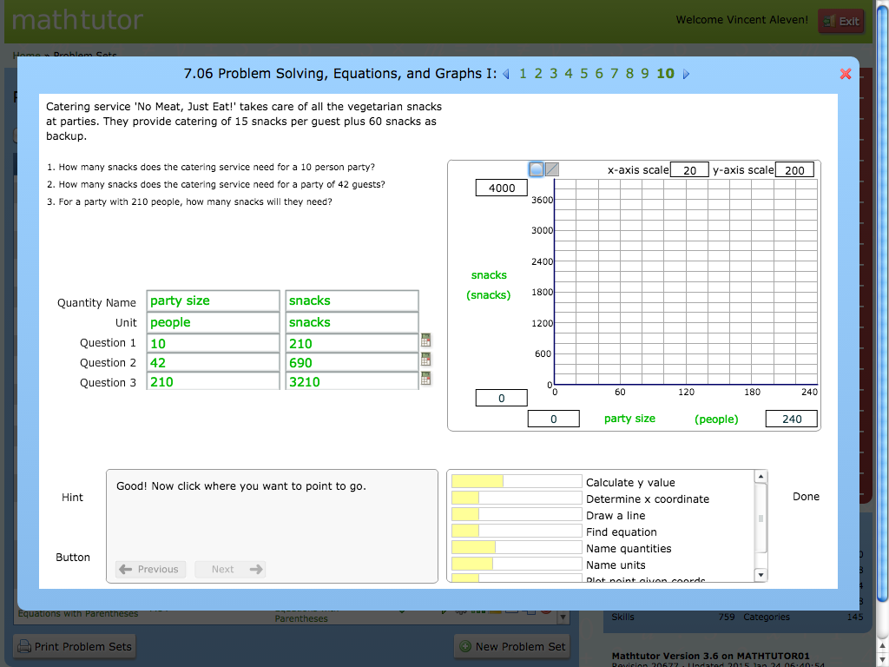
Hint
Done

Slide 34
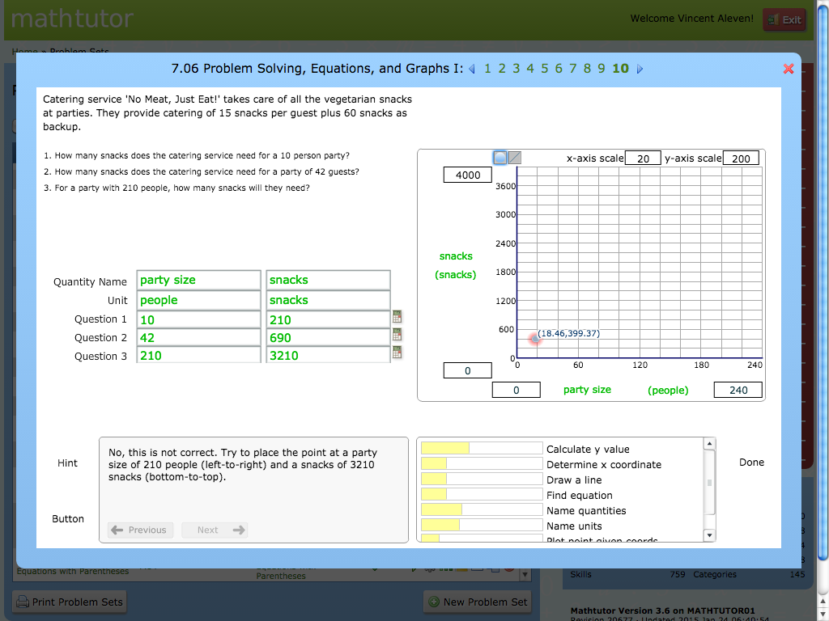
Hint
Done

Slide 35
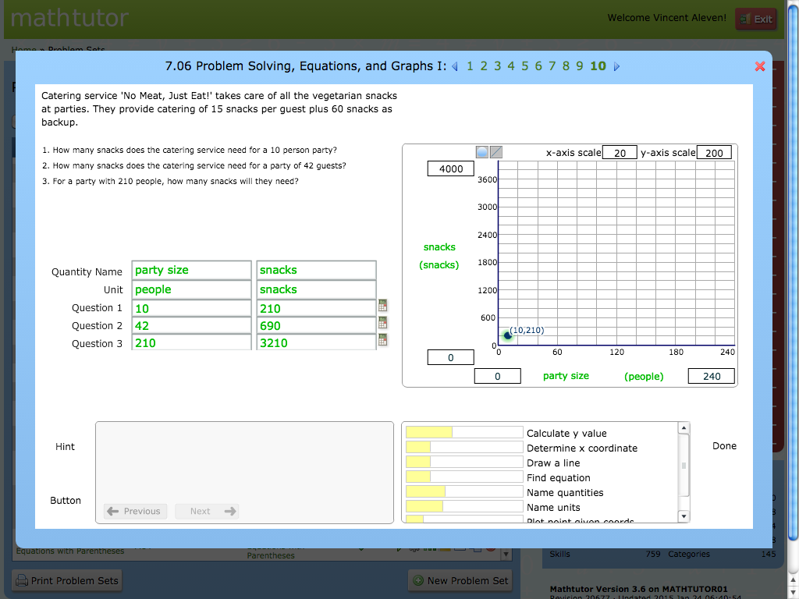
Hint
Done

Slide 36
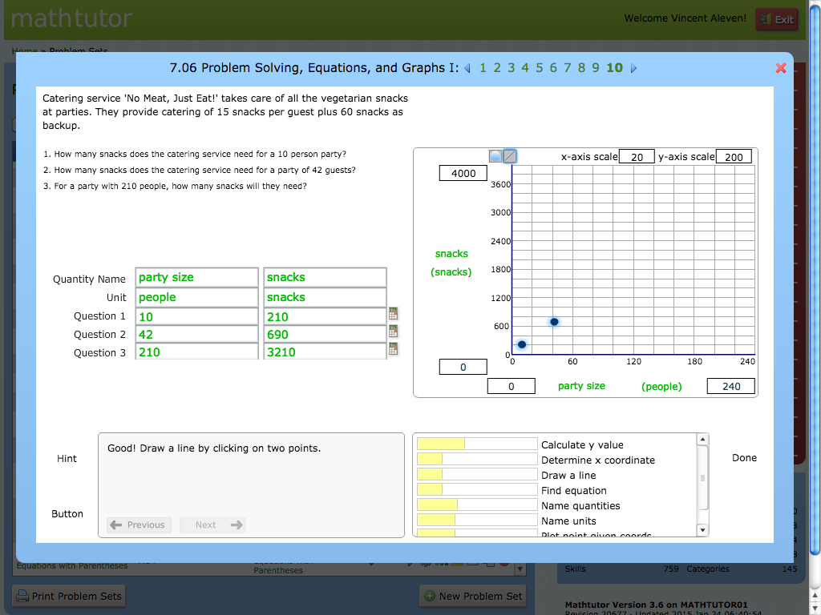
Hint
Done

Slide 37
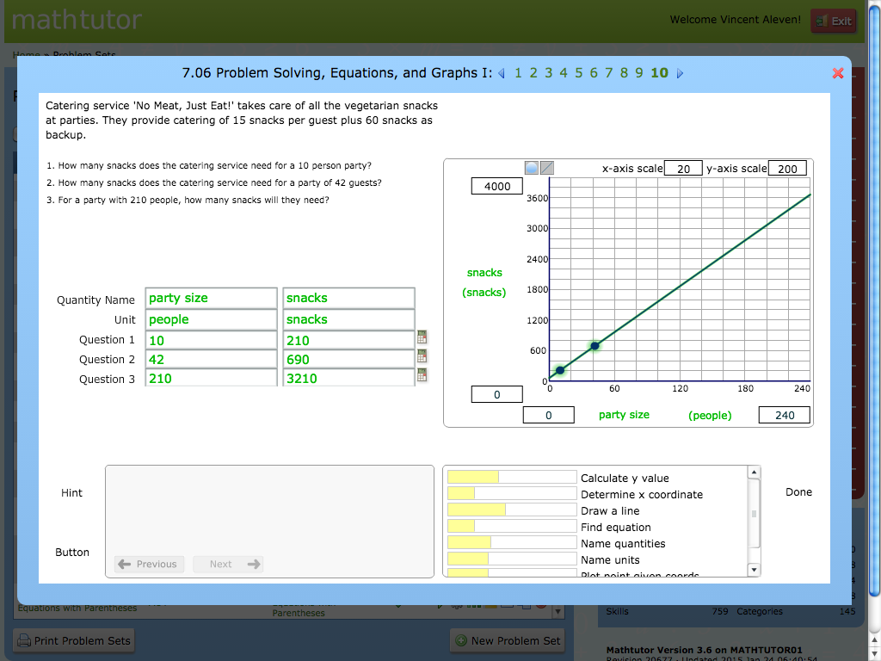
Hint
Done

Slide 38
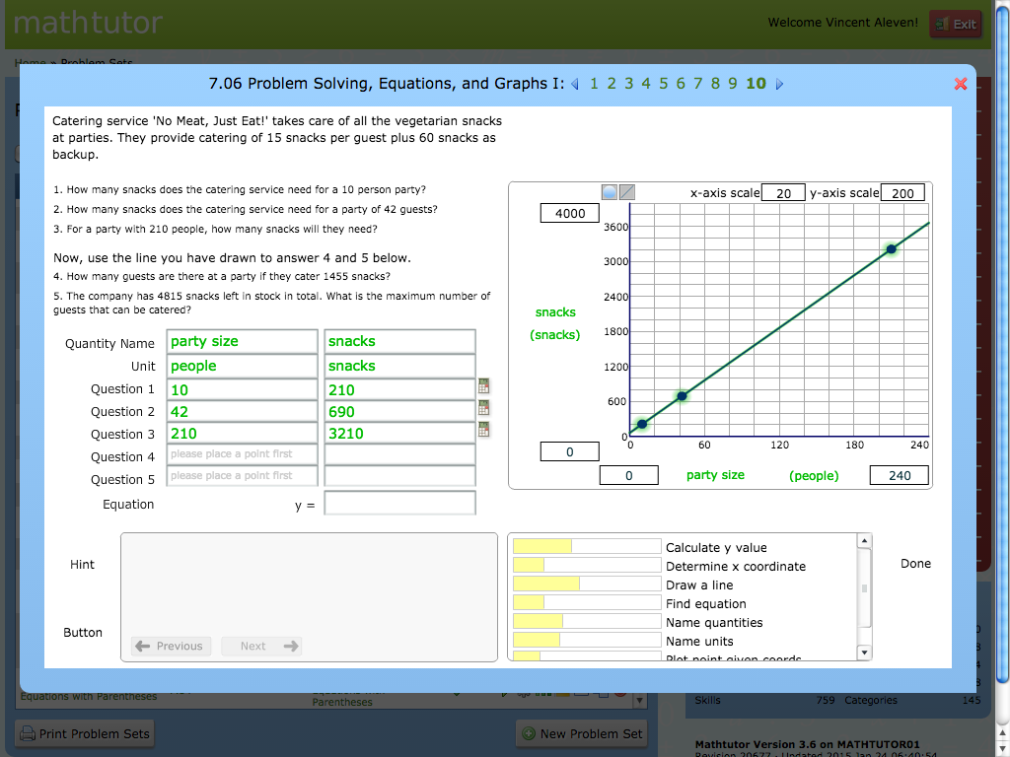
Hint
Done

Slide 39
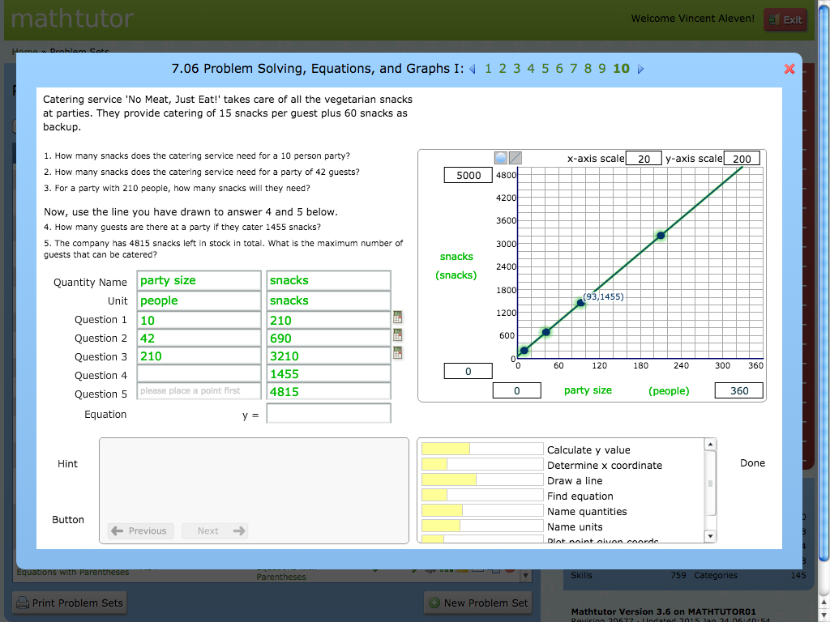
Hint
Done

Slide 40

Hint
Done

Slide 41
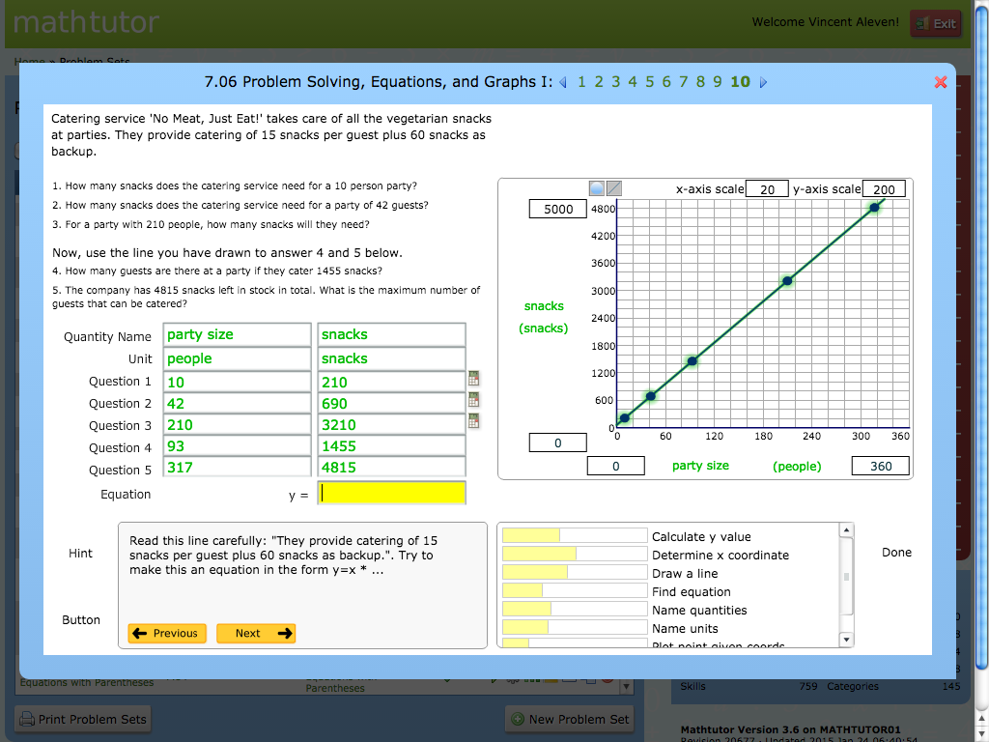
Hint
Done

Slide 42
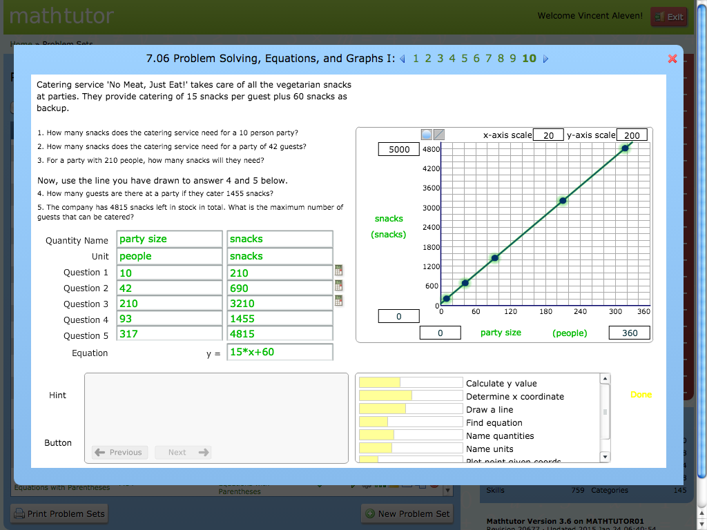
Hint
Done

Slide 43
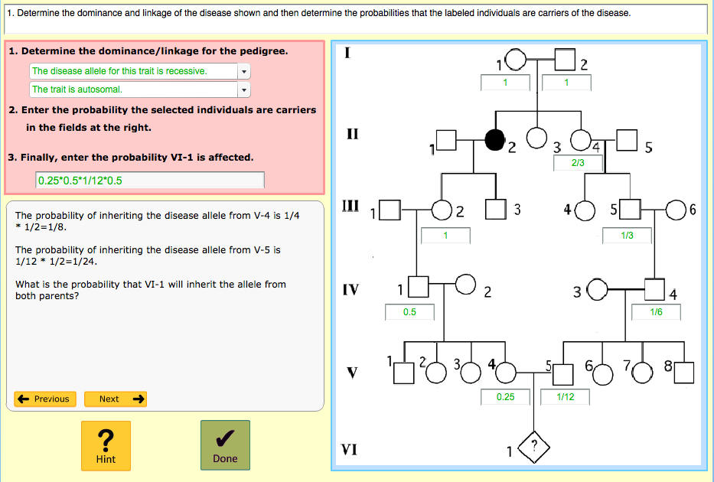
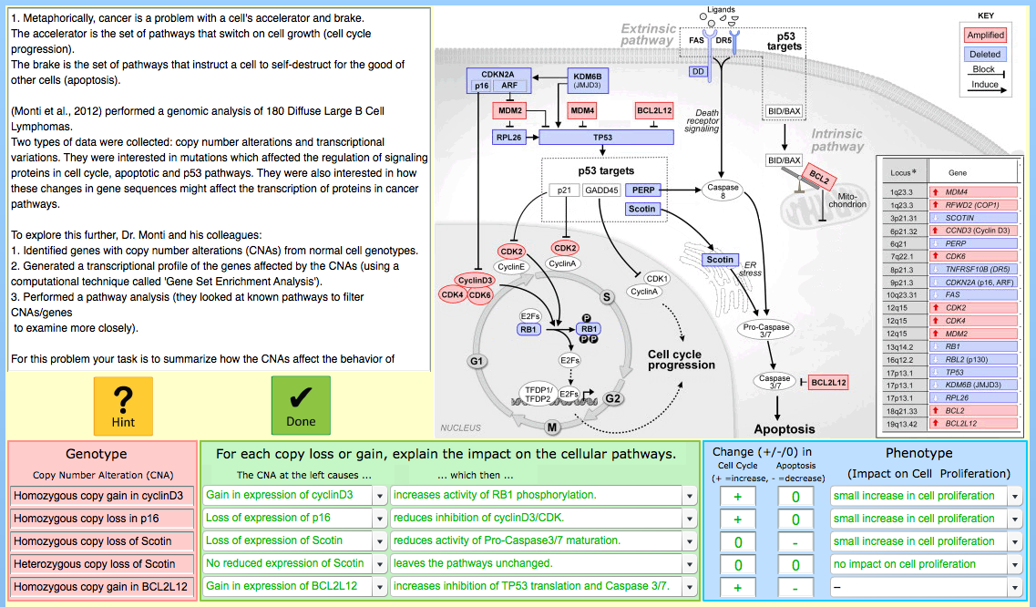
Genetics Tutor built with CTAT
Corbett et al.

Slide 44
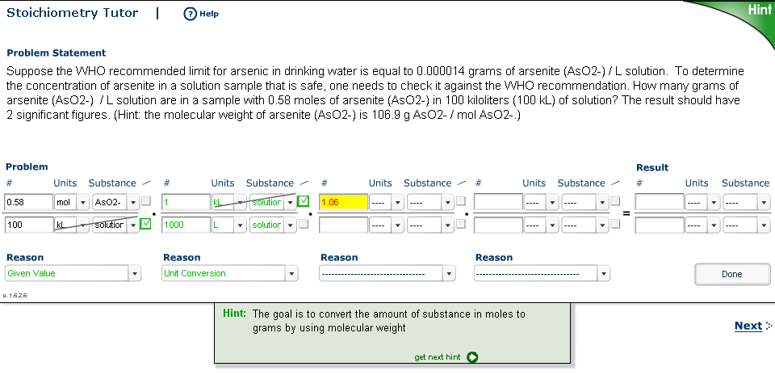
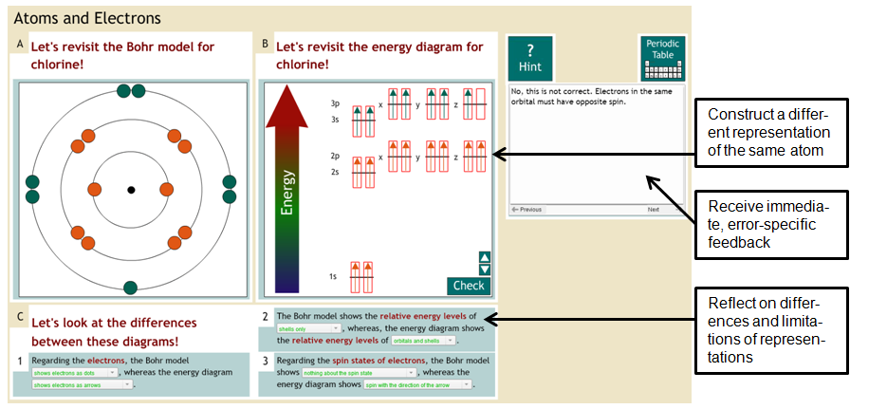
CTAT Tutors for Chemistry
Stoichiometry Tutor
McLaren, Yaron, et al.
ChemTutor
Rau et al.

Slide 45
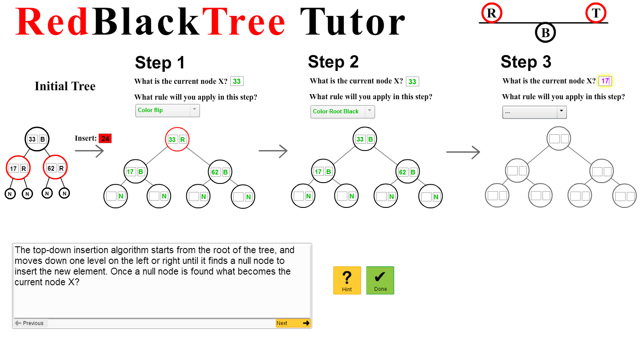
CTAT Tutors for Computer Science
The Tuning Tutor: Parameter fitting in machine learning
Rosé et al.
Tutor for RedBlackTree
data structure
Xhakaj and Liew

Slide 46
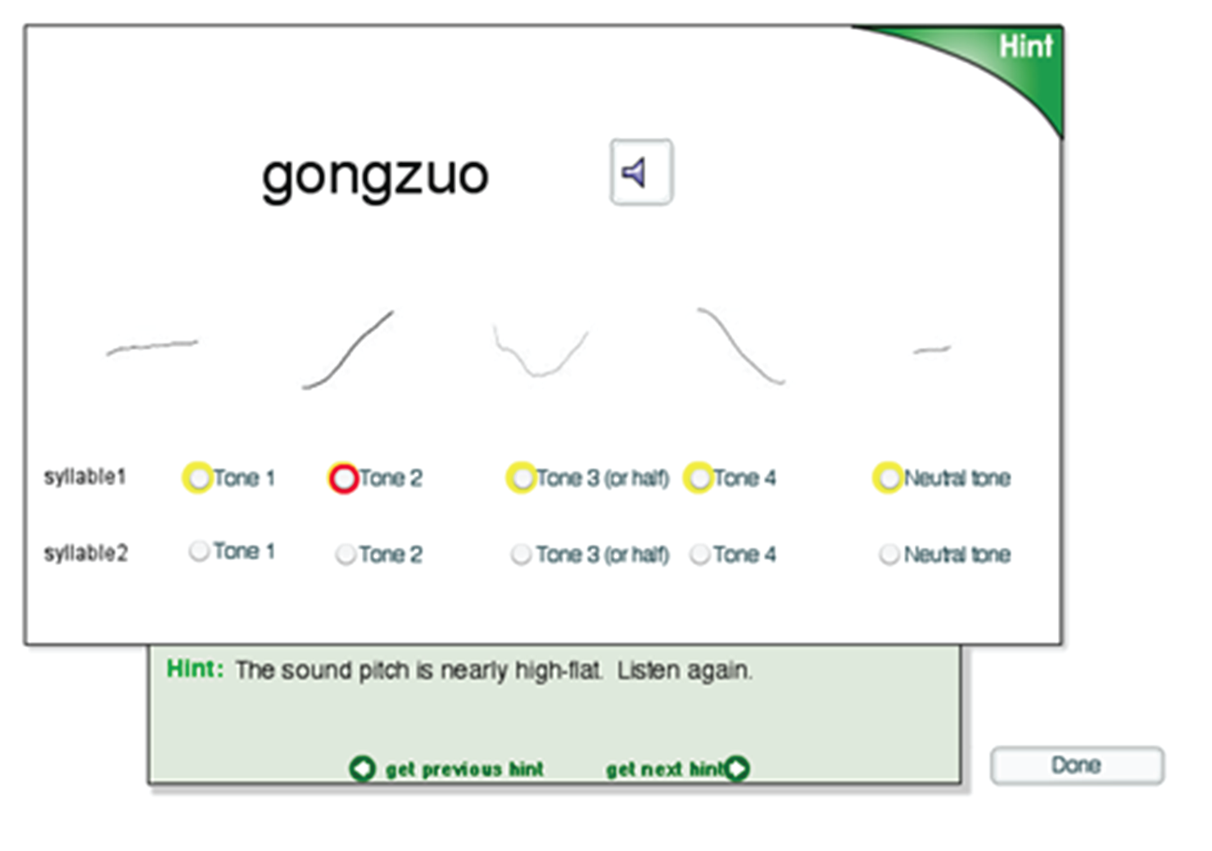
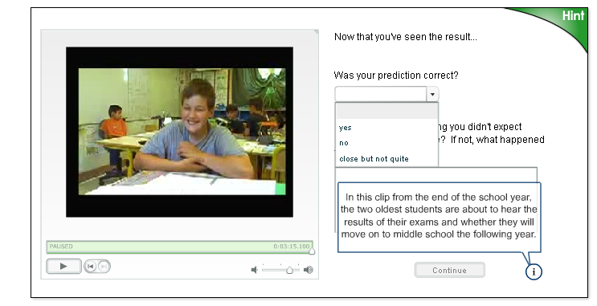
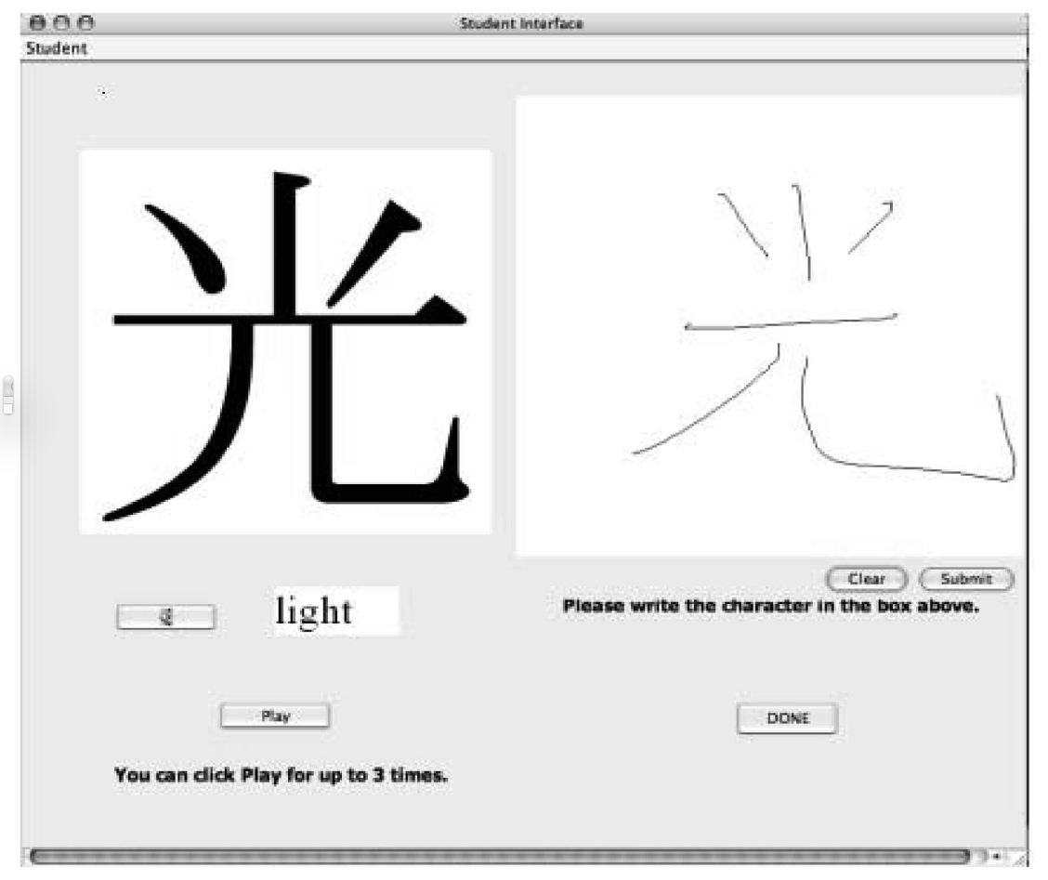
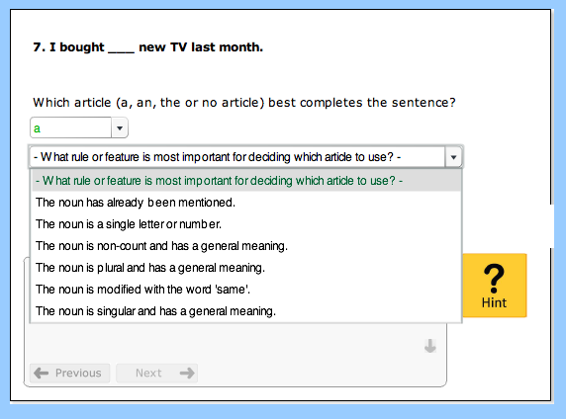
CTAT Tutors For Language Learning
Reading Chinese
Perfetti, Liu, et al.
Intercultural Competence (French)
Ogan, Aleven, & Jones
English Article Tutor
Wylie, Koedinger, & Mitamura
Chinese Writing Tutor
Guan, et al.

Slide 47
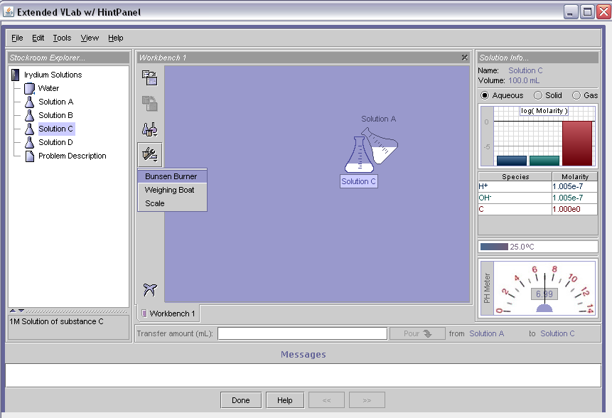
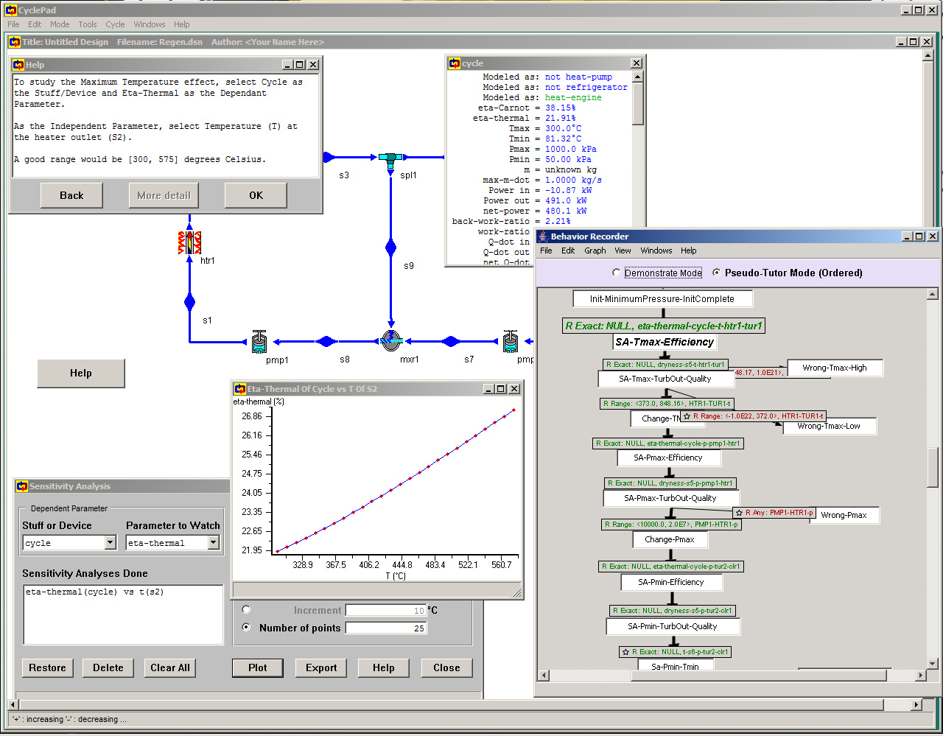
CTAT Tutors for Learning with Simulations
Chemistry Simulator (Vlab)
McLaren, Yaron, et al.
Thermo-dynamics (CyclePad)
Rosé, Aleven, et al.

Slide 48
CTAT Tutors for Business Modeling in Google Sheets
McLaren et al.
Google Sheets

Slide 49
Now, Some Theory!
Based on:
VanLehn, K. (2006). The behavior of tutoring systems. International Journal of Artificial Intelligence in Education, 16(3), 227-265.

Slide 50
The Nested Loops of Conventional Teaching
For each chapter in curriculum
Read chapter
For each exercise, solve it
Teacher gives feedback on all solutions at once
Take a test on chapter

Slide 51
The Nested Loops of CAI
For each chapter in curriculum
Read chapter
For each exercise
  Attempt answer
  Get feedback & hints on answer; try again
  If mastery is reached, exit loop
Take a test on chapter

Slide 52
The Nested Loops of ITSs
For each chapter in curriculum
Read chapter
For each exercise
  For each step in solution
    Student attempts step
    Get feedback & hints on step; try again
  If mastery is reached, exit loop
Take a test on chapter
Outer Loop (Task Loop)
Inner Loop (Step Loop)

Slide 53
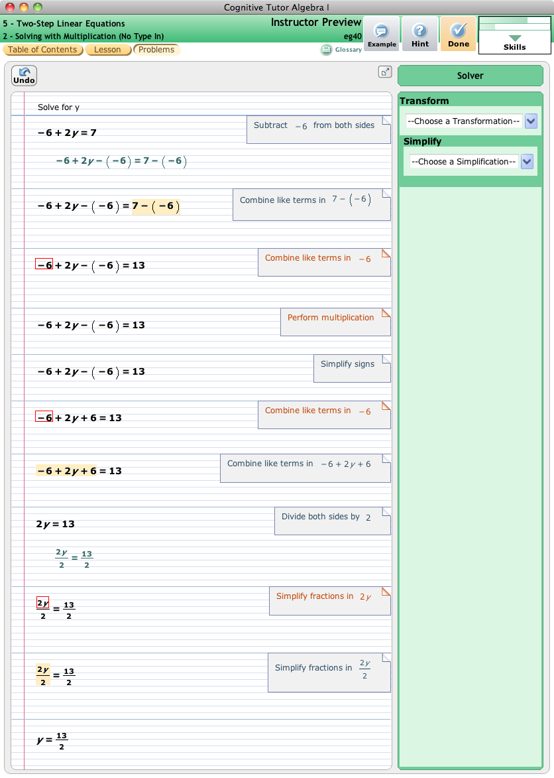
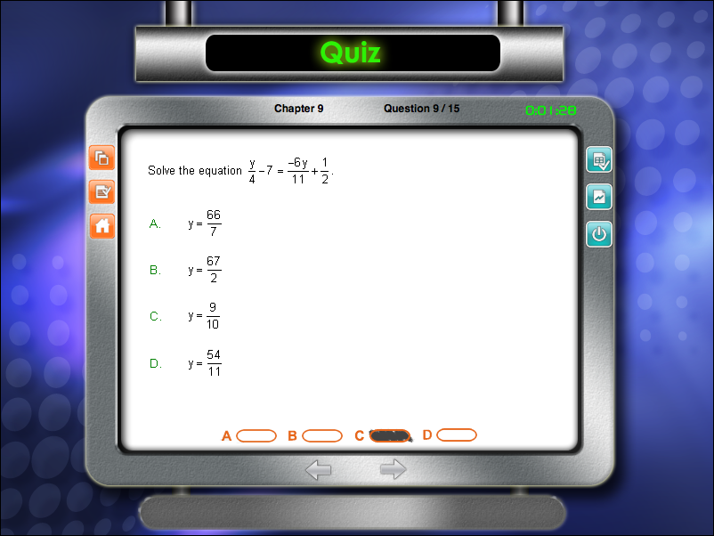
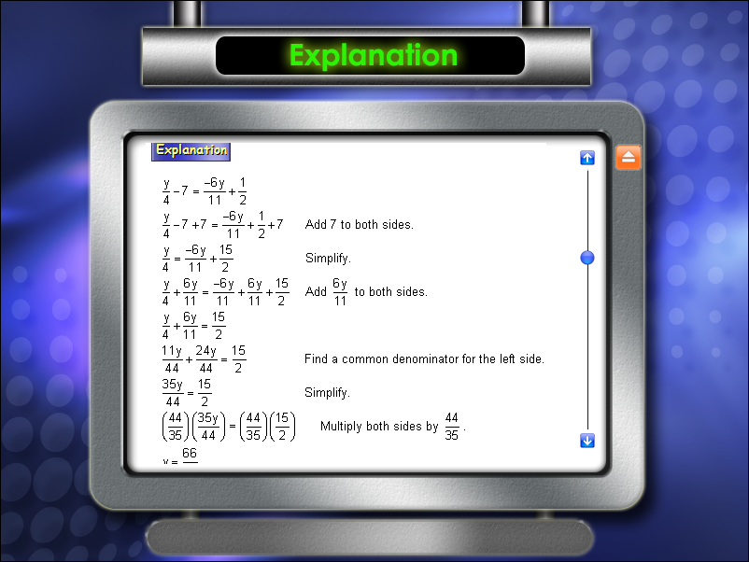
Inner Loop
Step-by-step guidance
Cognitive Tutor Algebra
No Inner Loop
Multiple Choice, End-of-quizz Explanation Math Success 2010

Slide 54
No Inner Loop: Khan Academy
Notes:
No inner loop means the feedback is delayed until the end of the problem and is not as targeted. Student has to figure out where, in a complex problem-solving process, they went wrong. This is very challenging for novices, and could be very time consuming.
Systems with an inner loop provide more support.

Slide 55
Why Are ITS Effective?
Inner Loop
  Step-level feedback and hints enhance learning
  (Anderson, Conrad, & Corbett, 1989)
Outer Loop
  “Cognitive Mastery” enhances learning
  (Corbett, Scarpinatto, & McLaughlin, 2000)
Notes:
Elements are known

Slide 56
Key Points: 1. ITSs and Effectiveness
Learning-by-doing is a key way of learning in online courses
  But they typically do not contain ITSs
ITSs support learning by doing
  Provide guidance with the steps of problems
ITS have been shown to enhance learning in many task domains
Notes:
Support many forms of adaptivity

Slide 57
2. How can ITSs be authored easily?

Slide 58
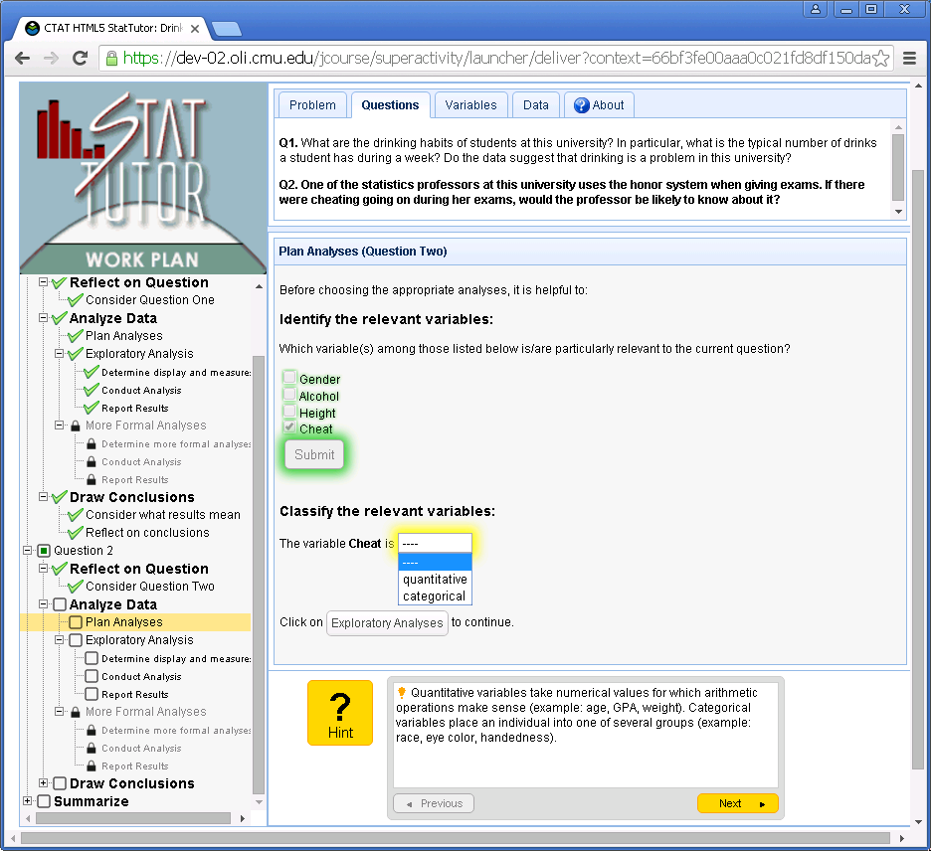
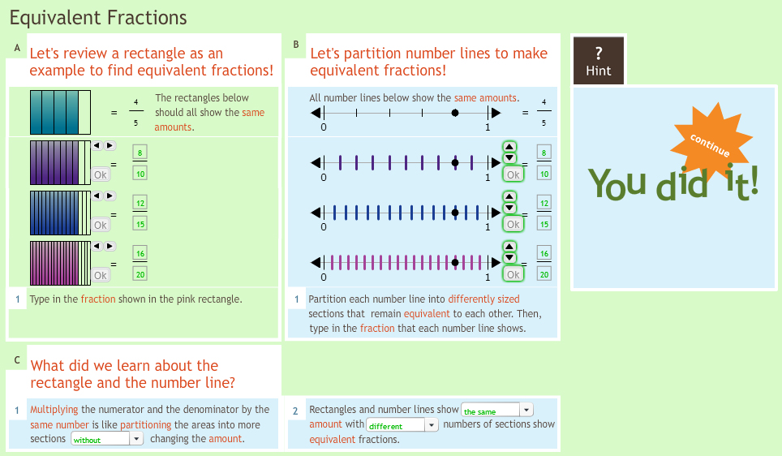
A Need to Build Many Tutors …

Slide 59
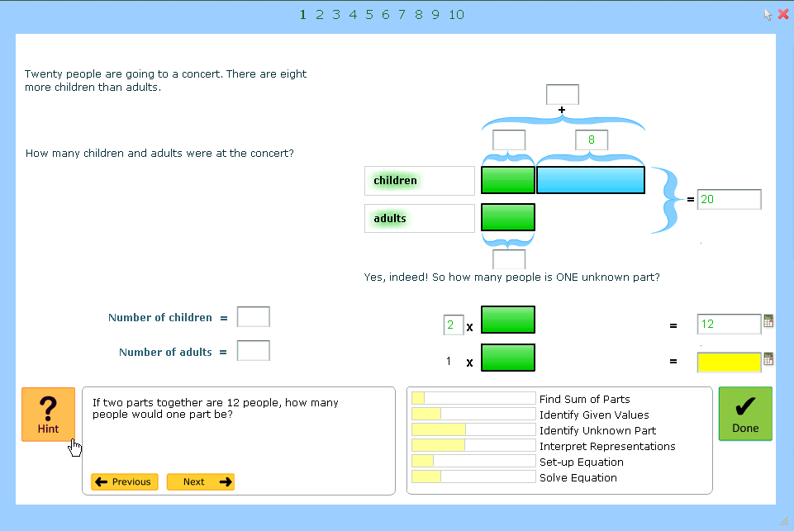
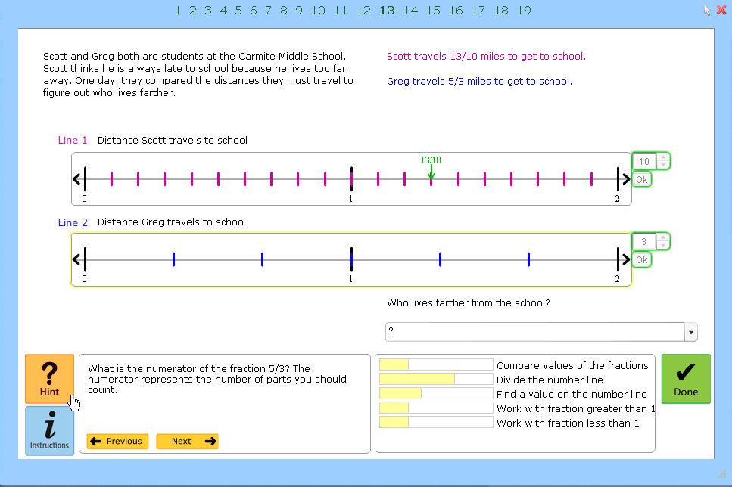
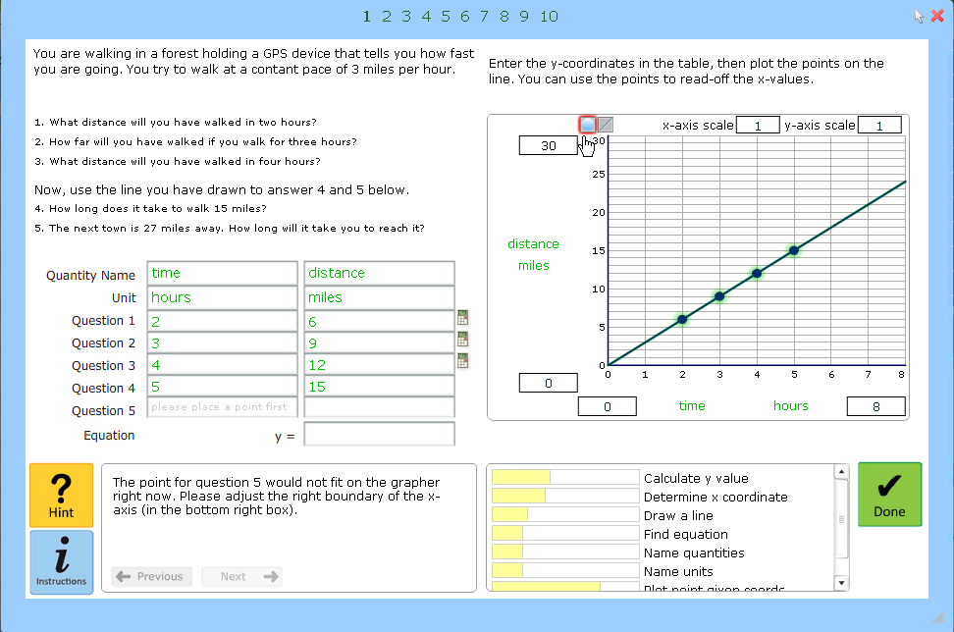
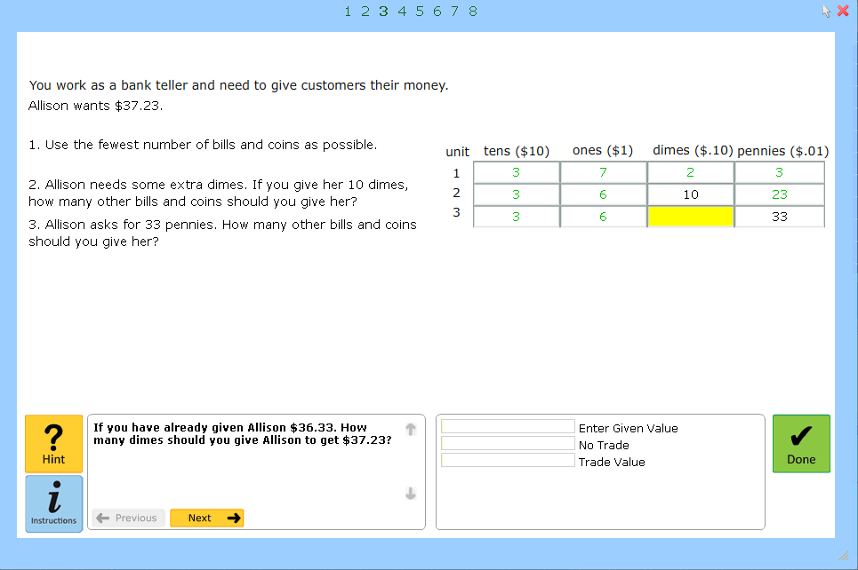
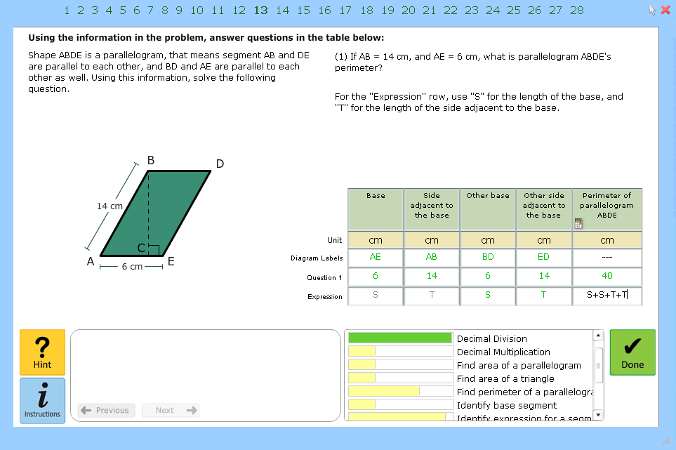
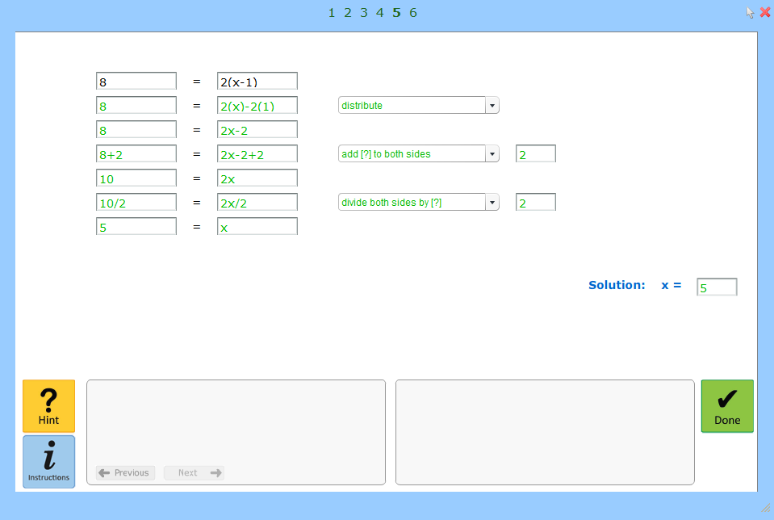
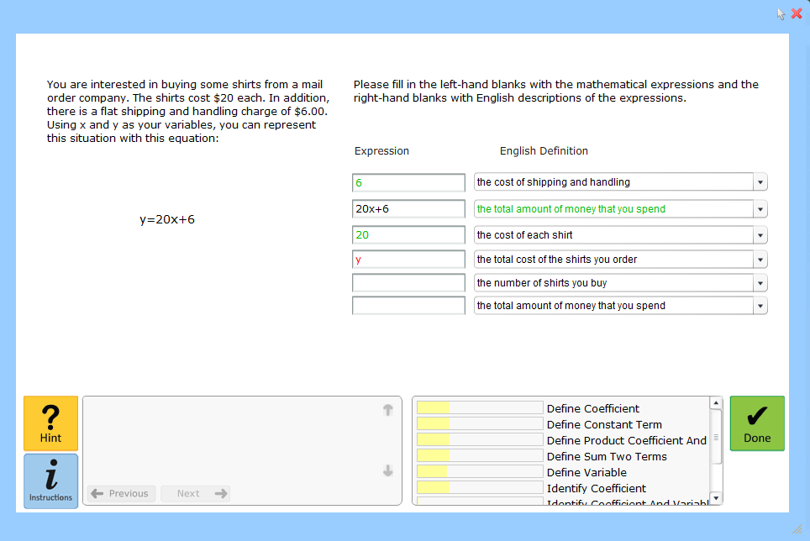
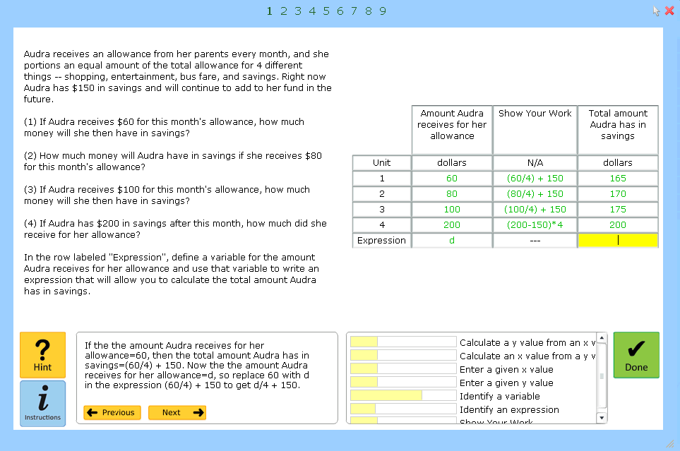

Each Tutor has Many Units – E.g., Mathtutor has 65 units
6.03 Algebra in Pictures
6.20 Fraction Ordering
7.06 Problem Solving, Equations, and Graphs I
6.06 Decimal Place Value I
6.16 Area of Polygons
7.52 Solving Linear Equations with Parentheses
7.02 Mathematical Modeling
7.04 Problem Solving and Linear Equations II
8.26 Interpreting Box-and-Whisker Graphs
Notes:
Support complex problem solving
Each problem type needs to be designed and implemented anew;
Any of these tutors would not be particularly difficult to create (although there are lost of details that you need to take care of to create smooth interactions).
want a process to create them efficiently, and preferably, without having to call on programmers. (Rather, we want tech-savvy instructional designers to be able to build these systems.)
Showing you 9, but Mathtutor has 65 units (and many more could be created)

Slide 60
The Cognitive Tutor Authoring Tools (CTAT)
Tools for building ITSs without programming
Combines end-user programming techniques
  Drag-and-drop interface building, Programming-by-demonstration, templates, Excel-like formulas
Freely available and supported
Notes:
Introduce CTAT as a way of authoring important and arguably sophisticated forms of adaptivity in a relatively simple way
Well, sort of: Working on making it possible to build HTML interfaces through drag-and-drop
Wants this technology to spead
Available for free for research
We host Tutorshop (an LMS for tutors) for researchers
Yearly summer school

Slide 61
Components of a CTAT Tutor
Tutor Interface
Behavior Graph
Specific to each problem type
Makes thinking visible
HTML/CSS/Javascript
Key knowledge representation
Captures problem-solving behavior as example
Can capture multiple solution paths, errors

Slide 62
Example-Tracing Tutors
Example tracing: Use behavior graph to provide tutoring (inner loop)
  Which path(s) is the student following?
  Based on student path
    Provide guidance (feedback and hints)
    Assess which knowledge components were practiced
Bayesian knowledge-tracing: assess individual knowledge (outer loop) (Corbett & Anderson, 1995)
Aleven, V., McLaren, B. M., Sewall, J., van Velsen, M., Popescu, O., Demi, S., . . . Koedinger, K. R. (2016). Example-Tracing tutors: Intelligent tutor development for non-programmers. International Journal of Artificial Intelligence in Education, 26(1), 224-269. doi:10.1007/s40593-015-0088-2
Notes:
How do student actions into the interface map into the behaviors implied by the graph?
Note: Graph is interpreted flexibly – it can stand for a wide range of behavior, not just literally the solution paths in the graph

Slide 63
Authoring a Tutor using CTAT
Create tutor interface
“Record” problem-solving behavior
Generalize behavior graph
Annotate behavior graph
Generate isomorphic problems
None of the steps involve programming!
Notes:
Drag-and-drop interface building or HTML/CSS coding
Programming-by-demonstration
So it stands for a wider range of problem-solving behavior
Attach hints, error messages to links in the graph
Attach knowledge component lables

Slide 64


1. Drag-and-Drop Interface Building
Create tutor interface with dedicated editor

Slide 65
1. Interface Building by Coding

Slide 66
2. Creating a Behavior Graph through “Programming by Demonstration”
Author demonstrates problem-solving behavior in the tutor interface
Behavior Recorder records it
Behavior Graph may eventually have multiple paths

Slide 67
3. Generalize a Behavior Graph
Widen the range of problem-solving behavior it stands for
Formulas can
Specify a range of acceptable student inputs for a given step
Capture dependencies between steps.
Notes:
To provide tutoring, want to attach hints and skill labels
To be flexible, may want to generalize the conditions under which a link matches
May also want to specify the order in which steps need to be done (i.e., more flexible than just the order in which they were recorded in the graph)

Slide 68
4. Annotate a Behavior Graph
Attach hint messages and error feedback messages
Attach “next-step hints” to links in the graph, usually with multiple levels.
Notes:
To provide tutoring, want to attach hints and skill labels
To be flexible, may want to generalize the conditions under which a link matches
May also want to specify the order in which steps need to be done (i.e., more flexible than just the order in which they were recorded in the graph)

Slide 69
4. Annotate a Behavior Graph
Map problem steps to knowledge components so tutor can track individual knowledge growth.
Attach “knowledge component labels” to the links of the graph.
Notes:
To provide tutoring, want to attach hints and skill labels
To be flexible, may want to generalize the conditions under which a link matches
May also want to specify the order in which steps need to be done (i.e., more flexible than just the order in which they were recorded in the graph)

Slide 70

5. Mass Production: template-based tutor authoring using Excel
Behavior Graph
template with
variables inserted
Dialog for merging
spreadsheet values
into template
Spreadsheet with
problem-specific info;
one column per problem

Slide 71
CTAT Use and Effectiveness
Tutor building 4-8 times as cost-effective (Aleven et al., 2009)
Has been used by ~650 authors
Many tutors have been built with CTAT and demonstrated learning gains in classrooms
  18 shown in recent IJAIED paper
CTAT tutors have been used in over 50 research studies
Aleven, V., McLaren, B. M., Sewall, J., van Velsen, M., Popescu, O., Demi, S., . . . Koedinger, K. R. (2016). Example-Tracing tutors: Intelligent tutor development for non-programmers. International Journal of Artificial Intelligence in Education, 26(1), 224-269. doi:10.1007/s40593-015-0088-2

Slide 72
Recent Developments
Made CTAT compatible with e-learning and MOOC platforms
Demonstrated embedding of CTAT tutors in EdX, Moodle, Blackboard, Open Learning Initiative (OLI), and Google Sheets
Would like to exchange much more information between tutor and LMS
Notes:
Conform LTI and SCORM e-learning standards
this we hope, will help the spread of ITS technology for example, it makes it possible to use them in MOOCs and online courses, where they might provide additional learning-by-doing opportunities of a kind that is not current supported very often

Slide 73

CTAT Tutors Used in an edX MOOC

Slide 74
StatTutor

Slide 75
Key Points – 2. Authoring of ITSs
ITSs can be authored without programming, using the Cognitive Tutor Authoring Tools
Could augment MOOCs and online courses
Future
  Make authoring easier through greater use of data
  Extend adaptivity while keeping non-programmer approach
Notes:
Other examples of such tools exist as well

Slide 76

3. Research study: Use of ITS technology to support domain-level learning and self-regulated learning (SRL)
Yanjin Long
Facebook

Slide 77
Self-regulated Learning (SRL)
“SRL is viewed as proactive processes that students use to acquire academic skill, such as setting goals, selecting and deploying strategies, and self-monitoring one’s effectiveness …”
                Zimmerman, 2008
Notes:
Often viewed as encompassing cognition, metacognition, and motivation
Often viewed as a cyclical process

Slide 78

Challenge: Students Are Not Good at Making Problem Selection Decisions
Making problem selection decisions is a critical Self-Regulated Learning (SRL) skill (Metcalfe, 2009)
Children tend to make random problem selection decisions (Metcalfe & Kornell, 2003; Schneider & Lockl, 2002)
Students select problems that they are confident with (Gay, 1986; Bandura, 1994)
Img src: http://www.churchleaders.com/children/childrens-ministry-how-tos/146759-how-to-recognize-kids-with-learning-disabilities.html

Slide 79
Background: Control Over Problem Selection in Learning Technologies
Computer-selected problems lead to better learning outcomes than student-selected problems (Atkinson, 1972; Mitrovic & Martin, 2003)
Granting students control over problem selection may promote higher motivation (Clark & Mayer, 2003)
Shared control over problem selection could lead to comparable learning outcomes with full system control (Corbalan et al., 2008; Long & Aleven, 2013)
Notes:
Check that task selection is hard at the college level!

Slide 80
Open Question
(How) can learning technologies help students to learn to make effective problem selection decisions?

Slide 81
Mastery Rule for Making Effective Problem Selection Decisions
Mastery Rule
Practice each problem type until mastery.
Once a problem type is mastered, stop doing that type of problem.
Notes:
The tutor will give you a choice of problem types – you need to practice each one until you master it, and no further than that

Slide 82



Lynnette – Equation Solving Tutor
Notes:
Built for Research

Slide 83

Pilot Study to Study Problem Selection
Shared Control without Guidance
Shared Control supported by Mastery Information
25 students worked with Lynnette for two class periods
Long, Y., Aman, Z., & Aleven, V. (2015). Motivational design in an intelligent tutoring system that helps students make good task selection decisions. In C. Conati, N. Heffernan, A. Mitrovic, & M. F. Verdejo (Eds.), Proceedings of the 17th International Conference on Artificial Intelligence in Education, AIED 2015 (pp. 226-236). New York: Springer International Publishing. doi:10.1007/978-3-319-197
Notes:
based on Bayesian Student Model

Slide 84
Results: Did Students Follow the Mastery Rule?
Shared Control without Guidance
Shared Control supported by Mastery Information
Violated Rule
Followed Rule
Followed Rule
Difference between conditions: F (1, 23)=7.207, p=.013, d=1.07
Notes:
Shows that presenting analytics about mastery to students helps them make better task selection decisions.

Slide 85
Examples of Students Not Following the Mastery Rule
Student H kept alternating between level 1 and level 2 without trying any of the higher levels.
Student M first tried to select one problem from each level, and then stayed in level 1 for the rest of the time.
Student C selected one problem from level 1, 2, and 3 to start with, and then worked in level 1 for several problems even after reaching mastery
Students often selected some problems from mastered lower levels after trying to solve a higher level problem, even with the presence of the OLM.
Notes:
Generally, students could be viewed as under-challenging themselves. The mastery bars helped, but even with the mastery bars, there was room for improvement.
Could raise the question whether these are actually good strategies?

Slide 86
Research Question
How can we use the ITS’ adaptive mechanism to support the learning of task selection skills?
Motivational support
  Foster a mastery-approach orientation through instructions and messages
Cognitive support
  Support application and learning of the Mastery Rule through feedback, rewards, and reflection

Slide 87

System-controlled Task Selection

Slide 88
System-controlled Task Selection

Slide 89
Shared Control with Cognitive and Motivational Support for Task Selection

Slide 90
Motivational Support: Rewards for Good Task Selection Decisions

Slide 91
Cognitive Support: Explicit Instruction about Task Selection

Slide 92
Cognitive Support: Feedback on Task Selection Decisions

Slide 93
Cognitive Support: Feedback on Task Selection Decisions

Slide 94
Cognitive Support: Reflection on Problem Selections, with Feedback

Slide 95

Objectives in Supporting SRL
Improve future domain learning
After the SRL support has been removed
Improve future
SRL
Improve current domain learning in the supported environment
While the SRL support is in effect
Ido Roll
Improve SRL in the supported environment
Koedinger, K. R., Aleven, V., Roll, I., & Baker, R. (2009). In vivo experiments on whether supporting metacognition in intelligent tutoring systems yields robust learning. In D. J. Hacker, J. Dunlosky, & A. C. Graesser (Eds.), Handbook of metacognition in education (pp. 897-964). The Educational Psychology Series. New York: Routledge.

Slide 96

Procedure
Conditions
System Control
Shared Control with Cognitive and Motivational Support
Conditions
System Control
Shared Control without Support
Pre-Test
10-15 minutes
Learning Phase
4 class periods
Mid-Test and Questionnaire
15-20 minutes
Future Learning Phase
2 class periods
Post-Test
10-15 minutes
After the SRL support has been removed
While the SRL support is in effect

Slide 97
Participants
200 6th - 8th grade students completed all activities

Slide 98
Results
Improve future domain learning
Improve future
SRL
Improve current domain learning in the supported environment
Learning Phase
Improve SRL in the supported environment
Long, Y., & Aleven, V. (2016). Mastery-Oriented shared student/system control over problem selection in a linear equation tutor. In A. Micarelli, J. Stamper, & K. Panourgia (Eds.), Proceedings of the 13th international conference on intelligent tutoring systems, ITS 2016 (pp. 90-100). Springer International Publishing. doi:10.1007/978-3-319-39583-8_9
98
Notes:
Not what we were hoping for, but still

Slide 99
Learning Phase: Summary of Findings
Domain-level learning
  Shared control with support enhances domain learning, over system-controlled problem selection
    d = 0.30 for the whole sample
    d = 0.37 for the lower-performing students
Task selection
  Students with supported shared control applied the Mastery Rule quite consistently
Process measures
  No difference between conditions in number of problems, errors, and hints
  The shared control condition did fewer problem steps
Enjoyment
  No difference between the conditions
Notes:
80% of students never violated the rule

Slide 100

Results
Improve future domain learning
Future Learning Phase
Improve future
SRL
Improve current domain learning in the supported environment
Learning Phase
Improve SRL in the supported environment
Long, Y., & Aleven, V. (2016). Mastery-Oriented shared student/system control over problem selection in a linear equation tutor. In A. Micarelli, J. Stamper, & K. Panourgia (Eds.), Proceedings of the 13th International Conference on Intelligent Tutoring Systems, ITS 2016 (pp. 90-100). Springer International Publishing. doi:10.1007/978-3-319-39583-8_9
100
Notes:
Discuss mechanism here?

Slide 101
Future Learning Phase: Summary of Findings
Domain-level learning
  No difference between the conditions
Task selection
  Students in both conditions shared control applied the Mastery Rule quite consistently

Slide 102

Overview of Results
Improve future domain learning
Future Learning Phase
Improve future
SRL
Improve current domain learning in the supported environment
Learning Phase
Improve SRL in the supported environment
Long, Y., & Aleven, V. (2016). Mastery-Oriented shared student/system control over problem selection in a linear equation tutor. In A. Micarelli, J. Stamper, & K. Panourgia (Eds.), Proceedings of the 13th International Conference on Intelligent Tutoring Systems, ITS 2016 (pp. 90-100). Springer International Publishing. doi:10.1007/978-3-319-39583-8_9
102
Notes:
Not what we were hoping for, but still

Slide 103
Shared Control without Support
Perhaps badges, mastery information provide sufficient support?

Slide 104
Contributions
Practical
  Effective way of giving learners more control in an ITS
Theoretical
  Shows that a combination of cognitive and motivational support for SRL can enhance domain-level learning
Methodological
  Illustrates a way of evaluating effect on future learning of interventions focused on SRL

Slide 105
Key Point
Experiment does not support the value of full student control!
Rather, it demonstrates value of shared control where
  Student picks level, system picks problem
  Student has cognitive support of an open learner model, and motivational support from badges
Notes:
Makes it harder to find a difference

Slide 106
Limitations and Open Questions
Mechanism by which Shared Control with Support enhances learning not fully identified
Impact on future learning not shown
Do task selection skills learned with Lynnette may transfer to other learning environments?
Notes:
what would be a more challenging task selection strategy to focus on in possible future work?
could be due to a ceiling effect in task selection
although many environments offer skill bars or something similar, many do not; this may limit the range of transfer, unless the work for example so students create their own skill bars, based on system feedback (it seems to me there has to be feedback)
With skill bars?
Without?

Slide 107
Overall Conclusions
ITSs provide effective, adaptive, learning-by-doing opportunities
  Adaptive inner loop and adaptive outer loop account for effectiveness
They can be built without programming
  Using dedicated authoring tools: CTAT
Adaptive mechanisms in ITSs can be used to support self-regulated learning (SRL)
  Students learn better when they they have some control over the select their own tasks

Slide 108

http://www.fasttrack.hk/wp-content/uploads/2015/05/THE-INSIDE-TRACK-15.gif

Slide 110
Common ITS Features
Interfaces designed to make thinking steps visible (Anderson, Corbett, Koedinger, & Pelletier, 1995)
Correctness feedback on steps
Feedback messages for commonly-occurring errors
On-demand hints about what to do next at any point
An open learner model that displays the system’s estimates of an individual student’s skill mastery
Individualized problem selection
Notes:
, as an indication of her progress towards her learning goals, and
Background materials such as a Glossary, online textbook, worked examples, etc.

Slide 111

Step-Loop Adaptivity in CTAT (1)
Green = steps entered by the student, with correctness feedback from the system
Gives guidance with the steps of problems, not just with the final answer.
Notes:
I.e., has a step loop.
Comes from having an interface that allows steps and from a behavior graph that records step-by-step solution paths.
Having a step loop at all is important!

Slide 112

Step-Loop Adaptivity in CTAT (2)
Can follow the student along multiple solution paths.
Notes:
Also, makes the hint sensitive to the path the student is following
Example-tracing algorithm tracks which path(s) the student is on; all the author needs to do is provide a graph with relevant solution paths

Slide 113




Step-Loop Adaptivity in CTAT (3)
Tutor’s on-demand hints explain the same solution step in different ways, depending on what prior steps the student has solved so far.
Notes:
Go through hints?
Whether this level of adaptivity is useful is a bit of an open question, but it is possible with this tool, so that makes it easier to investigate that question say in a classroom experiment.
Sid epoint. Bgr not purely a really purely a representation of problem solving. Some pedagogy gets mixed in. Behavior graphs should contain paths that you want the tutor to respond to differently.

Slide 114

Support for Task-Loop Adaptivity in CTAT
Adaptive, individualized task selection, based on students’ knowledge growth
  Cognitive Mastery based on Bayesian Knowledge Tracing (Corbett et al., 2000)
Have begun to support other student models and algorithms
Notes:
Uses KC-based student model
Relies on having a knowledge component model – on having analyzed problem-solving in terms of the underlying knowledge components, and having annotated the behavior graph with knowledge components.

Slide 115
Support for Design Loop Adaptivity
CTAT Tutors Compatible with DataShop
DataShop analysis can be used to improve tutors in the design loop
Koedinger, K. R., Baker, R. S. J. d., Cunningham, K., Skogsholm, A., Leber, B., & Stamper, J. (2010). A data repository for the EDM community: The PSLC datashop. In S. Ventura, C. Romero, M. Pechenizkiy, & R. S. J. d. Baker (Eds.), Handbook of educational data mining (pp. 43–55). Boca Raton, FL: CRC Press.
Notes:
to knowledge, strategies, errors
“Tune” parameters used for modeling student knowledge with BKT
Refine KC models, as illustrated with OLI Stats course

Slide 116

Cognitive Tutor Authoring Tools (CTAT)
Authoring Tools
TEL
research
(e.g., adaptive
learning technologies, ITSs)
Educational
practice
Notes:
How can we make authoring of adaptive learning technologies easy for non-programmers?

Slide 117

Extensible: Hooking Up External Javascript applications
CTAT tutor to teach JavaScript by Tomit Huynh, with the Ace Javascript editor.

Slide 118

Extensible: Building CTAT Components Using Standard Javascript Libraries
Tutor for finite state machines using D3 by Nathan Hahn and Pasan Julsaksrisakul.

Slide 119


Slide 120
Chinese Writing Tutor

Slide 121
English Article Tutor

Slide 122
Learning by Doing

Slide 123

OLI activity – “doing”

Slide 124
“The prototypical feature of a Massive Open Online Course (MOOC) is lecture videos, but many MOOCs also include [interactive] activities such as questions for students to answer or problems for them to solve, in some cases with immediate online feedback.”
First paper: Psychology MOOC
Second paper:
Five courses from four different content areas
“We also provide generalizability evidence across four different courses involving over 12,500 students that the learning effect of doing is about six times greater than that of reading.”
A second open question we explore is whether the doer effect
generalizes across multiple online courses. We do so with data
from four Open Learning Initiative online courses (Concepts in
Computing, Introduction to Biology, Introduction to Psychology,
and Statistical Reasoning)

Slide 125
The "doer effect" is an association between the number of online interactive practice activities students' do and their learning outcomes that is not only statistically reliable but has much higher positive effects than other learning resources, such as watching videos or reading text. Such an association suggests a causal interpretation--more doing yields better learning--which requires randomized experimentation to most rigorously confirm. But such experiments are expensive, and any single experiment in a particular course context does not provide rigorous evidence that the causal link will generalize to other course content. We suggest that analytics of increasingly available online learning data sets can complement experimental efforts by facilitating more widespread evaluation of the generalizability of claims about what learning methods produce better student learning outcomes. We illustrate with analytics that narrow in on a causal interpretation of the doer effect by showing that doing within a course unit predicts learning of that unit content more than doing in units before or after. We also provide generalizability evidence across four different courses involving over 12,500 students that the learning effect of doing is about six times greater than that of reading.

Slide 126


Tutor for Collaborative Learning of Fractions

Slide 127
Lynnette – Equation Solving Tutor
Waalkens,
Long,
Aleven
Notes:
Built for Research

Slide 128

Notes:
Here you see some students use Lynnette

Slide 130

Phases and subprocesses of self-regulation
Zimmerman, B. J. (2008). Investigating self-regulation and motivation: Historical background, methodological developments, and future prospects. American Educational Research Journal, 45(1), 166-183. doi:10.3102/0002831207312909
Notes:
ITS do some of this regulation for students; one the one hand, that’s a good thing, if they do it well; on the other hand, we’d like students to learn to self-regulate

Slide 131
Future: Really Easy Authoring!
Make authoring easier, faster
  Make greater use of data
Extend range of adaptivity
  Plug-and-play of “detectors” of affect, self-regulation
  Authoring of tutoring strategies
Maintain non-programmer approach
Create comprehensive, modular architecture where many tools and modules can be combined to support sophisticated tutoring strategies
  Community effort
Notes:
Make simple things really simple
Extend support for design loop
in the step and task loops

Slide 132

Learning Phase: Shared Control with Support Enhances Domain Learning
System Control
Shared Control with Support
Condition effect: F (1, 192) = 4.486, p=.035, d=.30
Notes:
Talk through slide.

Slide 133

Learning Phase: Shared Control with Support Enhances Domain Learning for Lower-Performing Students
System Control
Shared Control with Support
Learning gains:
F (1, 94) = 13.451, p<.000, d=.76
Condition effect:
F (1, 94) = 3.490, p=.065, d=.37
Notes:
Theoretical justification for this analysis?

Slide 134

Learning Phase: No Difference on Enjoyment Ratings
System Control
Shared Control + Support

Slide 135
Learning Phase: Problem Selection Decisions
Students consistently applied the Mastery Rule
  82 out of 102 students (80%) never violated the Mastery Rule.
  The maximum number of Mastery Rule violations by any given student was 7.
  Students violated the Mastery Rule on 1.4% problems
Notes:
Pertain only to the students in the experimental condition

Slide 136

Learning Phase: Shared Control + support condition enhances declarative knowledge of the Mastery Rule
System Control
Shared Control + Support
F (1, 184) = 8.263, p=.005, d=. 59

Slide 137

Future Learning Phase: No difference in learning gains between the conditions

Slide 138
Future Learning Phase: Both conditions showed good application of the Mastery Rule
 | Percentage of students who consistently applied the Mastery Rule | Percentage of violations of Mastery Rule (mastered problems out of total number of problems)
Shared Control + Support during Learning Phase | 69% | 2.7% (7.8%)
System Control during Learning Phase | 80% | 1.6% (5.1%)
In the Future Learning Phase, both conditions had Shared Control, without cognitive and motivational support for task selection

