Slide 1
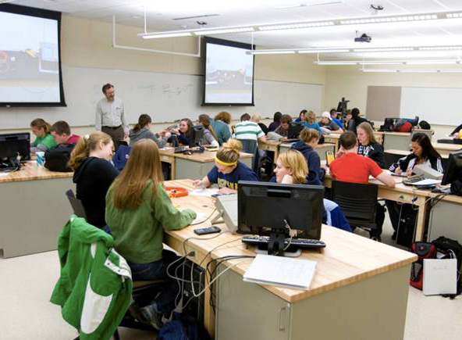


How do I implement innovation
in my courses?
Robert F. Mudde
r.f.mudde@tudelft.nl
- and did it work …...?

Slide 2


Slide 3
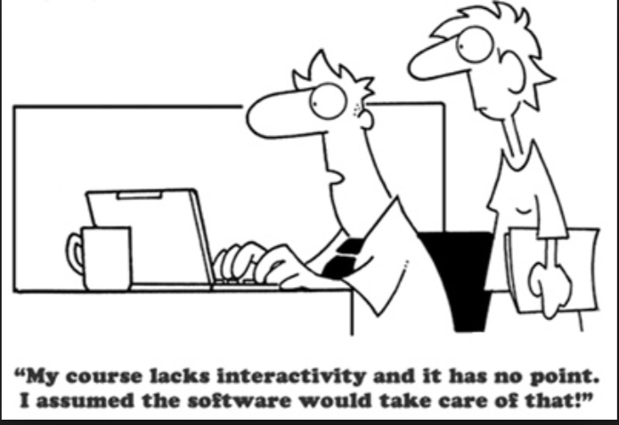


Why a MOOC???
a bit of each….
I (we) wanted to experiment
with blended....

Slide 4
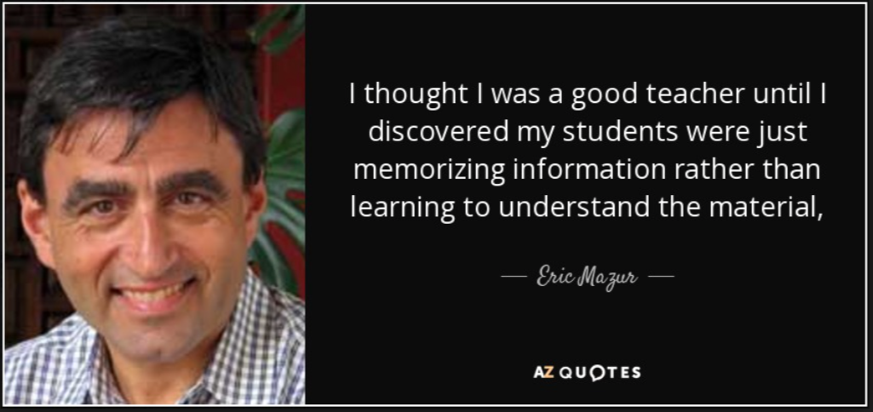
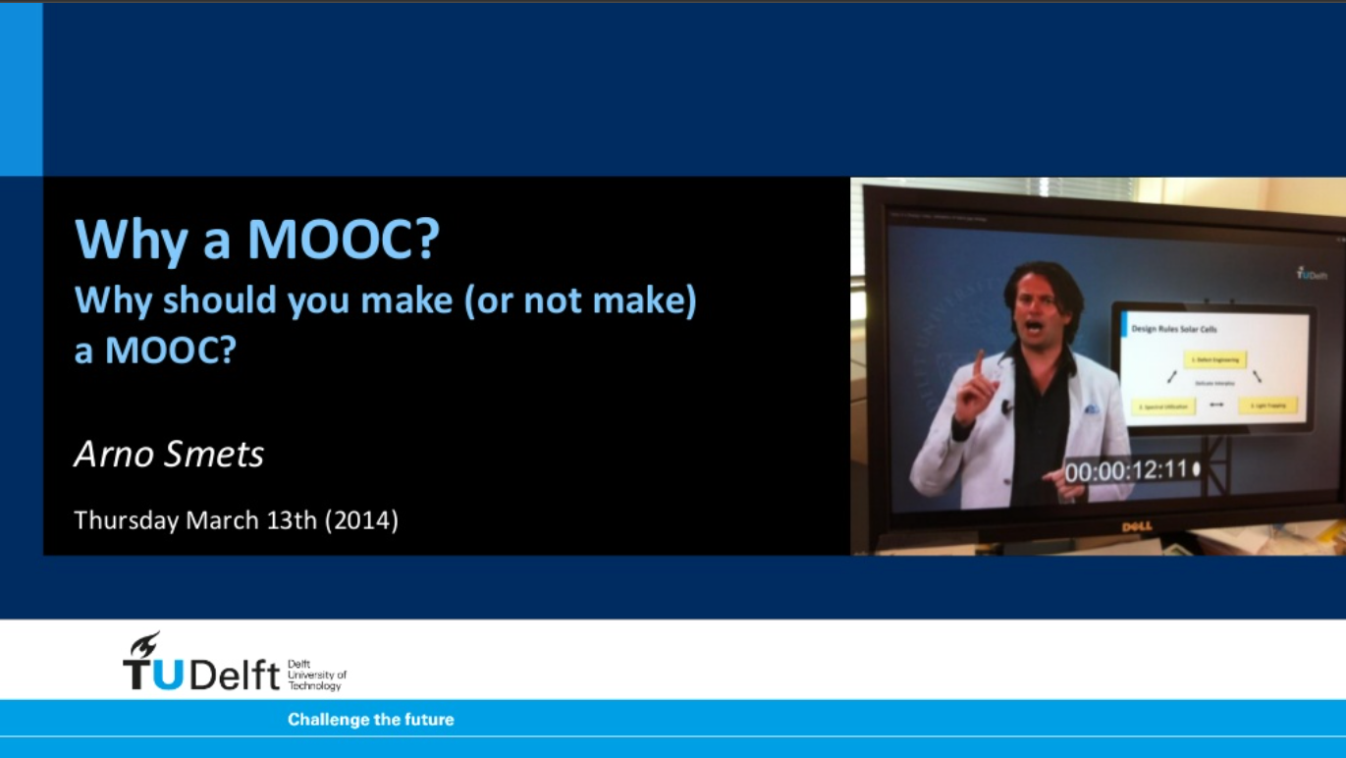
our observations & inspiration
students struggle with the course (Transport Phenomena)
students struggle with the course (Transport Phenomena)
we reached the end of the development curve
students struggle with the course (Transport Phenomena)
we reached the end of the development curve
we noticed that even students that passed had a shallow
  understanding in the long run
we were inspired by Eric
Mazur’s story of flipping
and by Arno Smets’
MOOC-succes
students struggle with the course (Transport Phenomena)
we reached the end of the development curve
we noticed that even students that passed had a shallow
  understanding in the long run

Slide 5
web site
Problem Solving
studio
class room
home work +
bonus
exercise book
70%
better
powerpoints
passing rate
new book
(Dutch & English)
physlets
40%
1990
now
years
Data Compagnion
App
iBook
hand outs

Slide 6


grosso modo: nett result …
student’s perception
time spend
hmm, …
I don’t like
the ratio of
the gradients
years
teacher’s perception
teacher
time spend
student
years

Slide 7
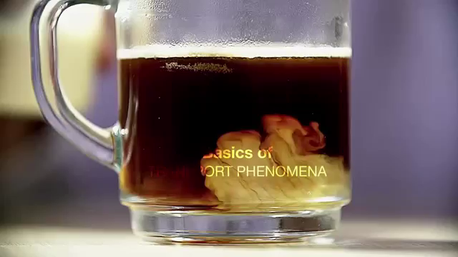
so, we started making our course blended

Slide 8
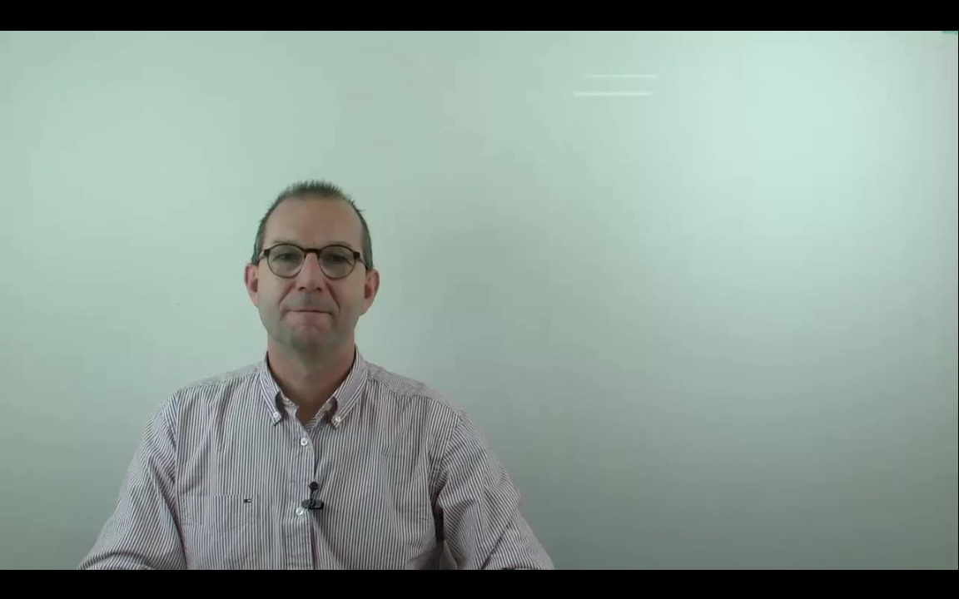
theory video’s
Do It Yourself’s
exercises, tests
glass plate exercise-examples

Slide 9



any
results
from
the
mid term
exam
to
share?
What did we achieve ….
Mister Succes Story
1st half of the course blended
80+ % of student watch the theory video’s prior to class
70+% did exercises & watched glass plate video’s
‘all’ were enthusiastic about material
yes:
passing rate = 42%
lowest since at least a decade
so, two happy teachers

Slide 10
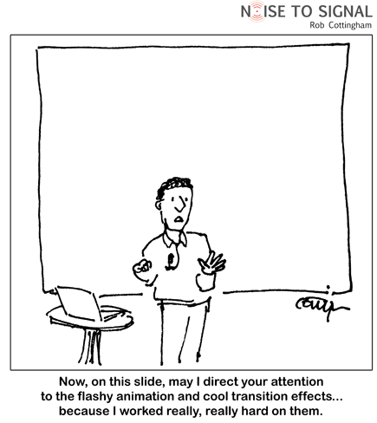


cause of this disaster?
material too good ….
making students
believe they
understood

Slide 11

cause of this disaster?
material too good ….
students don’t study book, prefer power points and movies ....

Slide 12

cause of this disaster?
material too good ….
students don’t study book, prefer power points and movies ....
students interrupt their activities constantly
  short long term memory

Slide 13

cause of this disaster?
material too good ….
students don’t study book, prefer power points and movies ....
students interrupt their activities constantly
  short long term memory
students quickly peek at the answer/solution

Slide 14

remedies ….
Did I make ‘studying’ too easy?
Cut it into too small parts?
watch video1
do exercise a
read §2.1.2
watch video 2
do exercise b
…..

Slide 15

did we loose the pace of the black board?
do the students miss me thinking out loud?
how to focus on concepts, story line?
should students ‘go back’ to reading/studying books?
do we pamper our students too much?

Slide 16


Do we really dare to challange?
Do the students accept a real challange?
We challange your brain,
your ambition and focus
my ideal student ….?

Slide 17
message to our students
“Your education will never be better than your ambition”
message to our teachers
“I can flip the class room, but I can’t flip the student”
“Innovate your teaching”:
it is fun
it revitalizes yourself
it has the potential to lift up our Education

