Slide 1
Exploring edX log traces
Guanliang Chen, Dan Davis, Claudia Hauff, Geert-Jan Houben
Web Information Systems
EEMCS, TU Delft

Slide 2
Outline
Transforming logs into queryable data
Current data-driven research lines
Concrete examples

Slide 3
edX events
Answer questions
Collaborate in forum discussion
Watch video
Profile information
Filling out survey

Slide 4
From raw logs to a data model
Log trace example
{"username": "hayword", "event_type": "play_video", "ip": "94.197.121.149", "agent": "Mozilla", "host": "courses.edx.org", "session": "4b6eed109122babdcd5d2d73b2ff7f93", "event": "{"id":"i4x-DelftX-FP101x-video-5386b7ed6da24715bb4cc2ae75df74b8", "currentTime":503.6000061035156,"code":"uA4J7DQ95cE"}", "event_source": "browser", "context": {"user_id": 123456, "org_id": "DelftX", "course_id": "DelftX/FP101x/3T2014"}, "time": "2014-10-17T19:31:32.542261+00:00"}
user_id | 123456
course_id | DelftX/FP101x/3T2014
video_id | i4x-DelftX-...
.... | ….

Slide 5
From raw logs to a data model
MOOCdb Data Model developed by MIT
http://moocdb.csail.mit.edu/
Observation Mode
Submission Mode
Collaboration Mode
Survey Mode
User Mode

Slide 6
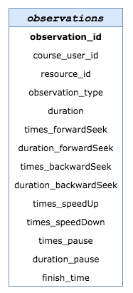
MOOCdb
MOOCdb Data Model
Observation Mode
Submission Mode
Collaboration Mode
Survey Mode
User Mode

Slide 7
MOOCdb
MOOCdb Data Model
Observation Mode
Submission Mode
Collaboration Mode
Survey Mode
User Mode

Slide 8
MOOCdb
MOOCdb Data Model
Observation Mode
Submission Mode
Collaboration Mode
Survey Mode
User Mode

Slide 9
MOOCdb
MOOCdb Data Model
Observation Mode
Submission Mode
Collaboration Mode
Survey Mode
User Mode

Slide 10
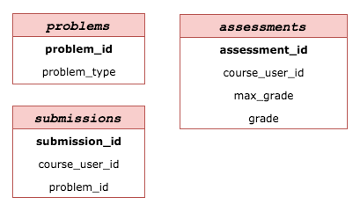
MOOCdb
MOOCdb Data Model
Observation Mode
Submission Mode
Collaboration Mode
Survey Mode
User Mode

Slide 11
MOOCdb
MOOCdb Data Model
Observation Mode
Submission Mode
Collaboration Mode
Survey Mode
User Mode

Slide 12
MOOCdb
MOOCdb Data Model
Observation Mode
Submission Mode
Collaboration Mode
Survey Mode
User Mode

Slide 13
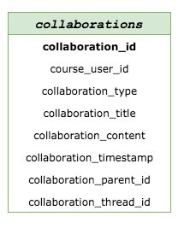
MOOCdb
MOOCdb Data Model
Observation Mode
Submission Mode
Collaboration Mode
Survey Mode
User Mode

Slide 14
MOOCdb
MOOCdb Data Model
Observation Mode
Submission Mode
Collaboration Mode
Survey Mode
User Mode

Slide 15
MOOCdb
MOOCdb Data Model
Observation Mode
Submission Mode
Collaboration Mode
Survey Mode
User Mode

Slide 16
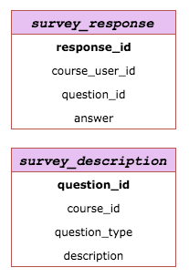
MOOCdb
MOOCdb Data Model
Observation Mode
Submission Mode
Collaboration Mode
Survey Mode
User Mode

Slide 17
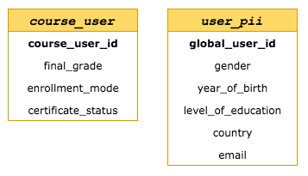
MOOCdb
MOOCdb Data Model
Observation Mode
Submission Mode
Collaboration Mode
Survey Mode
User Mode

Slide 18
MOOCdb
MOOCdb Data Model
Observation Mode
Submission Mode
Collaboration Mode
Survey Mode
User Mode

Slide 19
MOOCdb
MOOCdb Data Model
Observation Mode
Submission Mode
Collaboration Mode
Survey Mode
User Mode

Slide 20
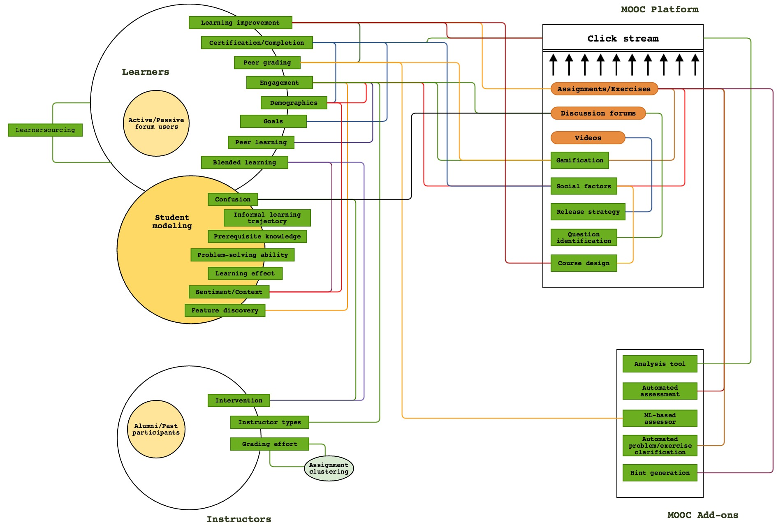
L@S 2015 research lines

Slide 21
L@S 2015 research lines

Slide 22
L@S 2015 research lines

Slide 23
L@S 2015 research lines

Slide 24
L@S 2015 research lines

Slide 25
L@S 2015 research lines

Slide 26
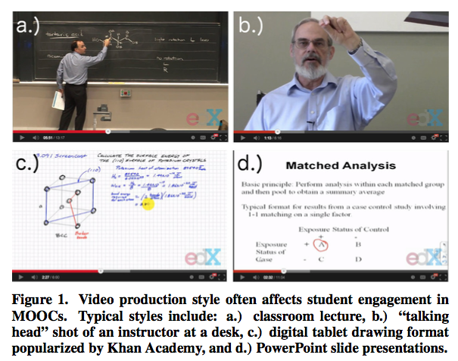
Example I
Guo P J, Kim J, Rubin R. How video production affects student engagement: An empirical study of mooc videos [C] // Proceedings of the first ACM conference on Learning@ scale conference. ACM, 2014: 41-50.
Major findings
Shorter videos are more engaging.
Informal talking-head videos are
more engaging.
Instructors’ speaking rate affects
engagement.
...

Slide 27
Example I
Students’ engagement
Time spent in watching videos
# questions attempted to solve
Video types
Length of the video
Styles of the video
Instructor’s speaking rate
...
A mix approach
Quantitative analysis: correlation analysis & significance analysis
Qualitative analysis: interview

Slide 28
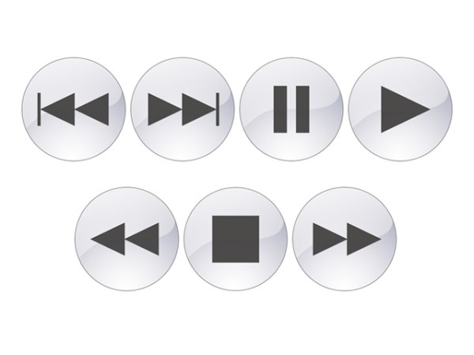
Example II
Li N, Kidzinski L, Jermann P, et al. How Do In-video Interactions Reflect Perceived Video Difficulty? [C] // Proceedings of the European MOOCs Stakeholders Summit 2015. PAU Education, 2015 (EPFL-CONF-207968): 112-121.
Major findings
Higher pause frequency and duration reflect
higher difficulty level.
Less frequent or large amount of replay indicates
higher difficulty level.
...

Slide 29
Example II
Perceived difficulty level of video
Survey
In-video interaction
The frequency and duration of pause
The frequency and duration of replay
The frequency of speed up & down
...
Approach
Regression based method
Significance analysis

Slide 30
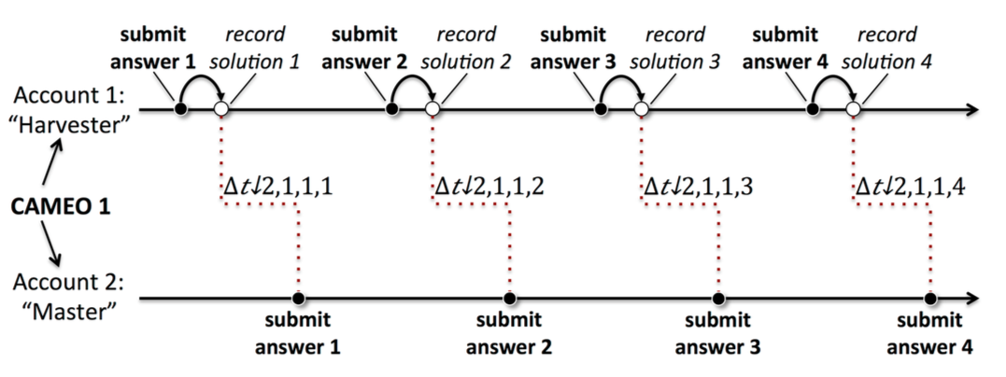
Example III
Northcutt C G, Ho A D, Chuang I L. Detecting and Preventing" Multiple-Account" Cheating in Massive Open Online Courses [J] . arXiv preprint arXiv:1508.05699, 2015.
Major finding
Multiple-Account cheating behaviour accounts for 1.3% of certificates in 69 MOOCs.

Slide 31
Example III
Data being used
Question submission
Time information
IP address
A mixed approach
Bayesian filter
Manually-developed filters

Slide 32
Take-home messages
The edX log traces can be translated into queryable data by adopting the MOOCdb data model developed by MIT.
Most of the existing data-driven research in MOOC are about learners.

Slide 33
The end
Thank you!
Web Information Systems
http://www.wis.ewi.tudelft.nl/projects/learning-analytics/

