Slide 1
The challenge of integrating research activities into a regular educational program
An example of a study on approaches for the teaching of clinical reasoning
Walter van den Broek, Sílvia Mamede
Institute of Medical Education Research Rotterdam

Slide 2
A bit of background
Training of clinical reasoning at ErasmusMC
Current format:

Slide 3
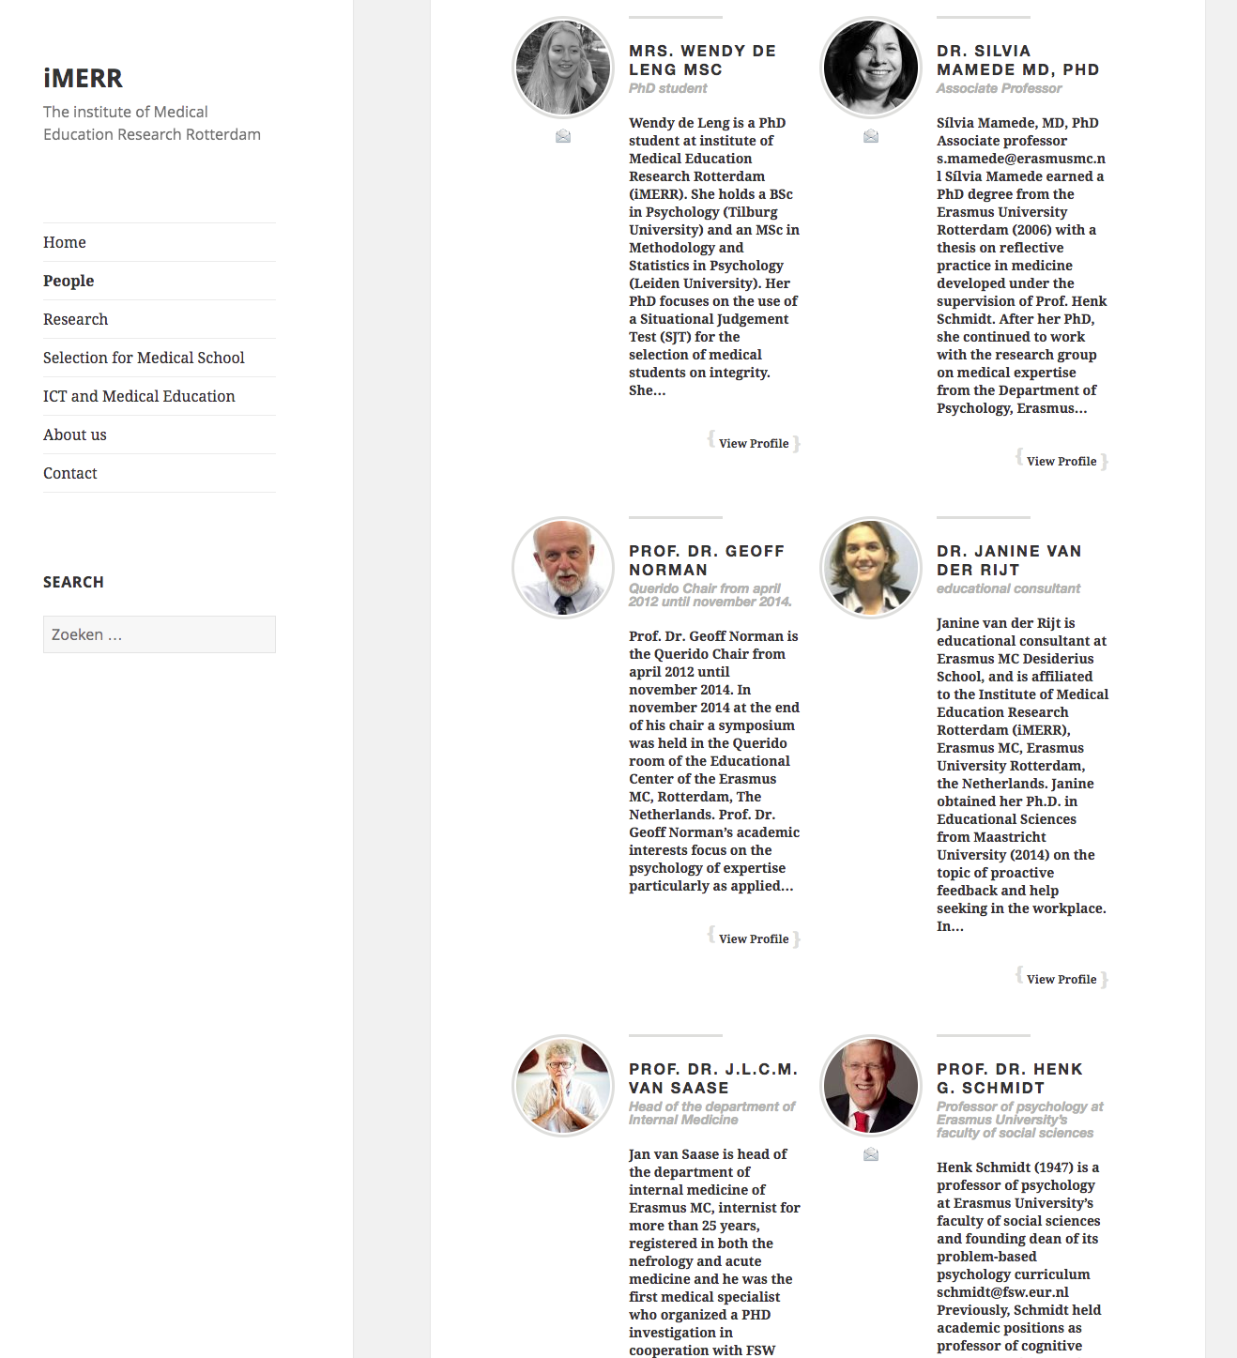

Slide 4
Evidence based medical education

Slide 5
How to teach clinical reasoning: A bit of background
Traditional teaching of clinical reasoning:
Clinical rotations
Drawbacks: limited practice, suboptimal supervision and feedback
Many medical schools: clinical reasoning courses
Notes:
Developing medical students’ clinical reasoning has traditionally been left to clinical rotations
Rotations usually offer limited practice and suboptimal supervision
Medical schools have recently responded by organizing clinical reasoning courses, starting early and going on throughout the years
The clinical reasoning training

Slide 6
A bit of background
Clinical reasoning courses:
Primary learning resource: clinical cases
Different formats of presentation
Most prevalent approach: simulation of a real clinical encounter (“serial-cue”)
(Schmidt & Mamede, 2015)
Notes:
Serial-cue approach
Simulates a real clinical encounter, in which students:
are provided with a few findings (patient’s present complaints)
are requested to say which additional information they need to arrive at a diagnosis
progress step-by-step, from history taking to ordering diagnostic tests, and case information is progressively unfolded

Slide 7
The patient is an obese 56-year-old woman, mother of four children, without co-morbidities. She presents with a cough of one-week duration initially with green expectoration that became yellowish in the last days.

Slide 8
The patient is an obese 56-year-old woman, mother of four children, without co-morbidities. She presents with a cough of one-week duration initially with green expectoration that became yellowish in the last days.
Which diagnostic hypotheses come to your mind?

Slide 9
The patient is an obese 56-year-old woman, mother of four children, without co-morbidities. She presents with a cough of one-week duration initially with green expectoration that became yellowish in the last days.
Which diagnostic hypotheses come to your mind?
Flu
Community-acquired pneumonia
Foreign body aspiration

Slide 10
The patient is an obese 56-year-old woman, mother of four children, without co-morbidities. She presents with a cough of one-week duration initially with green expectoration that became yellowish in the last days.
Which diagnostic hypotheses come to your mind?
Flu
Community-acquired pneumonia
Foreign body aspiration
What else would you like to know (and why)?

Slide 11
The patient is an obese 56-year-old woman, mother of four children, without co-morbidities. She presents with a cough of one-week duration initially with green expectoration that became yellowish in the last days.
Which diagnostic hypotheses come to your mind?
Flu
Community-acquired pneumonia
Foreign body aspiration
What else would you like to know (and why)?
Fever?
Malaise?
Wheezing?

Slide 12
Why serial-cue may not be better
Medical expertise development: stages theory
Notes:
Students progress through stages, each one characterized by differents ways in which knoweldge is organised in mind and applied to solve problems. In initial years: netwrks of concepts linking symptoms to their causal mechanisms. As they progress in their training, the concepts in these networks becomes ‘encapsulated’ in broader models that explain, labels that explain a chain of events, of faults in a body system that leads to a clinical presentations. Finaly, as students start toapply this knoweldge to solve clinical problems, a new change takes places. Scripts of disease, mental representations of typical patients with the diseases, with its symptoms and symptoms, itheconditions that enable the disease

Slide 13
Why serial-cue may not be better
Medical expertise development: stages theory
Other approaches have been empirically investigated:
Self-explanation
Structured reflection
Notes:
Two approaches are oriented towards knowledge acquisition and restructuring though different types of knowledge.

Slide 14
Self-explanation
Notes:
Self-explanation is a technique that has been successfully employed in education in other domains (Chi 1994)
It consists of having students explaining to themselves (out loud) to-be-learned materials presented to them.
SE fosters knowledge elaboration, organization and integration, which leads to revision of mental representations (Chi 2000)

Slide 15
Students (8th grade) generating self-explanations while reading a text on the circulatory system
Fragment of the to-be-learned material:
“The septum divides the heart lengthwise into two sides. The right side pumps blood to the lungs, and the left side pumps blood to the other parts of the body”
Fragment of a student’s self-explanation:
So the septum is like a wall that divides the heart into two parts…it kind of like separates it so that the blood doesn’t get mixed up…”.
(Chi 1994)

Slide 16
Self-explanation in medical education
While diagnosing clinical cases, students read the case and explain to themselves:
how the clinical findings could have been produced
how these signs and symptoms relate to each other
how they relate to the possible diagnoses
(Chamberland et al., 2011; 2013; 2015):

Slide 17
A 70-year-old woman presents with progressive jaundice. The patient presents a gradual yellow discoloration of her skin over three weeks with nausea. She noticed that her urine has become dark.. She has no abdominal pain other than vague epigastric discomfort and nausea. She reports no diarrhea and her stools are normal. She had low grade fever and is complaining of joint pain over the last week…

Slide 18
A 70-year-old woman presents with progressive jaundice. The patient presents a gradual yellow discoloration of her skin over three weeks with nausea. She noticed that her urine has become dark.. She has no abdominal pain other than vague epigastric discomfort and nausea. She reports no diarrhea and her stools are normal. She had low grade fever and is complaining of joint pain over the last week…
A 70-year-old woman presents with progressive jaundice. The patient presents a gradual yellow discoloration of her skin over three weeks with nausea. She noticed that her urine has become dark. It might be because there is more bilirubine in the urine. She has no abdominal pain other than vague epigastric discomfort and nausea. Well, that doesn’t sound very specific…might be related to the liver? She reports no diarrhea and her stools are normal. I remember, sometimes in jaundice, the stools become more pale… in fact when there is no bilirubine …when there is like an obstruction in the biliary track. So it might not be the case here. She had low grade fever and is complaining of joint pain over the last week. Joint pain?...I don’t actually see how this might be related to the problem…
Notes:
A series of studies with 3rd-year students have shown that students who SE during a learning phase in which they solve clinical cases perform better when diagnosing new cases in a test than studenst who only gave DD

Slide 19
Structured Reflection
Notes:
Deliberate reflection has been developed in medical education. focus on increasing students’ ability to distinguish between diseases that share similar clinical presentations – look alike but are in fact different
It consists of having students practicing with clinical cases that portray patients whose presentations look alike by comparing and contrasting the clinical findings of the alternative diagnoses for each case

Slide 20
Structured Reflection
Instructions to participants:
Read the case and provide a diagnostic hypothesis
Which signs and symptoms support your diagnostic hypothesis (Dx)? List them.
Which signs and symptoms do not support your Dx? List them.
Which findings should have been there if your Dx is correct and are not? List them.
Is there an alternative Dx? Write it down and start over.
Now, what is your decision on the most likely diagnosis?
(Mamede et al, 2012; 2014)
Notes:
Deliberate reflection has been developed in medical education. focus on increasing students’ ability to distinguish between diseases that share similar clinical presentations – look alike but are in fact different
It consists of having students practicing with clinical cases that portray patients whose presentations look alike by comparing and contrasting the clinical findings of the alternative diagnoses for each case

Slide 21
A 48-year-old man, previously healthy, presented to the emergency department after a sudden episode of cough, dyspnea, and a sensation of “chest tightness” that happened while he was climbing the stairs in his apartment. The patient reports two similar episodes during the last month, one when he was cutting threes in the garden and the other while he was repairing a sport court. In all occasions, the symptoms stopped spontaneously in a few hours, without any other intervention besides resting. Between the episodes, the patient felt well, without noticing restrictions to physical exercises.
He smoked 30 cigarretes per day during around 20 years, but stoped completely 3 years ago. He does not use any medication and there is no hystory of allergy. Family history: His father died due to myocardial infarction when he was 60.
Physical examination:
BP: 120/80mmHg Pulse: 90 bpm Temp:36,50ºC Respiratory: 20rpm
Patient appeared healthy but in respiratory distress. Jugular veins: no abnormalities. Heart: auscultation without abnormalities. Lungs: bilateral ronchi and whezees. No other abnormalities in the physicial examination.
Laboratory data:
Ht: 45%; Leukocytes: 13,5 x 10⁹/L, 82% neutrophils, 11% lymphocytes, 5% monocytes, 2% eosinophyl. Electrolytes, ureum, kreatinine, glucose: values within normal range. Blood gases (patient breathing environmental air) - pO2: 6,9 kPa, pCO2: 4,6 kPa, pH: 7.44.
ECG: without abnormalities except non-specific alterations in the ST-segment and T waves.
Blood gases in a subsequent measurement (patient breathing environmental air), after em nova mensuração, after symptoms remission - pO2: 13,5 kPa, pCO2: 4.3 kPa, pH: 7.41.
X-Ray: Thorax: normal cardiac area, clear lung fields. No signs of congestive cardiac insufficiency.

Slide 22
Notes:
Studies with 4th-year medical students have shown that deliberate reflection while practicing with clinical cases foster diagnostic performance relative to more conventional approaches such as providing DD

Slide 23
Summing up
serial-cue is the most prevalent teaching approach
it does not seem consistent with how clinical reasoning is learned
the scarce empirical research available has investigated (and supported) other approaches

Slide 24
Studies on approaches for teaching clinical reasoning
Purpose: To compare the effectiveness of three different teaching approaches (self-explanation, structured reflection, serial-cue) in different phases
Design: two-phase experiment, with a learning phase and a one-week later test phase
Using sessions of the regular curriculum

Slide 25
(385 2nd-year medical students)
Week 1
Learning phase
Differential diagnosis
(89)
Serial-cue
(74)
Self-explanation
(85)
Structured reflection
(76)
Week 3
Test phase
Diagnostic test
(324)

Slide 26
Assessment of prior knowledge and clinical experience
(385 2nd-year medical students)
Week 1
Learning phase
Differential diagnosis
Serial-cue
Self-explanation
Structured reflection
Week 3
Test phase
Diagnostic test
(324)

Slide 27
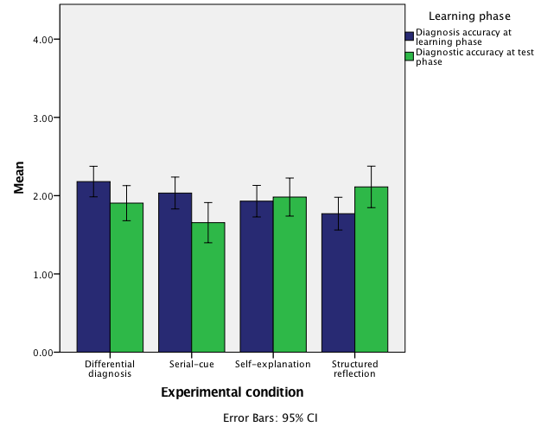
Final diagnostic accuracy score (N = 324)

Slide 28
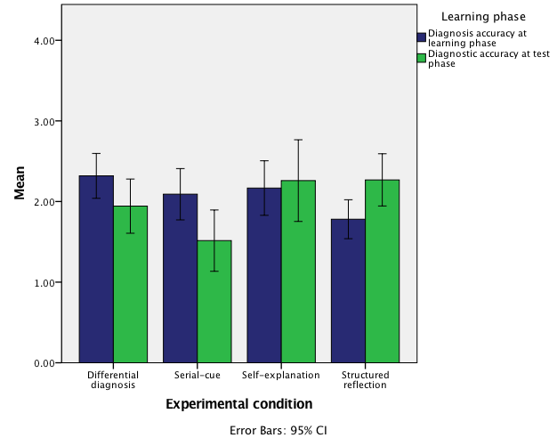
Final diagnostic accuracy score (N = 145)
Notes:
Only participants who indicated at least 1 alternative hypotheses (complied minimally with the treatment) and spent 7 minutes per case (mean in previous studies)

Slide 29
Influencing factors
Initial competence
Participants’ perceptions of the study
Unusual format, deviating from familiar tasks
Different environment
Teachers unaware of the study
Insufficient previous information
Participants’ different reactions

Slide 30
Influencing factors
Compliance with treatment:
Time on task in the learning phase:
Previous studies*: 7 min
Self-explanation: 27/85; Reflection: 41/76
Amount of reflection (preliminary analysis)
*Chamberland et al., 2011; Mamede et al. 2012, 2014

Slide 31
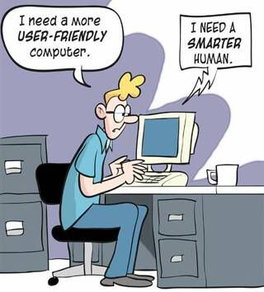
Notes:
Our question
How to match requirements of high-quality research and teaching demands?

