Slide 1
Goal-Setting Assistance Bot
Goal Setting and Chatbots and Learning Analytics, oh my!
Gabrielle Martins Van Jaarsveld
Write your message

Slide 2
Todays Presentation
11:25 AM
12:45 PM
1
Designing our chatbot
Developing our chatbot
2
What is goal setting and why is it important in higher education?
How do you develop a chatbot to support goal setting?
14:32 PM
12:45 PM
3
Deploying & testing our chatbot
Let’s talk about learning analytics
4
How do we use the chatbot, and what are its effects?
How can learning analytics be used to support this chatbot?
Write your message

Slide 3
1
Self-Regulated Learning and Goal Setting
Write your message

Slide 4
Digitalization in Education
Write your message

Slide 5
Digitalization in Education
Write your message

Slide 6
What is Self-Regulated Learning
Forethought Phase:
Goal Setting & Planning
Performance Phase:
Action & Self-monitoring
Reflection Phase:
Self-reflection & Adaptation
Write your message

Slide 7
The Importance of Goal Setting in SRL
Drives the self-regulated learning cycle by increasing goal directed behaviours
Is a powerful method of bringing about behavioural change
Prior studies have shown that when designed and implemented properly, goal setting interventions can have significant positive effects on academic performance
However, there is very little research on how to design effective goal setting tools, and how to use technology and data to support them
11:25 AM
Write your message

Slide 8
Why a Goal Setting Chatbot?
Prior study found that a goal setting intervention was more effective when delivered by an experimenter than when given via a pen and paper version (Wang et al., 2021)
Difficulties scaling any intervention that relies on experimenter delivery
1
Not every student needs the same kind of support when setting goals, instead the needs of students differ based on their individual characteristics
Chatbot allows for personalized and adaptive intervention
2

Slide 9
The Benefits of a Goal Setting Chatbot
1
3
Goal Setting Quality
Personalized and Adaptive
Scaffold a better goal setting process and develop better goal setting skills.
Allows for the personalization of the goal setting support to meet individual needs.
2
4
Student Engagement
Scalable and Flexible
Increase student interaction with the tool by making it more engaging.
Easily scalable for larger groups and adjustable to meet the needs of additional and unique populations.

Slide 10
What Does a Goal Setting Chatbot Look Like?
Goal Setting
Gives prompts which guide students through the process of setting effective study goals
Goal Reflection
After a week, prompts students to reflect on whether they feel they have attained the goal they set
Goal Feedback
Gives feedback on the quality of their previous goal, and tips for setting a more effective goal next time

Slide 11
What Does an Effective Goal Look Like?
S | M | I | P
Specific | Measurable | Important | Multisource Plan
Gives concrete details about what should be achieved | Should be able to measure their progress and achievement of the goal | Goal should have personal relevance, and the importance should be explicitly mentioned | Includes a plan with multiple steps, regarding how the goal can be achieved

Slide 12
2
Developing a Chatbot
Write your message

Slide 13
Question for the Audience
How many of you have technical backgrounds, or backgrounds in computer science?

Slide 14
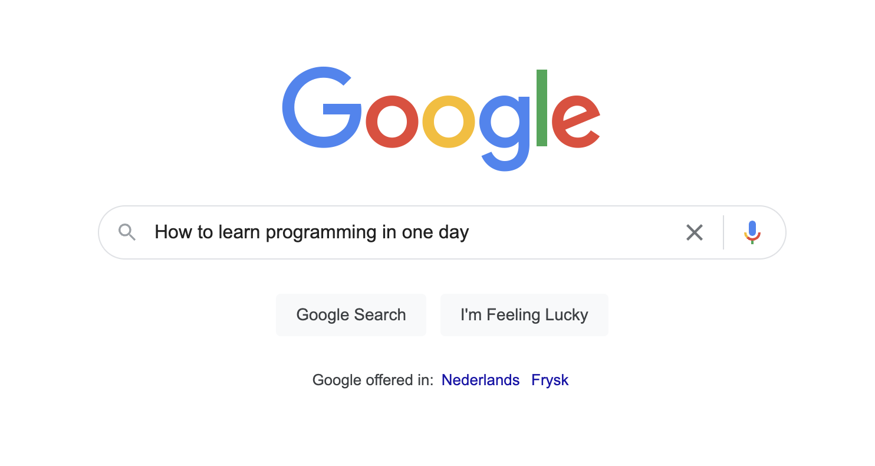
A Little Info About My Background

Slide 15
Different Kinds of Chatbots
9:22 AM
12:20 PM
Text-Based Chatbots
Voice-Based Chatbots

Slide 16
Different Kinds of Chatbots
9:22 AM
12:20 PM
Rule-Based Chatbots
AI (generative) Chatbots

Slide 17
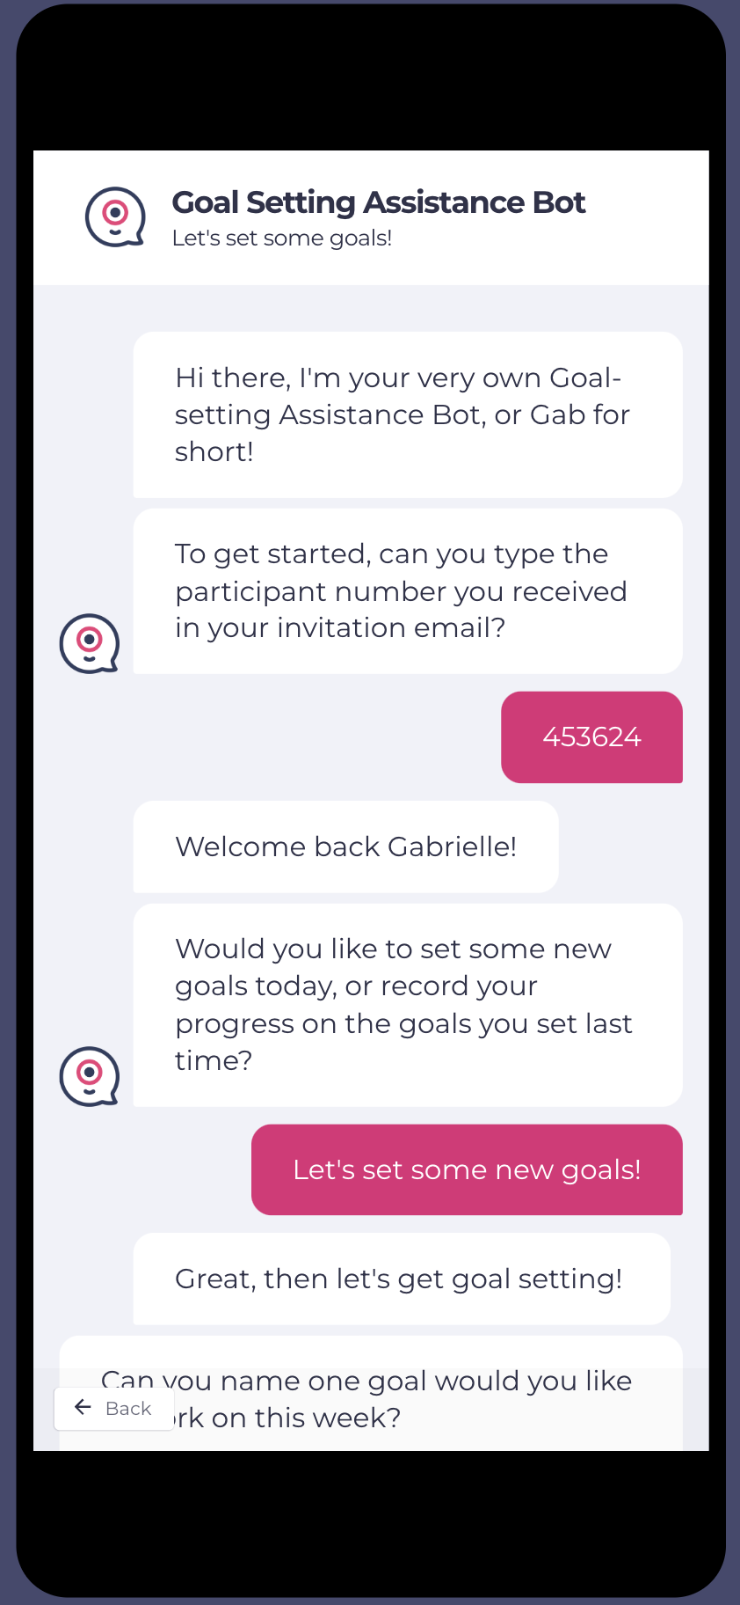
Meet The Goal-Setting Assistance Bot
Text based chatbot which can be accessed from any device’s browser
A rule-based chatbot which also employs some Natural Language Processing (NLP)
  NLP: Ability for the chatbot to process what a user says, correctly interpret what they mean, and respond according
Task Oriented Chatbot, with the aim of helping students set and reflect on academic goals across multiple different sessions

Slide 18

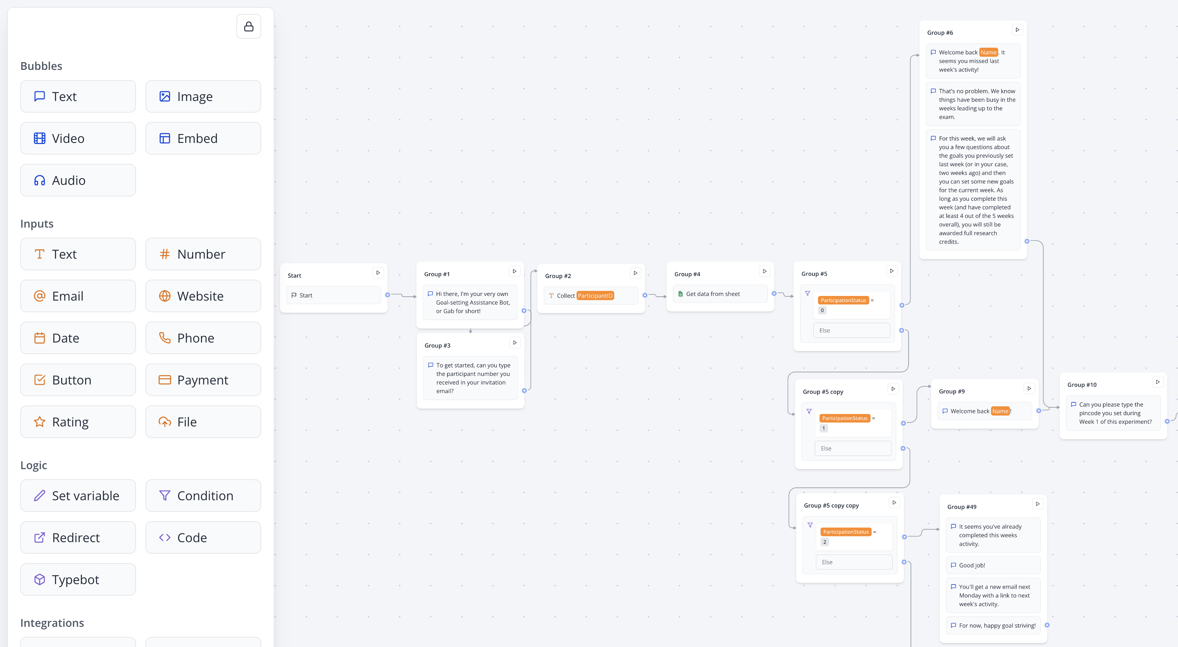
The Basics: A Chabot Framework for Non-Technical Researchers

Slide 19
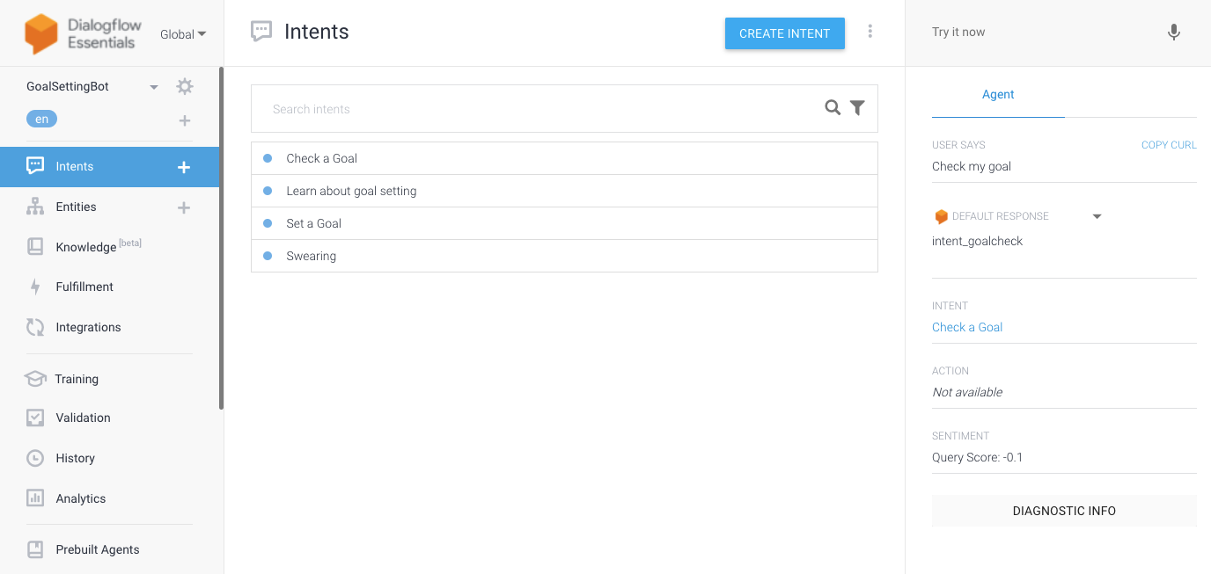
Natural Language Processing

Slide 20
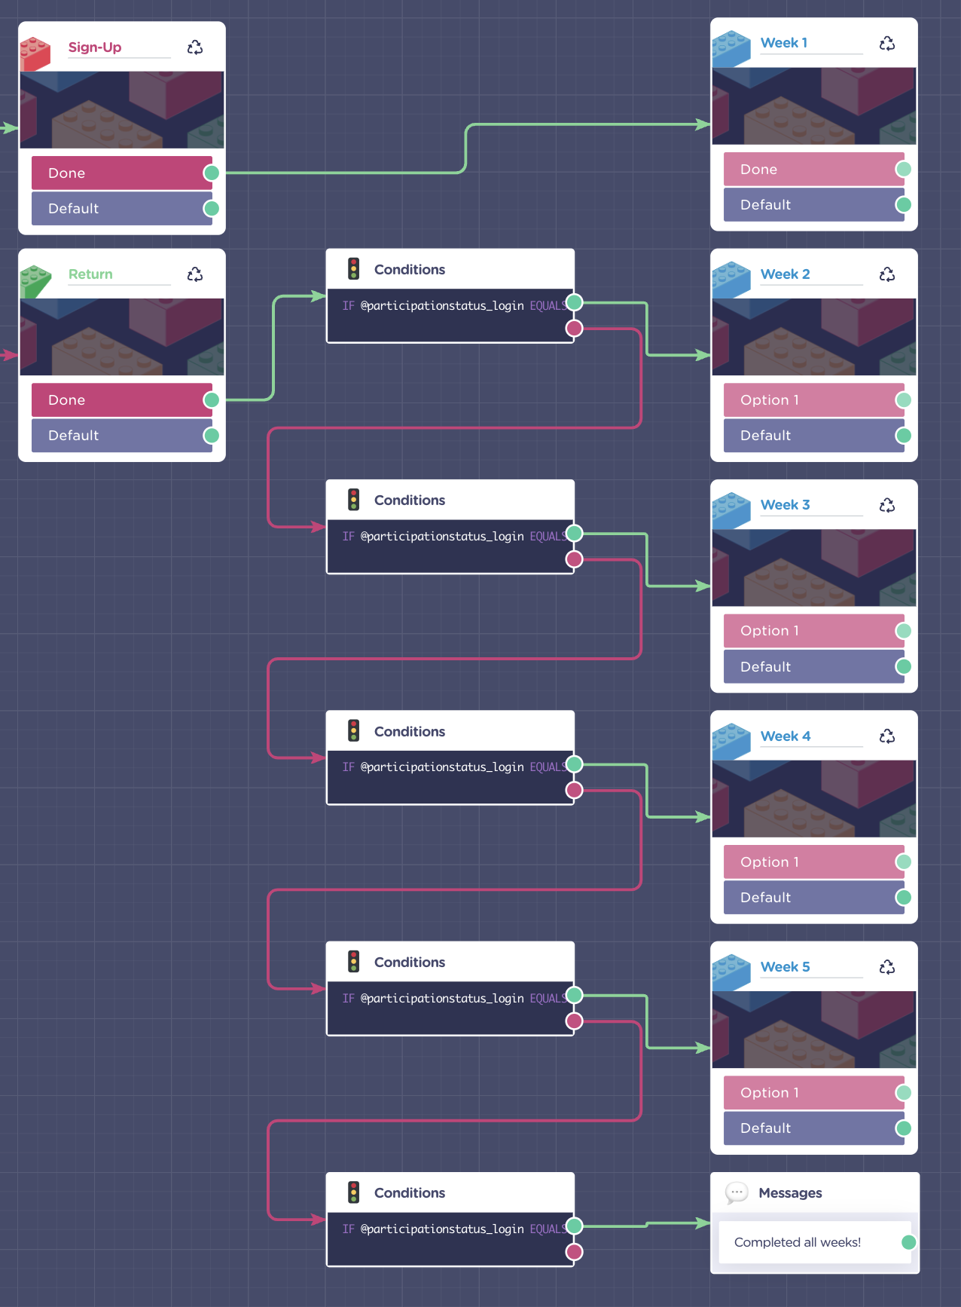
The Chatbot as a Research Tool
Incredibly powerful research tool
Allows you to collect large amounts of data in an interactive and adaptive manner
You can have a branching bot which deals with multiple sessions, different conditions and various kinds of personalization
Can be integrated with powerful NLP tools

Slide 21
3
Deploying and Testing a Chatbot
Write your message

Slide 22
Pilot Study & Main Study
Pilot Study: Testing the chatbot and exploring how students set goals when they are unguided.
Main Study: Testing Guidance and Feedback as a means of improving goal quality, and achievement.
RCT with 2x2 design
  Guidance vs. no guidance AND feedback vs. no feedback
±100 participants from higher education setting
Longitudinal study across 5 weeks

Slide 23
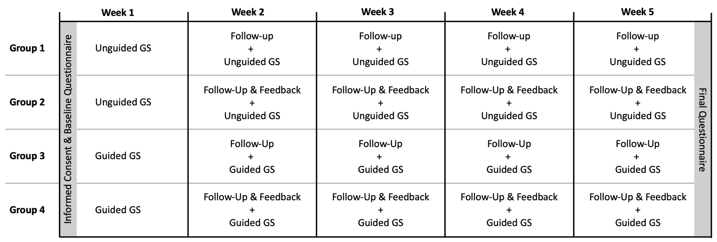
Upcoming: Main Study
Pilot Study: Using a conversational agent to support goal setting amongst higher education students

Slide 24
Delivery Preference & Ease of Use
100%
Easy or Very Easy to Use

Slide 25
Usefulness of the Chatbot
Feedback: Students liked the chatbot, but wanted more personalization

Slide 26
Results: Goal Quality

Slide 27
General Conclusions
Students are bad goal setters (when left to their own devices)
Students prefer interacting with chatbots over static webpages
Guidance & feedback both improve goal quality
Different students need different kinds of support
        - High vs low self-regulated learners
        - Highly perfectionistic
        - Prior knowledge on (or comfort with) the topic
12:20 PM

Slide 28
4
Let’s Talk About Learning Analytics
Write your message

Slide 29
Our Data Sources
12:20 PM
LMS Data
“Traditional” learning analytics trace data from online learning environments, including information about their performance
12:20 PM
Self-Report Data
Allowing students to self-report data and using this to offer them meaningful insight. Ties to both a self-monitoring aspect of SRL, as well as quantified self movement
12:20 PM
Goal Analytics
Data about the content, quality, and process of students goal setting, which can be used to offer them insight, feedback, and targeted goal setting support

Slide 30
How We Use Learning Analytics
Forethought Phase:
Goal Setting & Planning
1
Reflection Phase:
Self-reflection & Adaptation
Performance Phase:
Action & Self-monitoring
3
2

Slide 31
Next Up
More LA Integration: Start running tests of the chatbot with the LA feedback integrated, including for other SRL processes
Machine learning Module: Goal quality and feedback
Use Learning Analytics: Offer personalized goal setting support based on individual student characteristics
12:20 PM

Slide 32

Thanks for Listening!
Do you have any more questions?
Contact me:
Gabrielle Martins Van Jaarsveld
martinsvanjaarsveld@essb.eur.nl
Write your message

