Slide 1
Teaching in MOOCs: A systematic literature review of student engagement and student achievement
Dr. Olga Pilli & Prof. Dr. Wilfried Admiraal (ICLON)
[CEL Innovation Room 'Successfully teaching a MOOC', Den Haag, The Netherlands]
[17 December 2014]

Slide 2

CONTENT
Introduction
Significance of the study
Methodology
Results
Conclusion
Implications
Issues for reflection

Slide 3
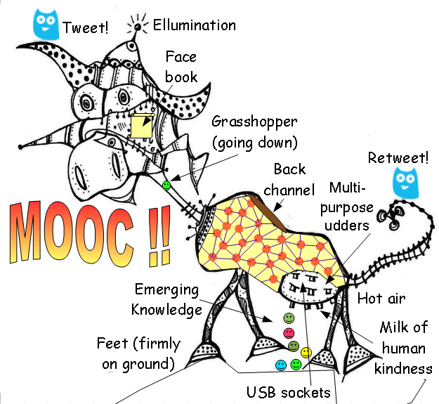

Slide 4




What is MOOC ?

Slide 5

“A MOOC is a course, it’s open, it’s participatory, it’s distributed, and it supports life-long networked learning.”
Dave Cormier

Slide 6

MOOCs are ….

Slide 7
Basic Features | xMOOCs | cMOOCs
Pedagogical Approaches | cognitive-behaviourist | networking-connectivist
Types of Teaching | objective-oriented | constructive-oriented
Types of Learning | transmission of information | sharing of knowledge
Interaction | limited interaction | S-S, S-C, S-I
Role of Students | receivers, follow instructions, complete the assignments | creators, contributors blog posts, tweets, discussion forms
Role of Teachers | to create the content, assignments, quizzes, exams | co-learner, create content, goals collaboratively
Content | subject-compelled | participant-compelled
Assessment | Multiple-choice, quizzes, computer-marked assignments, peer-review | no formal assessment, feedback from knowledgeable participants
Teaching Materials | Lecture videos, online readings, exercises, audio files | Social media; wikis, blogs, SNS, LMS (Moodle), student-created videos and exercises

Slide 8

Why this study ?
Traditional educational variables in HE might work out quite differently in MOOCs

Slide 9

Purpose
  To understand how teaching aspect is considered and related with students’ engagement and achievement in MOOCs.
How is the teaching in MOOCs related to students’ engagement?
How is the teaching in MOOCs related to students’ achievement?

Slide 10
Methodology
Key Words: Massive Open Online Course(s) or MOOCs and teaching.
Academic databases (Academic Search Premier (EBSCO), ProQuest, Annual Reviews, Science Direct, Cambridge Journals) with digital catalogue search of Leiden University
Inclusion
  Peer-review
  Teaching dimension
  NOT procedia, proceedings book
Two major themes were selected: students’ achievement and students’ engagement.
32 research studies

Slide 11
Results
Encouragement
Student engagement
Enrolment, completion and dropout
Instructional design
Student achievement
Instructional materials
Assessment

Slide 12

Engagement-Encouragement
  prior experiences, open structure of PLENK2010
  Collaboration and peer learning, cohesion of PBA, communication and creation of community
  confidence, prior experience and motivation
  different formats cMOOCs
  discussion forms are limited for participation → social network tools
  design of the course

Slide 13


Engagement-Enrollment, Completion, Dropout
  ‘lack of time’
  xMOOC have more dropout
  course length negatively associate completion rate (
  perceived reputation of university

Slide 14
Achievement- Instructional Design
instructional design quality of MOOCs is low and learning objectives were not provided. cMOOCs are much more qualified
most of MOOCs (among 24) oriented in the objectivist-individual approach
the challenge–lesson–resolution format in ‘Decoding Algebra’ xMOOC
small task-oriented cMOOC environment
“flexibility to do and read’ and ‘course instructional design’, and ‘receiving feedback from a knowledgeable person’
course activities (assignment, homework, and lab)
MOOC as a teaching method

Slide 15

Achievement- Instructional Materials
  instructor face on video lecturing → no significant main effects on recall and transfer learning
  reading (50%) and videos (40%) and discussion forms (6%)
  shared display and distributed individual controls is most effective

Slide 16
Achievement- Assessment
  providing rubric to students while conducting self- and peer assessment can help to improve the grading accuracy as well to enhance the students’ achievement in MOOC platform
  students’ self- and peer-assessments were not significantly correlated with their final exam scores
  84% of the MOOC participants (n = 342) specified that peers’ feedback was useful on their learning outcomes.
  AES (Automated Essay Scoring) tool may not be a completely accurate and reliable tool for measuring student success

Slide 18


Slide 19

To sum up…
No one denies that the current rise of MOOCs brings a vital change in HE, but this innovation must not change the real purpose of education; meaningful learning…
Needs of those who follow and who lead these MOOCs should be fulfilled.

Slide 20

Implications for practice
The need to use an instructional design (learning objectives) →better- quality learning
Team work while creating MOOC
miniMOOC (with sections/groups or SPOC)
Assignment-based MOOCs
Creative and authentic e-activities
Orientation for novice MOOC participants
Usage of feedback
Interactive video formats
Peer- assessment with rubrics

Slide 21

Implications for further research
Impact of MOOCS on students’ performance/achievement
Needs of learners and instructors
Impact of course design format
Differences between novice and experienced MOOC participants
Ways to increase engagement
Alternative assessment methods
Possible ways to provide individualized feedback

Slide 22


Are traditional ID models providing sufficient foundation for MOOCs? or do we need a redefinition of ID for MOOCs ?
To what extent are instructors or course designers responsible for facilitating learning, other than providing content ?
Do we need to change teacher preparation for successful MOOC teaching?

Slide 23
Thank you very much
for your kind attention !
o.pilli@iclon.leidenuniv.nl

