Slide 1
Opportunities and Challenges in Using Learning Analytics in Learning Design
Nynke Bos, PhD| CEL Innovation Room #10

Slide 2
Analytics….
Moneyball

Slide 3
“ People (students) are overlooked for a variety of biased reasons and perceived flaws: age, appearance , personality, (gender)….
Bill James and mathematics cut straight through that.”

Slide 4
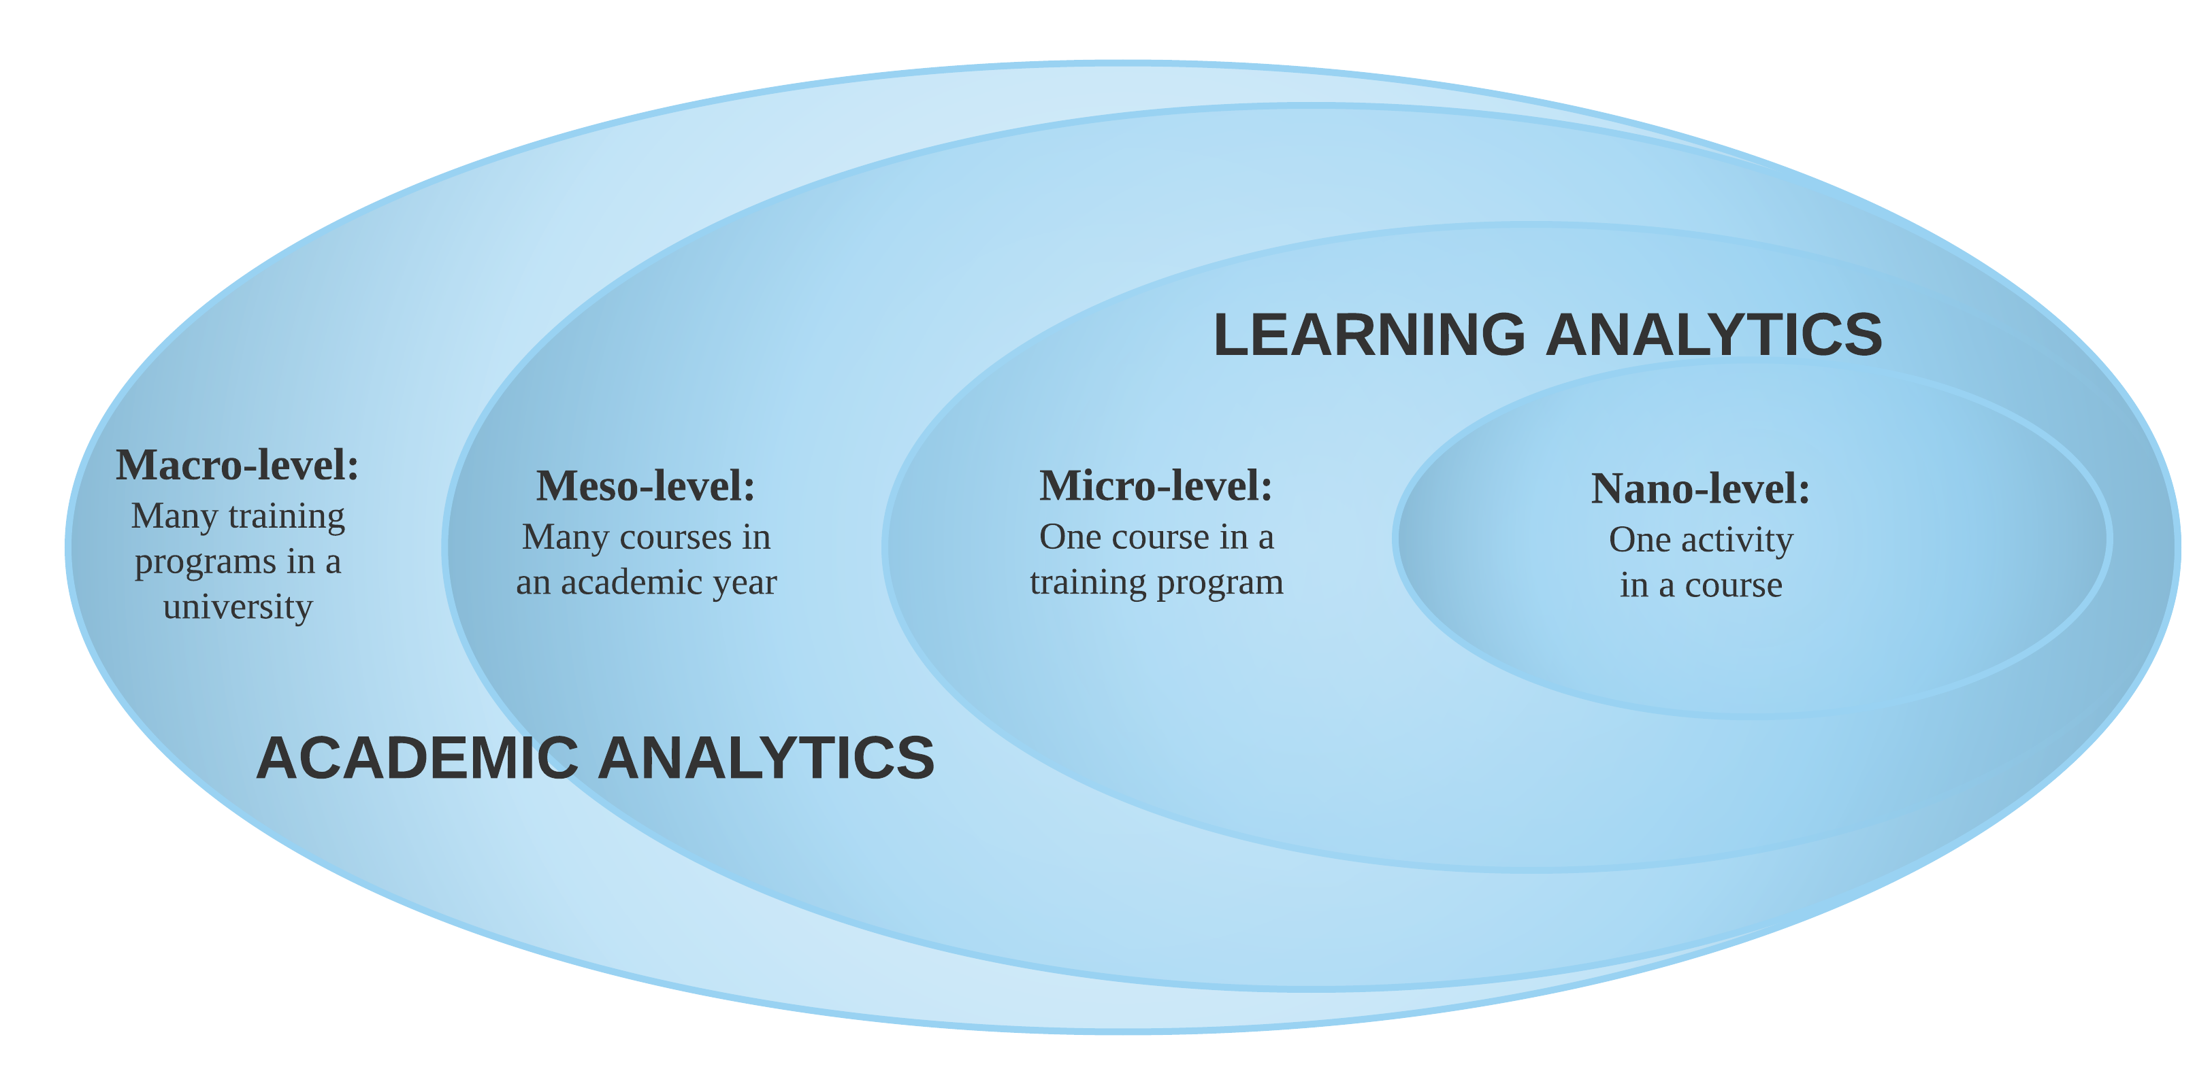
Analytics
INSTITUTIONAL ANALYTICS
STUDENT ANALYTICS
Pico-level: Assessment analytics
Hervatis et al., 2015

Slide 5
Definition
“Learning analytics definitions share an emphasis on converting educational data into useful actions to foster learning”

Slide 6
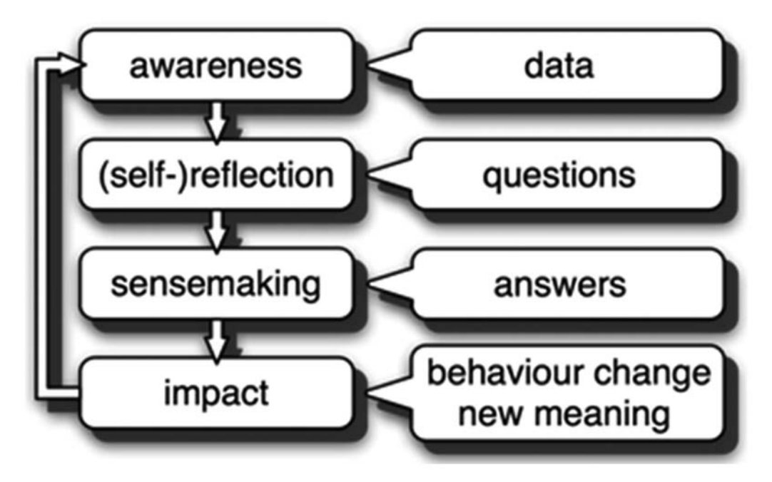
Learning Analytics Process Model
Verbert et al, 2013
Notes:
Awareness. This stage is concerned with just data, which can be visualized as activity streams, tabular overviews, or other visualizations. 2. Reflection. Data in themselves are not very useful. The reflection stage focuses on users’ asking questions and assessing how useful and relevant these are. 3. Sense making. This stage is concerned with users’ answering the questions identified in the reflection process and the creation of new insights.
4. Impact. In the end, the goal is to induce new meaning or change behavior if the user seems it useful to do so. This change can account for students and teachers!
Important to choose the right data, so behavior change will involve actual learning and increase student success.
We know already that LMS data are a poor proxy for learning. We also know that visualizations to students can lead to competition not learning since the goal of the students is get a higher rank, not learning. Numerous dashboards are based on clickstreams in the LMS, but they will lead to…..

Slide 8
Learning design
Sequence of learning tasks: pedagogical intent of the teacher (Laurillard, 1993)
To promote teaching quality
To facilitate integration of technology into teaching and learning
Combining pedagogical intent with data about the actual process -> actionable
Understanding of the learning design is imperative for establishing accurate predictive models alongside pedagogical recommendations.

Slide 9
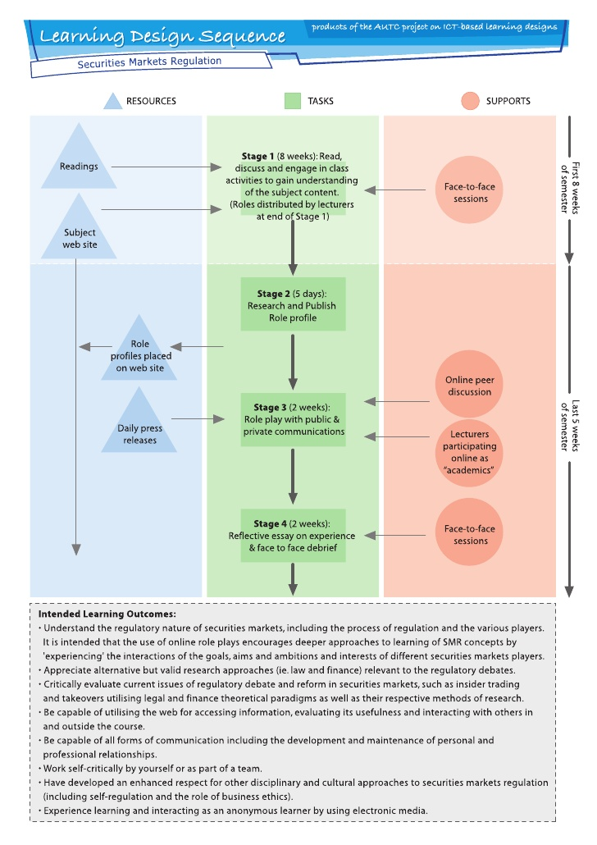
Notes:
The central point of the diagram is the learning task (represented as a square with green shading) that the students are expected to do, the associated content resources (represented as a triangle with blue shading), and the teacher and/or peer support that facilitates the tasks (represented as a circle with pink shading).
With regard to the potential of LA: what sometimes happens is that learning analytics is used as an checkpoint analysis. The snapshot data that indicates a student has met the terms for learning by accessing the relevant resources of the learning design. For example, checkpoint analysis would relate to metrics such as log-ins into the online course site, downloads of a file for reading. Although these forms of analytics may be valuable for providing lead indicators of student engagement, they do not, in isolation of other data, provide insight into the learning process or understanding how students are learning and what they are learning.

Slide 10
Checkpoint and Process Analytics
Notes:
Each step in the sequence of the learning design is associated with potential analytics: checkpoints (represented as crosses) and processes (represented as open circles). Process Analytics provide direct insight into learner information processing and knowledge application within the tasks that the student completes as part of a learning design. For example a network analysis to provide more insight into discussion activity or content analysis to determine the level of understanding (open-essay) or self-reflection.

Slide 11
Process Analytics
Formulating checkpoints is rather easy
Process Analytics in group work/ discussions: SNA
Other form of analyzing the process (translated in data)?
Situation: freshman class Psychology n = 450 students
Discuss with yourself or your neighbor.
Write your idea down on a post it.
CHECKPOINT ANALYSIS!

Slide 12
Results
Good connection between the instrument (dashboard) and the repertoire of the professional can support successful usage in daily classroom practice (Molenaar et al., 2017). There is a need for explicit guidance on how to use, interpret and reflect on the learning analytics findings to adequately refine and re-design learning activities (Mangaroska et al., 2017)

Slide 13
Recommended Reading
Mangaroska, K., & Giannakos, M. (2017, September). Learning Analytics for Learning Design: Towards Evidence-Driven Decisions to Enhance Learning. In European Conference on Technology Enhanced Learning (pp. 428-433). Springer, Cham.
Schmitz, M., van Limbeek, E., Greller, W., Sloep, P., & Drachsler, H. (2017, September). Opportunities and Challenges in Using Learning Analytics in Learning Design. In European Conference on Technology Enhanced Learning (pp. 209-223). Springer, Cham
Molenaar, I., & Knoop-van Campen, C. (2017, September). Teacher dashboards in practice: Usage and impact. In European Conference on Technology Enhanced Learning (pp. 125-138). Springer, Cham.
Lockyer, L., Heathcote, E., & Dawson, S. (2013). Informing pedagogical action: Aligning learning analytics with learning design. American Behavioral Scientist, 57(10), 1439-1459.

Slide 14
Wrap up: an example of institutional analytics explained by Samuel L. Jackson
https://youtu.be/Lor9kP5y_Tg

