Slide 1
Trusted Learning Analytics Infrastructures
Stefaan Ternier, George Ciordas-Hertel, Daniel Biederman, Maren Scheffel

Slide 2
xAPI
Capture data about a wide spectrum of learning experiences

Slide 3
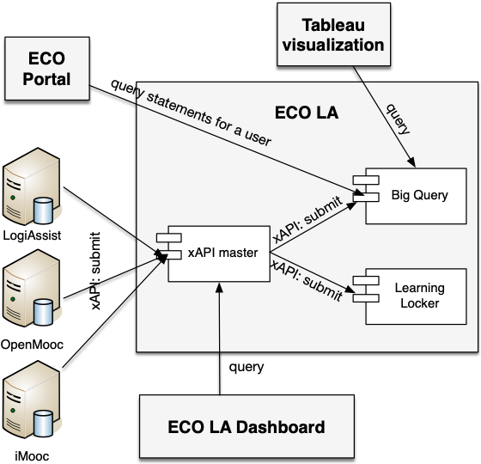
Learning Analytics Architecture

Slide 4
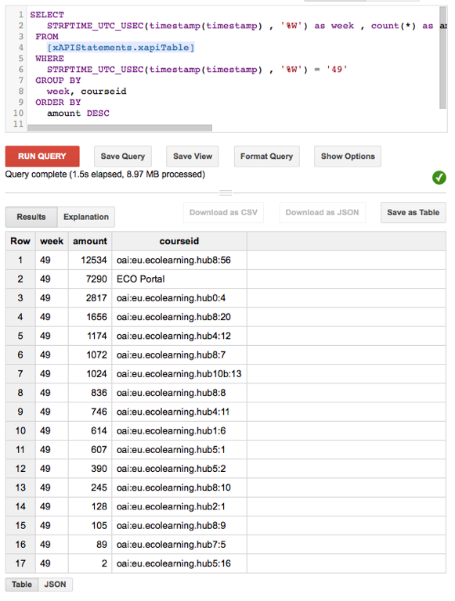
Big Query
Scalable
High amounts of data
Complex queries
Example query
SELECT actorId, count(*) as count from (SELECT actorId, courseId FROM xAPIStatements.xapiTable where courseId != 'todo' group by actorId, courseId) group by actorId having count >=2 order by count desc

Slide 5
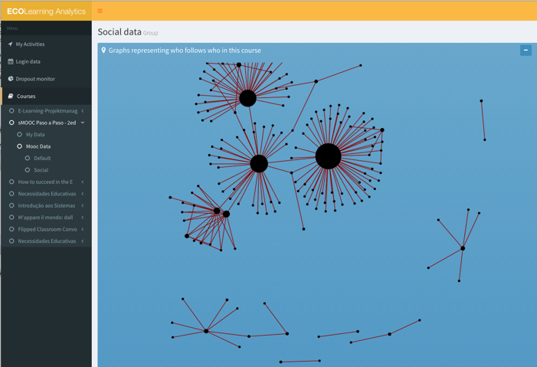
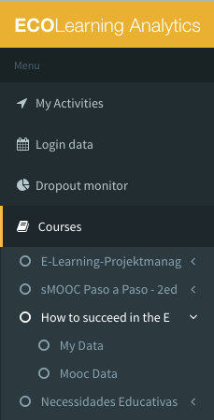
Dashboard

Slide 6
Lessons Learned from ECO
ECO Challenge
How to create a scalable solution for management of Learning Analytics Data
Storage
Query
Context
EU project
Moocs
Various MOOC platforms

Slide 7
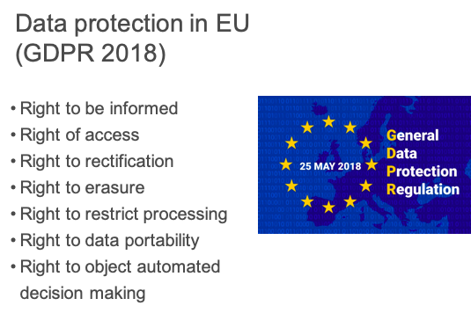
Trust?

Slide 8
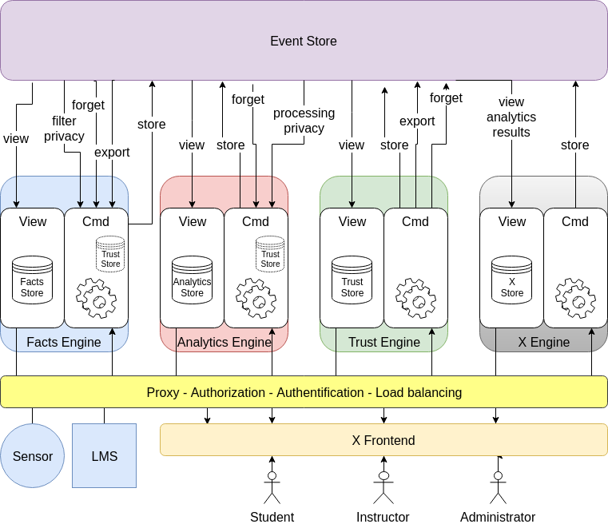
Interoperability Challenges
Learning scenarios
Student, Instructor, Administration
Heterogeneous data sources
LMS, Sensors, MOOC, HR software
Data transmission
Activity data vs static data
Data pre-processing
Enrichment, aggregation, interpretation
Analytics
DB queries, data mining, machine learning

Slide 9
Trust Features - How to increase Trust?
Easy access to GDPR rights
Right to be informed
Right of access
Right to rectification
Right of erasure
Right to restrict processing
Right to data portability
Automation
Be transparent about purposes

Slide 10
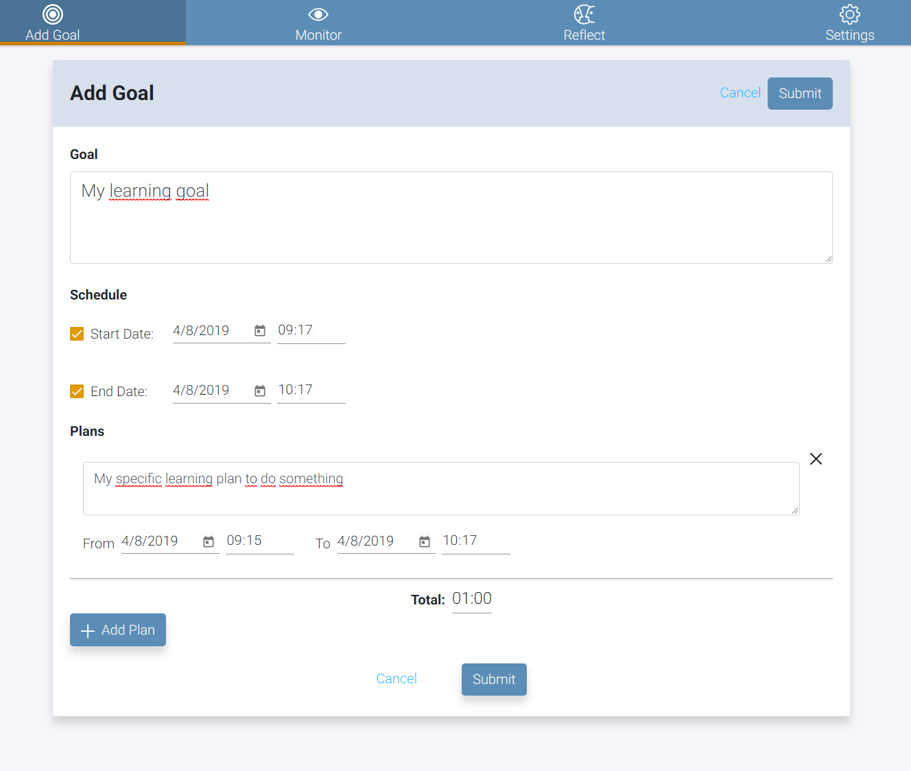
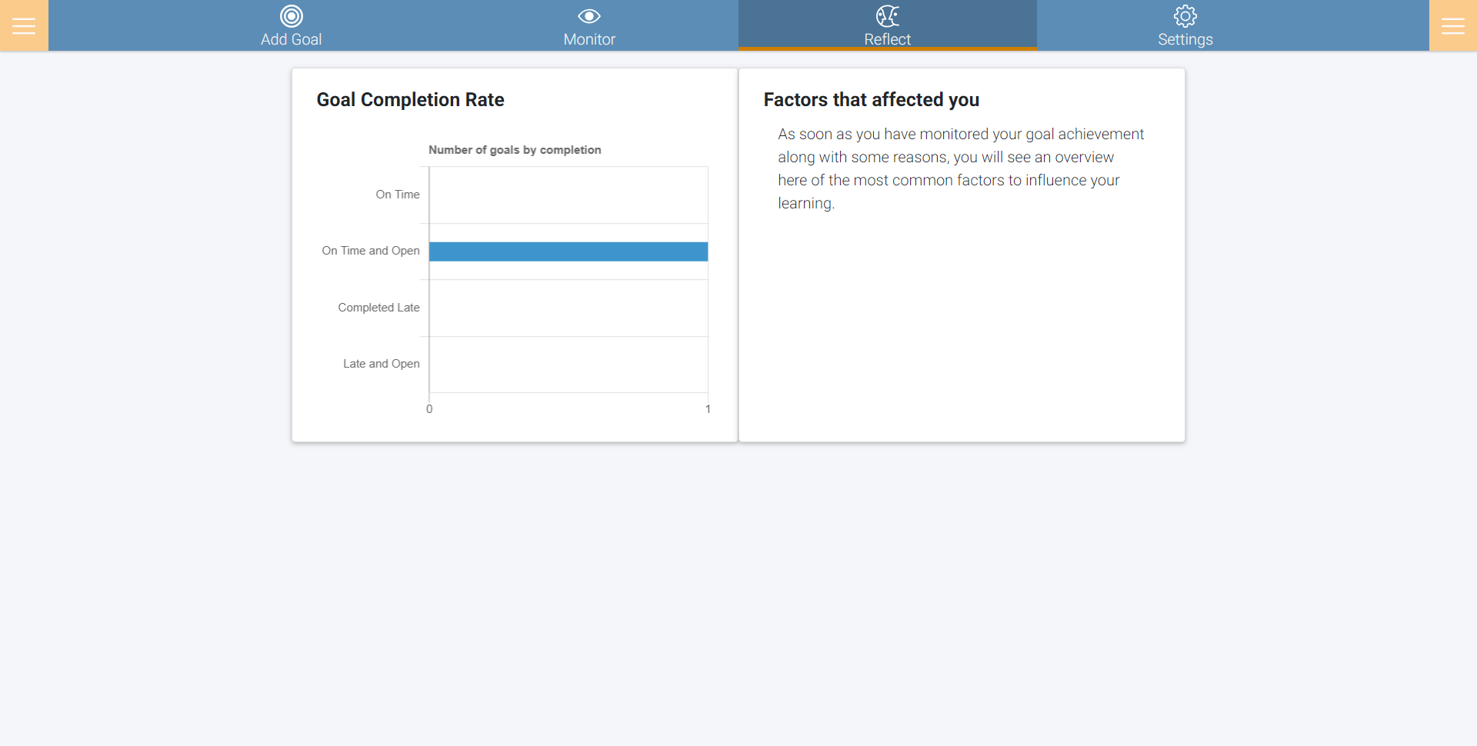
Trust Features in Practice
Example Serene:
Application for Planning & Monitoring

Slide 11
Trust Features in Practice - Privacy Settings
Privacy Settings:
GDPR compliance
Download Data
Delete Data
Contact Privacy Officer

Slide 12
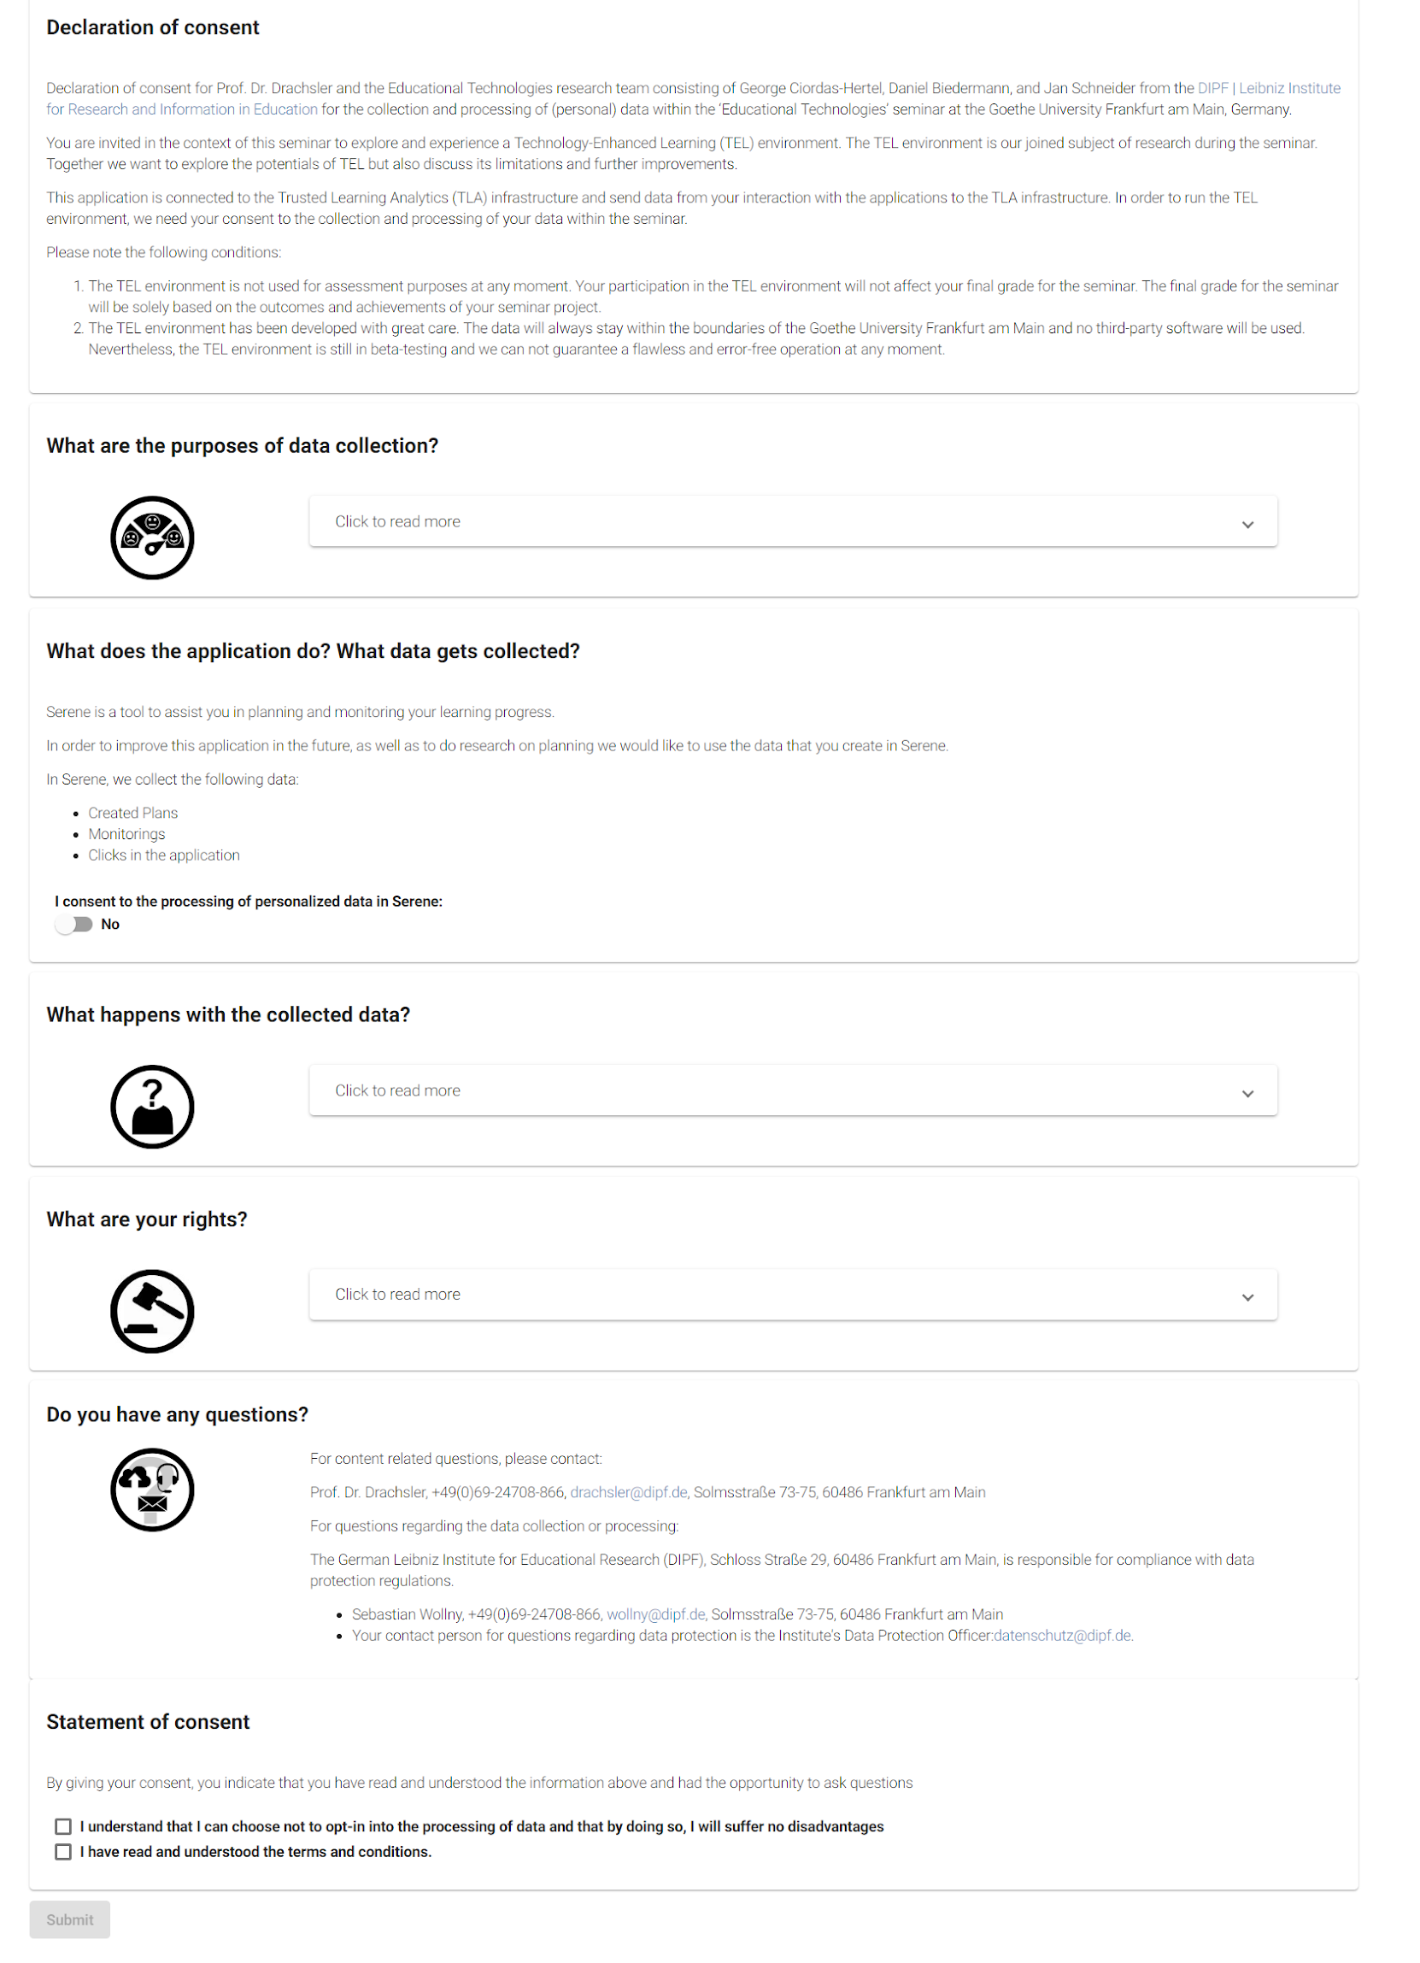
Trust Features in Practice - Consent Form
Consent Form to provide information:
Recognizable icons
Clear Headings
Expand additional information

Slide 13
Decoupled Infrastructure
Trust features only for LA, not about administrative data (grades, student records etc.)
VLE
Student Records
LMS
Sensors

Slide 14
Merging Trust and Interoperability
How do we want to implement generic Trust Features?
How to implement data portability?
How to delete data from multiple sources?
Shall we anonymize instead of delete totally?
How much effort should we put into transparency?

Slide 15
Trust and Interoperability Challenge
Is your LA infrastructure compatible with the use case from others?

