Slide 1
Student engagement and achievement in online and blended learning through e-tivities CEL Innovation Rooms
Prof A Armellini | @alejandroa | ale.armellini@northampton.ac.uk
Director, Institute of Learning & Teaching in HE
University of Northampton
17 December 2014

Slide 2
Plan
Principles
Enhancing quality
Hands-on, part 1: an online course on study skills
Pedagogical modelling
Developing a storyboard
Conclusions

Slide 3
One learning outcome?
By the end of this session, you’ll be able to…
… plan something different to pilot next week in your teaching

Slide 4
Principles
Transformational learning experiences through inspirational teaching
Low cost, high value for our students and colleagues
Knowledge and learning and open, mobile, connected and scalable
Overlapping modes of study:
‘blended’ = ‘campus & mobile’
Robust QE process
Notes:
Ale

Slide 5
Three disruptive waves
Competition for students
Competition from cheaper alternatives or providers
Competition from online delivery (sometimes free)
The Economist, 28 June 2014
Notes:
Jane

Slide 6
Responsive-reactive
Developmental-incremental
Radical- innovative
Quality enhancement
Good practice based on identified needs & evidence
Innovative ideas backed up by evidence of need
From niche to mainstream enhancement
Innovative approaches aligned with organisational culture and needs

Slide 7
Now… the SSAS hands-on bit Study Skills for Academic Success
Purpose
- To offer you an opportunity to engage with, discuss and provide feedback as a SSAS participant.
- To explore opportunities for reusing variants of SSAS in your institution.
Task
a. Go to http://bit.ly/ssas-join. Please use password Berlin
b. You will need to sign up for a Coursesites account if you do not already have it
c. Have a good look around the course. Chat to your neighbours.
d. Go to item 1: Welcome – Start here! and do e-tivities 1.1 and 1.2 in full.
Reflection and Feedback
Be prepared to comment of your experience on this course using this shared document
(http://tinyurl.com/SSAS-OEB14).
Time
30-40 minutes.

Slide 8
2014

Slide 9
2020: a possible scenario for Northampton

Slide 10
Pre-session cognitive exposure – multimedia resources
F2F session: analysis, discussion, reflection & goal setting
Post-session online work: consolidation & evaluation
Notes:
Ale

Slide 11
Pre-session cognitive exposure – multimedia resources
?
F2F session: analysis, discussion, reflection & goal setting
Post-session online work: consolidation & evaluation
Notes:
Ale

Slide 12
Pre-session cognitive exposure – multimedia resources
Pre-session activation of schemata – asynchronous online tasks
F2F session: analysis, discussion, reflection & goal setting
Post-session online work: consolidation & evaluation
Notes:
Ale

Slide 13
Pre-session cognitive exposure – multimedia resources
Pre-session activation of schemata – asynchronous online tasks
F2F session: analysis, discussion, reflection & goal setting
Post-session online work: consolidation & evaluation
Key ingredient!
Notes:
Ale

Slide 14
VLE design benchmarks
Level | Focus | Key features

Slide 15
VLE design benchmarks
Level | Focus | Key features
Foundation | Delivery | Absolute minimum expected Course information, handbook and guides Learning materials

Slide 16
VLE design benchmarks
Level | Focus | Key features
Foundation | Delivery | Absolute minimum expected Course information, handbook and guides Learning materials
Intermediate Essential in all ‘blended’ courses | Participation | In addition to ‘Delivery’: Online participation designed into the course. Tasks provide meaningful formative scaffold. Online participation encouraged and moderated, but not assessed.

Slide 17
VLE design benchmarks
Level | Focus | Key features
Foundation | Delivery | Absolute minimum expected Course information, handbook and guides Learning materials
Intermediate Essential in all ‘blended’ courses | Participation | In addition to ‘Delivery’: Online participation designed into the course. Tasks provide meaningful formative scaffold. Online participation encouraged and moderated, but not assessed.
Advanced Essential in all fully online courses | Collaboration | In addition to ‘Delivery’: Regular learner input designed into course & essential throughout. Online tasks provide meaningful scaffold to formative and summative assessment. Collaborative knowledge construction central to a productive learning environment & part of assessment.

Slide 18
VLE design benchmarks
Level | Focus | Objective
Foundation | Delivery | COMPLIANCE (or REPOSITORY!)
Intermediate Essential in all ‘blended’ courses | Participation | ENGAGEMENT
Advanced Essential in all fully online courses | Collaboration | ACTIVE LEARNING

Slide 19
CAIeRO = Carpe Diem @ Northampton
Creating Aligned Interactive educational Resource Opportunities
Design for effective online and blended learning:
A two-day intensive workshop

Slide 20
CAIeRO
blueprint
review
prototype
check reality
storyboard
Plan + action

Slide 21
Who: size & participants

Slide 22
Why: to design a great course, fast

Slide 23
Learning Outcomes
Start
End
Student-generated content resulting from the e-tivities
Assessment

Slide 26
Action plan

Slide 27
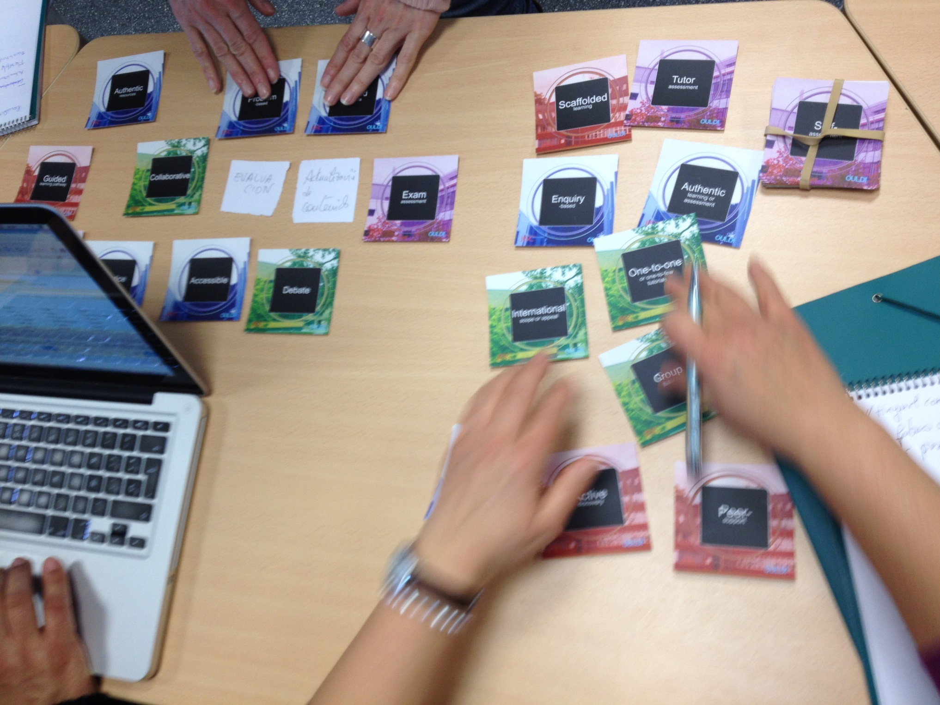

Slide 28
Storyboard a short 6-week course:
Principles of transnational education
Safer cycling in 21st Century cities
Learning innovation for today’s higher education students
Building diverse and effective teams
Organising successful academic events
2 weeks online
2 weeks f2f
2 weeks online
Target audience: staff at your institution. 4 hours of student work per week.
Decide on (a) level (e.g. undergraduate, PG, CPD) and (b) two key learning outcomes
Storyboard it!

Slide 29
Weeks
1 2 3 4 5 6
topic
topic
topic
topic
topic
topic
1.1 E-tivity
2.1 E-tivity
3.1 E-tivity
4.1E-tivity
6.1 E-tivity
3.2 E-tivity
5.1 E-tivity
1.2 E-tivity
2.2 E-tivity
Lab work
f:f seminar
Assess & feedback
Assess & feedback
Assess & feedback
Assess & feedback
Assess & feedback

Slide 30
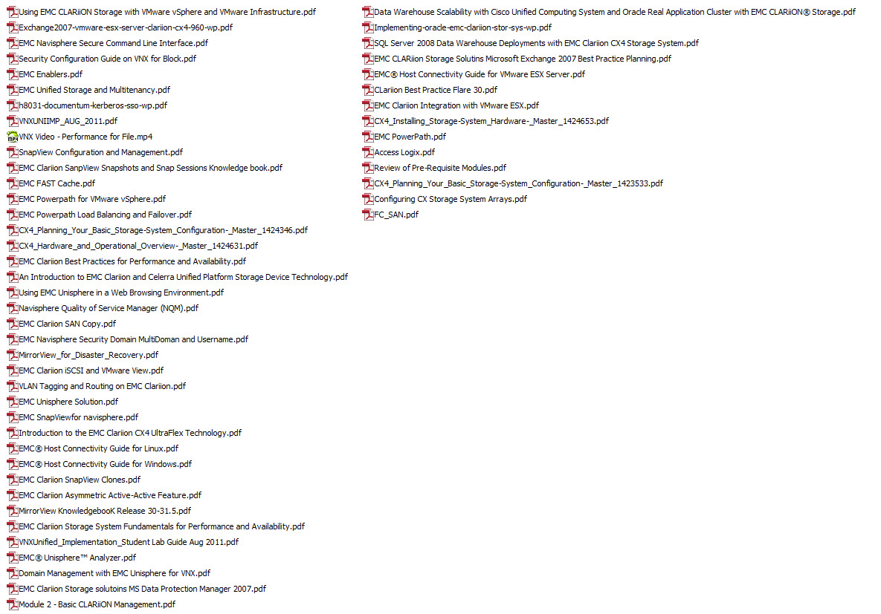
The resource is not the course

Slide 31
Content dump vs learning pathway
Trawl through stuff vs scaffold
Learning outcomes hidden in a pile vs explicit alignment
Mess vs structure
Push content vs engage
Upload vs design
Resource vs course
Deliver vs teach

Slide 32
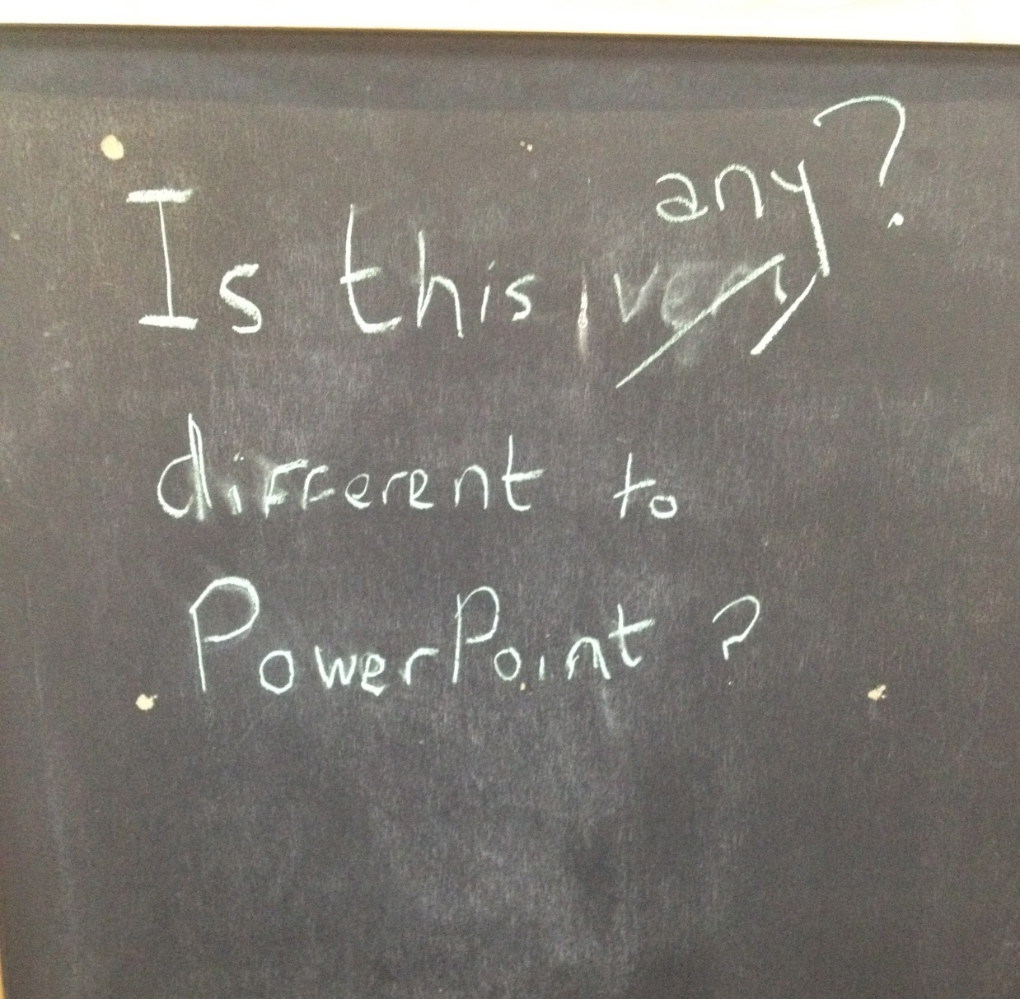

Slide 33
Aligning assessment

Slide 35
Pedagogic innovation
“Adapting to characteristics of students and responding to their development is an inherent aspect of pedagogy. […] These adaptations can be considered innovations if are based [sic] on a new idea and when they have the potential to improve student learning, or when they are linked with other outcomes […]”
(Vieluf, Kaplan, Klieeme & Bayer, 2012)
Notes:
Vieluf, S., Kaplan, D., Klieeme, E. & Bayer, S. (2012). Teaching Practices and Pedagogical Innovation: Evidence from TALIS. OECD Publishing. http://dx.doi.org/10.1787/9789264123540-en
If we consider this true, then anything could be considered innovative!
A “definition”: “Adapting to characteristics of students and responding to their development is an inherent aspect of pedagogy. […] These adaptations can be considered innovations if are based on a new idea and when they have the potential to improve student learning, or when they are linked with other outcomes (such as improving the health of students, preventing teenage violence or drug abuse, or improving the job satisfaction and well-being of teachers)” (Vieluf, Kaplan, Klieeme & Bayer, 2012).

Slide 36
Pedagogic innovation
“What is an innovation in one education system may be well-established practice in another; what is appreciated as an improvement may be rejected elsewhere.”
(Vieluf et al., 2012)
Notes:
Vieluf, S., Kaplan, D., Klieeme, E. & Bayer, S. (2012). Teaching Practices and Pedagogical Innovation: Evidence from TALIS. OECD Publishing. http://dx.doi.org/10.1787/9789264123540-en
If we consider this true, then anything could be considered innovative!
A “definition”: “Adapting to characteristics of students and responding to their development is an inherent aspect of pedagogy. […] These adaptations can be considered innovations if are based on a new idea and when they have the potential to improve student learning, or when they are linked with other outcomes (such as improving the health of students, preventing teenage violence or drug abuse, or improving the job satisfaction and well-being of teachers)” (Vieluf, Kaplan, Klieeme & Bayer, 2012).

Slide 37
Old wine in new bottles?
Old wine
Learners generate content as homework, which is used creatively in the following seminar
Course in a (digital) box
Talk to your classmates
New bottles
Flipped classroom
xMOOC
Social learning
Learners bring their books and pencil cases (among many other technologies)
Loops of personalised assessment for learning & feedback
Study on the bus or train, on campus or at home
Teaching methods
Bring your own device (BYOD)
Dynamic assessment
Mobile learning
Pedagogies

Slide 38
Innovating pedagogy. Really?
Old wine is often good, as is the quality of some of the new bottles
Very often, there’s hardly any innovation
Things don’t have to be innovative to be good
What is the problem to which [innovation x] is the solution?
Notes:
Tendríamos que decidir si hablar de “pedagogical innovation” es válido aunque sólo sea innovación real para la organización que la lleva a cabo.

Slide 39
Summary: shaping the futures we want
Adapting to the challenging climate not good enough: take action, take risks, evaluate, refine
Pilot small but also pilot big
Build capacity, model, review, scale up
Think assessment for innovation
Engage others in the change, share ownership
Disseminate, invite feedback
Remember: students want ‘contact time’
Notes:
Ale

Slide 40
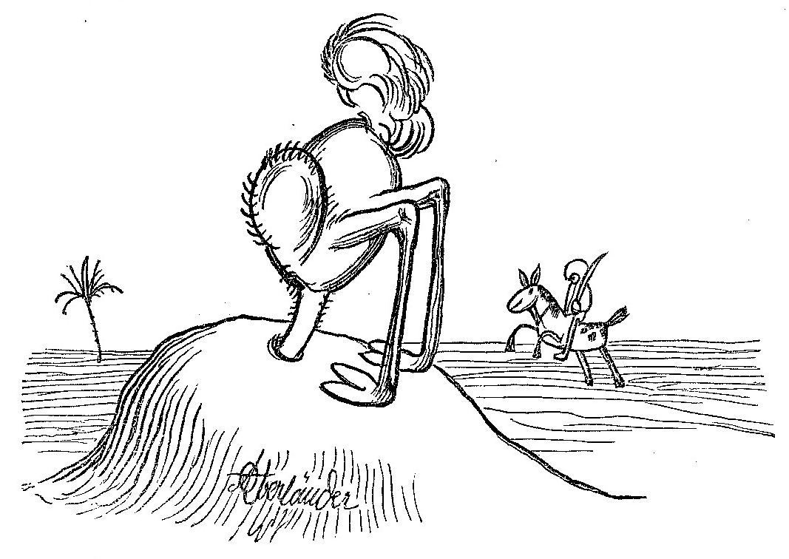
An opportunity for enhancement
Requirements from professional and accreditation bodies (including Royal Colleges) can be accommodated, and normally improved, within a blended, learner-centred mode of study

Slide 41
Viable and preferred futures for learning
An opinion
We can imagine, but not forecast future scenarios for learning
A hunch
There is far less pedagogic innovation than meets the eye
A wish
Teaching, in any mode of study, will be conducted with expertise, commitment and passion, and with a focus on benefiting our students and their communities

Slide 42
Reading
Gilly Salmon’s blog: http://www.gillysalmon.com/blog.html
Armellini, A. & Nie, M. (2013). Open educational practices for curriculum enhancement. Open Learning 28(1) 7-20.
Rogerson-Revell, P., Nie, M. & Armellini, A. (2012) An evaluation of the use of voice boards, e-book readers and virtual worlds in a postgraduate distance learning Applied Linguistics and TESOL programme. Open Learning, 27(2), 103-119.
Nie, M., Armellini, A., Witthaus, G. & Barklamb, K. (2011). How do e-book readers enhance learning opportunities for distance work-based learners? ALT-J, Research in Learning Technology, 19(1), 19-38.
Nie, M., Armellini, A., Randall, R., Harrington, S. & Barklamb, K. (2010). The role of podcasting in effective curriculum renewal. ALT-J, Research in Learning Technology 18(2), 105-118.
Armellini, A., & Aiyegbayo, O. (2010). Learning design and assessment with e-tivities. British Journal of Educational Technology 41(6), 922-935.
Armellini, A., & Jones, S. (2008). Carpe Diem: Seizing each day to foster change in e-learning design. Reflecting Education, 4(1), 17-29. Available from http://tinyurl.com/58q2lj
Salmon, G., Jones, S., & Armellini, A. (2008). Building institutional capability in e-learning design. ALT-J, Research in Learning Technology, 16(2), 95-109.
Salmon, G. (2013). E-tivities: The key to active online learning (2nd ed.). London and New York: Routledge.
Salmon, G. (2011). E-moderating: The key to teaching and learning online (3rd ed.). New York: Routledge.
Ale.Armellini@northampton.ac.uk
@alejandroa

Slide 43
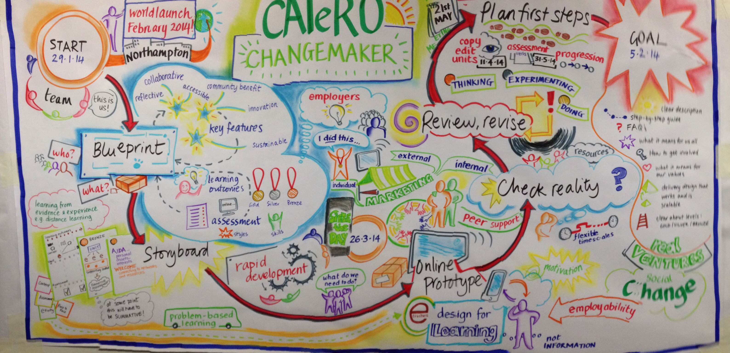
Thank you
Image by Topgold on Flickr
To access: search ARMELLINI on Slideshare.net
Professor Alejandro Armellini 17 December 2014
Ale.Armellini@northampton.ac.uk | @alejandroa

